Slide 1
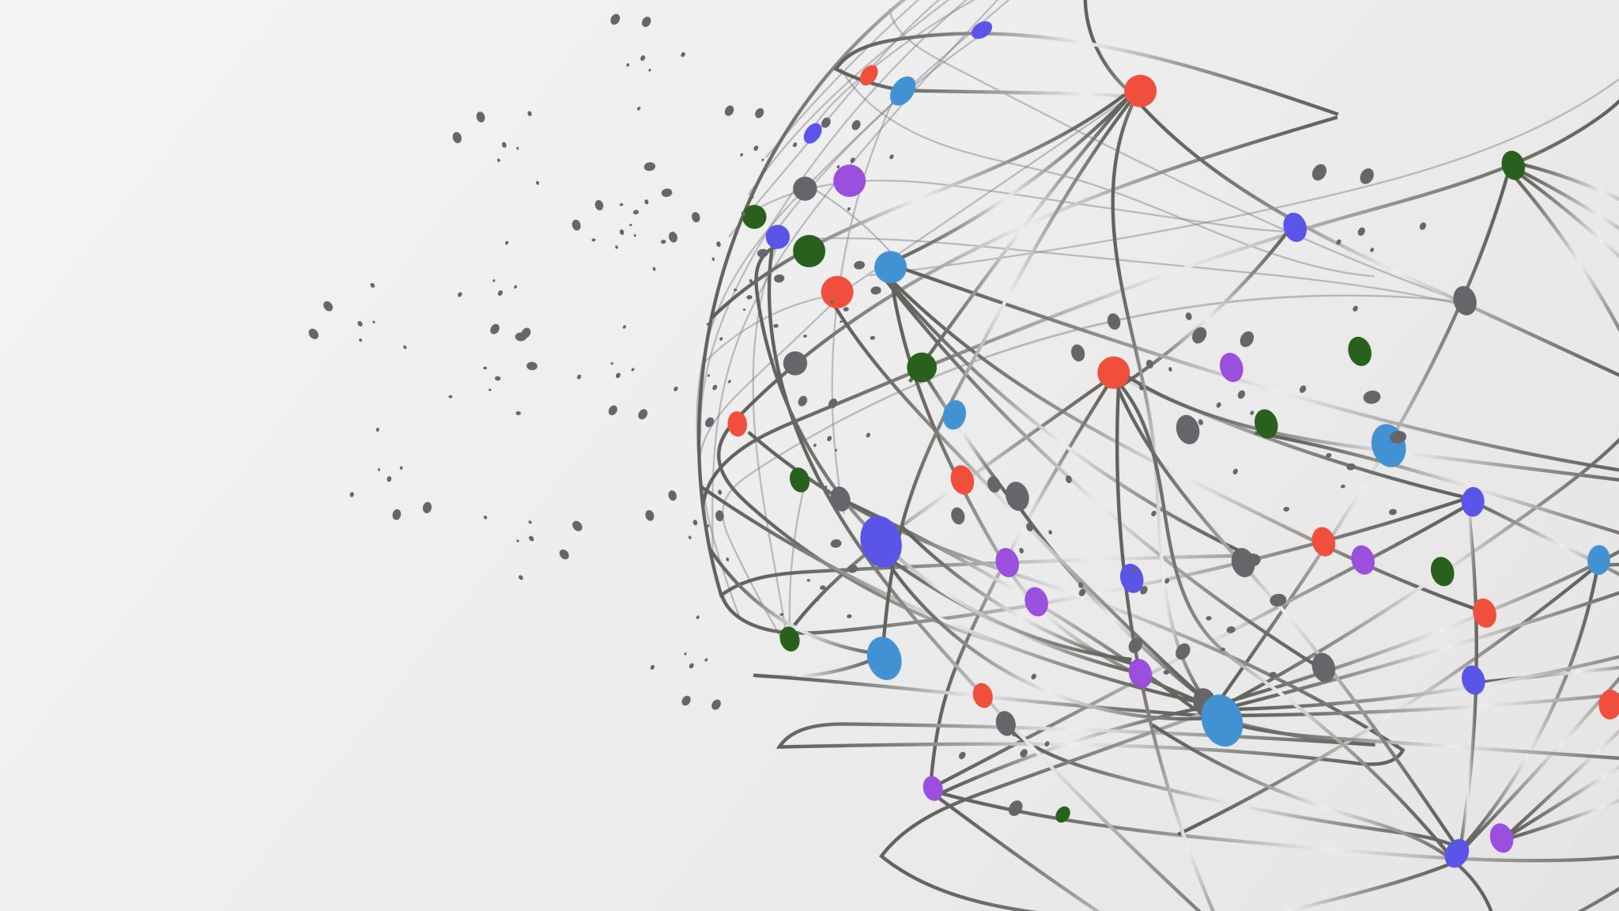
Secure File Management Web Application
Submitted by: Daniel Lin (dl1056)
Rohit Munshi (rm1993)

Slide 2
Project Overview
Project On
Tested a web application for security vulnerabilities, including login, sessions, file uploads, and user access. The user/admin and upload files securely and can control whom they want to make see these files.
Purpose
Ensure data and user accounts are safe, and the app follow security best practices as every user and guest credentials and files are safe.
Tools/Methods
→ Manual testing, browser dev tools, test inputs, observation of app behavior.

Slide 3
Security Architecture
Frontend: user interface for login, dashboard, file management
Backend: Flask app handles, authentication, sessions, and files
Database: stores users credentials, sessions, and file metadata
Security is enforced at every layer.
Guest register → guest login→ guest dashboard
Users register→ account gets approved by admin → user login → user dashboard
Authentication: register, login, password policies, account lockout, OTP expires.
Session management: session tokens, cookies with Secure, HttpOnly, SameSite.

Slide 4
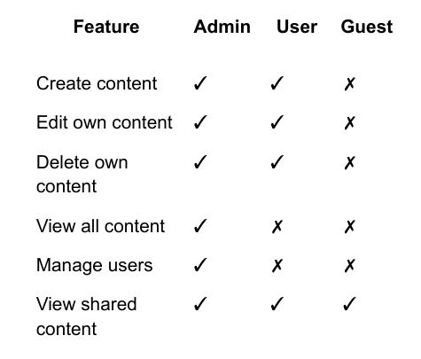
User Features

Slide 5
Security Implementation s
Strong passwords, account lockout after 5 failed logins
Role-based access control prevents unauthorized access
Input validation blocks XSS and command injection
File uploads restricted to safe types (.pdf, .txt, .jpg, etc.)
Sessions use secure, HttpOnly cookies with 30-min timeout
OTP for Reset password is sent to registered user’s email and expires in 10min.
Admin can delete any user and guest.
One user cannot see other user’s private files unless shared.

Slide 6
Configuration and Best Practices
Configuration Decisions:
Set security parameters in config.py (timeouts, lockout thresholds, upload limits)
Configured encrypted file storage and versioning controls.
Used separate metadata storage for users, sessions, and sharing relationships.
Configured HTTPS/TLS support and secure cookie settings.
Best Practices:
Applied least privilege in sharing and role permissions
Used Defense in depth across authentication, authorization, and encryption.
Followed secure file handling practices (sanitization + controlled storage)
Used separation of concerns across modules (auth.py, decorator.py, encrpytion.py)

Slide 7
Challenges Faced
Designing secure document sharing logic across multiple roles, and managing file versioning while preserving access controls were also difficult.
It was also hard to convert implementation details into formal threat modeling, and then documenting our steps to do it.
Additionally, with how much code we had to put down, it was difficult to nail down on some bugs that we had while testing our application.
Throughout the entire project, we had to verify that we were keeping in mind both functional and security requirements, and to make sure to not miss/overcomplicate certain steps.

Slide 8
Lesson Learned
Security design is more than adding controls — architecture choices matter
Small configuration choices can have major security impact
Threat modeling helped identify weaknesses early
Documentation must accurately reflect implemented protections
Security review is iterative and improves overall system quality
It is really important to build the security alongside the main project, or else you can struggle to go back and try to add security measures/issues.

