Slide 1
Mutual Fund Analytics Platform
Capstone Project – Bluestock Fintech Internship
Presented By:
Rohit M

Slide 2
Problem Statement & Objectives
Problem Statement :
The mutual fund industry generates large volumes of investment, performance, and investor data. Extracting meaningful insights from this data is essential for evaluating fund performance, understanding investor behavior, and supporting investment decisions.
Objectives :
Build an end-to-end mutual fund analytics platform
Perform data cleaning and validation
Store data using SQLite
Analyze fund performance and risk
Study investor behavior and SIP trends
Develop an interactive Power BI dashboard

Slide 3
Data Sources
Datasets Used:
Fund Master Data
NAV History
AUM by Fund House
Monthly SIP Inflows
Category Inflows
Industry Folio Count
Scheme Performance
Investor Transactions
Portfolio Holdings
Benchmark Indices
Tools Used:
Python, Pandas, SQLite, Power BI

Slide 4
ETL Architecture
Project Workflow :
Raw CSV Data
↓
Data Cleaning & Validation
↓
SQLite Database
↓
SQL Analysis
↓
EDA & Performance Analytics
↓
Advanced Risk Analytics
↓
Power BI Dashboard

Slide 5
EDA Highlights
NAV Trend Analysis :
Analyzed NAV movement across 40 schemes
Identified growth trends and market corrections
SIP Inflow Analysis :
Evaluated monthly SIP contributions
Observed consistent industry growth
AUM Analysis :
Compared Assets Under Management across AMCs
Identified market-leading fund houses
Folio Growth :
Studied investor participation growth over time

Slide 6
EDA Highlights
Category Inflow Analysis :
Compared inflows across fund categories
Investor Demographics :
Age-group distribution
Gender analysis
Geographical Analysis :
State-wise investment comparison
Tier-wise investor participation
Sector Allocation :
Evaluated portfolio sector concentration

Slide 7
Performance Analytics
Metrics Calculated :
Daily Returns
CAGR (1Y, 3Y, 5Y)
Sharpe Ratio
Sortino Ratio
Purpose :
Measure fund performance
Compare risk-adjusted returns
Rank mutual fund schemes

Slide 8
Advanced Risk Analytics
Risk Metrics :
Alpha
Beta
Maximum Drawdown
Tracking Error
Value at Risk (VaR)
Conditional VaR (CVaR)
Additional Analytics :
Rolling 90-Day Sharpe Ratio
Fund Scorecard Ranking
Portfolio Concentration (HHI)

Slide 9
Dashboard: Industry Overview & Fund Performance
Industry Overview Dashboard :
Total AUM
SIP Inflows
Folio Count
Scheme Count
Fund Performance Dashboard :
Risk vs Return Analysis
Fund Ranking
Benchmark Comparison

Slide 10
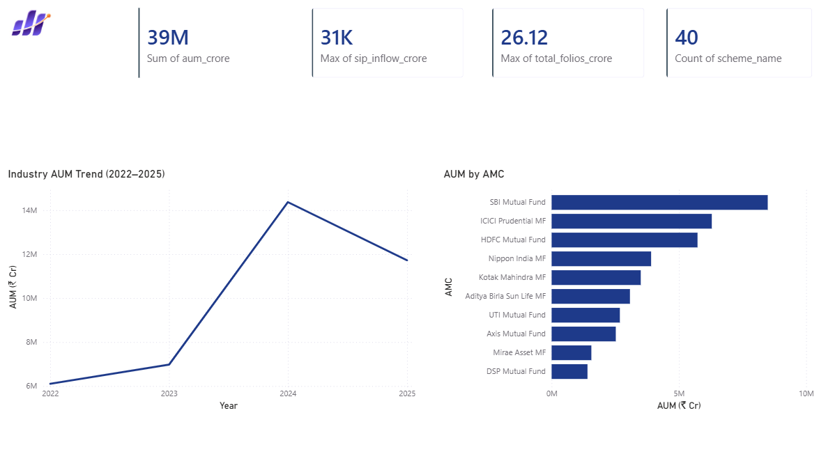
Industry Overview

Slide 11
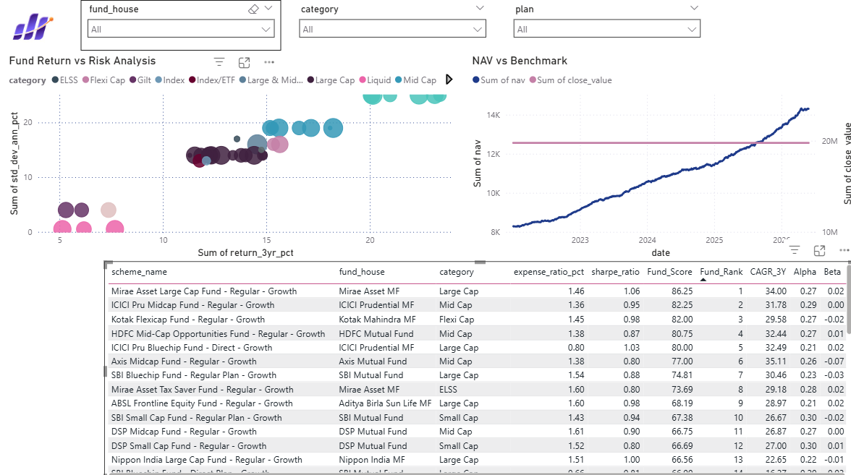
Fund Performance

Slide 12
Dashboard: Investor Analytics & Market Trends
Investor Analytics :
Transaction Analysis
Investor Demographics
State-wise Investments
SIP & Market Trends :
SIP Growth Trends
Category Inflows
Market Comparison

Slide 13
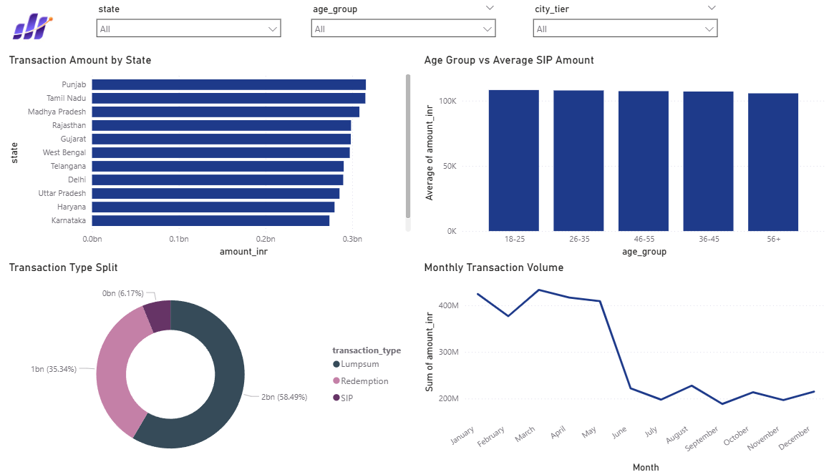
Investor Analytics

Slide 14
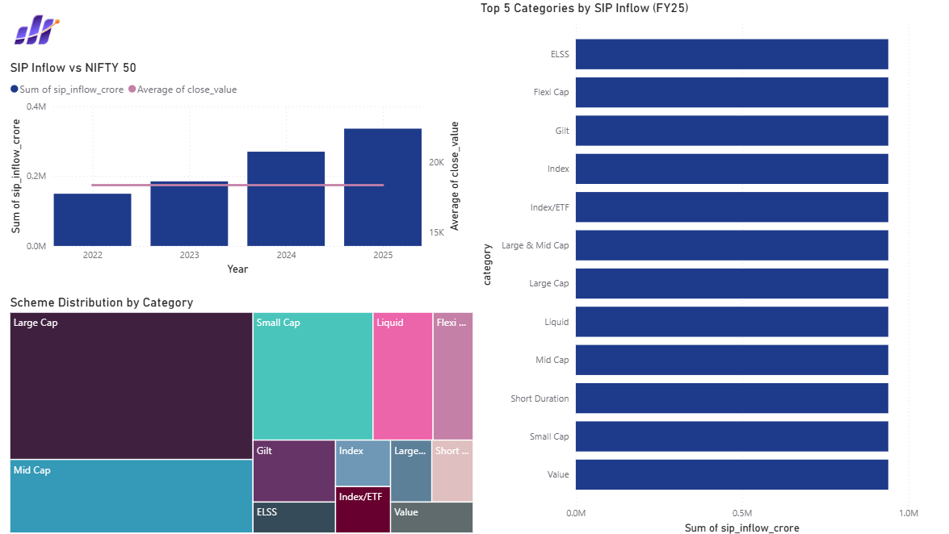
Market Trends

Slide 15
Key Findings & Recommendations
Key Findings :
Risk-adjusted metrics provide better evaluation than absolute returns.
SIP inflows showed strong growth during the study period.
Investor participation increased steadily across categories.
Certain funds consistently outperformed benchmarks.
Portfolio concentration varies significantly across schemes.
Recommendations :
Use Sharpe Ratio for fund comparison.
Monitor drawdowns alongside returns.
Encourage SIP continuity to improve investor retention.

Slide 16
Conclusion
Project Summary:
Built complete ETL pipeline
Performed EDA and performance analytics
Developed advanced risk metrics
Created interactive Power BI dashboard
Generated actionable investment insights
GitHub Repository:
github.com/rohitmurthy2803/mutual_fund_analytics

Slide 17
THANK YOU ROHIT M

