Slide 1
Carbon Emission Score
Team QUARK, VIT Pune.

Slide 2
Table of contents
01
02
03
04
Features
Tech Stack
Future Scope
Environmental benefits

Slide 3
01
Features

Slide 4
Calculated Carbon emission values for below use cases:
Home Appliances
Vehicle
Waste

Slide 5
Key Features
Calculated Oxygen emission values using plant species present in individuals house
User can share his calculated carbon score via mail or on social media.
Suggestions are provided to reduce carbon footprint

Slide 6
Key Features
Leaderboard for users to know where they stand compared to other users in respect of their carbon score.
Visual representation of carbon score is included.

Slide 7
02
Tech Stack

Slide 8








TECH STACK
Database and Backend
Web
Machine Learning

Slide 9
ML Algorithms to predict carbon footprint
Created mock data for CO2 emission and oxygen.
Used Random Forest Regressor, XGBoost Regressor resulting in 98+ accuracy value.
All the used algorithms resulted in a MSE value of less than 2, making our predictions much more accurate.

Slide 10
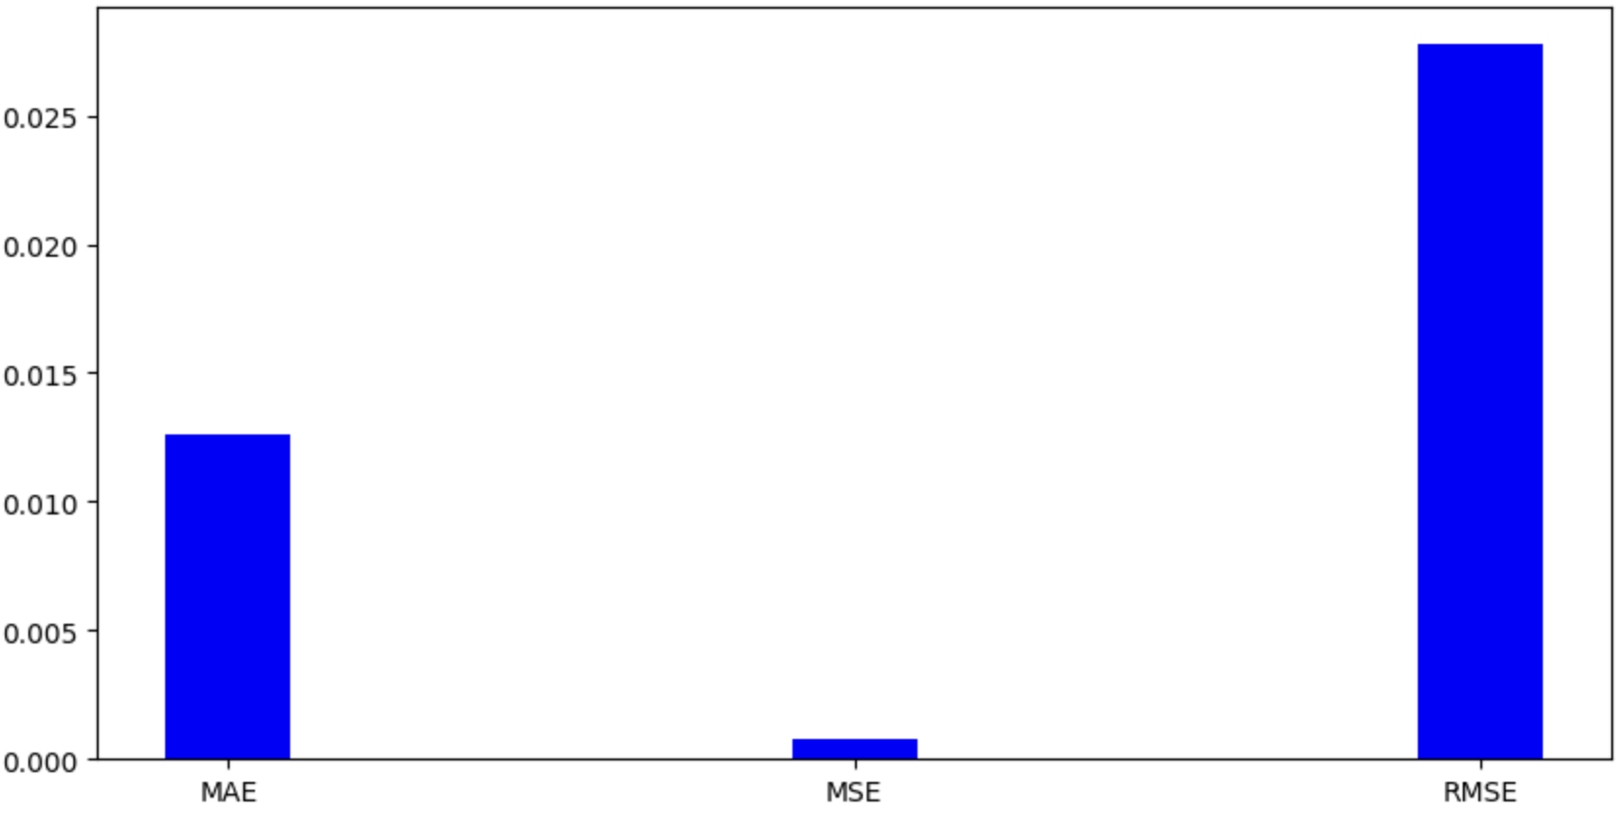
Error Comparison

Slide 11
03
Environmental benefits

Slide 12
Generate employment opportunities
Generate employment opportunities for plant sellers.
Sustainable Agriculture
Increase of awareness towards sustainable agriculture.
3R
Environmental benefits
Inculcating the values of 3R’s in individuals to increase awareness and promote sustainable lifestyle.

Slide 13
04
Future Scope

Slide 14
Plant Recommendation based on Carbon score.
Customised eco friendly solutions to reduce carbon footprint.
Promote business of plants sellers and vendors selling eco friendly products.

Slide 15
Demonstration https://carbonscore.omkarjahagirdar.com/

Slide 16
THANK YOU

