Slide 1
Decongest Canteen
Problem Statement Number 4
By Team White_Hat_Sr

Slide 2
Problem Statement
A food ordering application which will help the canteen caterer manage the limited seating problem
Placing an order in the application. Placing advanced orders can help reduce food wastage
Getting slots for eating in the canteen. Book your seats in advance/get token numbers based on FIFO queue
Get notified when your food is ready and seats are available

Slide 3
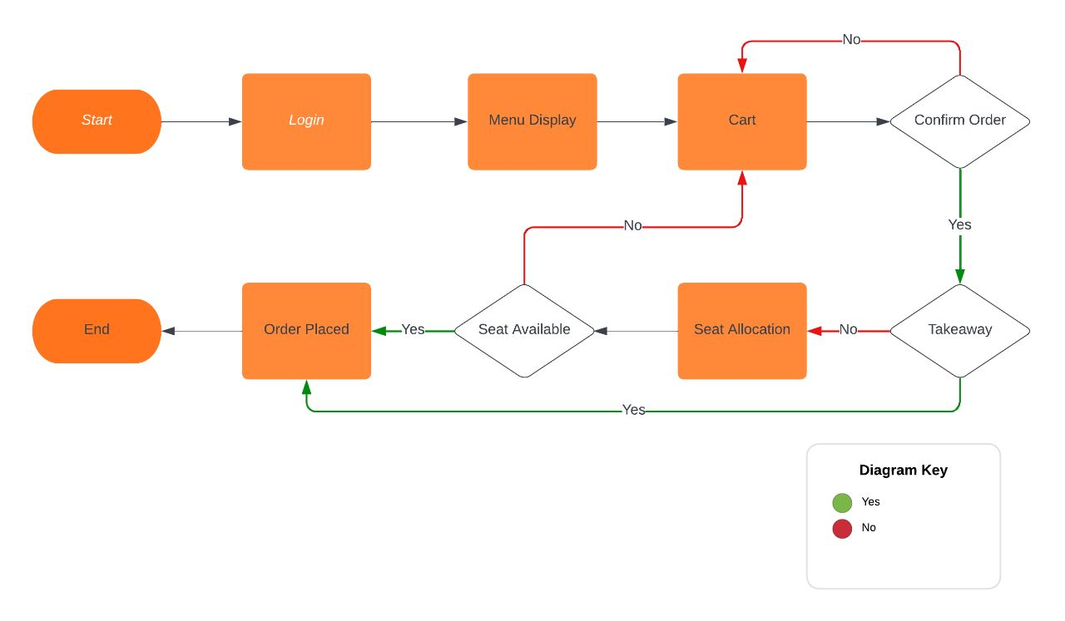
Our Solution

Slide 4
Our Solution - Implementation Details
A responsive Web App written in React .
An API server, written in python, is hosted on Microsoft Azure Cloud. This allows us to handle requests without regional barriers and have our service available all the time.
The API server will manage the database, insert/delete/update/retrieve data and perform integrity checks on the data it receives before serving the requests.
A dedicated notification Handler for sending order ready/new order notifications.
A git repository hosted on GitHub with GitHub Actions set up to automatically deploy our code to the Azure Cloud at every commit to the main branch, assuring a stable CI/CD workflow.

Slide 5
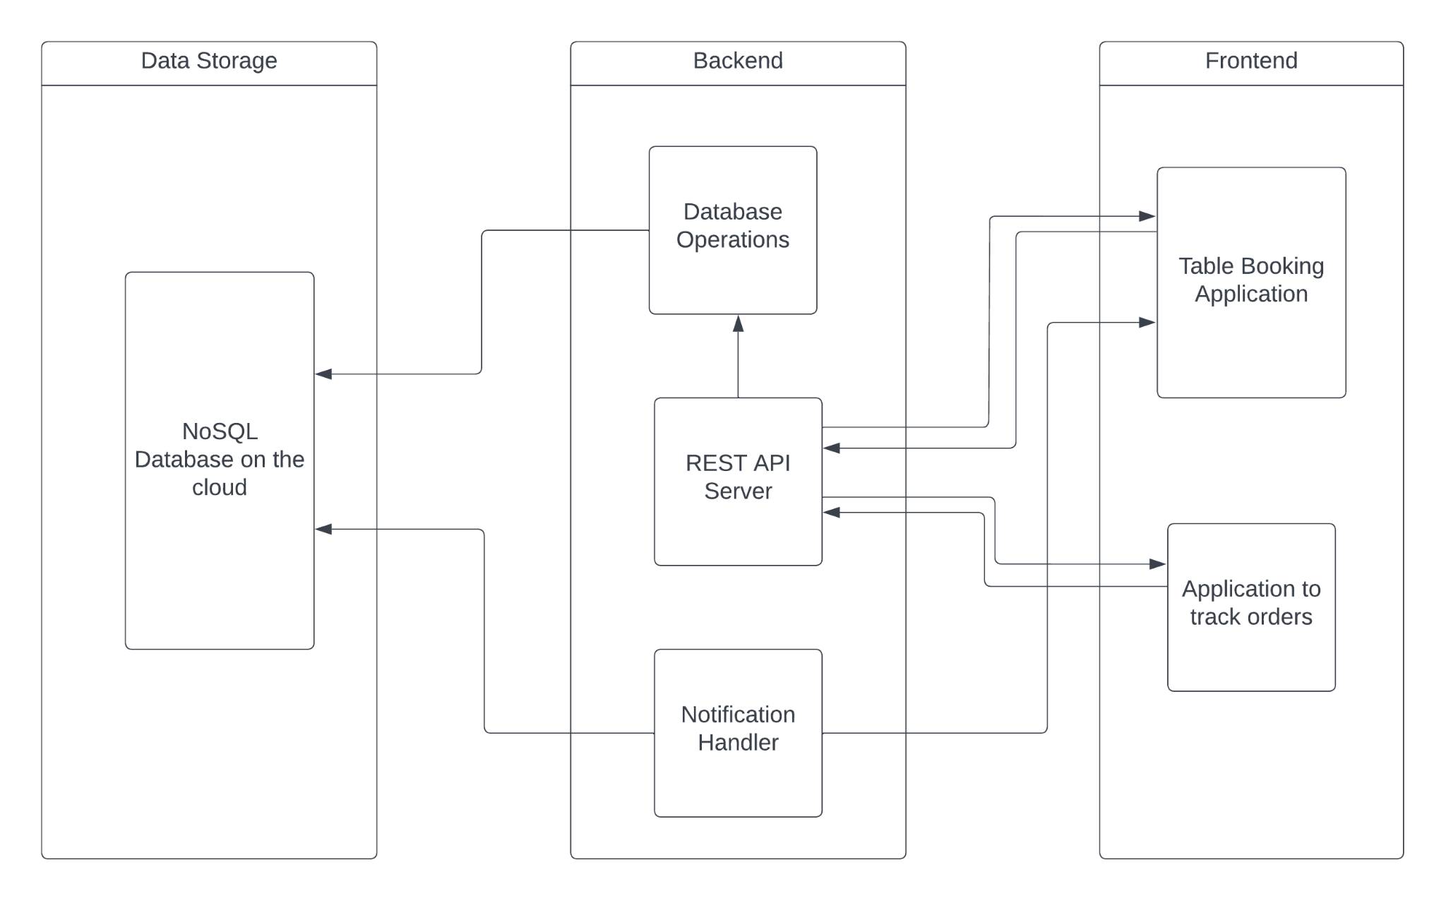

Slide 6
Tech Stack
Front End(React):
Responsive
Reusable Components
Compatible with both iOS and Android
Back End(Python, MongoDB, Azure):
Cloud native
Scalable and Modular
REST APIs
NoSQL
Deployment:
Azure
Git
GitHub Actions
CI/CD Pipelines

Slide 7
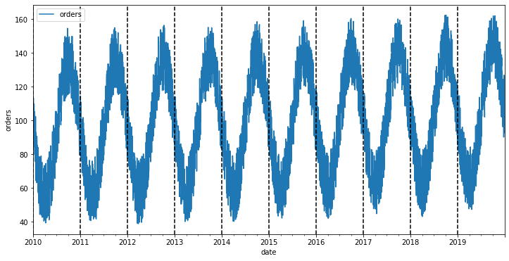
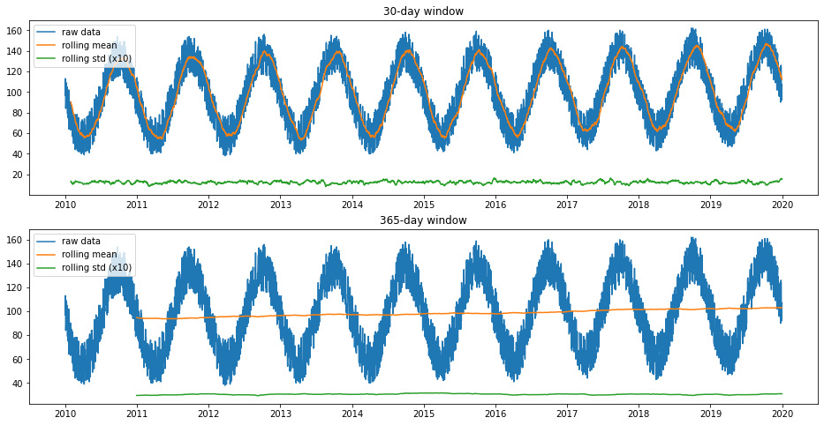
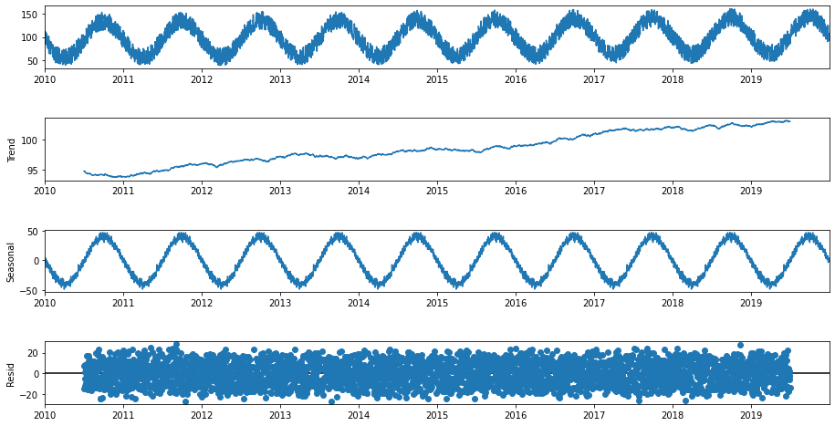
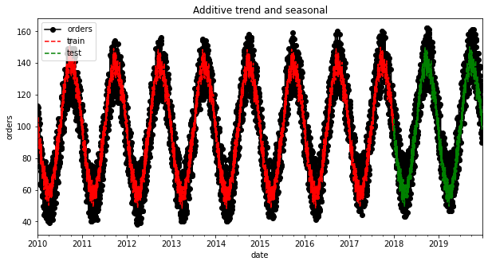

Slide 8
Challenges
Technical Challenges:
Adapting and learning to a front end framework like Javascript was a difficult task
Integrating the front end with the cloud hosted backend
Figuring out how to store and access data on a NoSQL database
Dataset for the ML model

Slide 9
What We learnt
Teamwork
Pressure Handling
Deploying on Azure using CI/CD
Integration of front-end and back-end

Slide 10
Future Scope
Custom time slots booking
Features for the ML model
Automatic separation of menu items
UI to select seats like BookMyShow
Payment

Slide 11
THANK YOU!

