Slide 1

Detailed Project Report
(DPR)
Airport and Airline Data Analysis
Prepared by: Rohit Nautiyal and Mansi

Slide 2
Contents
➢ Introduction
➢ GivenTasks
➢ Data Preparation and Description
➢ Visuals
➢ About tools and theme
➢ Analysis

Slide 3
Introduction
➢ The Airport and Airline Data Analysis Dashboard project aims to provide insights into flight destinations, busy and lengthy routes, and meaningful relationships between attributes. The dashboard will be developed using Python for data transformation and Power BI for interactive visualizations.
➢ Benefits: The project will utilize an airport and airline dataset to analyze flight routes and related metrics. The analysis will focus on flight counts, distances, delays, and flight status. The dashboard will not include real-time data or operational functionalities.

Slide 4
Given Tasks
write the process and data added to the current dataset. In addition, mention the theme on which you will be creating the dashboard.
You can add your data as per your convenience.
Do the data preparation part.
Build the dashboards
Build a Storyline

Slide 5
Data Preparation & Description
Data Transformation: Python will be used for data cleaning, preprocessing, and any additional transformations required for analysis.
Data Visualization: Power BI will be used to create interactive and insightful visualizations based on the transformed data.

Slide 6
DATA Description
Geometry Coordinates Lat Origin: The latitude of the flight origin airport's geographical coordinates.
Geometry Coordinates Long Origin: The longitude of the flight origin airport's geographical coordinates.
Geometry Coordinates Lat Destination: The latitude of the flight destination airport's geographical coordinates.
Geometry Coordinates Long Destination: The longitude of the flight destination airport's geographical coordinates.
Geometry Type: The type of geometry associated with the flight data.
Properties Edtf Cessation: The end date of the flight's validity in the Extended Date/Time Format (EDTF).
Properties Edtf Inception: The start date of the flight's validity in the Extended Date/Time Format (EDTF).
Properties Flysfo Actual Timestamp: The actual timestamp of the flight event at San Francisco International Airport (FLYSFO).
Properties Flysfo Airline: The airline associated with the flight event at FLYSFO.
Properties Flysfo Base Airline: The base airline for the flight event at FLYSFO.
Properties Flysfo Base Flight Number: The base flight number for the flight event at FLYSFO.
Date: The date of the flight event.
Properties Flysfo Estimated Timestamp: The estimated timestamp of the flight event at FLYSFO.
Properties Flysfo Event: The type of flight event at FLYSFO (e.g., arrival, departure).
Properties Flysfo Flight Number: The flight number associated with the flight event at FLYSFO.
Properties Flysfo Gate: The gate number for the flight event at FLYSFO.
Route: The flight route in the format "Origin-Destination."
day_of_week: The day of the week corresponding to the flight event date.
Distance: The calculated distance between the origin and destination airports, representing the distance to be covered in the flight route.
City: The city associated with the flight event, derived from the origin and destination airports.
Flight Status: The status of the flight, indicating whether it is on-time, delayed, or canceled.

Slide 7



Tool used
For Data Visualization and Dashboards
For data transformation and EDA
For Data Preparation, add additional data and Data Pre-processing

Slide 8


Theme
Embrace the diversity of airports worldwide with a collage-style theme showcasing iconic elements from different airports. A collage can feature airport terminals, control towers, and aviation symbols.

Slide 9
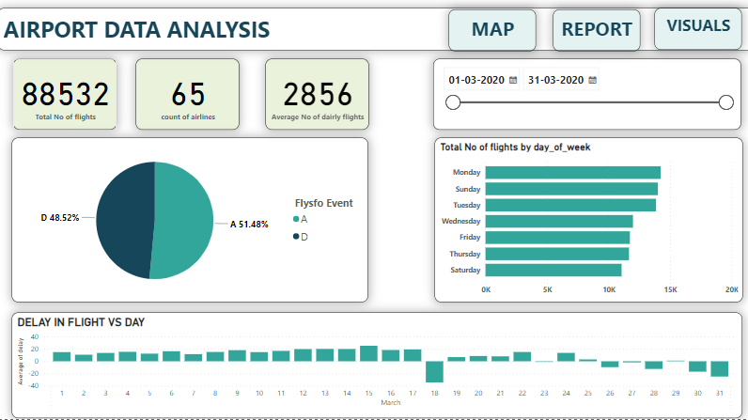
Visuals

Slide 10
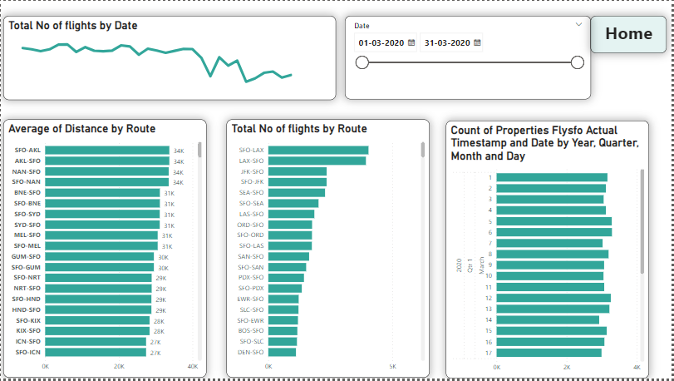

Slide 11
