Slide 1

Airport and Airline Data Analysis
Wireframe
By-
Rohit Nautiyal and Mansi

Slide 2
Homepage
Home Page - Airport Flights Dashboard
The Airport Flights Dashboard serves as the central hub for monitoring and analyzing critical performance indicators related to airport flights. It provides a comprehensive overview of key metrics, enabling stakeholders to gain valuable insights into flight operations and performance. The dashboard is designed to be visually intuitive and interactive, allowing users to explore data effortlessly.
Key Performance Indicators (KPIs):
Total Number of Flights:
This KPI showcases the overall volume of flights operating through the airport. It presents a single, easily digestible number, updating dynamically as new data is received.
Count of Airlines:
Here, users can quickly identify the total number of airlines currently serving the airport. A simple count provides a snapshot of the diversity and size of the airlines in operation.
Average Number of Daily Flights:
This KPI represents the mean number of flights departing or arriving at the airport on a daily basis. A line chart visually illustrates daily trends over time, helping identify patterns and fluctuations.
Flight Delay Overview:
This section offers an insightful overview of flight delays. A combination of charts and statistics highlights the total number of delayed flights and their distribution across airlines and time periods.

Slide 3
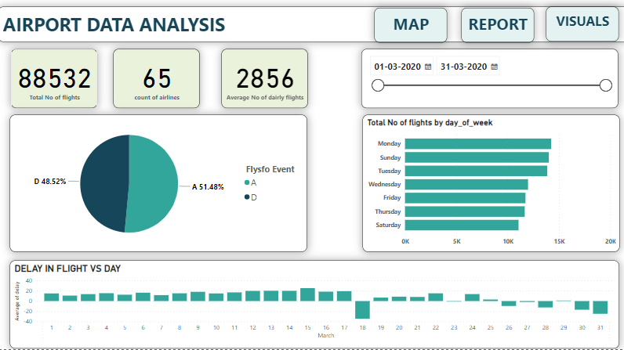
Total Number of Flights by Day of the Week:
A bar chart showcases the distribution of flights across each day of the week. This KPI provides an understanding of peak travel days and identifies any significant variations.
Flight Delay vs. Date:
This line chart plots flight delays against dates, revealing patterns and trends over time. The chart's interactivity enables users to zoom in and analyze specific periods in greater detail.

Slide 4
Page 2 - Flight Route Map
The Flight Route Map is an interactive visualization that provides a geographical representation of different flight routes using a flow map. This page aims to offer a visual exploration of flights' paths, and users can apply various filters to gain insights into specific routes based on date, airlines, and origin-destination combinations.
Flow Map Visualization:
The main focus of this page is the interactive flow map. The flow map displays flight routes as arrows connecting the origin airport to the destination airport, with the thickness of the arrows representing the volume of flights on each route.
Filters:
Users can apply the following filters to customize the flow map and narrow down their analysis:
Date Filter: A date range selector allows users to filter flights based on departure or arrival dates. This filter helps identify patterns and trends over specific time periods.
Airlines Filter: Users can choose specific airlines from a dropdown list to isolate and analyze the routes operated by those airlines exclusively.
Route Filter: A text-based search filter allows users to enter airport names or IATA codes to focus on specific origin-destination combinations. As users type, the filter suggests matching routes for easy selection.

Slide 5
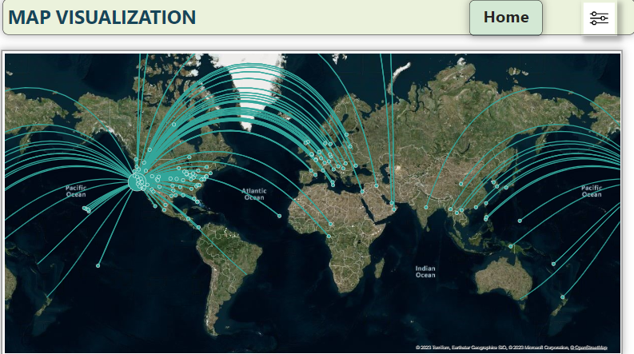

Slide 6
Line Graph - Total Number of Flights Over Time:
The line graph visualizes the total number of flights over a selected time range. The X-axis represents the date, and the Y-axis shows the count of flights. Users can zoom in or use the date slicer to analyze specific periods of interest.
Histogram - Flight Distance Distribution:
The histogram displays the distribution of flight distances. The X-axis represents the distance bins, and the Y-axis shows the frequency of flights falling into each bin. Users can observe the range and frequency of different flight distances.
Bar Chart - Total Number of Flights by Routes:
The bar chart visualizes the total number of flights on different routes. Each bar represents a specific route, and the height of the bar indicates the total count of flights on that route. Users can click on a bar to see additional details about the route.
Bar Chart - Total Number of Flights by Days of the Week:
This bar chart illustrates the total number of flights on each day of the week. Each bar corresponds to a day, and the height of the bar represents the total count of flights on that specific day. Users can quickly identify peak and off-peak days for air travel

Slide 7
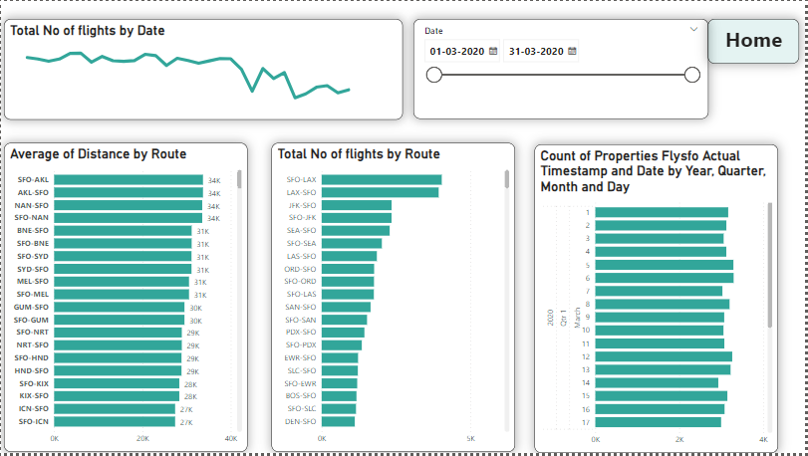

Slide 8
