Slide 1

Detailed Project Report
(DPR)
ENTERTAINER DATA ANALYSIS
Prepared by: Rohit Nautiyal

Slide 2
Contents
➢ Introduction
➢ GivenTasks
➢ Data Preparation and Description
➢ Visuals
➢ About tools and theme
➢ Analysis

Slide 3
Introduction
➢ Normal life can be stressfull , and people need to relax. Being entertained by others is a wonderful way to take some time out of life. It can reduce stress and make life's issues easier to face. The media and entertainment industry consists of film, television, radio and print. These segments include movies, TV shows, radio shows, news, music, newspapers, magazines, and books. Entertainment industry is a group of subindustries devoted to entertainment. Entertainment industry is used to describe the mass media companies that control the distribution and manufacture of mass media entertainment.
➢ Benefits: User can easily analyse about their favourite entertainer through the dashboards in terms of how many awards he/she won.

Slide 4
Given Tasks
write the process and data added to the current dataset. In addition, mention the theme on which you will be creating the dashboard.
You can add your data as per your convenience.
Do the data preparation part.
Build the dashboards
Build a Storyline

Slide 5
Data Preparation & Description
Data was given into three parts:
(1) Entertainer – Basic Info, (2) Entertainer – Breakthrough Info and (3) Entertainer – Last work Info.
I combined them into a single file named "Entertainer - Final".
Given data is not that much sufficient for analysis part,so additional information is required to add.
I added number of awards and nominees won by them,awards from breakthrough etc.
Data is in form of numeric and alphabets.
Additional data is added from IMDb's official website.
Source: IMDb

Slide 6
Column Name | Description
Entertainer | Name of entertainer.
Profession | Category of entertainer (actor or singer).
Gender (traditional) | Gender of entertainer
Birth Year | Birth year of entertainer
Year of Breakthrough/#1 hit/Award Nomination | Year of breakthrough of entertainer . Breakthrough means super hit or career changing performance by entertainer.
Breakthrough Name | Name of breakthrough. It can be any musical album, TV shows, movie etc.
Number of total other awards won by entertainer. | Number of total other awards won by entertainer.
Year of Last Major Work (arguable) | Number of total other awards won by entertainer.
Year of Death | Number of total other awards won by entertainer.
Total Awards won | Total number of awards won by entertainer.
Total Nominees | Total number of nominees by entertainer for whichever award they were candidate.
Oscar won | Number of total Oscars won by entertainer
Grammy won | Number of total Grammies won by entertainer
Emmy won | Number of total Emmies won by entertainer.
No. of other awards won | Number of total other awards won by entertainer.

Slide 7


Tool used
For Data Visualization and Dashboards
For Data Preparation, add additional data and Data Pre-processing

Slide 8




Theme
Decide top entertainer based on awards they won and analyse them.

Slide 9
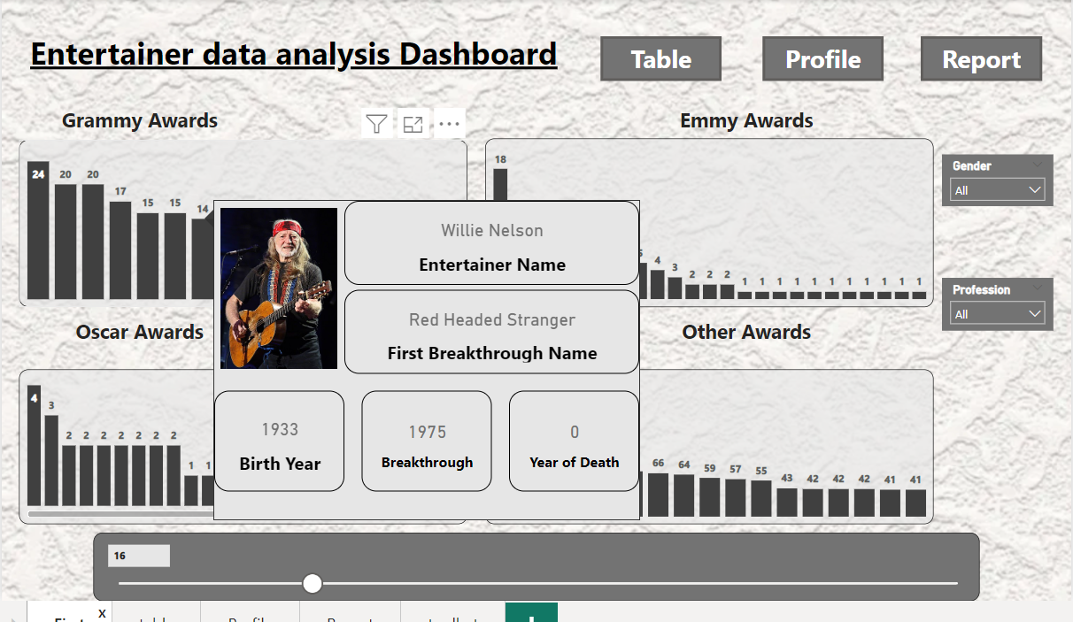
Visuals

Slide 10
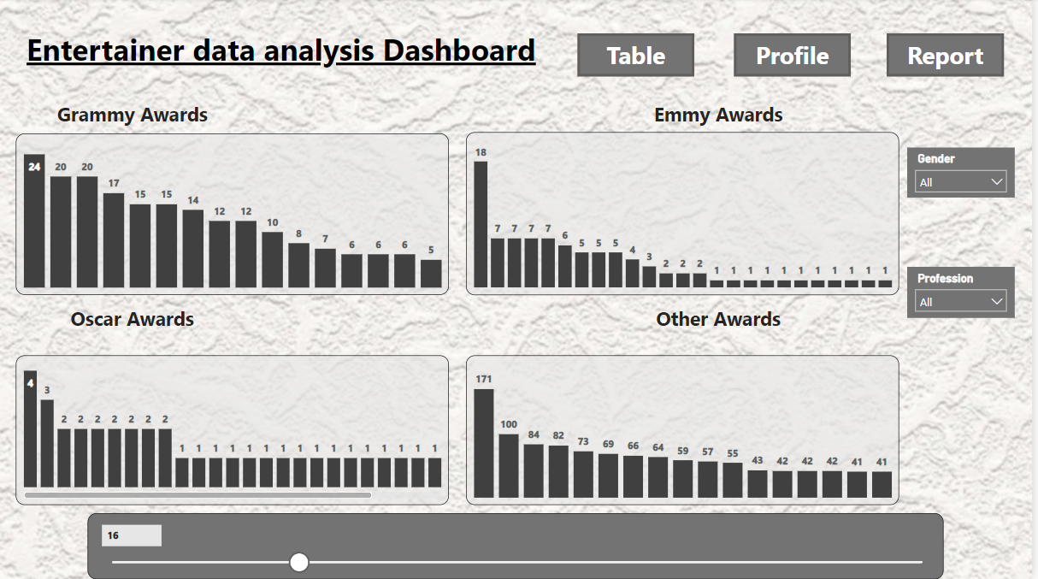

Slide 11
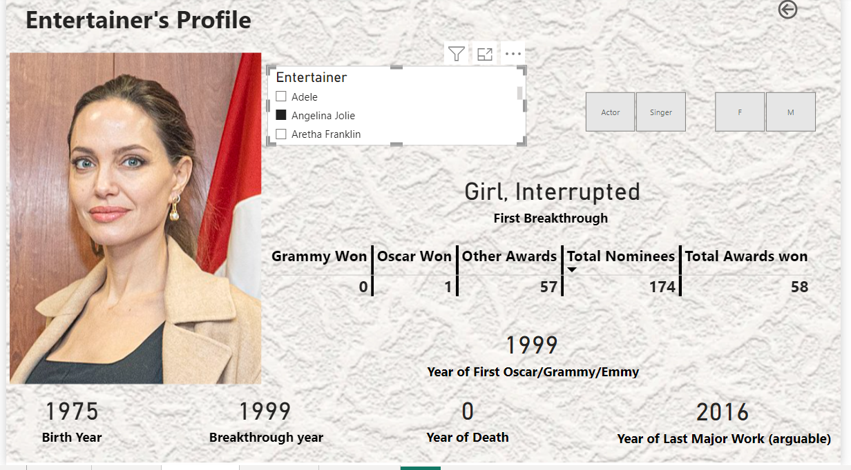

Slide 12
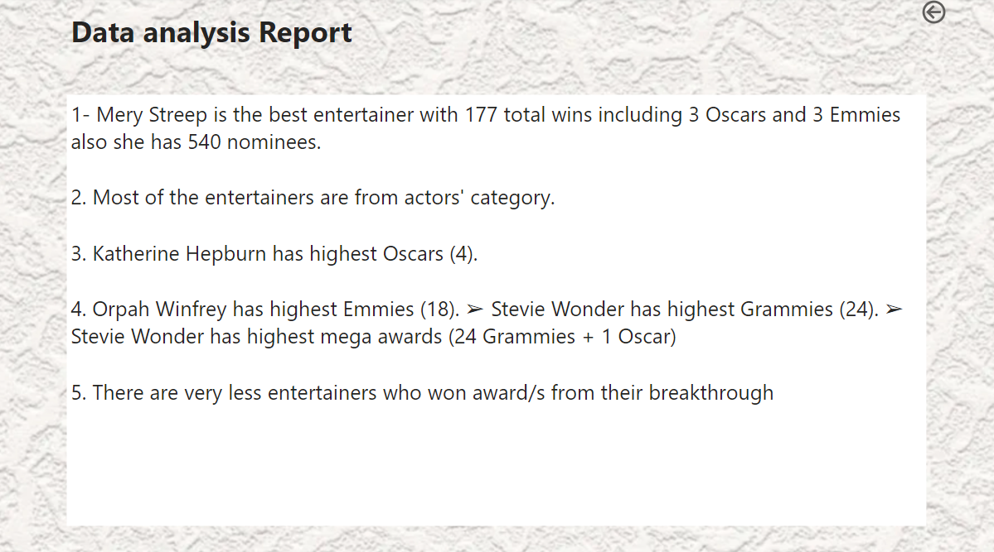

Slide 13
