Slide 1

Entertainer Data Analysis
Wireframe
By-
Rohit Nautiyal

Slide 2
Homepage
Title and Theme: Include a prominent title that reflects the purpose of your dashboard, such as "Entertainer Data Analysis." Consider incorporating a theme or branding elements that align with the entertainment industry.
Bar Graphs for Awards: Create bar graphs to visually represent the awards won by artists. Display the different awards categories, such as Grammy, Emmy, Oscar, and others, on the x-axis and the corresponding number of awards on the y-axis. Ensure that the graphs are visually appealing and easily understandable.
Slicers for Filtering: Add slicers to allow users to filter the data shown in the bar graphs. Include slicers based on relevant criteria, such as entertainer name, gender (male/female), and profession. Users can interact with the slicers to dynamically update the graph based on their selections.
Toolkit Element: Integrate a toolkit element to provide additional information and visual assets related to the selected entertainer. This can include the entertainer's picture, name, profession, notable works, or other relevant details. The toolkit should be visually appealing and located adjacent to the bar graphs for easy reference.
Top Filters: Place filters at the top of the home page, allowing users to refine their selections quickly. These filters could include options to filter by gender (male/female), profession, or any other relevant attributes. Ensure these filters are intuitive to use and clearly labeled.

Slide 3
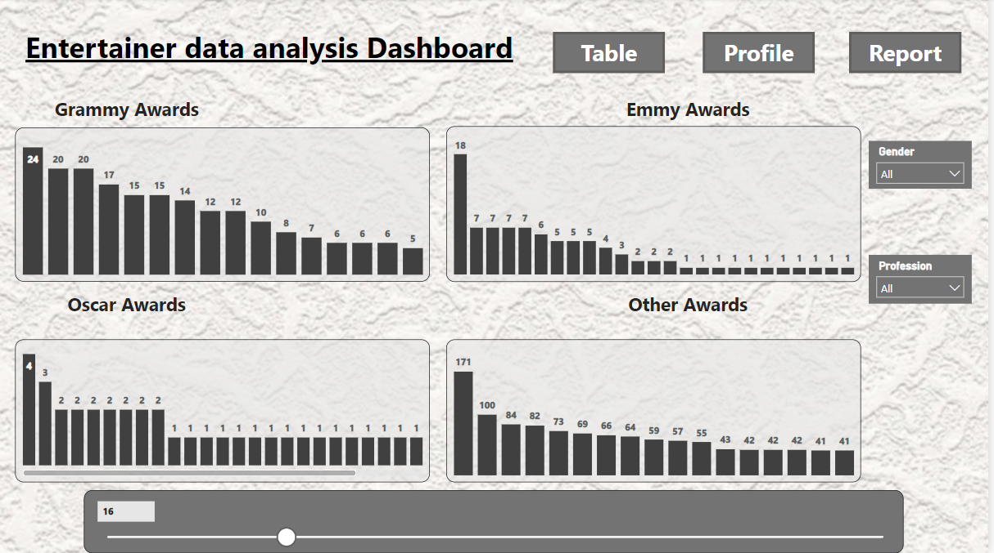
Navigation Buttons: Add three buttons at the top of the home page for easy navigation to other sections of the dashboard. Label the buttons as "Report," "Table," and "Profile." Clicking on each button will redirect users to the respective pages.

Slide 4
Table
Table: The table will display detailed information about entertainers, including their name, picture, awards won (Oscar, Grammy, Emmy, and others), total nominations, and total awards.
The table will have seven columns:
Name: Display the name of the entertainer.
Pic: Include a column to display the picture or image of the entertainer.
Oscar: Show the number of Oscar awards won by the entertainer.
Grammy: Display the number of Grammy awards won by the entertainer.
Total Nomination: Show the total number of nominations received by the entertainer across all awards.
Emmy: Display the number of Emmy awards won by the entertainer.
Other: Show the number of awards won by the entertainer that are not categorized under Oscar, Grammy, or Emmy.
Total Awards: Calculate and display the total number of awards won by the entertainer (sum of Oscar, Grammy, Emmy, and other awards).

Slide 5
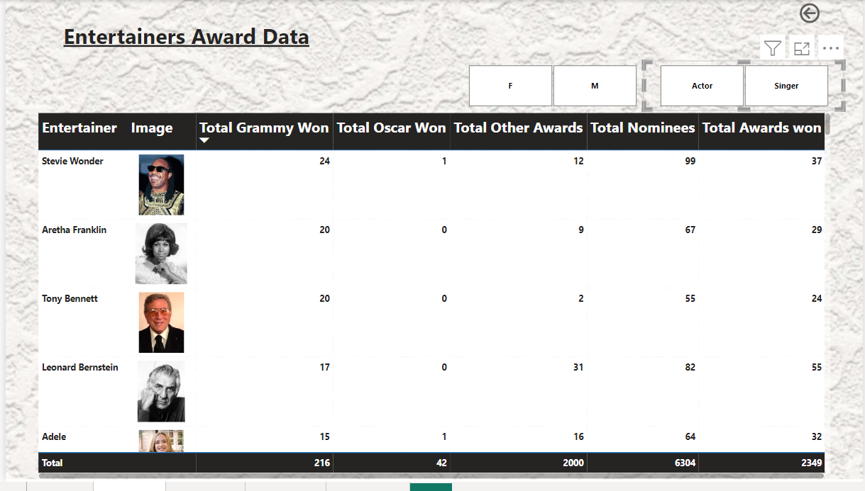
2.Filters: Include filters at the top of the table to allow users to refine the data based on specific criteria.
Gender: Add a filter for gender, providing options such as male and female. Users can select their desired gender to filter the entertainers accordingly.
Professions: Include a filter for professions, such as singer, actor, or any other relevant categories. Users can choose the profession to filter the entertainers based on their field.
3.Navigation Button: Add a button at the top right corner of the table page to navigate back to the home page. Label the button as "Home" or "Back to Home." Clicking on this button will redirect users to the home page.

Slide 6
Profile
Large Picture of Entertainer: Include a prominent section for a large picture or image of the entertainer. This section should visually showcase the entertainer's image and create a focal point on the page.
Breakthrough Information: Display essential details about the entertainer's breakthrough in their career. This can include:
Breakthrough Year: Show the specific year when the entertainer had a significant career breakthrough.
Breakthrough Work Name: Display the name of the breakthrough work that propelled the entertainer's career.
Personal Information: Provide important personal information about the entertainer:
Date of Birth (DOB): Display the entertainer's date of birth to provide their age or birthdate information.
Year of First Major Award: Indicate the year when the entertainer received their first major award.
Year of Last Major Work: Display the year of the entertainer's most recent or last significant work.
Table of Awards: Create a table to showcase all the awards received by the entertainer. The table will contain the following columns:
Award Name: Display the name of the award.
Year: Indicate the specific year when the entertainer received the award.
Category: Specify the category or field in which the award was given.
Result: Show whether the entertainer won or was nominated for the award.

Slide 7
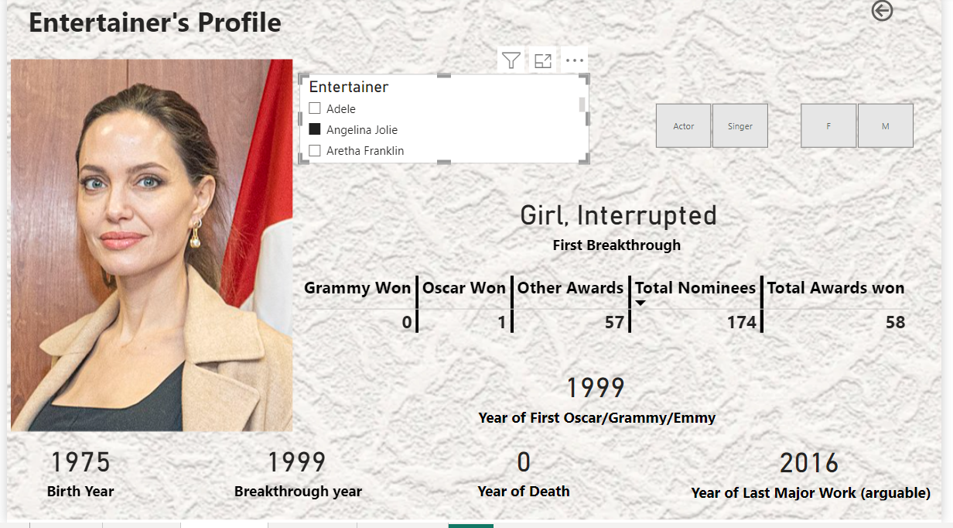
5.Navigation Button: Add a button at the top right corner of the profile page to navigate back to the home page. Label the button as "Home" or "Back to Home." Clicking on this button will redirect users to the home page.
6. Filters: Include filters at the top of the profile page to allow users to filter the data based on specific criteria:
Gender: Add a filter for gender, providing options such as male and female. Users can select their desired gender to filter the entertainers accordingly.
Profession: Include a filter for professions, such as singer, actor, or any other relevant categories. Users can choose the profession to filter the entertainers based on their field.
Entertainer Name: Provide a slicer or search bar to allow users to filter and quickly find specific entertainers by name.

Slide 8
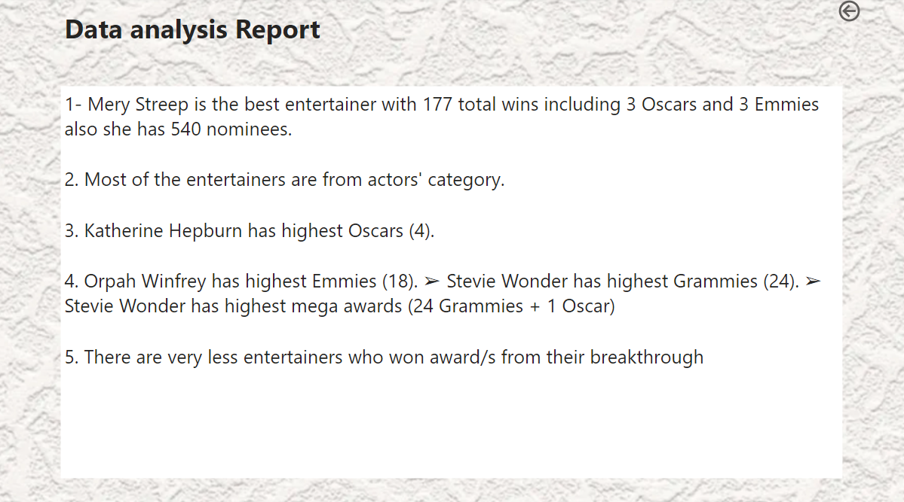
Report
Report: The report page will present the final report about your project. This section will provide a comprehensive analysis and summary of the entertainer data analysis project.

Slide 9
Tooltip: The tooltip component will provide additional information when users hover over or interact with specific elements on your dashboard, such as images or data points. The tooltip will contain relevant details about the entertainer, including their photo, name, and other information.
Photo: Display a small thumbnail or scaled-down version of the entertainer's photo within the tooltip.
Name: Include the entertainer's name prominently in the tooltip.
Other Information: Depending on the specific requirements of your project, you can include additional information about the entertainer in the tooltip. This can include their profession, notable works, awards, or any other relevant details.
The tooltip will appear dynamically when users hover over or interact with an element, providing quick contextual information without cluttering the main dashboard view.

Slide 10
