Slide 1
1
Wireframe Documentation
Amazon Food Sales Data Analysis

Slide 2
2
Contents
1. Key Insights ............................................................................................................................................... 3
1.1 Cards ................................................................................................................................................... 3
1.2 Monthly Sales Trend ........................................................................................................................... 3
1.3 Revenue by Country............................................................................................................................ 4
2. Sales Analysis ............................................................................................................................................ 4
2.1 Revenue vs Sales Quantity can be drilled through year , month and quarter.................................... 5
2.2 Data Table of countries based on Revenue, YOY sales, Revenue Contribution, Profit contribution.. 5
3.Customer Analysis...................................................................................................................................... 6
3.1 The revenue, sales quantity, Last purchase date of selected customer ............. Error! Bookmark not
defined.
3.2 Revenue categorize by region ............................................................................................................ 6
3.3 Data table for customer based on revenue contribution , profit contribution. ................................. 7
3.4 Top products tooltip for selected customers...................................................................................... 7
4. Product Analysis........................................................................................................................................ 8
4.1 Top 20 Product slicers w.r.t revenue .................................................................................................. 9
4.2 Detail Cards of Sales Quantity, YOY Sales Growth%, Profit Margin.................................................... 9
4.3 Detailed Overall sales using waterfall chart for selected date ........................................................ 10

Slide 3
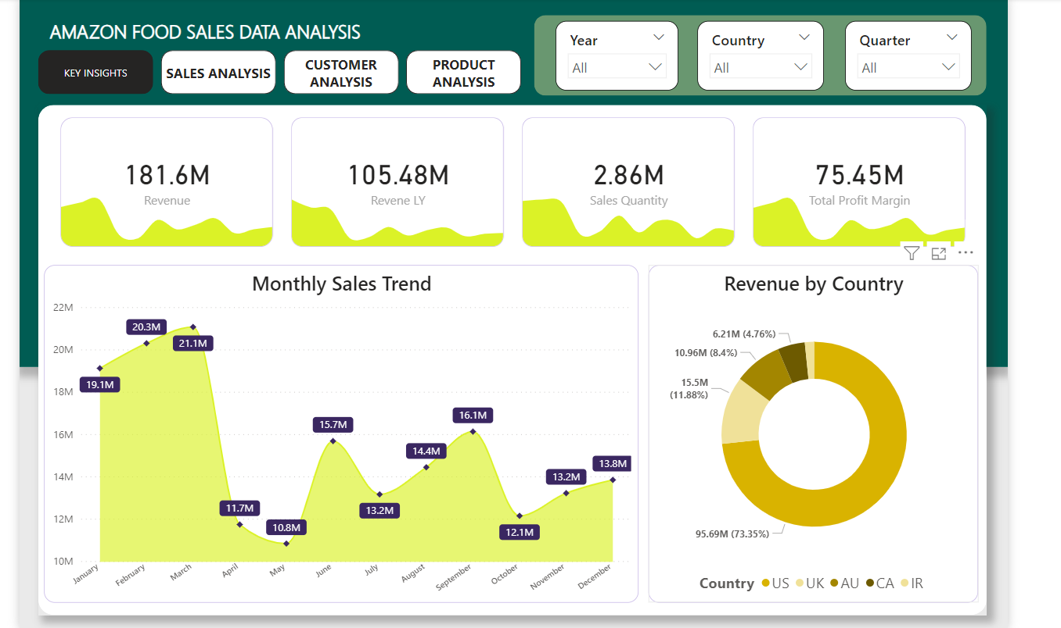
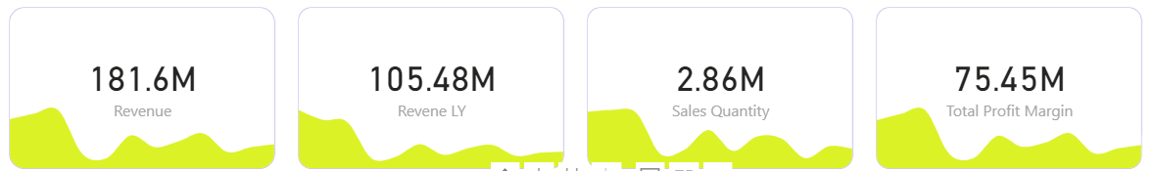
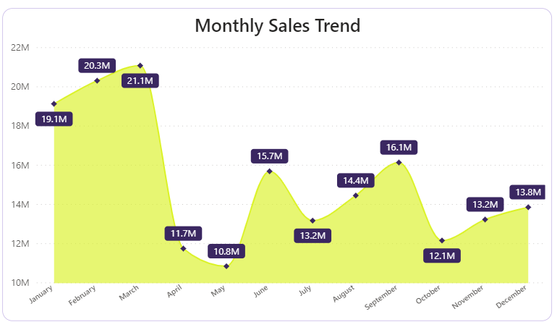
3
1. Key Insights
1.1 Cards
The card slicers that shows Revenue, Revenue Last Year, Total Sales Quantity, Total Profit
Margin
1.2 Monthly Sales Trend
The area chart for monthly, yearly and quarterly sales

Slide 4
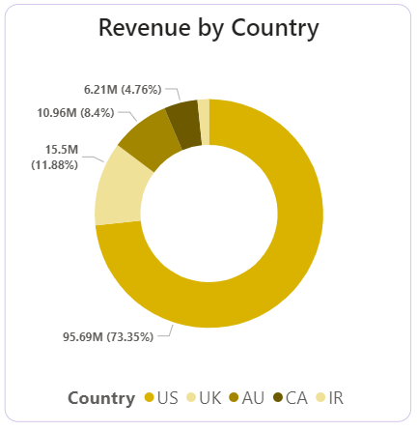
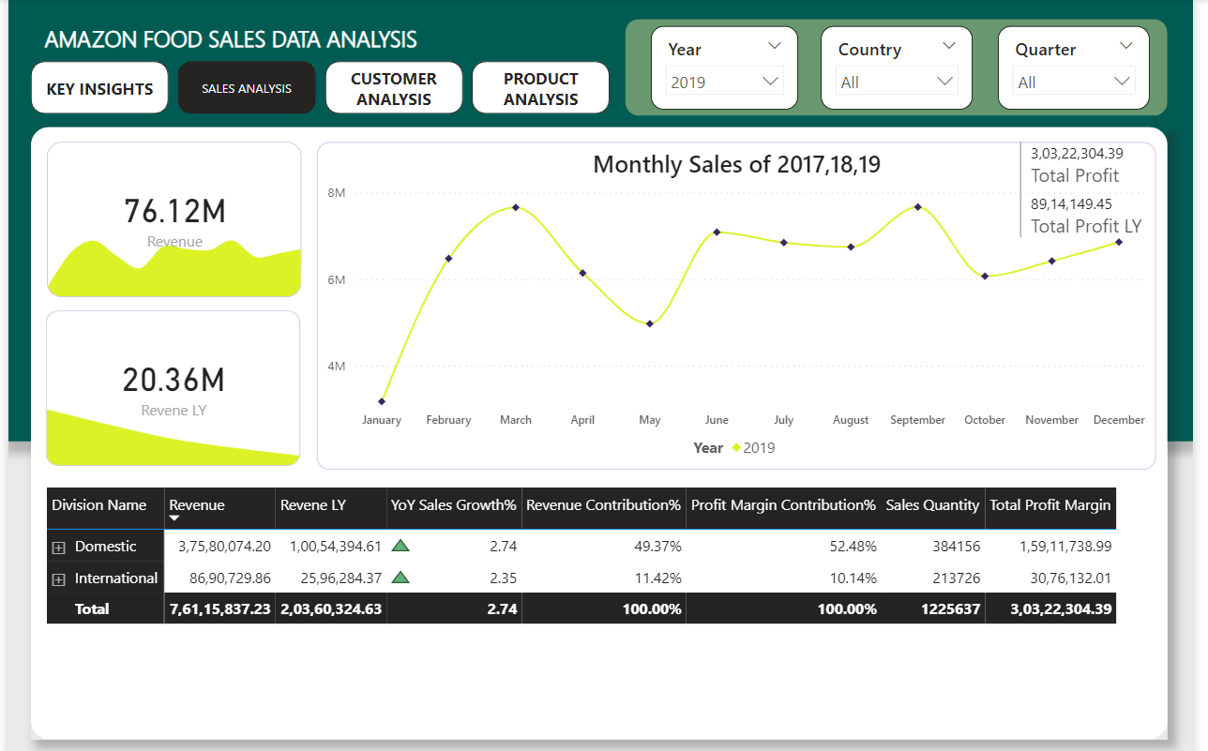
4
1.3 Revenue by Country
2. Sales Analysis

Slide 5
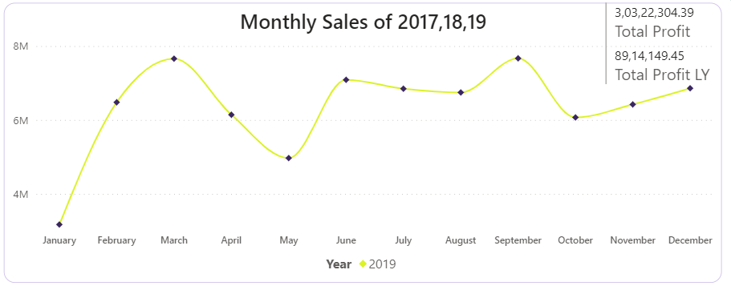
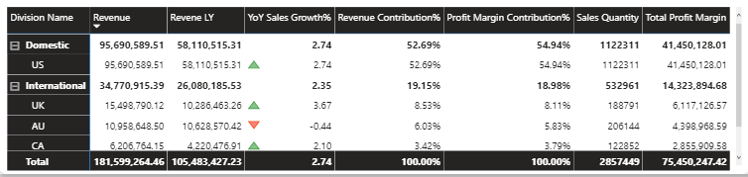
5
2.1 Monthly Sales for 2017 , 2018, 2019
2.2 Data Table of countries based on Revenue, YOY sales, Revenue Contribution,
Profit contribution

Slide 6
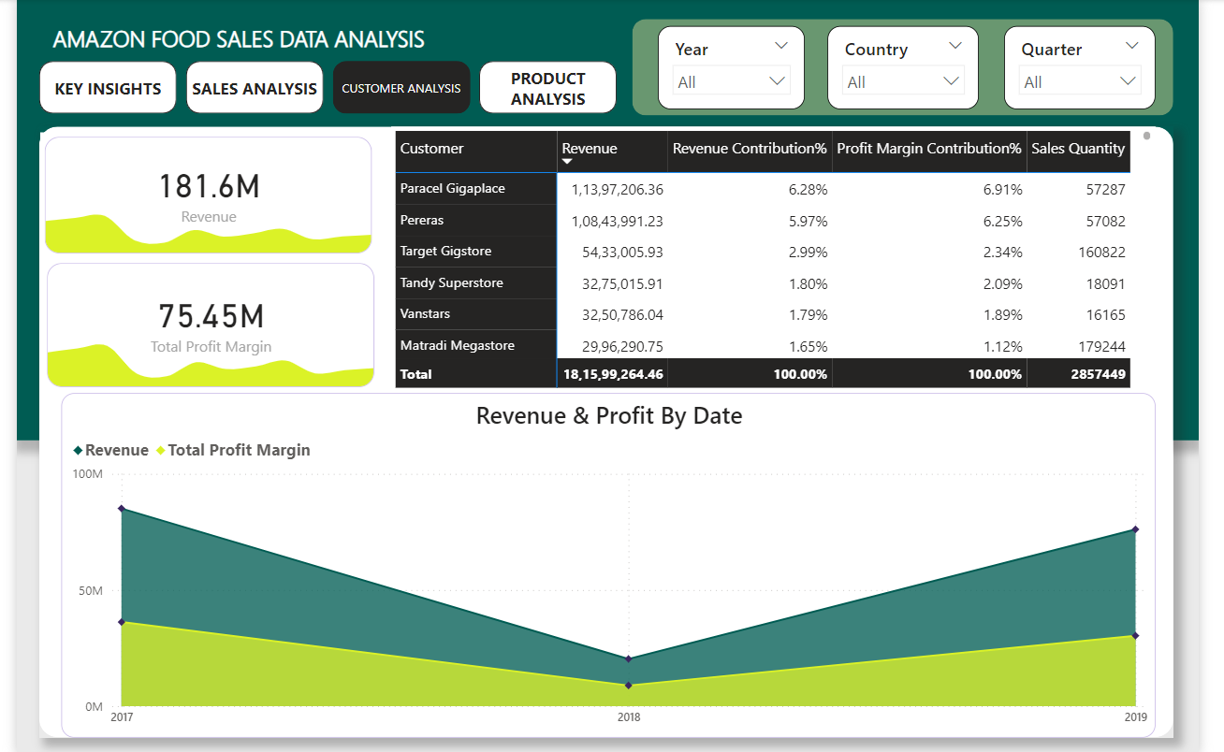
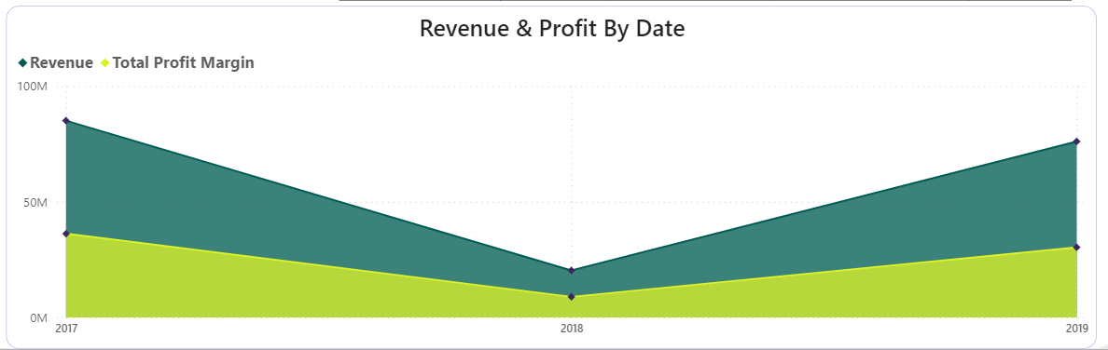
6
3.Customer Analysis
3.1 Revenue and Profit categorize by region

Slide 7
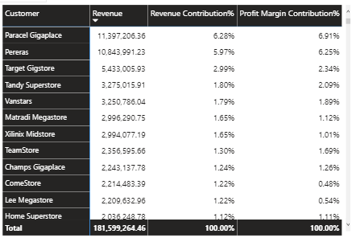
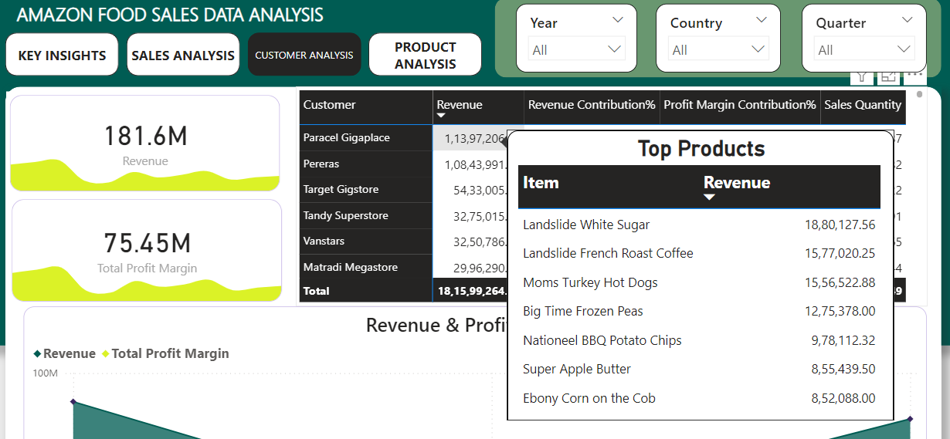
7
3.2 Data table for customer based on revenue contribution , profit contribution.
3.3 Top products tooltip for selected customers

Slide 8
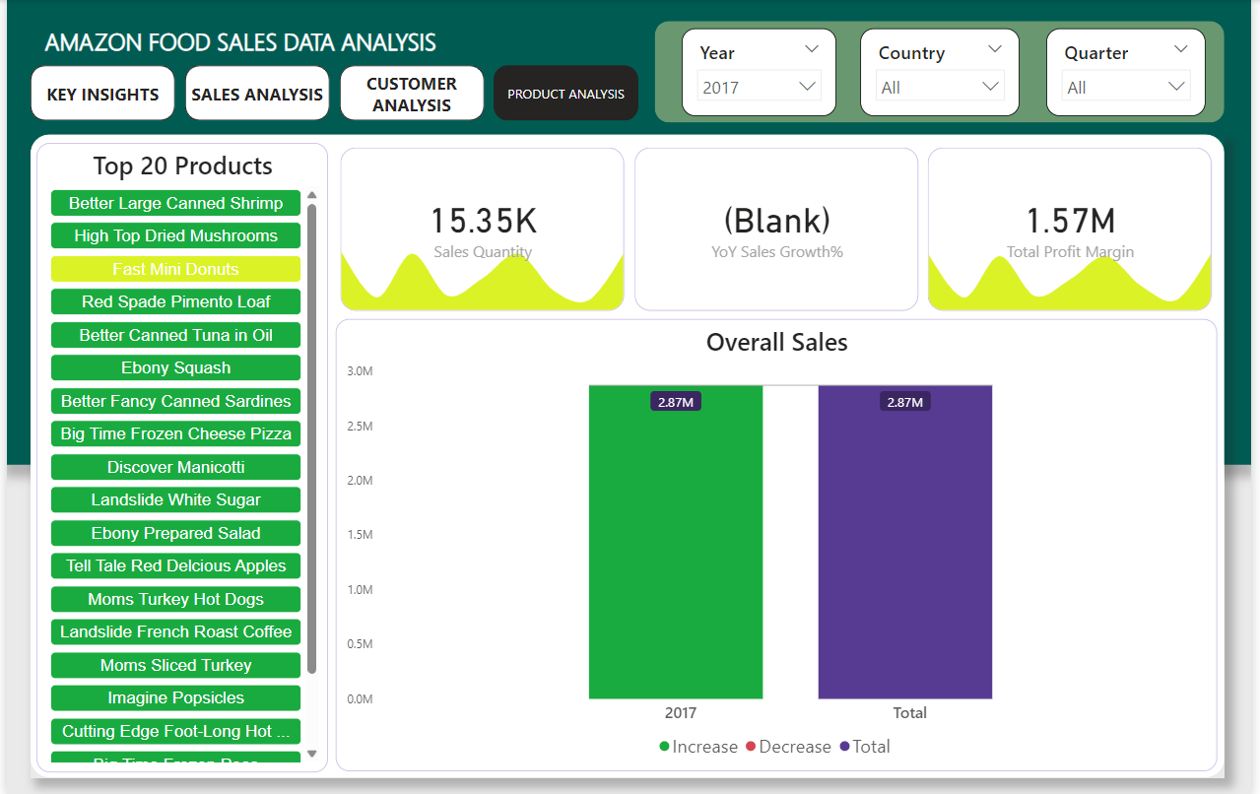
8
4. Product Analysis

Slide 9
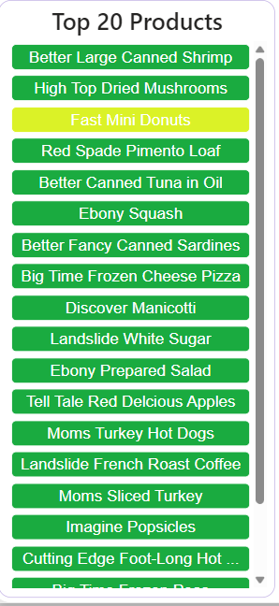
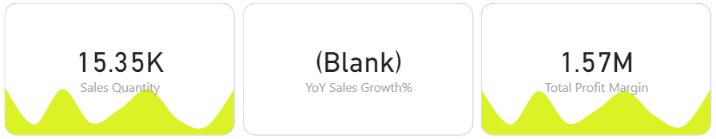
9
4.1 Top 20 Product slicers w.r.t revenue
4.2 Detail Cards of Sales Quantity, YOY Sales Growth%, Profit Margin

