Slide 1


Fashion Trend Analysis

Slide 2
Brand & Category Analysis:

Slide 3
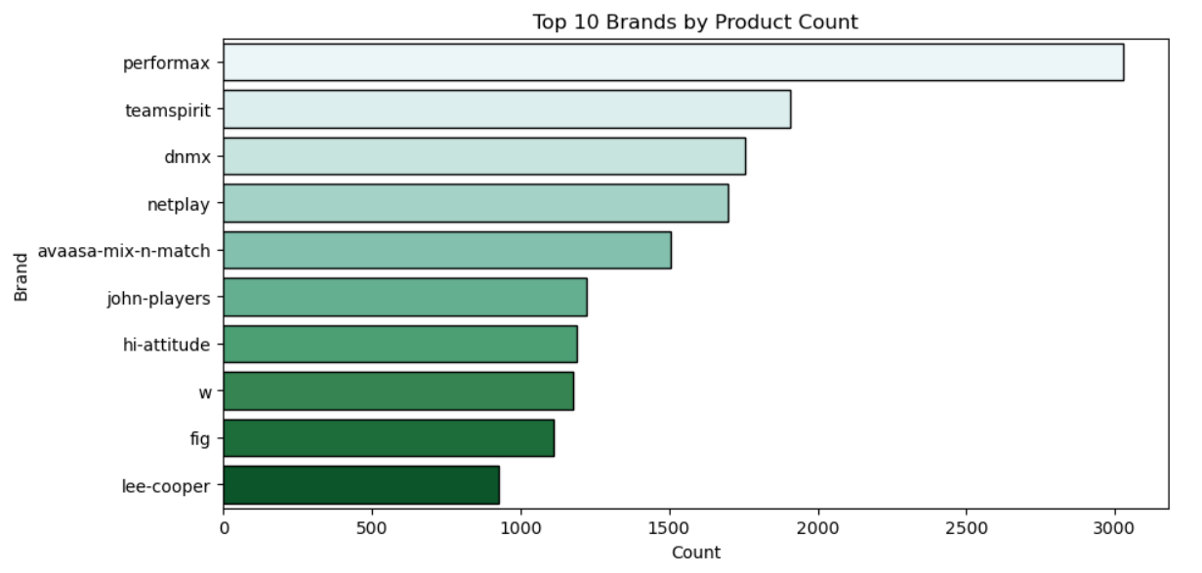
Top Brands: Which brands have the most products?
Performax leads with the highest number of products, exceeding 3000.
Brands like Teamspirit, dnmx, and Netplay follow, each with over 1500 products.
A few brands account for most of the inventory, indicating market concentration among leading brands.

Slide 4
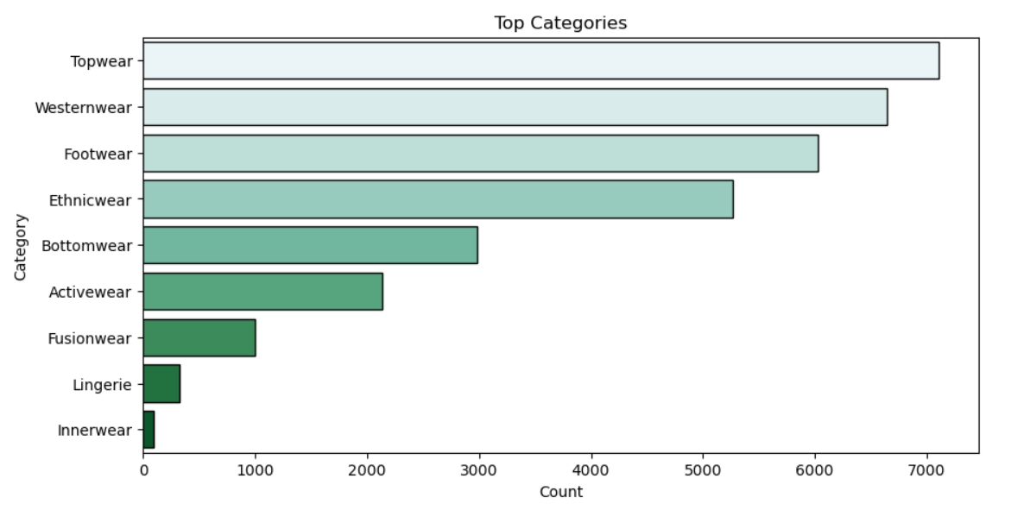
Category Analysis: Which categories dominate overall?
Topwear is the largest category, with more than 7000 products.
Westernwear, Footwear, and Ethnicwear are also major categories, each with 5000–7000 products.
Smaller categories such as Fusionwear, Lingerie, and Innerwear make up a minor portion of the total assortment.

Slide 5
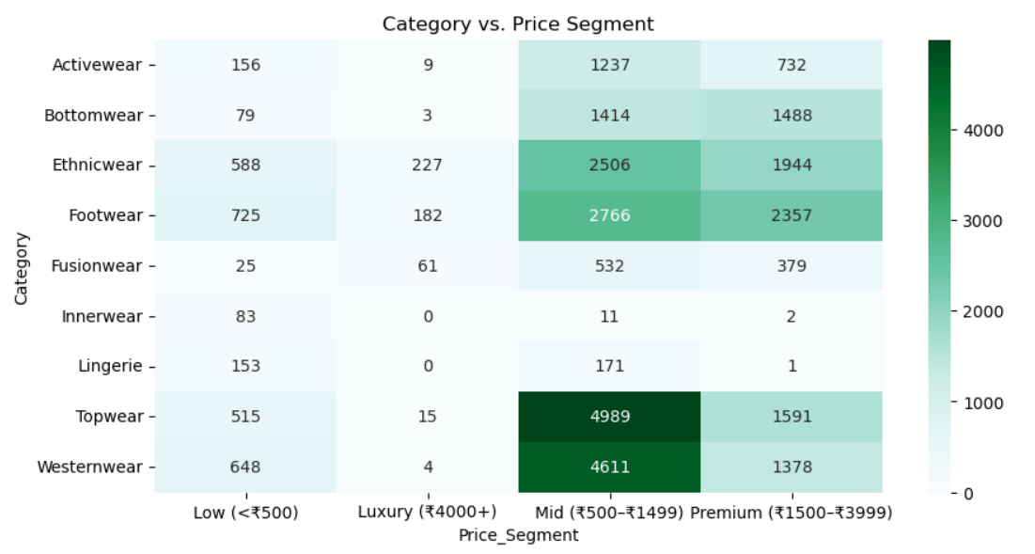
Category vs Price Segment: Which categories dominate in Budget, Mid, Premium, Luxury?
Most products are concentrated in the Mid (₹500–₹1499) price range across all categories.
Topwear and Westernwear dominate the mid and Footwear and Ethnicwear to the premium segments.
High-end (Luxury) and low-cost segments have significantly fewer product options, highlighting a focus on accessible and premium pricing for mainstream categories.

Slide 6
Product Type Analysis:

Slide 7
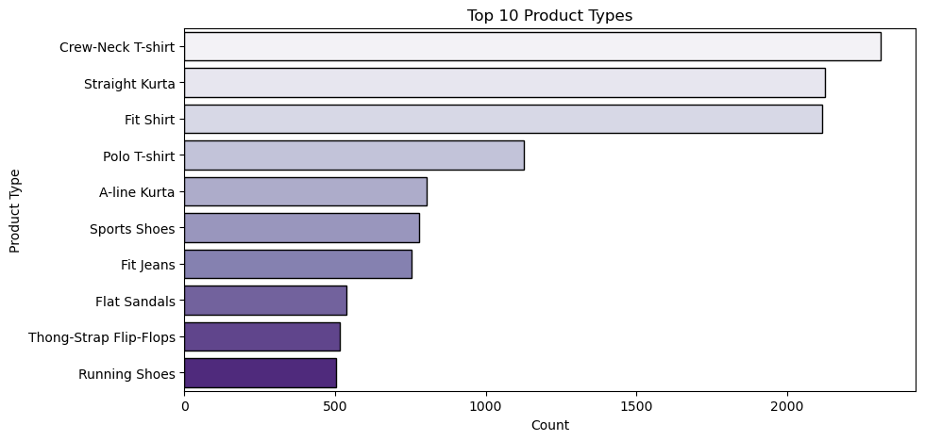
Which product types (T-shirts, Jeans, Sarees, Shoes) are most common?
Crew-Neck T-shirt, Straight Kurta, and Fit Shirt are the highest-count product types, all exceeding 2000.
The top 10 list includes both apparel and footwear, reflecting broad consumer demand for comfort and versatility.
T-shirts, kurtas, and jeans consistently lead as everyday staples.

Slide 8
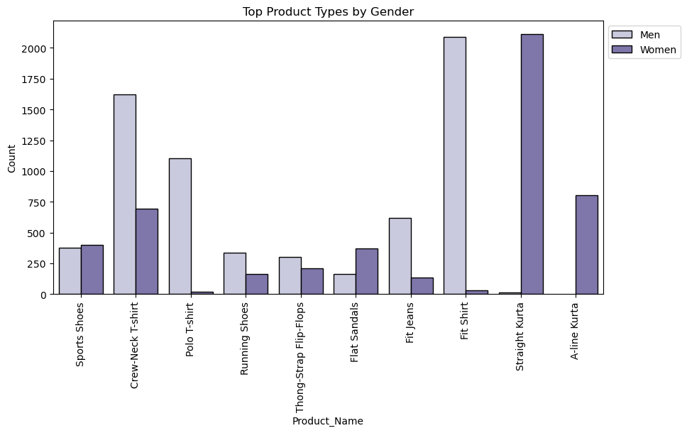
Compare product type distribution across genders.
Shirts and t-shirts (especially Crew-Neck T-shirt and Fit Shirt) are dominated by the men's segment.
Kurtas (Straight Kurta, A-line Kurta) are almost entirely concentrated in women’s products.
Footwear types (e.g., Sports Shoes, Running Shoes, Flip-Flops) show moderate counts for both men and women but are more prominent for men.

Slide 9
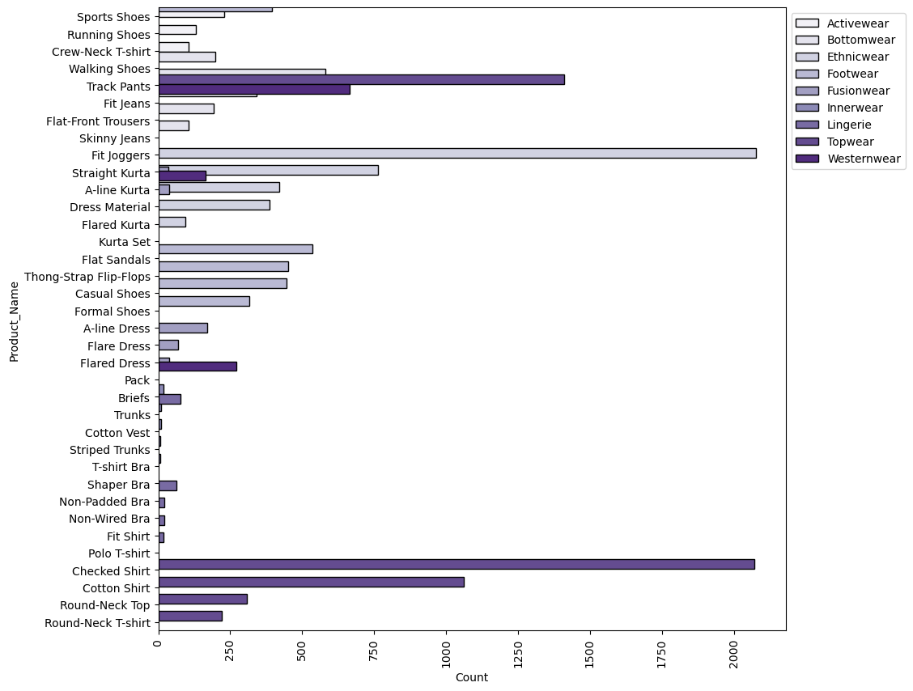
Identify top product types within each category.
Checked Shirt and Cotton Shirt dominate in Topwear/Westernwear, far outnumbering other product types.
Fit Joggers, Track Pants, and Fit Jeans are the top items within Bottomwear, focusing on casual and athletic comfort.
Straight Kurta, A-line Kurta, and Dress Material are central to Ethnicwear/Fusionwear, mainly for women.
Footwear product types (e.g., Walking Shoes) hold notable positions but are less dominant than topwear or bottomwear.
The chart demonstrates that most inventory is concentrated in a small number of high-volume categories and product types, especially those associated with everyday wear and mainstream preferences.

Slide 10
Discount Analysis:

Slide 11
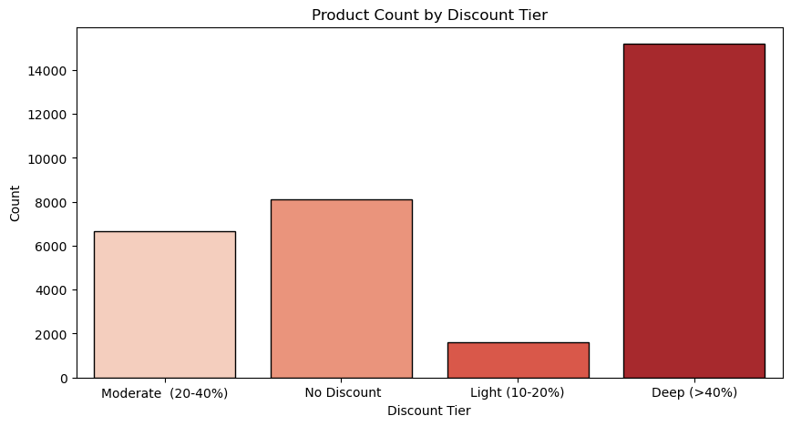
Discount Tier Comparison: How many products fall into each discount tier?
The Deep (>40%) discount tier contains the highest number of products—over 15,000.
A significant portion of products (over 8,000) have no discount applied.
Moderate (20–40%) discounts cover around 6,500 items, while Light (10–20%) discounts are rare.
There is a strong tendency toward either heavy discounting or no discount, with fewer products in between tiers.

Slide 12
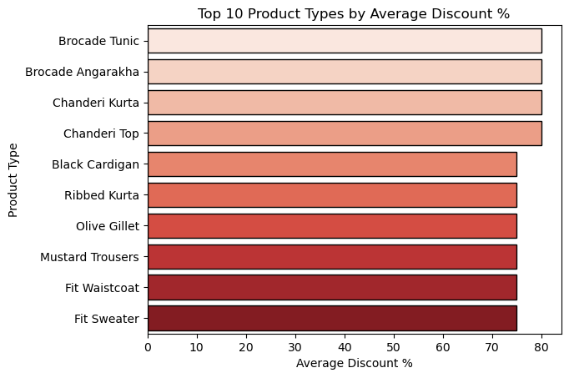
Discount % vs Product Type: Which product types get the highest average discount?
Product types with the highest average discounts (over 75%) are Brocade Tunic, Brocade Angarakha, Chanderi Kurta, and Chanderi Top.
Other highly discounted types include Black Cardigan and Fit Sweater.
These top 10 types are typically niche or ethnic-focused items, possibly driving aggressive discounting to boost sales.

Slide 13
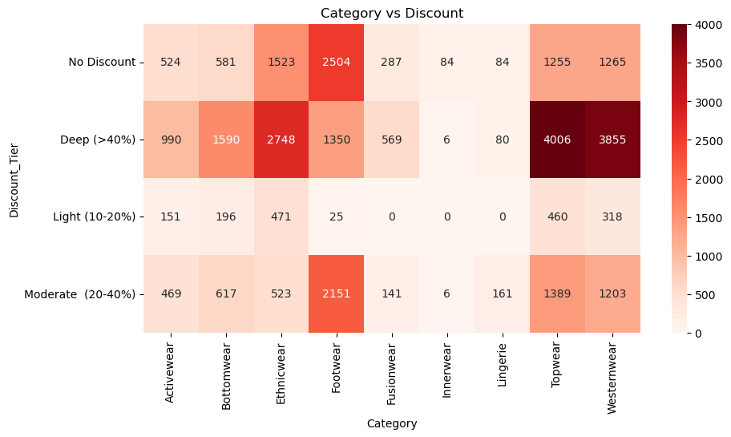
Discounts Across Categories: Which categories rely most on heavy discounts?
Topwear and Westernwear categories have the largest concentration of products under the Deep (>40%) discount tier.
Footwear and Ethnicwear categories have substantial representation across both deep discount and no discount segments.
Light discounts are minimal in all categories, reinforcing the "all or none" discounting trend.

Slide 14
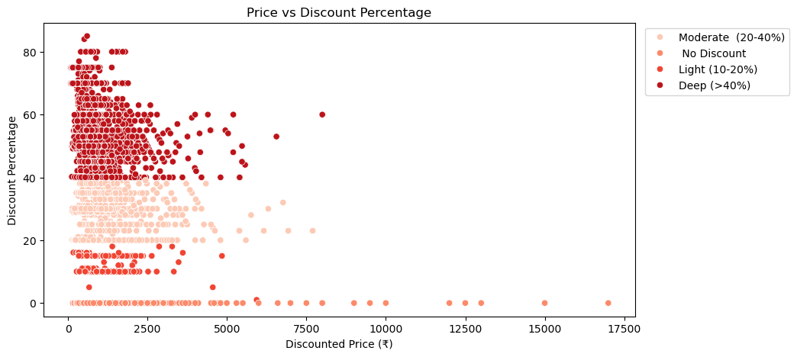
Price vs Discount Analysis: Are higher-priced products more likely to have higher discounts?
The highest discount percentages are mostly found among lower and mid-priced products.
Products with no or light discounts are dispersed across the full price range, but deep discounts cluster at lower price points.
Extremely high-priced products rarely receive large discounts, suggesting premium items are less likely to be heavily marked down.

Slide 15
Gender-Based Preferences:

Slide 16
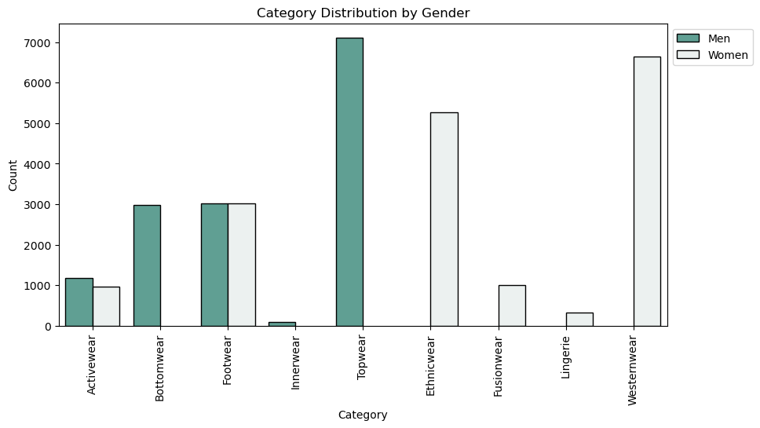
Which categories and product types dominate for Men vs Women?
Topwear is predominantly offered for men, while Ethnicwear and Westernwear are focused on women’s products.
Bottomwear and Footwear categories have nearly equal representation for both genders.
Fusionwear and Lingerie are almost entirely for women, and Innerwear is nearly exclusive to men.
The chart highlights distinct gender segmentation across fashion categories.

Slide 17
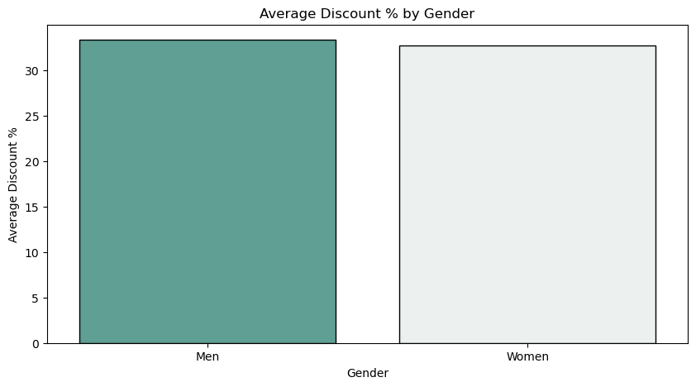
Gender-wise average discount %
The average discount percentage is similar for men and women, both just above 32%.
The visual suggests there is no major bias in discounting strategy by gender.
Both men’s and women’s products receive comparable levels of promotional activity.

Slide 18
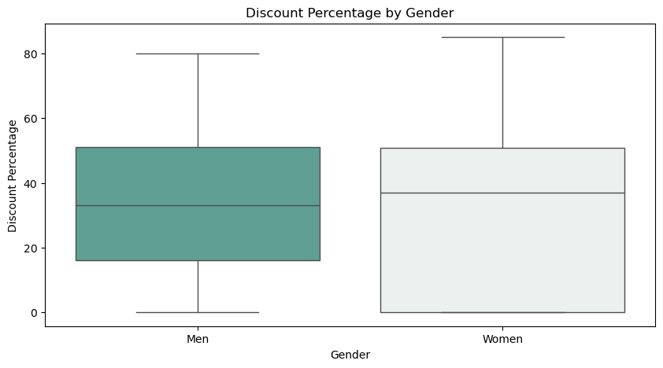
Identify whether men’s or women’s products are more discount-driven
The median discount percentage and spread (interquartile range) are slightly higher for women’s products compared to men’s.
Both genders show similar minimum and maximum discount ranges, reaching up to 80–85%.
There is a broad range of discounts available for both men and women, but women's products tend to have more variability in discount levels.

Slide 19
Price Segment Analysis:

Slide 20
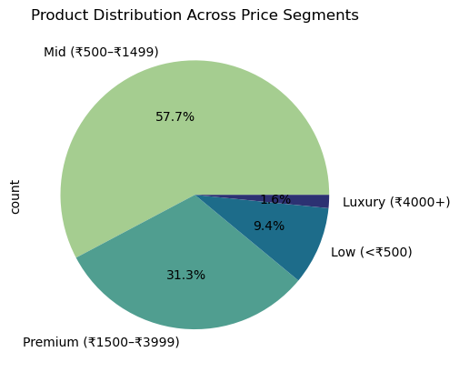
Distribution of products across Budget, Mid, Premium, Luxury.
The Mid (₹500–₹1499) segment holds the majority share, with 57.7% of all products.
Premium (₹1500–₹3999) products make up 31.3%, representing a significant secondary tier.
Only 9.4% of products fall in the Low (<₹500) range, while Luxury (₹4000+) accounts for just 1.6%.
The bulk of products are priced in the affordable-to-premium range, with very limited focus on budget and luxury items.

Slide 21
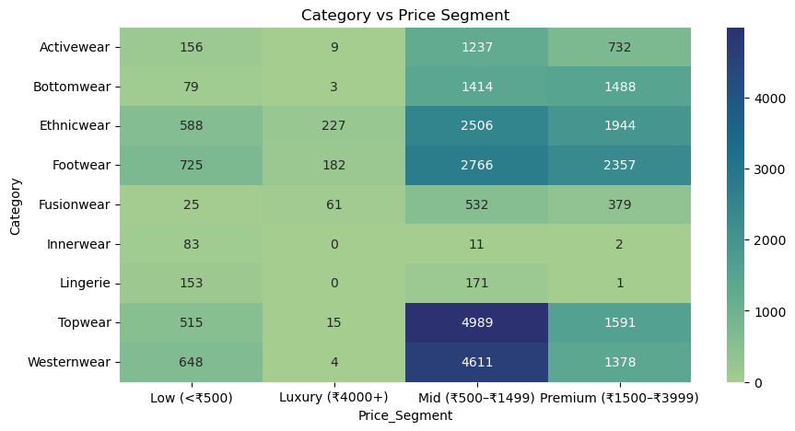
Which categories dominate in each segment?
Topwear and Westernwear have the highest counts in the Mid segment (4,989 and 4,611 respectively).
Footwear and Ethnicwear are also strongly represented in both the mid and premium segments.
The Luxury segment has sparse products in almost all categories.
Most categories show their greatest inventory concentration within the mid-range price segment, further emphasizing its central role in pricing strategy.

