Slide 1
CS535: Algorithm Design and Analysis Analysis of Algorithms: Methodologies and Case Studies
Prof. Rohit P. Singh
Department of Computer Science
University of Wisconsin, Milwaukee
September 11, 2024
Readings: Chapter 1.4

Slide 2
Review: Big-Oh Rules
Given functions f(n) and g(n), we say that f(n) is O(g(n)) if there are positive constants c and n₀ such that: f(n) ≤ cg(n) for n ≥ n₀
In general, the following growth rate applies:
O(1) O(logn) O(log²n) O(sqrt(n)) O(n) O(nlogn) O(n²) O(n^{k}) (k>=2) O(a^{n}) (a>1)
If f(n) is a polynomial of degree d, then f(n) is O(n^{d}), i.e.,
Drop lower-order terms
Drop constant coefficients
Use the smallest possible class of functions
Say “2n is O(n)” instead of “2n is O(n²)”
Use the simplest expression of the class
Say “3n + 5 is O(n)” instead of “3n + 5 is O(3n)”

Slide 3
Review: Some Other Useful Rules
Let d, e, f, g are nonnegative functions:
If d(n) is O(f(n)), then a*d(n) is O(f(n)) for any constant a>0.
If d(n) is O(f(n)) and e(n) is O(g(n)), then d(n)+e(n) is O(f(n)+g(n)).
If d(n) is O(f(n)) and e(n) is O(g(n)), then d(n)*e(n) is O(f(n)*g(n)).
If d(n) is O(f(n)) and f(n) is O(g(n)), then d(n) is O(g(n))

Slide 4
More Big-Oh Examples
Example 1: 7n-2 is O(n)
need c > 0 and n₀ ≥ 1 such that 7n-2 ≤ c•n for n ≥ n₀
this is true for c = 7 and n₀ = 1
Example 2: 3n³ + 20n² + 5 is O(n³)
need c > 0 and n₀ ≥ 1 such that 3n³ + 20n² + 5 ≤ c•n³ for n ≥ n₀
this is true for c = 4 and n₀ = 21
Example 3: 3 log n + log log n is O(log n)
need c > 0 and n₀ ≥ 1 such that 3 log n + log log n ≤ c•log n for n ≥ n₀
this is true for c = 4 and n₀ = 2

Slide 5
Asymptotic Algorithm Analysis
The asymptotic analysis of an algorithm determines the running time in big-Oh notation
To perform the asymptotic analysis
We find the worst-case number of primitive operations executed as a function of the input size
We express this function with big-Oh notation
Example:
We determine that algorithm arrayMax executes at most 7n − 2 primitive operations
We say that algorithm arrayMax “runs in O(n) time”
Since constant factors and lower-order terms are eventually dropped anyhow, we can disregard them when counting primitive operations. This is also the weakness of the big-Oh notation:
Ex: 10¹⁰⁰ n vs n log n
Galactic algorithm - Wikipedia

Slide 6
Relatives of Big-Oh
big-Omega
f(n) is Ω(g(n)) if there is a constant c > 0
and an integer constant n₀ ≥ 1 such that
f(n) ≥ c•g(n) for n ≥ n₀
big-Theta
f(n) is Θ(g(n)) if there are constants c’ > 0 and c’’ > 0 and an integer constant n₀ ≥ 1 such that c’•g(n) ≤ f(n) ≤ c’’•g(n) for n ≥ n₀
little-oh
f(n) is o(g(n)) if, for any constant c > 0, there is an integer constant n₀ ≥ 1 such that f(n) < c•g(n) for n ≥ n_{0.}
little-omega
f(n) is ω(g(n)) if, for any constant c > 0, there is an integer constant n₀ ≥ 1 such that f(n) > c•g(n) for n ≥ n₀

Slide 7
Intuition for Asymptotic Notation
Big-Oh
f(n) is O(g(n)) if f(n) is asymptotically less than or equal to g(n)
big-Omega
f(n) is Ω(g(n)) if f(n) is asymptotically greater than or equal to g(n)
big-Theta
f(n) is Θ(g(n)) if f(n) is asymptotically equal to g(n)
little-oh
f(n) is o(g(n)) if f(n) is asymptotically strictly less than g(n)
little-omega
f(n) is ω(g(n)) if is asymptotically strictly greater than g(n)
O(1) O(logn) O(log²n) O(sqrt(n)) O(n) O(nlogn) O(n²) O(n^{k}) (k>2) O(a^{n}) (a>1)

Slide 8
Examples of the Relatives of Big-Oh
3logn+loglogn is Ω(logn)
f(n) is Ω(g(n)) if there is a constant c > 0 and an integer constant n₀ ≥ 1 such that f(n) ≥ c•g(n) for n ≥ n₀
3logn+loglogn >= 3logn for n>=2
3logn+loglogn is Θ(logn)
f(n) is Θ(g(n)) if there are constants c’ > 0 and c’’ > 0 and an integer constant n0 ≥ 1 such that c’•g(n) ≤ f(n) ≤ c’’•g(n) for n ≥ n0
3logn+loglogn <= 4logn for n>=2
12n²+6n is o(n³)
f(n) is o(g(n)) if, for any constant c > 0, there is an integer constant n0 ≥ 1 such that f(n) < c•g(n) for n ≥ n0
Let c>0, take n₀ = (12+6)/c, then cn³ >= 12n²+6n² >= 12n²+6n
12n²+6n is ω(n)
f(n) is ω(g(n)) if, for any constant c > 0, there is an integer constant n₀ ≥ 1 such that f(n) > c•g(n) for n ≥ n₀
For any c, take n0 = c/12, then 12n²+6n >= 12n² >= cn

Slide 9
More Examples
5n² is Ω(n²)
f(n) is Ω(g(n)) if there is a constant c > 0 and an integer constant n₀ ≥ 1 such that f(n) ≥ c•g(n) for n ≥ n₀
let c = 5 and n₀ = 1
5n² is Ω(n)
f(n) is Ω(g(n)) if there is a constant c > 0 and an integer constant n₀ ≥ 1 such that f(n) ≥ c•g(n) for n ≥ n₀
let c = 1 and n₀ = 1
5n² is ω(n)
f(n) is ω(g(n)) if, for any constant c > 0, there is an integer constant n₀ ≥ 0 such that f(n) > c•g(n) for n ≥ n₀
need 5n₀² > c•n₀ → given c, the n₀ that satifies this is n₀ ≥ c/5 ≥ 0

Slide 10
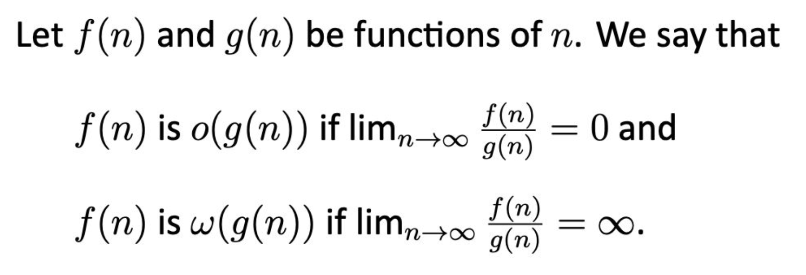
Limit-Ratio Tests
Additionally,
NOTE: When f(n) is o(g(n)), f(n) is O(g(n)) but not 𝚹(g(n)).
Similarly, when f(n) is ω(g(n)), f(n) is Ω(g(n)) but not 𝚹(g(n)).

Slide 11
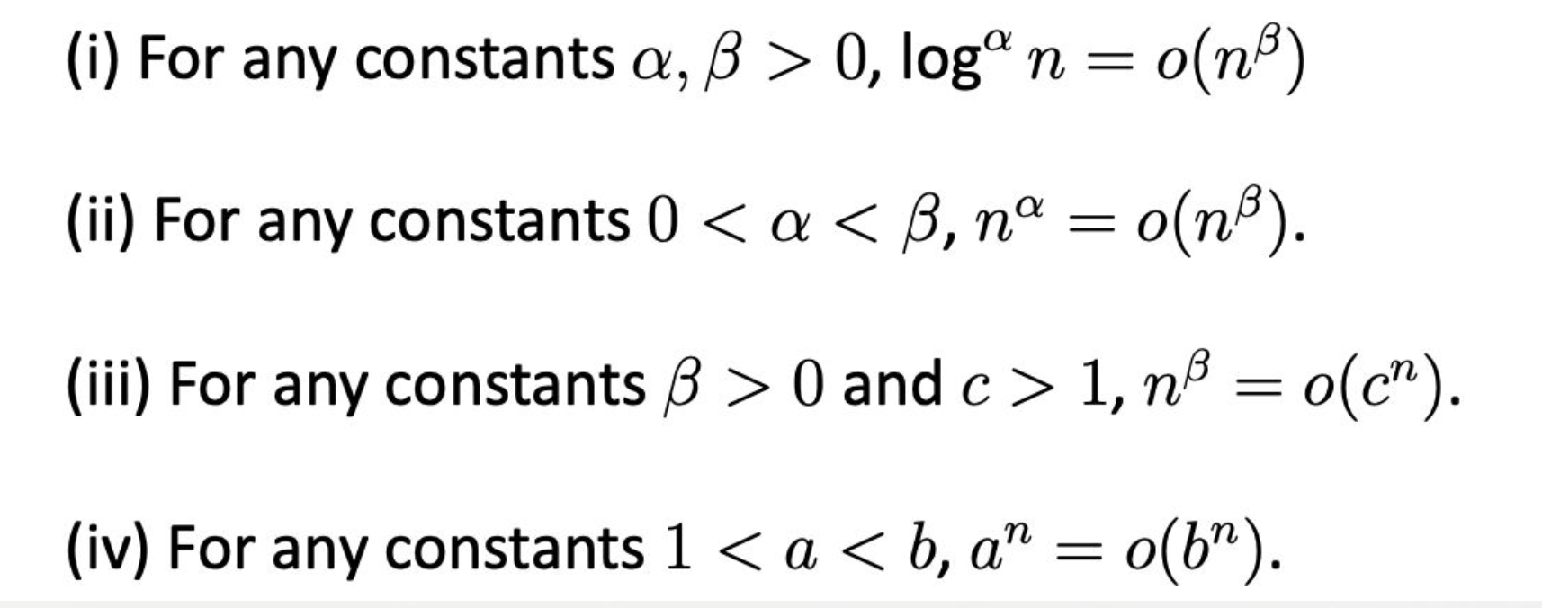
Very Useful Facts

Slide 12
Case Study
Computing prefix averages:
The i-th prefix average of an array X is average of the first (i + 1) elements of X:
A[i] = (X[0] + X[1] + … + X[i])/(i+1)

Slide 13
Examples
X
A
1 2 3 4 5 6 7 8 9 10
Applications:
Finance, Data smoothing, etc.

Slide 14
Prefix Averages (Quadratic)
The following algorithm computes prefix averages in quadratic time by applying the definition
Algorithm prefixAverages1(X, n)
Input array X of n integers
Output array A of prefix averages of X #operations
A ← new array of n integers O(n) (initialization)
for i ← 0 to n − 1 do O(n) (comparison)
s ← 0 O(n) (assignment and addition)
for j ← 0 to i do (1 + 2 + …+ n)*c1 O(n²)
s ← s + X[j] (1 + 2 + …+ n)*c2 O(n²)
A[i] ← s / (i + 1) O(n) (math, indexing, assignment)
return A 1
Algorithm prefixAverages1 runs in O(n²) time

Slide 15
Prefix Averages (Linear)
The following algorithm computes prefix averages in linear time by keeping a running sum
Algorithm prefixAverages2(X, n)
Input array X of n integers
Output array A of prefix averages of X #operations
A ← new array of n integers O(n) (initialization)
s ← 0 O(1) (initialization)
for i ← 0 to n − 1 do O(n) (comparison)
s ← s + X[i] O(n) (math, indexing, assignment)
A[i] ← s / (i + 1) O(n) (math, indexing, assignment)
return A 1
Algorithm prefixAverages2 runs in O(n) time

Slide 16
Recurrence Relation -> Recursive Function
Recursive FindMax(A,n)
If(n=0)
return A[0]
Findmax(A,n) = max(FindMax(A,n-1) , A[n-i])
Recurrence Relations
a_{n}=a_{n-1}+3
Recursive Balanced Binary Tree Search
T_{n} = T_{n/2} + 1

Slide 17
Solving Recurrence Relation
Loop Unrolling or substitution
Master Theorem
Master Theorem
Given a recurrence of the form
T(n)=aT(n/b)+f(n),
for constants a(≥1) ) and b(>1) with f asymptotically positive, the following statements are true:
Case 1. If f(n)=O(n^{logb a - e}) for some e>0, then T(n)=Θ(n^{logb a)}
Case 2. If f(n)=Θ(nlogb​a), then T(n)=Θ(n^{logb a} logn).
Case 3. If f(n)=Ω(nlog⁡ba+ϵ) for some ϵ>0 (and af(n/b)≤c f(n) for some c<1 for all n sufficiently large), then T(n)=Θ(f(n)).

Slide 18
Loop Unrolling or Substitution Method
A_{n} = A_{n-1} + 2 = A_{n-2} + 2 + 2 = A_{n-k} + 2+2+2 … k-times = 2+2+2+ … n times
2*n
A_{n} = A_{n/2} +n = A_{n/4} +n+n -> n+n +n .. Log n times = nlogn
n/2^{steps} = 1; Steps = log n

Slide 19
Solving Homogeneous Recurrence Equation Using Polynomial Reduction
Linear Recurrence Relation
Homogeneous if b_{n} = 0
Substituting h_{n} as X^{n} , we have a characteristic polynomial equation
X^{n} = a₁X^{n-1} + a₁X^{n-2} ….. a₁X^{n-k}
Let q != 0. The geometric sequence h_{n} = q^{n} is a solution of the recurrence relation if and only if the number q is a root of the characteristic equation
If the characteristic equation has k distinct roots q₁,q₂,...,q_{k}, then the general solution of is
h_{n} = c₁ q₁^{n} +c₂ q₂^{n} + …. +c_{k} q_{k}^{n}.

Slide 20
Find Solution for the Fibonacci recurrence relation
X_{n `} = X_{n-1} + X_{n-2}
With initial conditions X₀ = 1, X₁ = 1

Slide 21
Find the computational complexity (in “Big-Oh”) of the following code snippet and explain how it is derived using the basic features of the “Big-Oh” notation:
for( int bound = 1; bound <= n; bound *= 2 ) {
for( int i = 0; i < bound; i++ ) {
for( int j = 0; j < n; j += 2 ) {
... // constant number of operations
}
for( int j = 1; j < n; j *= 2 ) {
... // constant number of operations
}
}
}

Slide 22
Outer Loop:
bound -> 1, 2, 2²,2³ …… n -> 2^{steps} = n => Steps = log₂n
Inner Loop:
1->1
1->2
1->2²
…
1->n
Innermost loop1: 0,2,4,6,8 … n (n/2)
Innermost loop2: 0,2,2²2³ … n (log₂n)
n/2(1+2+2² +…. + n) =n/2(2^{log2 n} -1) = O(n^2)

Slide 23
Extra

Slide 24
