Slide 1
Quiz #9
Is the following statement true or false?
  Dijkstra’s algorithm runs in O((n + m) log n) time, where n and m are the numbers of vertices and edges respectively, and it allows for negative edge weights and negative cycles.
7
D
Draw the minimum spanning tree of the graph on the right by following the Kruskal’s Algorithm:
Given a flow network on the right, is the flow a maximum flow of the network?
B
4
9
2
5
F
C
8
8
3
E
A
7
v
1/3
2/6
1/1
3/7
t
s
3/3
w
1/1
2/9
4/5
3/5
u
2/2
z

Slide 2
CS535: Algorithm Design and Analysis
Applications of Min-Cuts in Image Analysis
Prof. Zane Yu
Department of Computer Science
University of Wisconsin, Milwaukee
April 30, 2024

Slide 3
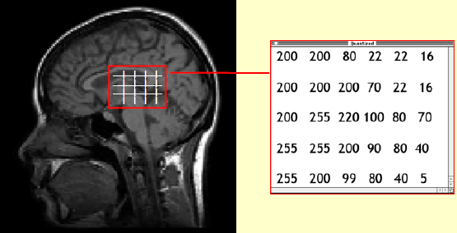
What is an Image?
Any picture taken by physical devices, generated (synthesized) by computers, or even drawn by hands
  Normally we are talking about 2D pictures
Digital images
  An array of numbers (intensities)
  Obtained by scanners or digital devices (e.g., digital camera)
  Not only is the space digitized, the functions value (intensities) can be digitized too

Slide 4
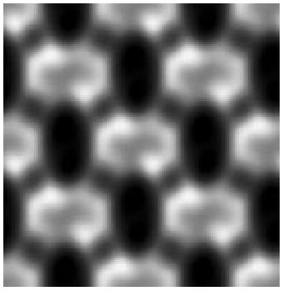
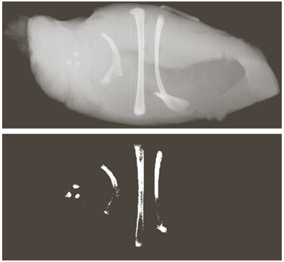
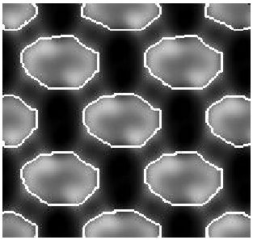
What is Image Segmentation?
Image segmentation generates binary images
  Features: “1”
  Non-features: “0”
A simple way to do is by thresholding the image intensities (A pixel with intensity higher than a threshold is said to be a feature. But the problem is the continuity of features.)
Thresholding

Slide 5
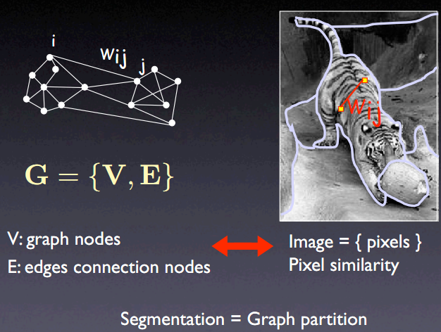
The Graph
(Jianbo Shi)

Slide 6
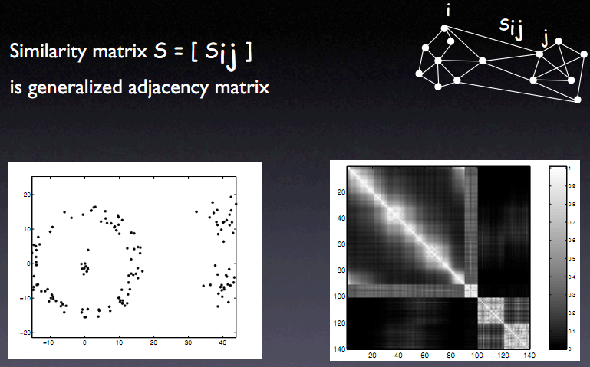
Similarity Matrix
(Jianbo Shi)

Slide 7
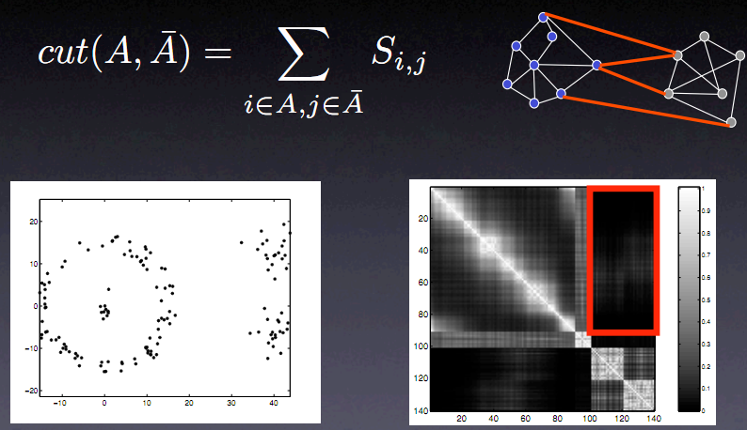
Minimal Graph-Cut
(Jianbo Shi)

Slide 8
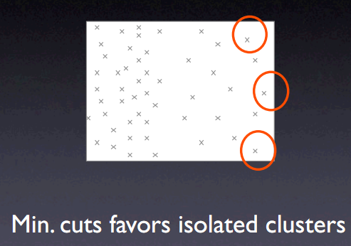
Problem with Min Graph-Cut

Slide 9
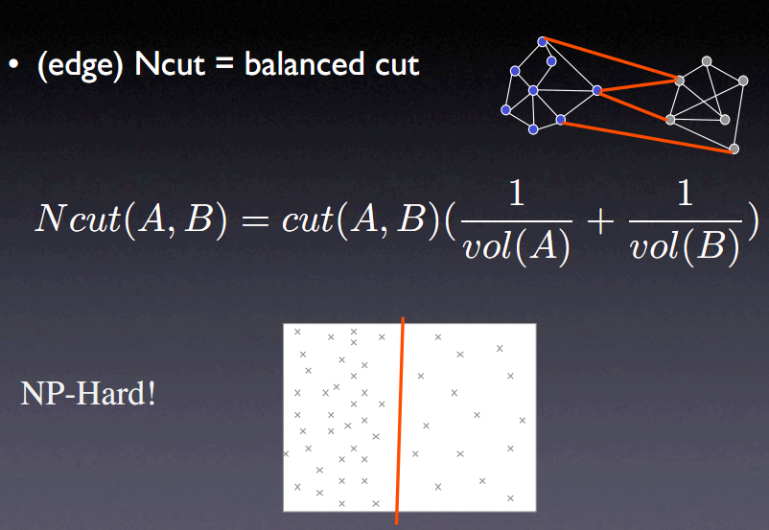
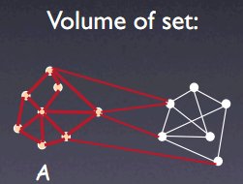
Normalized Graph Cuts

Slide 10
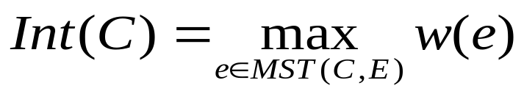
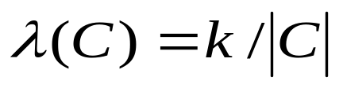
Implementation
We define the internal difference of a component C to be the largest weight in the minimum spanning tree of the component, MST (C, E):
Minimum internal difference between two components:
where,
k: user-specified parameter
|C|: the size of component C

Slide 11

The Algorithm
1 Sort E into , by non-decreasing edge weight.
2 Start with a segmentation S₀, where each vertex v_{i} is in its own component.
3 Repeat step 4 for q=1,…, m.
4 Construct S_{q} given S_{q-1} as follows: Let v_{i} and v_{j} denote the vertices connected by the q-th edge in the ordering, o_{q}= (v_{i}, v_{j}). If v_{i} and v_{j} are in disjoint components of S_{q-1} and the edge weight w (o_{q}) is small compared to the minimum internal difference of both components, then merge the two components; otherwise do nothing.
5 Return S = S_{m}.
For details: Pedro F. Felzenszwalb & Daniel P. Huttenlocher, Efficient Graph Based Image Segmentation, Journal of Computer Vision, 2004.

Slide 12
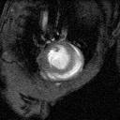
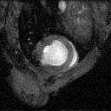
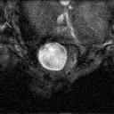
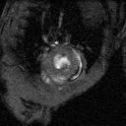
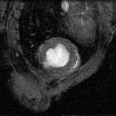
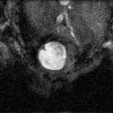
MRI Imaging of the Heart (Mouse)
Spatial: 0.5 mm per slice
….
….
Time: 6ms per frame
….
….
….
….
….
Data courtesy of Andrew D. McCulloch and Masahiko Hoshijima, UCSD

Slide 13
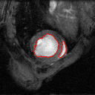

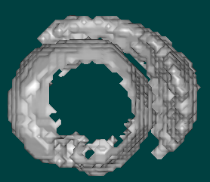
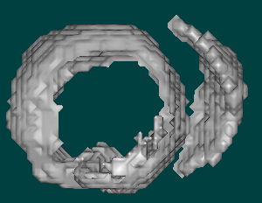
Image Segmentation: Results
Time step #1 Time step #3

Slide 14
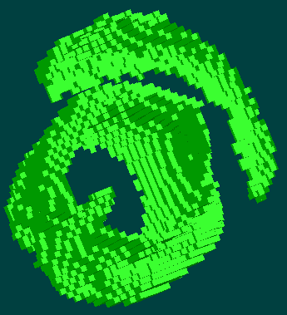

Quadrilateral Surface Mesh Generation
Time step #1 Time step #3

Slide 15
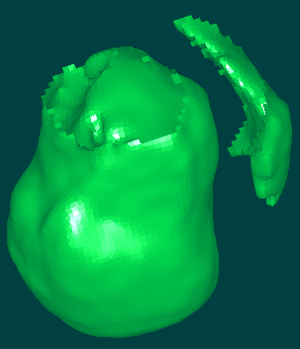
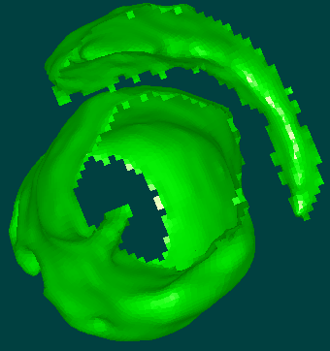
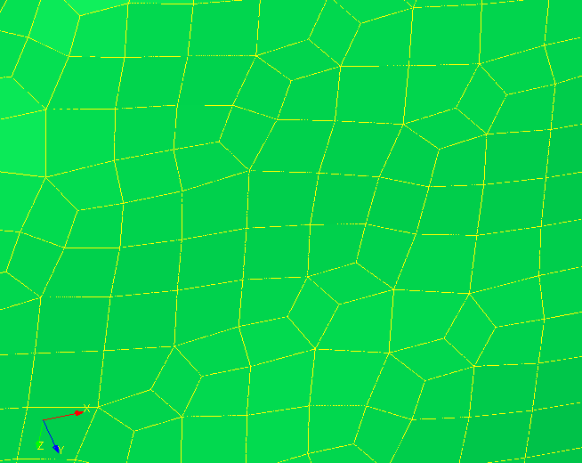
Mesh Smoothing Results

Slide 16
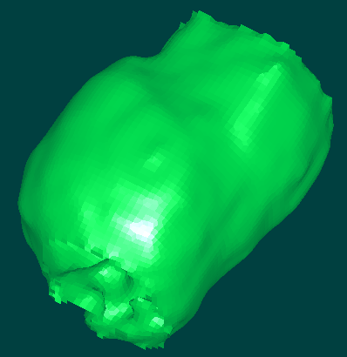
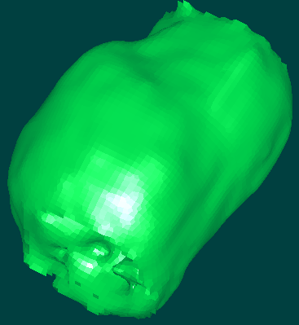
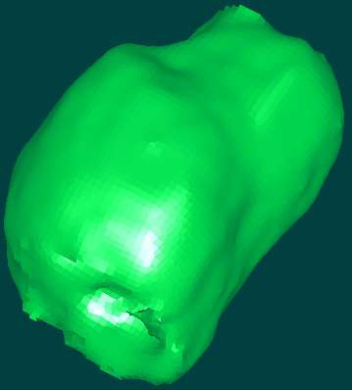
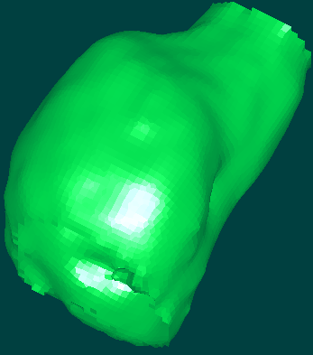
The Heart Motion
Time step #1 Time step #3
Time step #5 Time step #10

Slide 17
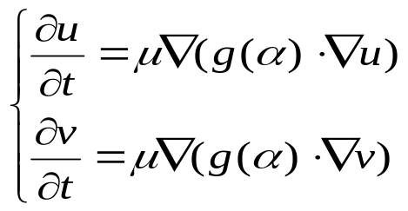
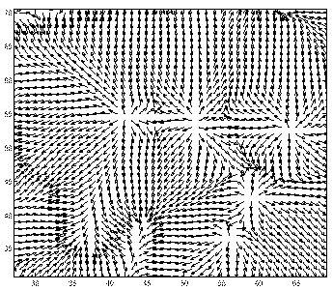
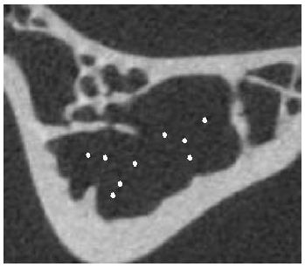
Improvement Using Pre-segmentation
Generating Initial Gradient Vector Field
Anisotropic Vector Diffusion (Yu’04)
  Source points: all neighboring vectors point outward
  Sink points: all neighboring vectors point inward
Medical images: source points (Yu & Bajaj, ’02)

Slide 18
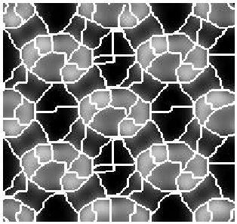
Improvement Using Pre-segmentation
Original image
105 seeds/regions
14 regions after merging
Node: each region
Edge: two adjacent regions
Edge weight:
(1) intensity difference
(2) gradient magnitude
on the common boundary
between two regions
Use the normalized graph-cut method to find the minimum cut.

Slide 19
Constrained Graph-Cut Method
A user-guided, semi-automatic method
  The user picks some seed points and assigns the types, which will be given the highest priority during the segmentation
  The regions containing the selected seeds are assigned the corresponding types. Regions containing different types are NOT allowed to merge, no matter how similar they are.
  All other regions are free to merge, but whenever they are merged to a region with a type, they will be assigned with the same type too.
The weighted graph Graph cut allowed Graph cut not allowed

