Slide 1
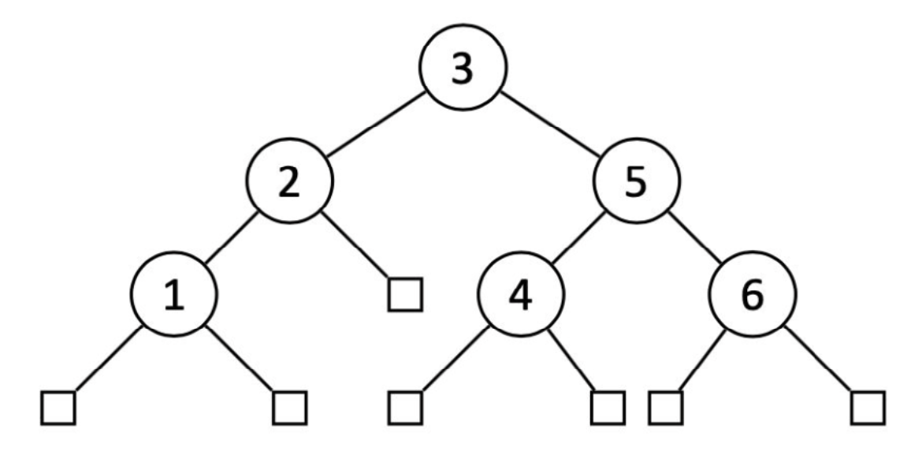
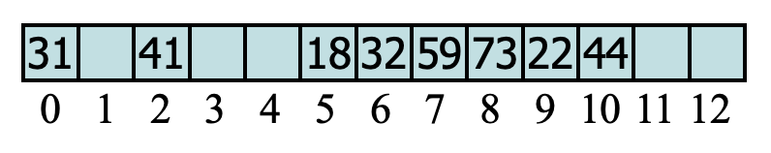
Quiz #4
For the binary search tree (BST) below, draw the BST after:
Inserting a new item of key 1.5.
Deleting the existing key 3, on the original tree (see below).
With the example of double hashing in Lecture 7, let N = 13, h(k) = k mod 13, and d(k) = 7 − k mod 7. Assuming we have already inserted the keys in the array shown below, where would the new key 19 go in the array?

Slide 2
CS535: Algorithm Design and Analysis AVL Trees
Prof. Zane Yu
Department of Computer Science
University of Wisconsin, Milwaukee
February 20, 2024
Readings: Chapter 3.2

Slide 3
AVL Tree Definition
AVL trees are balanced.
An AVL Tree is a binary search tree such that:
for every internal node v of T, the heights of the children of v can differ by at most 1.
An example of an AVL tree where the heights are shown next to the nodes:

Slide 4
Height of an AVL Tree
Fact: The height of an AVL tree storing n keys is O(log n).
Proof: Let us bound n(h): the minimum number of internal nodes of an AVL tree of height h.
We easily see that n(1) = 1 and n(2) = 2
For h > 2, an AVL tree of height h contains the root node, one AVL subtree of height h-1 and another of height h-2.
That is,
n(h) = 1 + n(h-1) + n(h-2)
Knowing n(h-1) > n(h-2), we get n(h) > 2*n(h-2). So
n(h) > 2*n(h-2), n(h) > 4*n(h-4), n(h) > 8*n(n-6), … (by induction),
n(h) > 2^{i*}n(h-2i)
Solving the base case we get: n(h) > 2 ^{h/2-1}
Taking logarithms: h < 2log n(h) +2
Thus the height of an AVL tree is O(log n)

Slide 5
Insertion in an AVL Tree
Insertion is as in a binary search tree
Always done by expanding an external node.
Example: Insert(54)
44
44
17
78
17
78
c=z
a=y
32
50
88
32
50
88
48
62
48
62
b=x
54
w
before insertion
after insertion

Slide 6
Trinode Restructuring
Must keep two properties:
Binary search tree (in-order traversal)
Height-balance property
The height changes only on path from the new node w to the root
Start from w along this path, find the first un-balanced node z, then one of its children, denoted by y, with higher height (y must be the ancestor of w), finally one of y’s children, denoted by x, with higher height
let (a, b, c) be an in-order listing of x, y, z, so that a ≤ b ≤ c
Four cases to arrange a, b, c

Slide 7
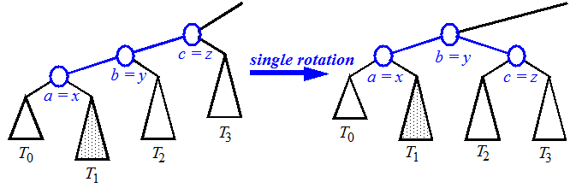
Restructuring (as Single Rotations)
Single Rotations:

Slide 8
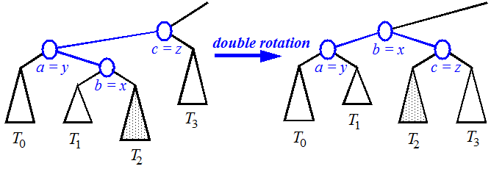
Restructuring (as Double Rotations)
double rotations:

Slide 9
Insertion Example
unbalanced
T
4
1
44
2
3
x
17
y
62
z
1
2
2
32
50
78
1
1
1
balanced
48
54
88
T
2
T
T
T
0
1
3

Slide 10
Removal in an AVL Tree
Removal begins as in a binary search tree, which means the node removed will become an empty external node. Its parent, w, may cause an imbalance (the path from w to the root). However, at most one node on this path is unbalanced.
Example:
44
44
17
62
17
62
32
50
78
50
78
48
54
88
48
54
88
before deletion of 32
after deletion

Slide 11
Rebalancing after a Removal
Let z be the unbalanced node encountered while travelling up the tree from w. Also, let y be the child of z with the larger height (y must not be an ancestor of w), and let x be the child of y with the larger height (otherwise, choose x to be the same side of y).
We perform the restructuring procedure to restore balance at z.
As this restructuring may upset the balance of another node higher in the tree, we must continue checking for balance until the root of T is reached (consider, for example, 48 and 54 are both external nodes)
62
a=z
44
44
78
w
17
62
b=y
17
50
88
50
78
c=x
48
54
48
54
88

Slide 12
Running Times for AVL Trees
a single restructuring operation is O(1)
using a linked-structure binary tree
find is O(log n)
height of tree is O(log n), no restructures needed
insert is O(log n)
initial find is O(log n)
Restructuring up the tree, maintaining heights is O(log n)
remove is O(log n)
initial find is O(log n)
Restructuring up the tree, maintaining heights is O(log n)

