Slide 1
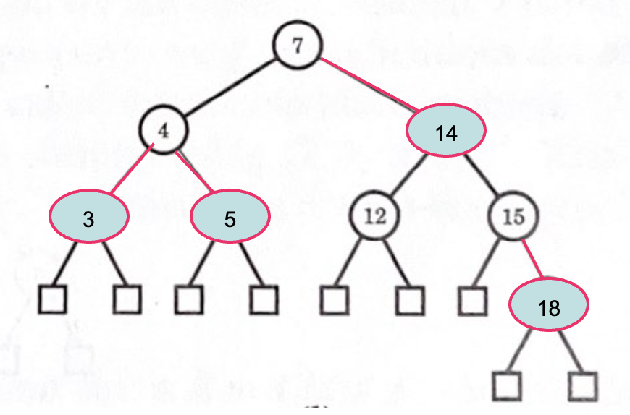
Quiz #6
Draw the red-black tree after inserting
the key 6 into the tree on the right.
Note: use bold line to indicate red nodes
in your tree.
Given the tree on the right,
Draw the splay tree after deleting
the key (5, H).
(8, N)
(7, T)
(10, A)
(1, Q)
(7, P)
(14, J)
(1, C)
(5, H)
(10, U)
(2, R)
(5, G)
(5, I)
(6, Y)

Slide 2
CS535: Algorithm Design and Analysis Merge-Sort and Quick-Sort
Prof. Zane Yu
Department of Computer Science
University of Wisconsin, Milwaukee
March 5, 2024
Readings: Chapter 4.1, 4.3

Slide 3
Divide-and-Conquer
Divide-and-conquer is a general algorithm design strategy:
Divide: divide the input data S in two disjoint subsets S₁ and S₂
Recur: solve the subproblems associated with S₁ and S₂
Conquer: combine the solutions for S₁ and S₂ into a solution for S
The base case for the recursion are subproblems of size 0 or 1

Slide 4
Divide-and-Conquer
Algorithm PQ-Sort(S, C)
Input sequence S, comparator C for the elements of S
Output sequence S sorted in increasing order according to C
P ← priority queue with comparator C
while ¬S.isEmpty ()
e ← S.remove (S. first ())
P.insertItem(e, e)
while ¬P.isEmpty()
e ← P.removeMin()
S.insertLast(e)
Like heap-sort
It uses a comparator
It has O(n log n) running time
Unlike heap-sort
It does not use a priority queue
It accesses data in a sequential manner (suitable to sort data on a disk)

Slide 5
Merge-Sort
Merge-sort on an input sequence S with n elements consists of three steps:
Divide: partition S into two sequences S₁ and S₂ of about n/2 elements each
Recur: recursively sort S₁ and S₂
Conquer: merge S₁ and S₂ into a unique sorted sequence
Algorithm mergeSort(S, C)
Input sequence S with n elements, comparator C
Output sequence S sorted
according to C
if S.size() > 1
(S₁, S₂) ← partition(S, n/2)
mergeSort(S₁, C)
mergeSort(S₂, C)
S ← merge(S₁, S₂)

Slide 6
Merging Two Sorted Sequences
The conquer step of merge-sort consists of merging two sorted sequences A and B into a sorted sequence S containing the union of the elements of A and B
Merging two sorted sequences, each with n/2 elements and implemented by means of a doubly linked list, takes O(n) time
Algorithm merge(A, B)
Input sequences A and B with n/2 elements each
Output sorted sequence of A ∪ B
S ← empty sequence
while ¬A.isEmpty() ∧ ¬B.isEmpty()
if A.first().element() < B.first().element()
S.insertLast(A.remove(A.first()))
else
S.insertLast(B.remove(B.first()))
while ¬A.isEmpty() S.insertLast(A.remove(A.first()))
while ¬B.isEmpty() S.insertLast(B.remove(B.first()))
return S

Slide 7
Merge-Sort Tree
An execution of merge-sort is depicted by a binary tree
each node represents a recursive call of merge-sort and stores
unsorted sequence before the execution and its partition
sorted sequence at the end of the execution
the root is the initial call
the leaves are calls on subsequences of size 0 or 1
7 2 ⏐ 9 4 → 2 4 7 9
7 ⏐ 2 → 2 7
9 ⏐ 4 → 4 9
7 → 7
2 → 2
9 → 9
4 → 4

Slide 8
Execution Example
7 2 9 4 ⏐ 3 8 6 1 → 1 2 3 4 6 7 8 9
7 2 ⏐ 9 4 → 2 4 7 9
3 8 ⏐ 6 1 → 1 3 6 8
7 ⏐ 2 → 2 7
9 ⏐ 4 → 4 9
3 ⏐ 8 → 3 8
6 1 → 1 6
7 → 7
2 → 2
9 → 9
4 → 4
3 → 3
8 → 8
6 → 6
1 → 1

Slide 9
Analysis of Merge-Sort
The height h of the merge-sort tree is O(log n)
at each recursive call we divide in half the sequence
The overall amount or work done at the nodes of depth i is O(n)
we partition and merge 2^{i} sequences of size n/2^{i}
Thus, the total running time of merge-sort is O(n log n)
depth | #seqs | size
0 | 1 | n
1 | 2 | n/2
i | 2^{i} | n/2^{i}
… | … | …

Slide 10
Summary of Sorting Algorithms
Algorithm | Time | Notes
selection-sort (unsorted priority queue) | O(n²) | slow in-place for small data sets (< 1K)
insertion-sort (sorted priority queue) | O(n²) | slow in-place for small data sets (< 1K)
heap-sort (using a heap) | O(n log n) | fast trees for large data sets (1K — 1M)
merge-sort | O(n log n) | fast sequential data access for huge data sets (> 1M)

Slide 11
Quick-Sort
Quick-sort is a randomized sorting algorithm based on the divide-and-conquer strategy:
Divide: pick a random element x (called pivot) and partition S into
L elements less than x
E elements equal x
G elements greater than x
Recur: sort L and G
Conquer: join L, E and G
x
x
L
G
E
x

Slide 12
Partition
We partition an input sequence as follows:
We remove, in turn, each element y from S and
We insert y into L, E or G, depending on the result of the comparison with the pivot x
Each insertion and removal is at the beginning or at the end of a sequence, and hence takes O(1) time
Thus, the partition step of quick-sort takes O(n) time
Algorithm partition(S, p)
Input sequence S, position p of pivot
Output subsequences L, E, G of the elements of S less than, equal to, or greater than the pivot, resp.
L, E, G ← empty sequences
x ← S.remove(p)
while ¬S.isEmpty()
y ← S.remove(S.first())
if y < x
L.insertLast(y)
else if y = x
E.insertLast(y)
else { y > x }
G.insertLast(y)
return L, E, G

Slide 13
Quick-Sort Tree
An execution of quick-sort is depicted by a binary tree
Each node represents a recursive call of quick-sort and stores
Unsorted sequence before the execution and its pivot
Sorted sequence at the end of the execution
The root is the initial call
The leaves are calls on subsequences of size 0 or 1
7 4 9 6 2 → 2 4 6 7 9
4 2 → 2 4
7 9 → 7 9
2 → 2
9 → 9

Slide 14
Execution Example
7 2 9 4 3 7 6 1 → 1 2 3 4 6 7 7 9
2 4 3 1 → 1 2 3 4
7 9 7 → 17 7 9
1 → 1
4 3 → 3 4
8 → 8
9 → 9
9 → 9
4 → 4

Slide 15
Worst-case Running Time
The worst case for quick-sort occurs when the pivot is the unique minimum or maximum element
One of L and G has size n − 1 and the other has size 0
The running time is proportional to the sum
n + (n − 1) + … + 2 + 1
Thus, the worst-case running time of quick-sort is O(n²)
depth | time
0 | n
1 | n − 1
… | …
n − 1 | 1
…

Slide 16
Expected Running Time
Consider a recursive call of quick-sort on a sequence of size s
Good call: the sizes of L and G are each less than 3s/4
Bad call: one of L and G has size greater than 3s/4
A call is good with probability 1/2
1/2 of the possible pivots cause good calls:
7 2 9 4 3 7 6 1 9
7 2 9 4 3 7 6 1
2 4 3 1
7 9 7 1 → 1
1
7 2 9 4 3 7 6
Good call
Bad call
1 2 3 4 5 6 7 8 9 10 11 12 13 14 15 16
Bad pivots
Good pivots
Bad pivots

Slide 17
Expected Running Time (Cont’d)
Probabilistic Fact: The expected number of coin tosses required in order to get k heads is 2k
For a node of depth i, we expect
i/2 ancestors are good calls
The size of the input sequence for the current call is at most (3/4)^{i/2}n
Therefore, we have
1 ≤ (3/4)^{h/2}n, where h is the height
The expected height of the quick-sort tree is O(log n)
The amount or work done at the nodes of the same depth is O(n)
Thus, the expected running time of quick-sort is O(n log n)

Slide 18
Summary of Sorting Algorithms
Algorithm | Time | Notes
selection-sort | O(n²) | in-place slow (good for small inputs)
insertion-sort | O(n²) | in-place slow (good for small inputs)
quick-sort | O(n log n) expected | in-place, randomized fastest (good for large inputs)
heap-sort | O(n log n) | in-place fast (good for large inputs)
merge-sort | O(n log n) | sequential data access fast (good for huge inputs)

Slide 19
Comparison-Based Sorting
Many sorting algorithms are comparison based.
They sort by making comparisons between pairs of objects
Examples: selection-sort, insertion-sort, heap-sort, merge-sort, quick-sort, ...
Let us therefore derive a lower bound on the running time of any algorithm that uses comparisons to sort n elements, x₁, x₂, …, x_{n}.
Is x_{i} < x_{j}?
no
yes

Slide 20
Counting Comparisons
Let us just count the number of comparisons then.
Each possible run of the algorithm corresponds to a root-to-leaf path in a decision tree
Y
N

Slide 21
Decision Tree Height
The height of this decision tree is a lower bound on the running time
Every possible input permutation must lead to a separate leaf output.
Since there are n!=1*2*…*n leaves, the height is at least log (n!)

Slide 22
The Lower Bound
Any comparison-based sorting algorithms takes at least log (n!) time
Therefore, any such algorithm takes time at least
That is, any comparison-based sorting algorithm must run in Ω(n log n) time.

