Slide 1
CS535: Algorithm Design and Analysis
Divide-and-Conquer
Prof. Zane Yu
Department of Computer Science
University of Wisconsin, Milwaukee
March 28, 2024
Readings: Chapter 5.2

Slide 2
Divide-and-Conquer
Divide-and conquer is a general algorithm design paradigm:
  Divide: divide the input data S in two or more disjoint subsets S₁, S₂, …
  Recur: solve the subproblems recursively
  Conquer: combine the solutions for S₁, S₂, …, into a solution for S
The base case for the recursion are subproblems of constant size
Analysis can be done using recurrence equations

Slide 3
Merge-Sort Review
Merge-sort on an input sequence S with n elements consists of three steps:
  Divide: partition S into two sequences S₁ and S₂ of about n/2 elements each
  Recur: recursively sort S₁ and S₂
  Conquer: merge S₁ and S₂ into a unique sorted sequence
Algorithm mergeSort(S, C)
Input sequence S with n elements, comparator C
Output sequence S sorted
  according to C
  if S.size() > 1
  (S₁, S₂) ← partition(S, n/2)
  mergeSort(S₁, C)
  mergeSort(S₂, C)
  S ← merge(S₁, S₂)

Slide 4
Merge-Sort Tree
An execution of merge-sort is depicted by a binary tree
  each node represents a recursive call of merge-sort and stores
    unsorted sequence before the execution and its partition
    sorted sequence at the end of the execution
  the root is the initial call
  the leaves are calls on subsequences of size 0 or 1
7 2 ⏐ 9 4 → 2 4 7 9
7 ⏐ 2 → 2 7
9 ⏐ 4 → 4 9
7 → 7
2 → 2
9 → 9
4 → 4

Slide 5
Execution Example
7 2 9 4 ⏐ 3 8 6 1 → 1 2 3 4 6 7 8 9
7 2 ⏐ 9 4 → 2 4 7 9
3 8 ⏐ 6 1 → 1 3 6 8
7 ⏐ 2 → 2 7
9 ⏐ 4 → 4 9
3 ⏐ 8 → 3 8
6 1 → 1 6
7 → 7
2 → 2
9 → 9
4 → 4
3 → 3
8 → 8
6 → 6
1 → 1

Slide 6
Analysis of Merge-Sort
The height h of the merge-sort tree is O(log n)
  at each recursive call we divide in half the sequence
The overall amount or work done at the nodes of depth i is O(n)
  we partition and merge 2^{i} sequences of size n/2^{i}
Thus, the total running time of merge-sort is O(n log n)
depth | #seqs | size
0 | 1 | n
1 | 2 | n/2
i | 2^{i} | n/2^{i}
… | … | …

Slide 7
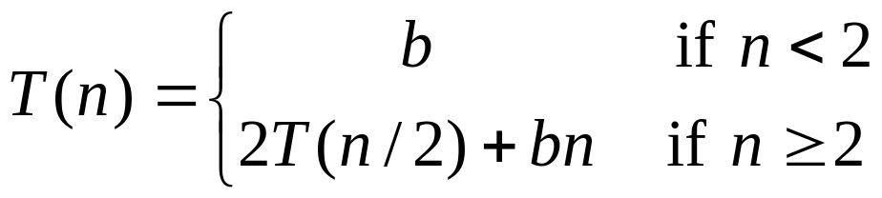
Recurrence Equation Analysis
The conquer step of merge-sort consists of merging two sorted sequences, each with n/2 elements and implemented by means of a doubly linked list, takes at most bn steps, for some constant b.
Likewise, the basis case (n < 2) will take at most b steps.
Therefore, if we let T(n) denote the running time of merge-sort:
We can therefore analyze the running time of merge-sort by finding a closed form solution to the above equation.
  That is, a solution that has T(n) only on the left-hand side.

Slide 8
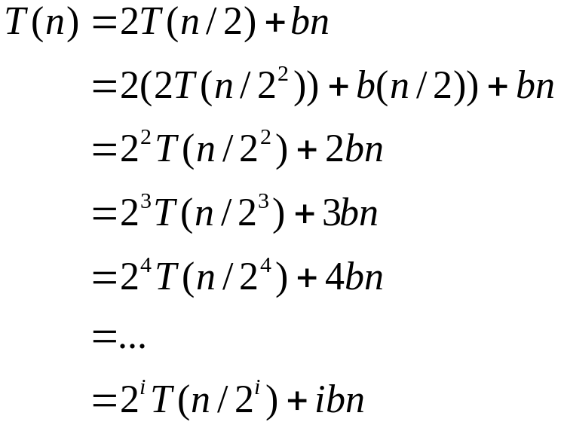

Iterative Substitution
In the iterative substitution technique, we iteratively apply the recurrence equation to itself and see if we can find a pattern:
Note that the base case, T(n)=b, occurs when 2^{i}=n.
That is, i = log n when i reaches the base case.
So,
Thus, T(n) is O(n log n).

Slide 9
The Recursion Tree
Draw the recursion tree for the recurrence relation and look for a pattern:
depth | # of seqs | size
0 | 1 | n
1 | 2 | n/2
i | 2^{i} | n/2^{i}
… | … | …
time
bn
bn
bn
…
Total time = bn + bn log n
(last level plus all previous levels)

Slide 10
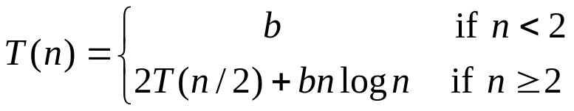
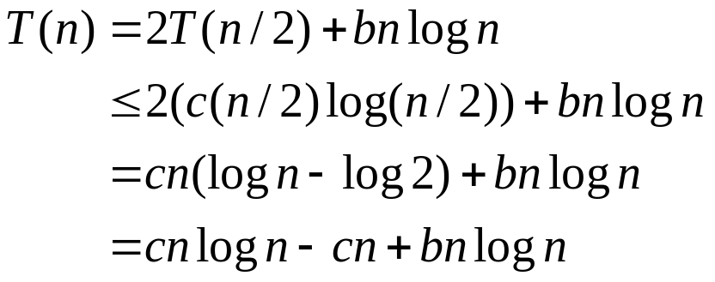
Guess-and-Test Method
In the guess-and-test method, we guess a closed form solution and then try to prove it is true by induction:
Guess: T(n) < cn log n.
Wrong: we cannot make this last line less than cn log n

Slide 11
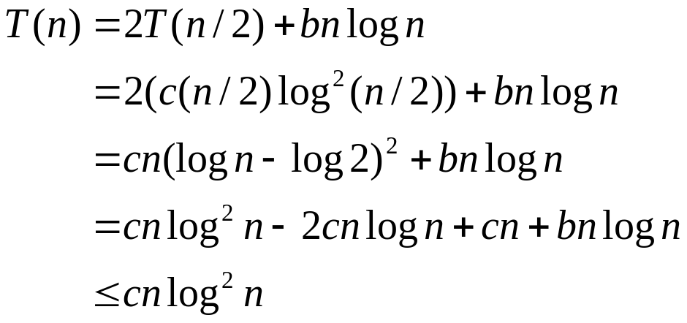
Guess-and-Test Method, Part 2
Recall the recurrence equation:
Guess #2: T(n) < cn log² n.
So, T(n) is O(n log² n).
In general, to use this method, you need to have a good guess and you must know how to use the induction proof.
(if c > b)

Slide 12
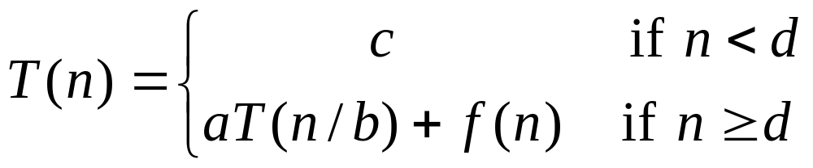
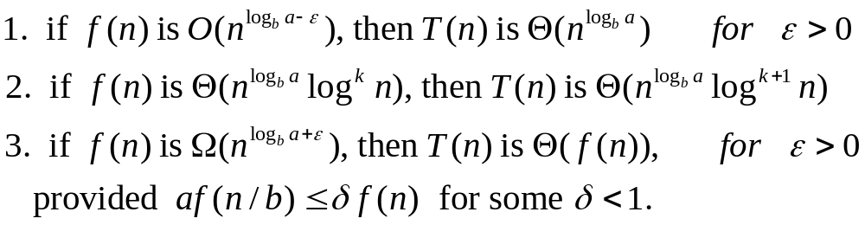
Master Method
Many divide-and-conquer recurrence equations have the form:
The Master Theorem:

Slide 13
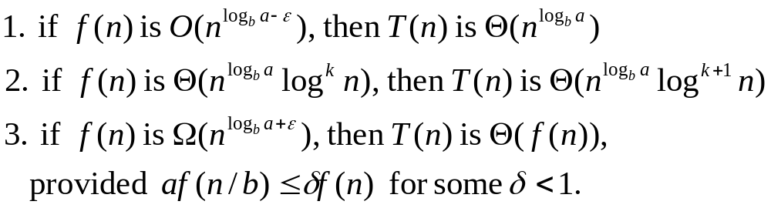
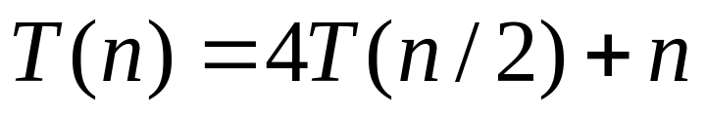
Master Method, Example 1
The form:
The Master Theorem:
Example:
Solution: log_{b}a=2, so case 1 says T(n) is O(n²).

Slide 14
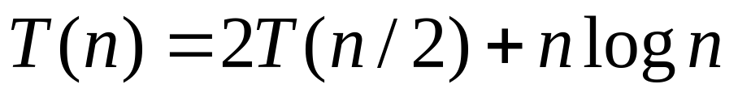
Master Method, Example 2
The form:
The Master Theorem:
Example:
Solution: log_{b}a=1, so case 2 says T(n) is O(n log² n).

Slide 15
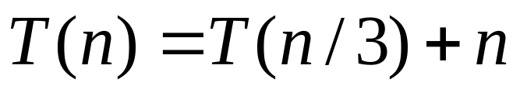
Master Method, Example 3
The form:
The Master Theorem:
Example:
Solution: log_{b}a=0, so case 3, T(n) is Θ(n).

Slide 16
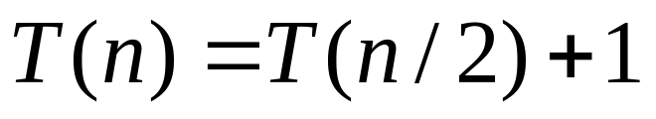
Master Method, Example 4
The form:
The Master Theorem:
Example:
(binary search)
Solution: log_{b}a=0, so case 2 says T(n) is O(log n).

Slide 17
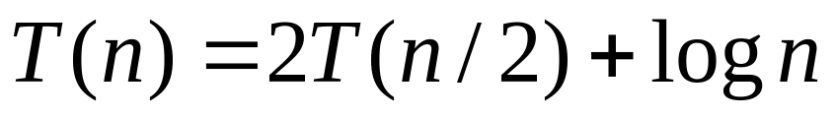
Master Method, Example 5
The form:
The Master Theorem:
Example:
(heap construction)
Solution: log_{b}a=1, so case 1 says T(n) is O(n).

Slide 18
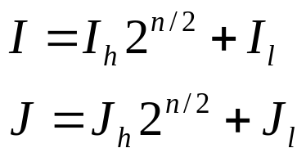
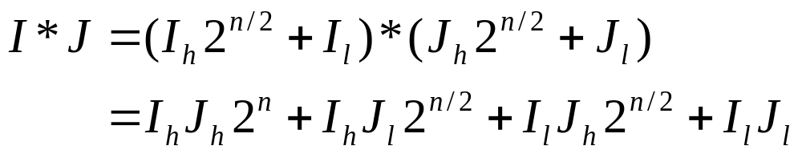
Case Study: Integer Multiplication
Algorithm: Multiply two n-bit integers I and J.
  Divide step: Split I and J into high-order and low-order bits
  We can then define I*J by:
  So, T(n) = 4T(n/2) + n, which implies T(n) is O(n²).
  (Case 1 in the Master method)

Slide 19
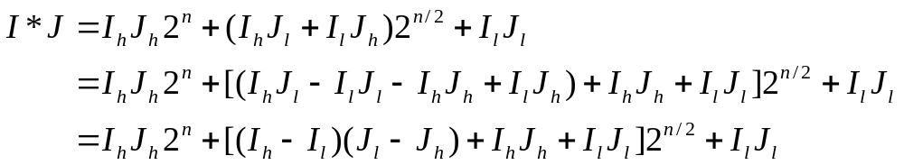
An Improved Integer Multiplication Algorithm
Algorithm: Multiply two n-bit integers I and J.
  Divide step: Split I and J into high-order and low-order bits
  Observe that there is a different way to multiply parts:
  So, T(n) = 3T(n/2) + n, which implies T(n) is O(n^{log}2³), by the Master Theorem (Case 1).
  Thus, T(n) is O(n^{1.585}).

Slide 20

Extra Slides

Slide 21
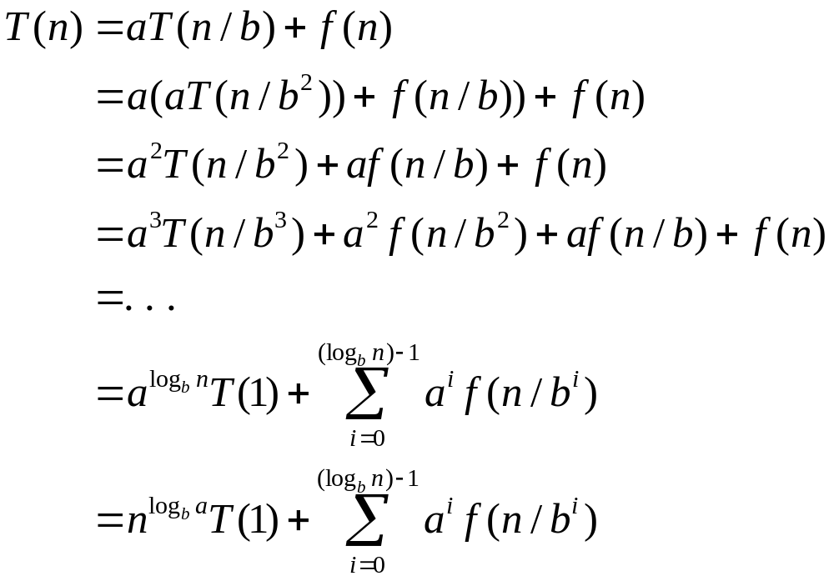
Iterative “Proof” of the Master Theorem
Using iterative substitution, let us see if we can find a pattern:
We then distinguish the three cases as
  The first term is dominant
  Each part of the summation is equally dominant
  The summation is a geometric series

