Slide 1
CS535: Algorithm Design and Analysis
Introduction to Graphs
Prof. Zane Yu
Department of Computer Science
University of Wisconsin, Milwaukee
April 4, 2024
Readings: Chapter 6.1, 6.2

Slide 2
Graph
A graph is a pair (V, E), where
  V is a set of nodes, called vertices
  E is a collection of pairs of vertices, called edges
  Vertices and edges are positions and store elements
Example:
  A vertex represents an airport and stores the three-letter airport code
  An edge represents a flight route between two airports and stores the mileage of the route
849
PVD
1843
ORD
142
SFO
802
LGA
337
1743
1387
HNL
2555
1099
LAX
1233
DFW
1120
MIA

Slide 3
Edge Types
Directed edge
  ordered pair of vertices (u,v)
  first vertex u is the origin
  second vertex v is the destination
  e.g., a flight
Undirected edge
  unordered pair of vertices (u,v)
  e.g., a flight route
Directed graph
  all the edges are directed
  e.g., flight network
Undirected graph
  all the edges are undirected
  e.g., route network
Mixed graph
flight
AA 1206
ORD
PVD
849
miles
ORD
PVD

Slide 4
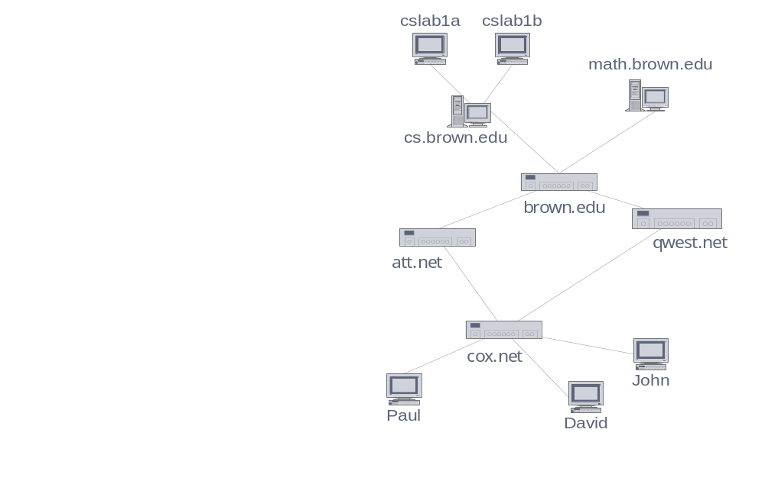
Applications
Electronic circuits
  Printed circuit board
  Integrated circuit
Transportation networks
  Highway network
  Flight network
Computer networks
  Local area network
  Internet
  Web
Databases
  Entity-relationship diagram

Slide 5
Terminology
End vertices (or end points) of an edge
  U and V are the endpoints of a
Edges incident on a vertex
  a, d, and b are incident on V
Adjacent vertices
  U and V are adjacent
Degree of a vertex
  X has degree 5
Parallel edges
  h and i are parallel edges
Self-loop
  j is a self-loop
Simple graph
  No parallel edges or self-loops
V
a
b
h
j
U
d
X
Z
c
e
i
W
g
f
Y

Slide 6
Terminology (cont’d)
Path
  sequence of alternating vertices and edges
  begins with a vertex
  ends with a vertex
  each edge is preceded and followed by its endpoints
Simple path
  path such that all its vertices and edges are distinct
Examples
  P₁=(V,b,X,h,Z) is a simple path
  P₂=(U,c,W,e,X,g,Y,f,W,d,V) is a path that is not simple
V
a
b
P₁
d
U
X
Z
P₂
h
c
e
W
g
f
Y

Slide 7
Terminology (cont’d)
Cycle
  circular sequence of alternating vertices and edges
  each edge is preceded and followed by its endpoints
Simple cycle
  cycle such that all its vertices and edges are distinct (except the first and last vertex)
Examples
  C₁=(V,b,X,g,Y,f,W,c,U,a,↵) is a simple cycle
  C₂=(U,c,W,e,X,g,Y,f,W,d,V,a,↵) is a cycle that is not simple
V
a
b
d
U
X
Z
C₂
h
e
C₁
c
W
g
f
Y

Slide 8
Properties
Notation
  n number of vertices
  m number of edges
  deg(v) degree of vertex v
Property 1
  Undirected graph: Σ_{v} deg(v) = 2m
  Proof: each edge is counted twice
  Directed graph:
  Σ_{v} indeg(v) = Σ_{v} outdeg(v) = m
Property 2
  In a simple undirected graph,
  m ≤ n (n − 1)/2
  Proof: each vertex has degree at most (n − 1)
What is the bound for a directed graph?
Example
  n = 4
  m = 6
  deg(v) = 3

Slide 9
Subgraphs
A subgraph S of a graph G is a graph such that
  The vertices of S are a subset of the vertices of G
  The edges of S are a subset of the edges of G
A spanning subgraph of G is a subgraph that contains all the vertices of G
Subgraph
Spanning subgraph

Slide 10
Connectivity
A graph is connected if there is a path between any two vertices
A connected component of a graph G is a maximal connected subgraph of G.
Thus, a connected component cannot be a subgraph of another bigger connected subgraph of G
Connected graph
Non connected graph with two connected components

Slide 11
Trees and Forests
A (free) tree is an undirected graph T such that
  T is connected
  T has no cycles
  This definition of tree is different from the one of a rooted tree
A forest is an undirected graph without cycles
Each connected components of a forest is a tree
Tree
Forest

Slide 12
Spanning Trees and Forests
A spanning tree of a connected graph is a spanning subgraph that is a tree
A spanning tree is not unique unless the graph is a tree
Spanning trees have applications to the design of communication networks
A spanning forest of a graph is a spanning subgraph that is a forest
Graph
Spanning tree

Slide 13
Summary: Subgraphs and Trees
Subgraph
  Subsets of vertices and edges
  Spanning subgraph (a subgraph that contains all the vertices of the original graph)
Connected Graph
  There is a path between any two vertices
  Connected components
Tree (free tree, no root)
  Connected graph without circles
Forest
  Graph without circles
Spanning Tree of a Graph
  Spanning subgraph that is a (free) tree
V
a
b
h
j
U
d
X
Z
c
e
i
W
g
f
Y
Property: Let G be an undirected graph with n vertices and m edges, then:
If G is connected, then m ≥ n-1
If G is a tree, then m = n-1
If G is a forest, then m ≤ n-1

Slide 14
Main Methods of the Graph ADT
Vertices and edges
  are positions
  store elements
Accessor methods
  aVertex(): return an arbitrary vertex of G
  incidentEdges(v)
  endVertices(e)
  isDirected(e)
  origin(e)
  destination(e)
  opposite(v, e)
  areAdjacent(v, w)
Update methods
  insertVertex(o)
  insertEdge(v, w, o)
  insertDirectedEdge(v, w, o)
  removeVertex(v)
  removeEdge(e)
Generic methods
  numVertices(): # of vertices
  numEdges(): # of edges
  vertices(): iterator of vertices
  edges(): iterator of edges

Slide 15
Edge List Structure
Vertex object
  element
  reference to position in vertex sequence
Edge object
  element
  origin vertex object
  destination vertex object
  reference to position in edge sequence
Vertex sequence
  sequence of vertex objects
Edge sequence
  sequence of edge objects
Not efficient for some operations
  e.g., IncidentEdges(v)
u
a
c
b
d
v
w
z
u
v
w
z
a
b
c
d

Slide 16
Adjacency List Structure
Edge list structure
Incidence sequence for each vertex
  sequence of references to edge objects of incident edges
Augmented edge objects
  references to associated positions in incidence sequences of end vertices
Good for some operations
  IncidentEdges(v)
  areAdjacent(u, v)
  removeVertex(v)
a
v
b
u
w
u
v
w
a
b

Slide 17
Adjacency Matrix Structure
Edge list structure
Augmented vertex objects
  Integer key (index) associated with vertex
2D adjacency array
  Reference to edge object for adjacent vertices
  Null for non nonadjacent vertices
  May be simplified (store edge info in the matix)
  Symmetric (undirected) or non-symmetric (directed)
The “old fashioned” version just has 0 for no edge and 1 for edge
a
v
b
u
w
0
u
1
v
2
w
 | 0 | 1 | 2
0 | ∅ |  | ∅
1 |  | ∅
2 | ∅ |  | ∅
a
b

Slide 18
Asymptotic Performance
n vertices, m edges no parallel edges no self-loops Bounds are “big-Oh” | Edge List | Adjacency List | Adjacency Matrix
Space | n + m | n + m | n²
incidentEdges(v) | m | deg(v) | n
areAdjacent (v, w) | m | min(deg(v), deg(w)) | 1
insertVertex(o) | 1 | 1 | n
insertEdge(v, w, o) | 1 | 1 | 1
removeVertex(v) | m | deg(v) | n²
removeEdge(e) | 1 | 1 | 1

