Slide 1
CS535: Algorithm Design and Analysis
Minimum Spanning Tree
Prof. Zane Yu
Department of Computer Science
University of Wisconsin, Milwaukee
April 18, 2024
Readings: Chapter 7.3

Slide 2
Single Source Shortest Path
n vertices, m edges Bounds are “big-Oh” | Dijkstra | Bellman-Ford | DAG (topol. ordering)
Graphs | Undirected* | Directed | Directed
Time | mlogn | nm | n+m
No directed cycle | N/A | N/A | Yes
No negative cycle | Yes | Yes | Yes
No negative weight | Yes | N/A | N/A
* Can be extended to directed graphs
849
ORD
1843
PVD
142
HNL
802
LGA
1205
337
1743
1387
SFO
2555
1099
LAX
1233
DFW
1120
MIA

Slide 3
All-Pairs Shortest Paths
Find the distance between every pair of vertices in a weighted graph G.
We can make n calls to Dijkstra’s algorithm (if no negative edges), which takes O(nmlog n) time.
Likewise, n calls to Bellman-Ford would take O(n²m) time.

Slide 4
All-Pairs Shortest Paths
We can achieve O(n³) time using dynamic programming
(similar to the Floyd-Warshall algorithm for transitive closure).
Algorithm AllPair(G) {assumes vertices 1,…,n}
for all vertex pairs (i,j)
if i = j
D₀[i,i] ← 0
else if (i,j) is an edge in G
D₀[i,j] ← weight of edge (i,j)
else
D₀[i,j] ← + ∞
for k ← 1 to n do
for i ← 1 to n do
for j ← 1 to n do
D_{k}[i,j] ← min{D_{k-1}[i,j], D_{k-1}[i,k]+D_{k-1}[k,j]}
return D_{n}
Uses only vertices numbered 1,…,k
(compute weight of this edge)
i
j
Uses only vertices
numbered 1,…,k-1
k
Uses only vertices
numbered 1,…,k-1

Slide 5
Minimum Spanning Tree
Spanning subgraph
  Subgraph of a graph G containing all the vertices of G
Spanning tree
  Spanning subgraph that is a (free) tree
Minimum spanning tree (MST)
  Spanning tree of a weighted graph with minimum total edge weight
Applications
  Communications networks
  Transportation networks
ORD
10
1
PIT
DEN
6
7
9
3
DCA
4
STL
8
5
2
DFW
ATL

Slide 6
Cycle Property
f
8
  Let T be a minimum spanning tree of a weighted graph G
  Let e be an edge of G that is not in T and C the cycle formed by e with T
  For every edge f of C, weight(f) ≤ weight(e)
  Proof:
  By contradiction
  If weight(f) > weight(e) we can get a spanning tree of smaller weight by replacing e with f
4
C
9
2
6
3
e
8
7
7
Replacing f with e yields
a better spanning tree
f
8
4
C
9
2
6
3
e
8
7
7

Slide 7
Partition Property
  Consider a partition of the vertices of G into subsets U and V
  Let e be an edge of minimum weight across the partition
  There is a minimum spanning tree of G containing edge e
  Proof:
  Let T be an MST of G
  If T does not contain e, consider the cycle C containing e and f , where f is the edge of T across the partition
  By the cycle property,
  weight(f) ≤ weight(e)
  Thus, weight(f) = weight(e)
  We obtain another MST by replacing f with e
U
V
f
7
4
9
2
5
8
8
e
3
7
Replacing f with e yields
another MST
U
V
f
7
4
9
2
5
8
8
e
3
7

Slide 8
Kruskal’s Algorithm
A priority queue stores the edges outside the cloud
  Key: weight
  Element: edge
At the end of the algorithm
  We are left with one cloud that encompasses the MST
  A tree T which is our MST
Algorithm KruskalMST(G)
for each vertex V in G do
define a Cloud(v) of ← {v}
let Q be a priority queue.
Insert all edges into Q using their weights as the key
T ← ∅
while T has fewer than n-1 edges do (u, v) = Q.removeMin()
Let C(v) the cloud containing v
and C(u) the cloud containing u
if C(v) ≠ C(u) then
Add edge e to T
Merge C(v) and C(u)
return T

Slide 9
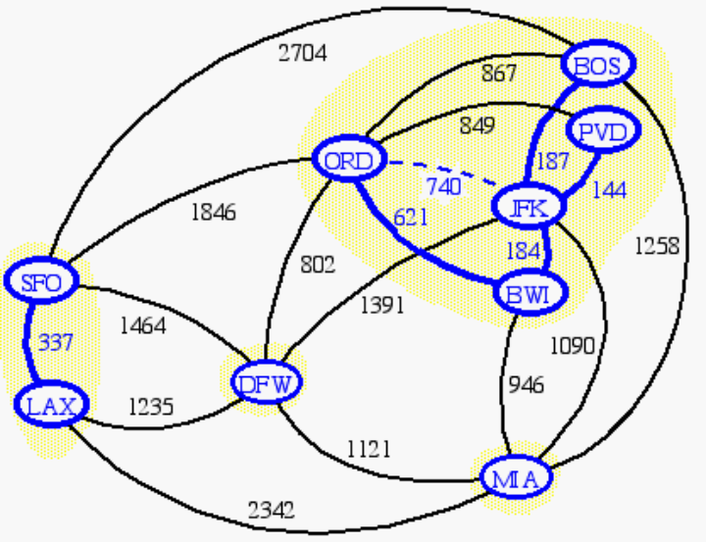
Data Structure for Kruskal Algortihm
The algorithm maintains a forest of trees
An edge is accepted if it connects distinct trees
We need a data structure that maintains a partition, i.e., a collection of disjoint sets, with the operations:
- find(u): return the set storing u
- union(u,v): replace the sets storing u and v with their union

Slide 10
Analysis
Each set is stored in a sequence
Each element has a reference back to the set
  operation find(u) takes O(1) time, and returns the set of which u is a member.
  in operation union(u,v), we move the elements of the smaller set to the sequence of the larger set and update their references
  the time for operation union(u,v) is min(n_{u},n_{v}), where n_{u} and n_{v} are the sizes of the sets storing u and v
Whenever an element is processed, it goes into a set of size at least double, hence each element is processed at most logn times
Total time: O(mlogm + nlogm + nlogn) or O((n+m)logm) or O(mlogm).

Slide 11
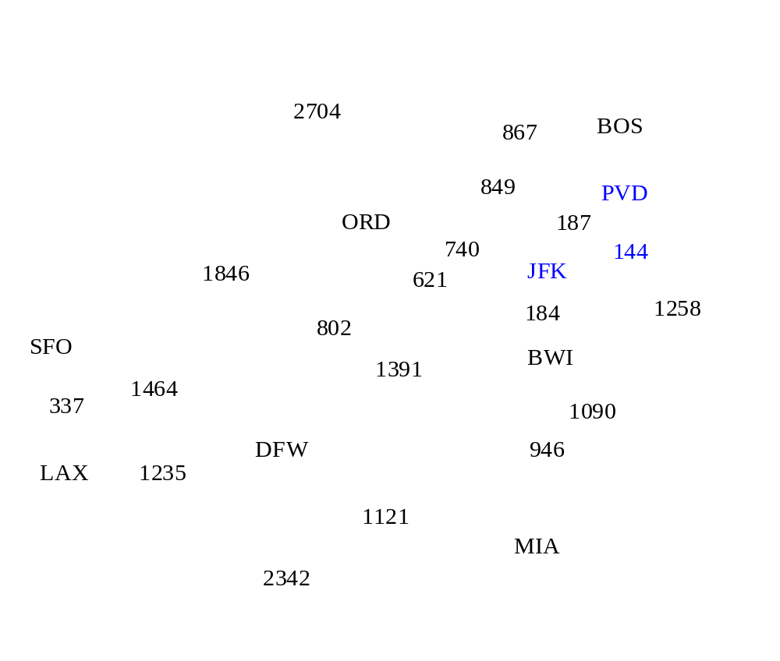
Example

Slide 12
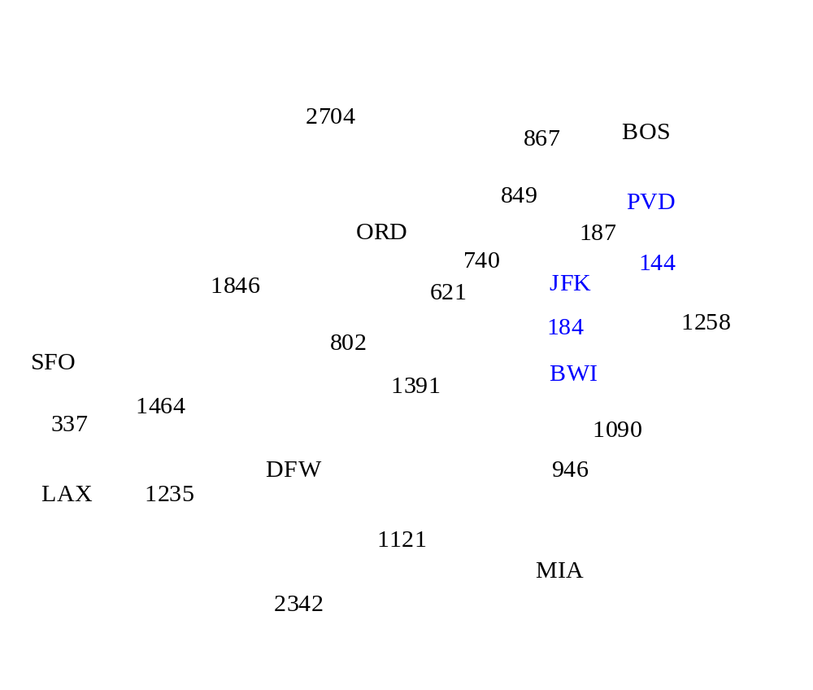
Example

Slide 13
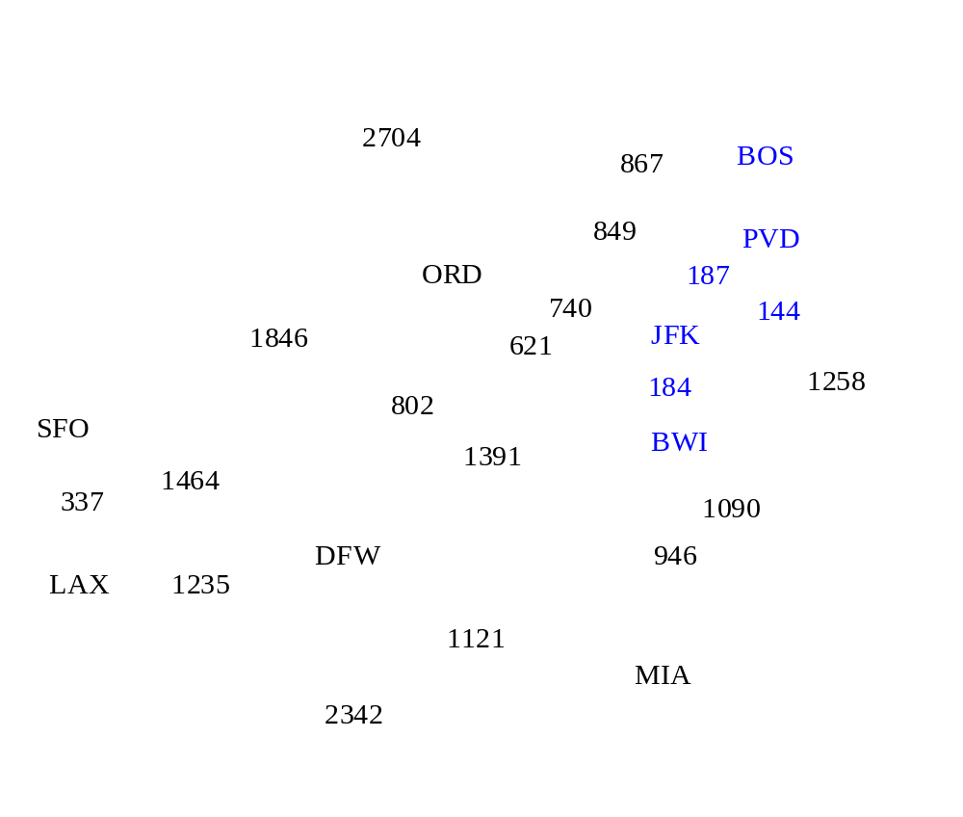
Example

Slide 14
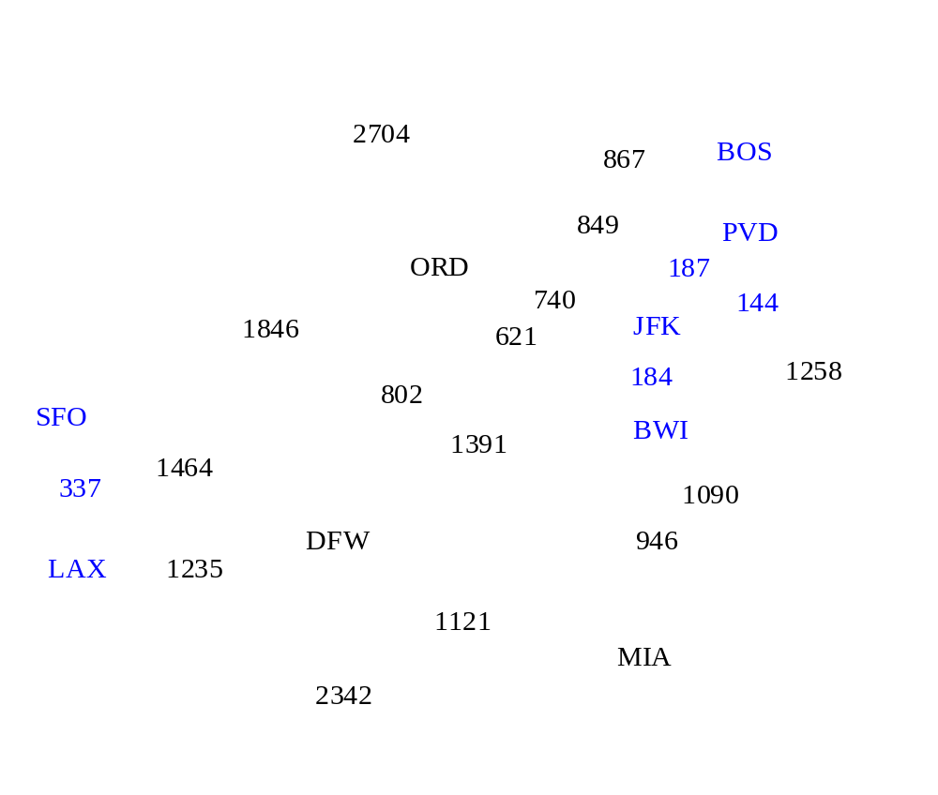
Example

Slide 15
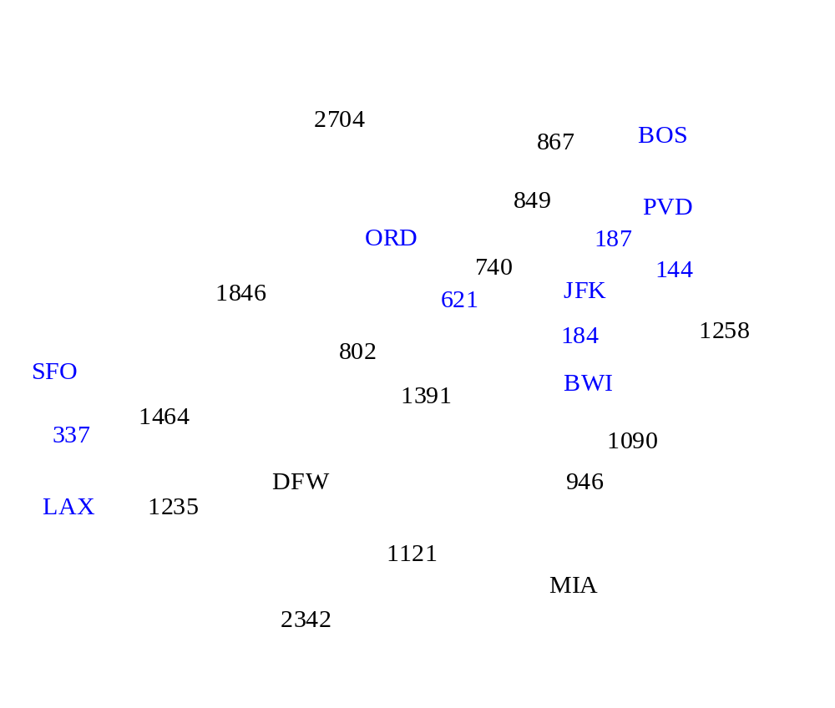
Example

Slide 16
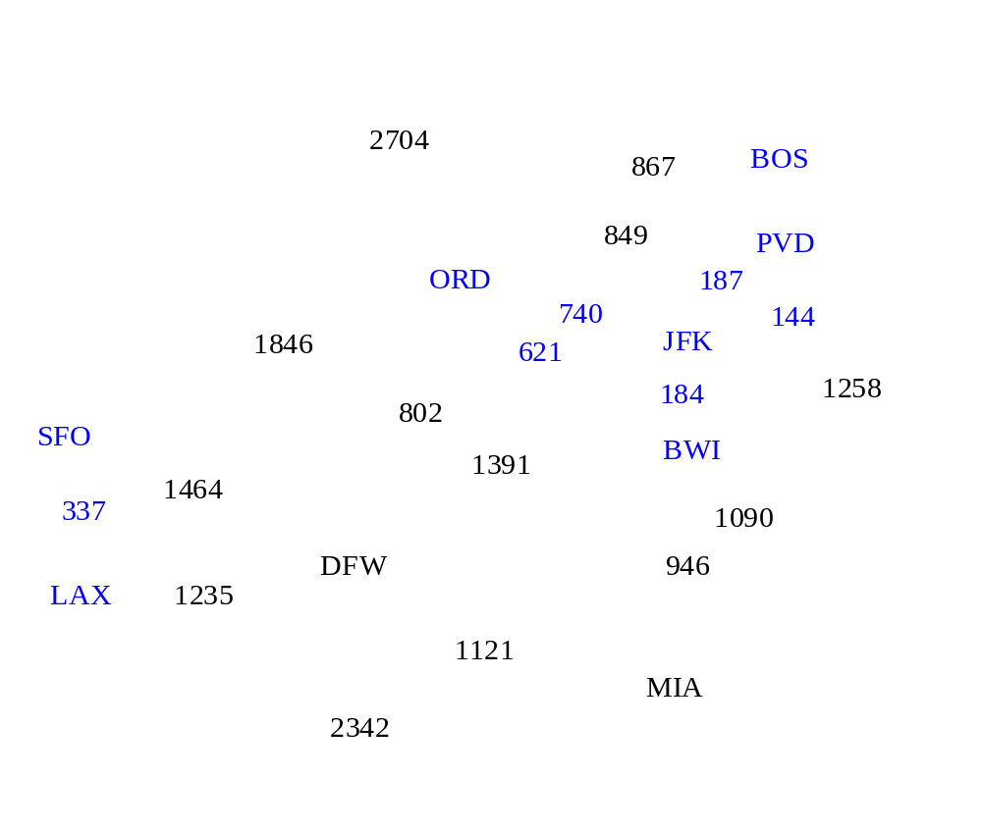
Example

Slide 17
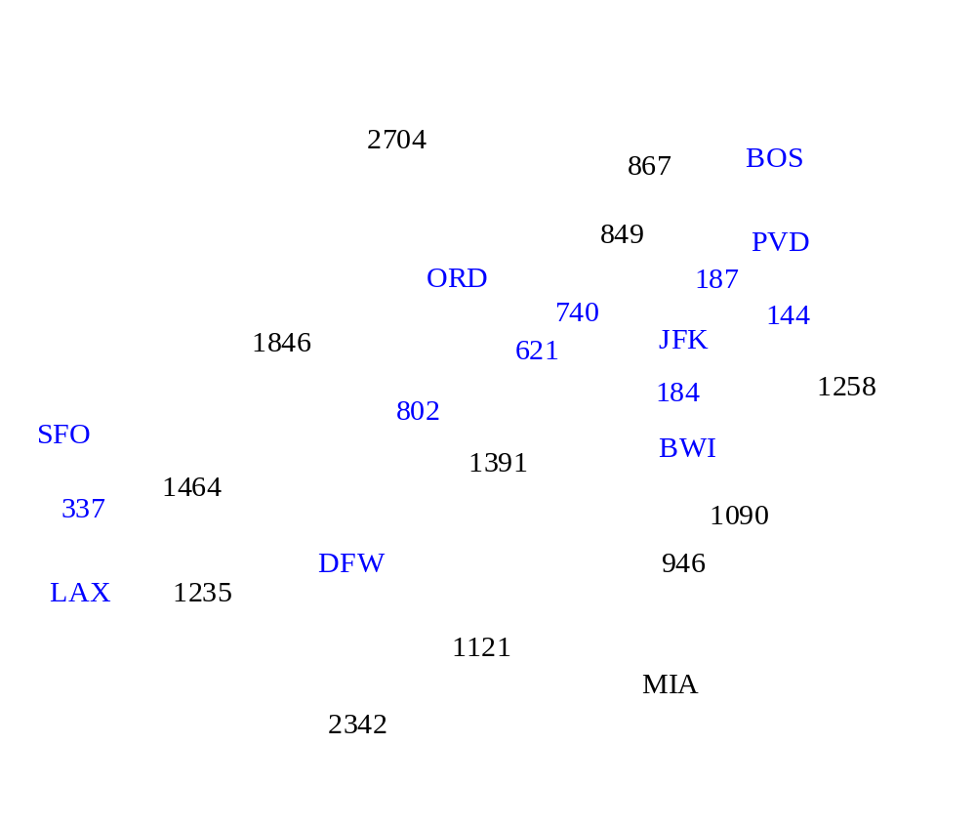
Example

Slide 18
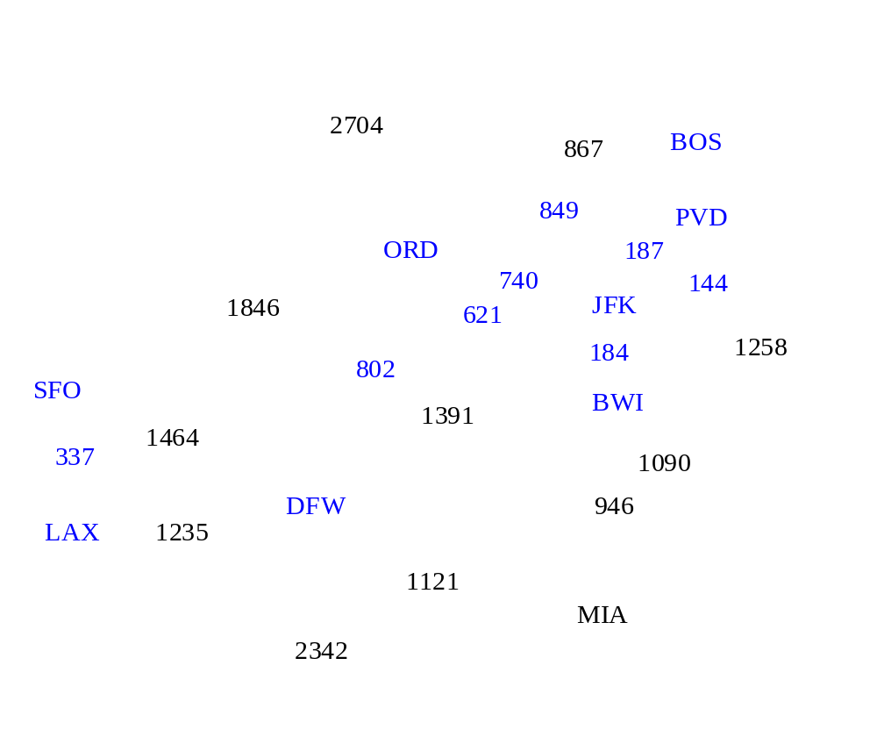
Example

Slide 19
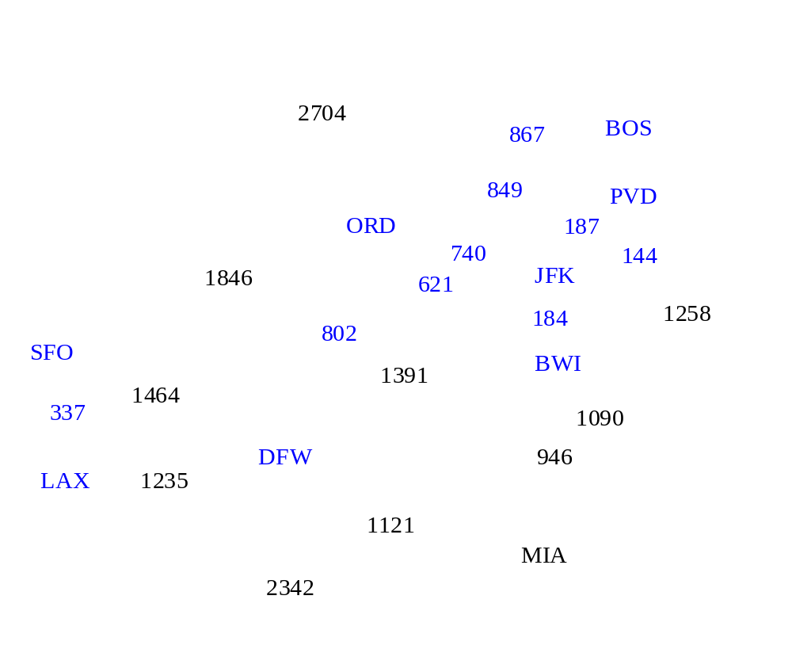
Example

Slide 20

Example

Slide 21
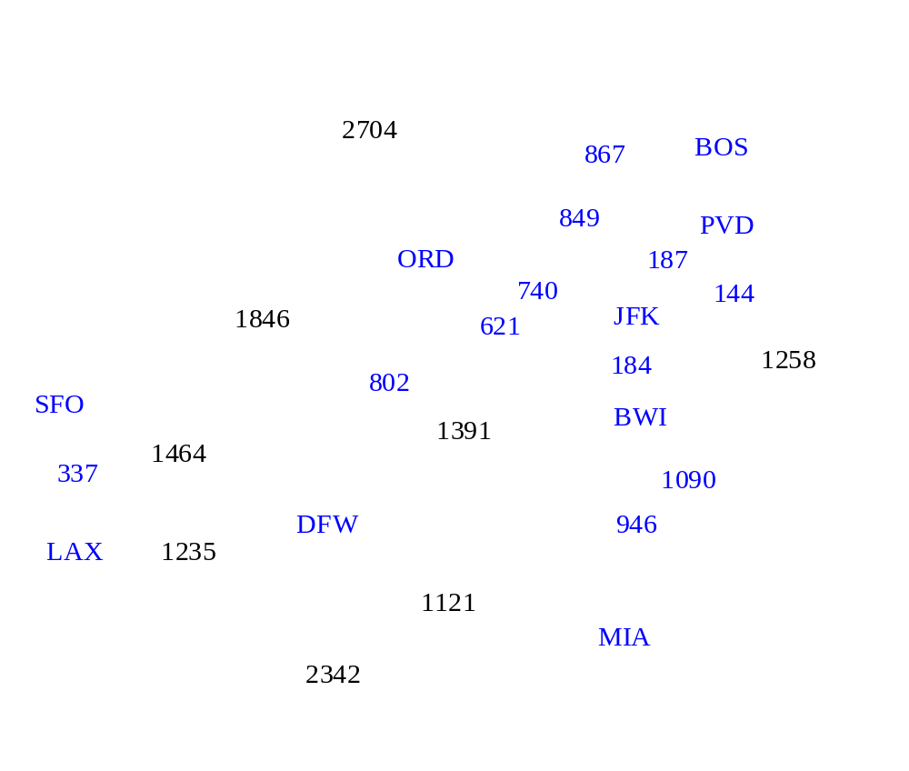
Example

Slide 22

Example

Slide 23
Example
2704
867
BOS
849
PVD
ORD
187
740
144
1846
621
JFK
184
1258
802
SFO
BWI
1391
1464
337
1090
DFW
946
LAX
1235
1121
MIA
2342

Slide 24
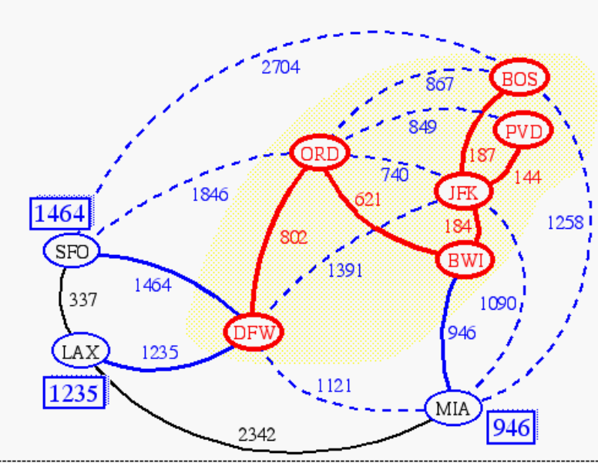
Prim-Jarnik’s Algorithm
Similar to Dijkstra’s algorithm (for a connected graph)
We pick an arbitrary vertex s and we grow the MST as a cloud of vertices, starting from s
We store with each vertex v a label D(v) = the smallest weight of an edge connecting v to a vertex in the cloud
At each step:
  We add to the cloud the vertex u outside the cloud with the smallest distance label
  We update the labels of the vertices adjacent to u

Slide 25
Prim-Jarnik’s Algorithm (cont’d)
A priority queue stores the vertices outside the cloud
  Key: distance
  Element: vertex
Locator-based methods
  insert(k,e) returns a locator
  replaceKey(l,k) changes the key of an item
We store three labels with each vertex:
  Distance
  Parent edge in MST
  Locator in priority queue
Algorithm PrimJarnikMST(G)
Q ← new heap-based priority queue
s ← a vertex of G
for all v ∈ G.vertices()
if v = s
D[v] ← 0
else
D[v] ← ∞
Construct the heap Q with items (v, ∅, D[v]) where D[v] is the key
  while ¬Q.isEmpty()
  (u, e) ← Q.removeMin()
  Add u and e to the MST
  for each vertex z in Q and adjacent to u
  if w(u,z) < D(z)
  D[z] ← w(u,z)
  Change the element of vertex z in Q to (z, (u,z), D[z])

Slide 26
Example
∞
7
2
7
D
2
7
D
B
4
B
4
8
9
∞
5
9
∞
2
5
F
2
5
F
C
8
C
8
8
3
8
3
E
E
A
7
7
A
7
7
0
0
7
7
2
7
D
7
D
B
4
2
B
4
5
9
∞
9
4
2
5
F
5
5
C
2
F
8
C
8
8
3
3
E
8
A
7
E
0
7
A
7
7
0

Slide 27
Example (contd.)
7
2
7
D
B
4
5
9
4
2
5
F
C
8
8
3
E
A
7
3
7
0
7
D
2
B
4
5
9
4
2
5
F
C
8
8
3
E
A
7
3
0

Slide 28
Analysis
Graph operations
  Method incidentEdges is called once for each vertex
Priority queue operations
  Each vertex is inserted once into and removed once from the priority queue, where each insertion or removal takes O(log n) time
  The key of a vertex w in the priority queue is modified at most deg(w) times, where each key change takes O(log n) time
Prim-Jarnik’s algorithm runs in O((n + m) log n) time provided the graph is represented by the adjacency list structure
  Recall that Σ_{v} deg(v) = 2m
The running time is O(m log n) since the graph is connected
(m ≥ n-1).

Slide 29
Extra Slides

Slide 30
Baruvka’s Algorithm
Like Kruskal’s Algorithm, Baruvka’s algorithm grows many “clouds” at once.
Each iteration of the while-loop halves the number of connected compontents in T.
  The running time is O(m log n).
Algorithm BaruvkaMST(G)
T ← V {just the vertices of G}
while T has fewer than n-1 edges do
for each connected component C in T do
Let edge e be the smallest-weight edge from C to another component in T.
if e is not in T then
Add edge e to T
return T

Slide 31
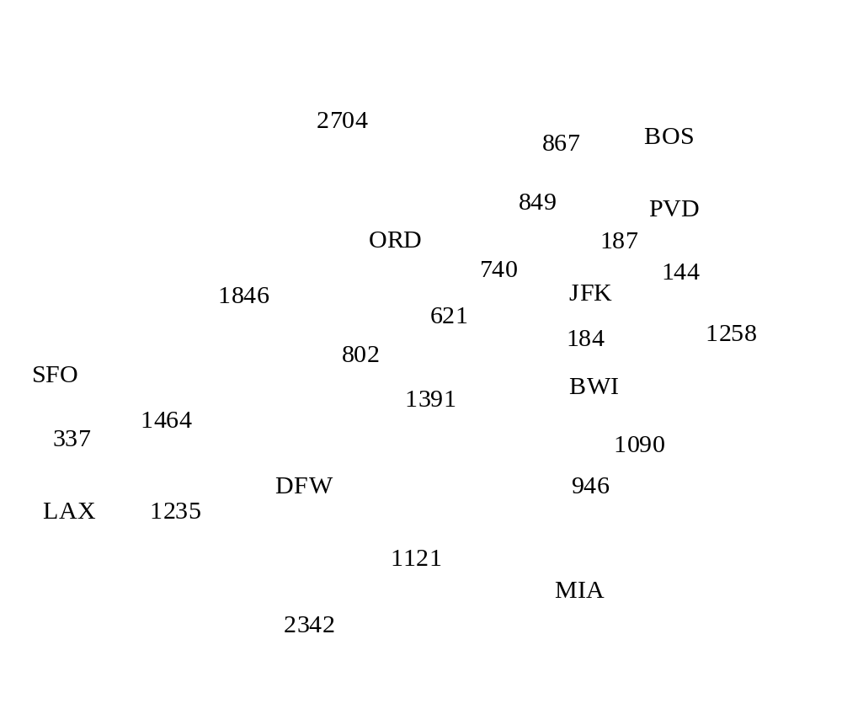
Baruvka Example

Slide 32
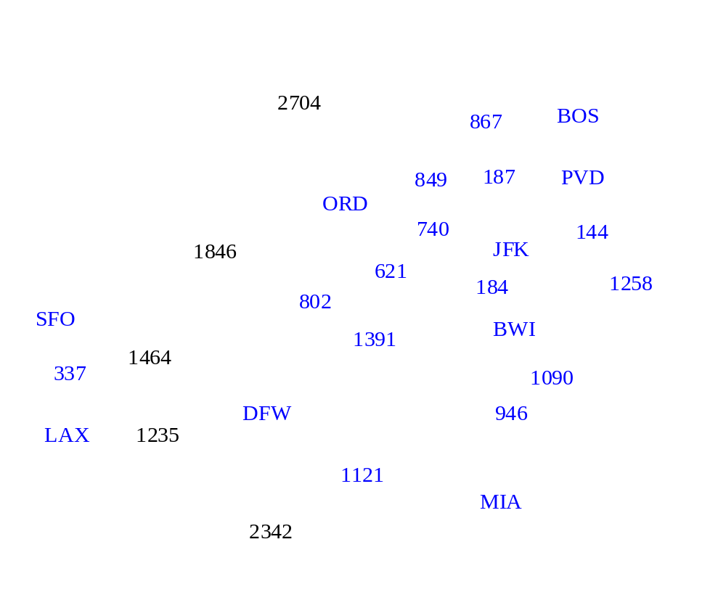
Example

Slide 33
Example
2704
867
BOS
849
187
PVD
ORD
740
144
1846
JFK
621
184
1258
802
SFO
BWI
1391
1464
337
1090
DFW
946
LAX
1235
1121
MIA
2342

