Slide 1
CS535: Algorithm Design and Analysis
Applications in Text Processing
Prof. Zane Yu
Department of Computer Science
University of Wisconsin, Milwaukee
May 2, 2024
Adapted from “M. Goodrich and R. Tamassia, Algorithm Design: Foundations, Analysis and Internet Examples, John Wiley and Sons, 2002”

Slide 2
Strings
A string is a sequence of characters
Examples of strings:
  Java program
  HTML document
  DNA sequence
  Digitized image
An alphabet Σ is the set of possible characters for a family of strings
Example of alphabets:
  {A,B,C,…Z}
  {0,1,2,…9}
  {0, 1}
  {A, C, G, T}
Let P be a string of size m
  A substring P[i .. j] of P is the subsequence of P consisting of the characters with ranks between i and j
  A prefix of P is a substring of the type P[0 .. i]
  A suffix of P is a substring of the type P[i ..m − 1]
Given strings T (text) and P (pattern), the pattern matching problem consists of finding a substring of T equal to P
Applications:
  Text editors
  Search engines
  Biological research

Slide 3
Brute-Force Algorithm
Algorithm BruteForceMatch(T, P)
Input text T of size n and pattern
P of size m
Output starting index of a
substring of T equal to P or −1
if no such substring exists
  for i ← 0 to n − m
  { test shift i of the pattern }
  j ← 0
  while j < m ∧ T[i + j] = P[j]
  j ← j + 1
  if j = m
  return i {match at i}
  else
  break while loop {mismatch}
  return -1 {no match anywhere}
The brute-force pattern matching algorithm compares the pattern P with the text T for each possible shift of P relative to T, until either
  a match is found, or
  all placements of the pattern have been tried
Brute-force pattern matching runs in time O(nm)
Example of worst case:
  T = aaa … ah
  P = aaah
  may occur in images and DNA sequences
  unlikely in English text

Slide 4
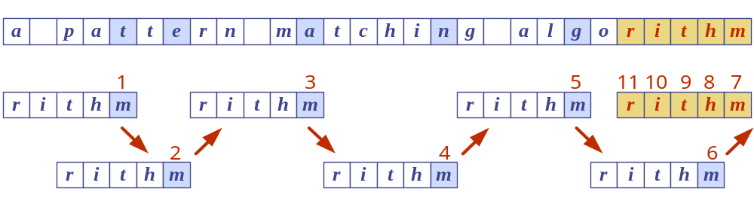
Boyer-Moore Heuristics
The Boyer-Moore’s pattern matching algorithm is based on two heuristics
Looking-glass heuristic: Compare P with a subsequence of T moving backwards
Character-jump heuristic: When a mismatch occurs at T[i] = c
  If P contains c, shift P to align the last occurrence of c in P with T[i]
  Else, shift P to align P[0] with T[i + 1]
Example

Slide 5
Last-Occurrence Function
Boyer-Moore’s algorithm preprocesses the pattern P and the alphabet Σ to build the last-occurrence function L mapping Σ to integers, where L(c) is defined as
  the largest index i such that P[i] = c or
  − −1 if no such index exists
Example:
  − Σ = {a, b, c, d}
  P = abacab
The last-occurrence function can be represented by an array indexed by the numeric codes of the characters
The last-occurrence function can be computed in time O(m + s), where m is the size of P and s is the size of Σ
c | a | b | c | d
L(c) | 4 | 5 | 3 | −1

Slide 6
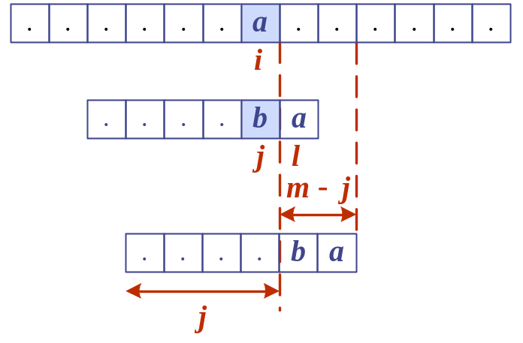
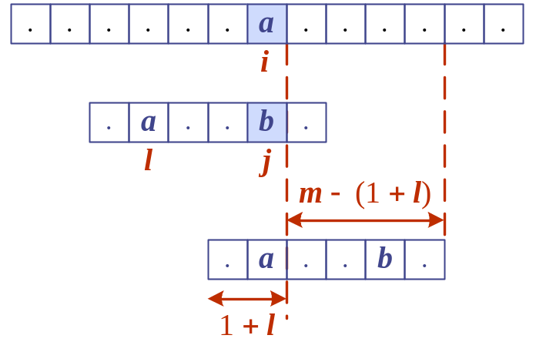
The Boyer-Moore Algorithm
Algorithm BoyerMooreMatch(T, P, Σ)
L ← lastOccurenceFunction(P, Σ )
i ← m − 1
j ← m − 1
repeat
  if T[i] = P[j]
  if j = 0
  return i { match at i }
  else
  i ← i − 1
  j ← j − 1
  else
  { character-jump }
  l ← L[T[i]]
  i ← i + m – min(j, 1 + l)
  j ← m − 1
  until i > n − 1
  return −1 { no match }
Case 1: j ≤ 1 + l
Case 2: 1 + l < j

Slide 7
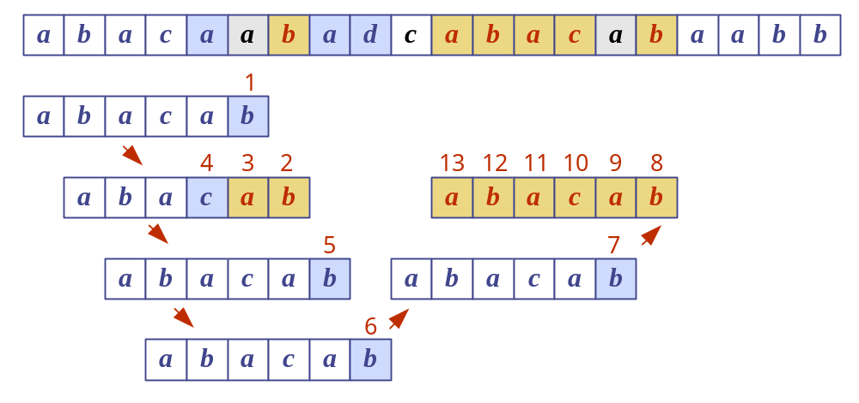
Example

Slide 8
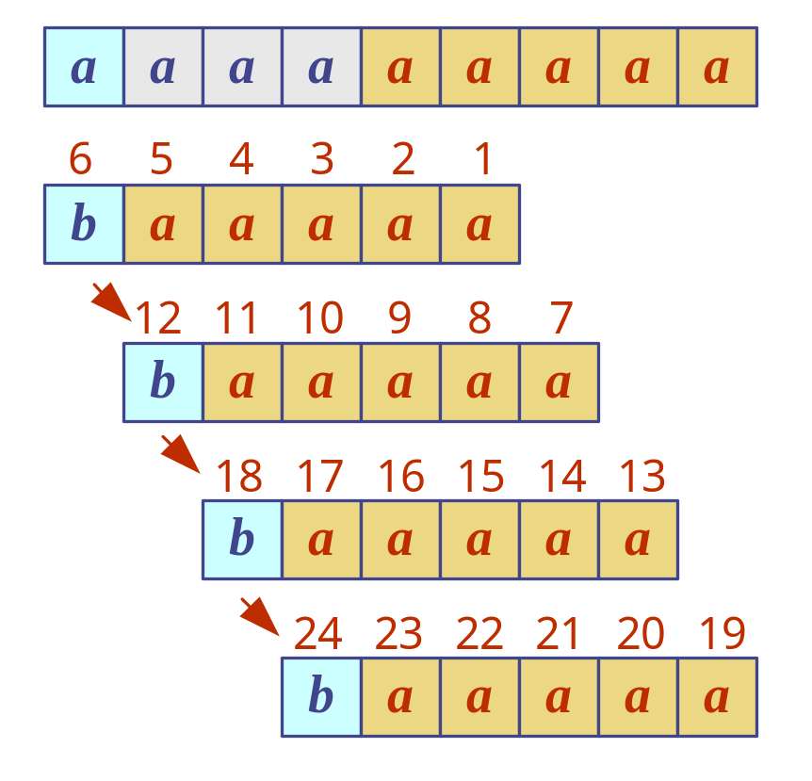
Analysis
Boyer-Moore’s algorithm runs in time O(nm + s) in the worst cases
Example of worst case:
  T = aaa … a
  P = baaa
The worst case may occur in images and DNA sequences but is unlikely in English text
Boyer-Moore’s algorithm is significantly faster than the brute-force algorithm on English text (on average, 0.24 comparison per text character)

Slide 9
Tries
If the text is large, immutable and frequently searched, we may want to preprocess the text instead of the pattern
A trie is a compact data structure for representing a set of strings, such as all the words in a text
  A tries supports pattern matching queries in time proportional to the pattern size

Slide 10
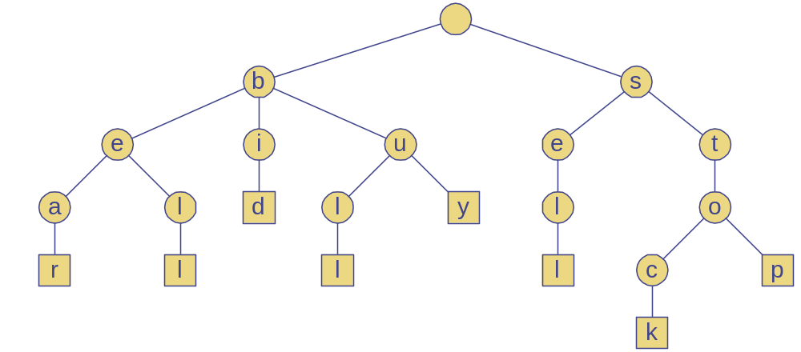
Standard Trie (1)
The standard trie for a set of strings S is an ordered tree such that:
  Each node but the root is labeled with a character
  The children of a node are alphabetically ordered
  The paths from the external nodes to the root yield the strings of S (in inverse order)
Example: standard trie for the set of strings
  S = { bear, bell, bid, bull, buy, sell, stock, stop }

Slide 11
Standard Trie (2)
A standard trie uses O(n) space and supports searches, insertions and deletions in time O(dm), where:
  n total size of the strings in S
  m size of the string parameter of the operation
  d size of the alphabet

Slide 12
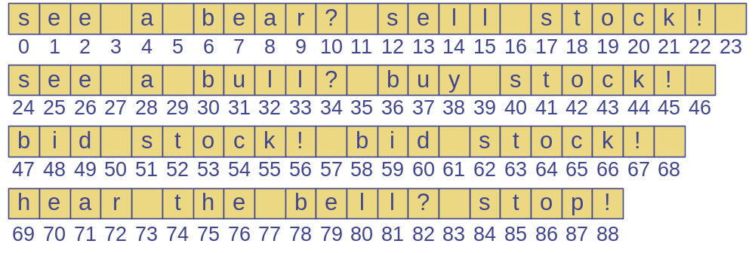
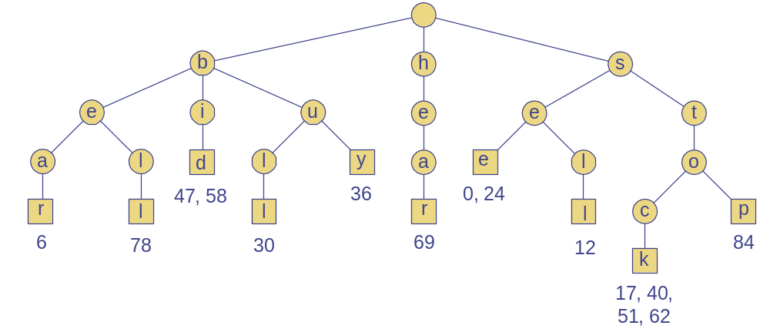
Word Matching with a Trie
We insert the words of the text into a trie
Each external node stores the occurrences of the associated words in the text

Slide 13
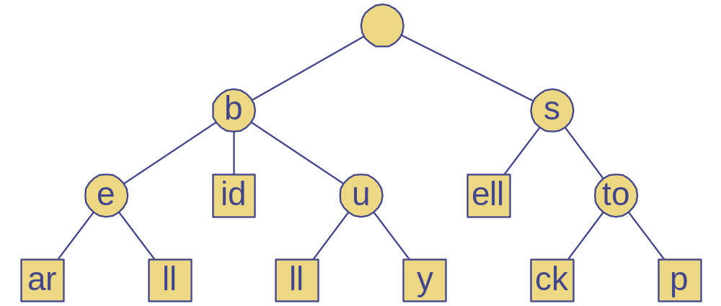
Compressed Trie
A compressed trie has internal nodes of degree at least two
It is obtained from standard trie by compressing chains of “redundant” nodes

Slide 14

Extra Slides

Slide 15
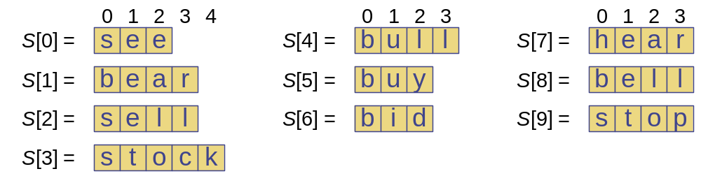
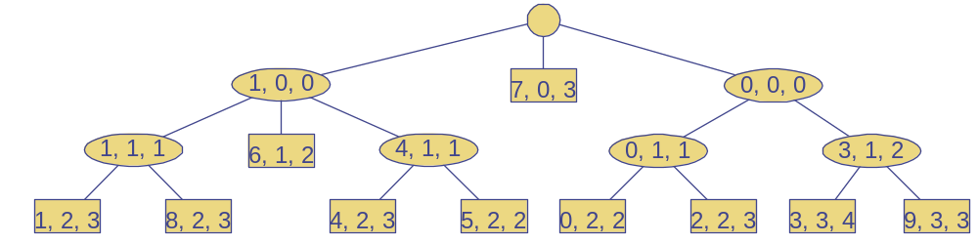
Compact Representation
Compact representation of a compressed trie for an array of strings:
  Stores at the nodes ranges of indices instead of substrings
  Uses O(s) space, where s is the number of strings in the array
  Serves as an auxiliary index structure

