Slide 1

Hello!
I am ROHIT PANDEY.
I am here to give presentations no.
Smart Door Lock System

Slide 2
Abstract
Now a days the home security system is very poor. This paper is consists of a smart door lock system in this we developed on a great solution to improve the home safety system. Arduino IDE software in this we used Bluetooth devices to operate the door lock-in the home. The microcontroller is connected to l293d driver IC that driver IC is used to operate the DC Gearmotor in forward(Open) and backward (Close) and the motor is controlling the door lock. In this method, all data are controlling by Bluetooth android application in that app we are sending the data through Bluetooth to control the home door lock one is open and another one close form the application. Nobody can hack the system it was a closed-loop and most secure system.

Slide 3
Existing System
1
Before there is no safety system for home applications and anybody can use the home equipment.

Slide 4
Proposed System
In this project, we are controlling the door lock in the Bluetooth android application.
Form the Android application we are sending the information to open and close the door lock. When the data was received for the android app the Arduino Uno has transferred the information to the l293d driver that the driver controls the dc gear motor. When we pass the 'F' character door lock will open. if we pass the 'R ' character door lock will close. This method is called a Bluetooth smart door lock system.

Slide 5
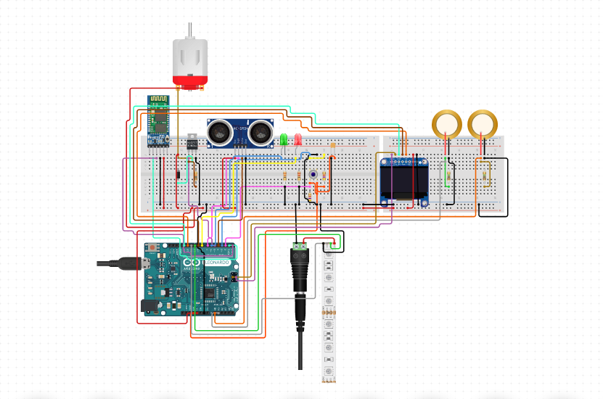

Slide 6
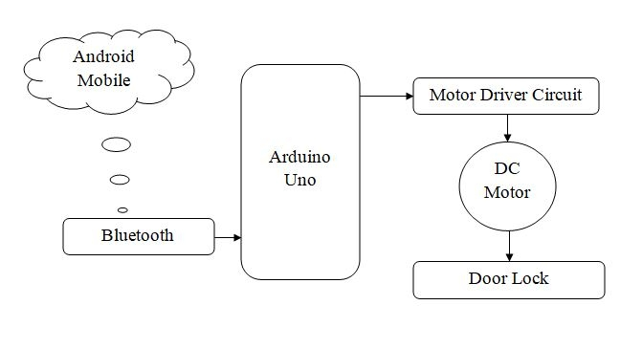
Block Digram

Slide 7
Software Tools
Arduino IDE
Embedded-C
Auto Cad
Circuto

Slide 8
Thanks!
✋👆👉👍👤👦👧👨👩👪💃🏃💑❤😂😋😒😭👶😸🐟🎨🏈🏰🌏🔌🔑

