Slide 1

Analyzing Gym Member Data and Predicting Calories Burned: A Data-Driven Approach to Optimize Fitness Outcomes Rohit Patil DSC530-T302 Data Exploration and Analysis Matthew Metzger February 28, 2024

Slide 2

Problem Statement:
With a focus on physical fitness and health, gyms have become an important part of any individual's fitness journey. Still, several gym members are not in a position to achieve their aims due to irregularity of attendance, poorly structured workout routines, and absence of personal guidance. The project aims to solve these problems by collecting and analyzing member data from different gyms to look for workout patterns and predict the calories estimated to be burnt during gym workouts. These changes will allow us to make recommendations to both gym members and trainers to give recommendations focused on optimizing fitness.

Slide 3

AIM & Objectives
Aim of the project:
This project aims to perform exploratory data analysis (EDA) on a gym membership dataset and develop a strategy that can estimate the calories burned by an individual during workout sessions. Further, the project will likely provide definitive factors affecting calorie burn and recommendations for various workout plans for individual practice.
Objectives:
Conduct exploratory data analysis (EDA) on the gym member data to identify trends, patterns, and correlations.
Identify and analyze key factors affecting calories burned during exercise.
To provide useful recommendations to gym members and trainers to refine workout programs aligned with their fitness goals.

Slide 4

Variables
As part of the analysis, we will use the variables below
Age: The age of gym member in years.
Gender: The gender of the gym member (Male or Female).
Session Duration: The total time spent during a workout, measured in hours.
Calories Burned: The number of calories burned during the workout session.
Workout Type: The type of workout performed.
BMI: Body mass index of an individual

Slide 5
AIM & Objectives
Aim of the project:
This project aims to perform exploratory data analysis (EDA) on a gym membership dataset and develop a strategy that can estimate the calories burned by an individual during workout sessions. Further, the project will likely provide definitive factors affecting calorie burn and recommendations for various workout plans for individual practice.
Objectives:
Conduct exploratory data analysis (EDA) on the gym member data to identify trends, patterns, and correlations.
Identify and analyze key factors affecting calories burned during exercise.
To provide useful recommendations to gym members and trainers to refine workout programs aligned with their fitness goals.

Slide 6
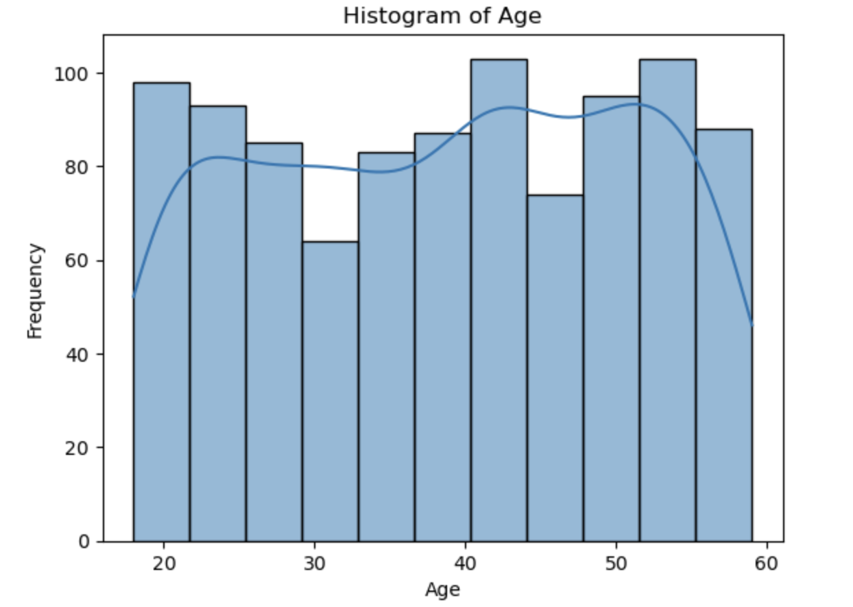
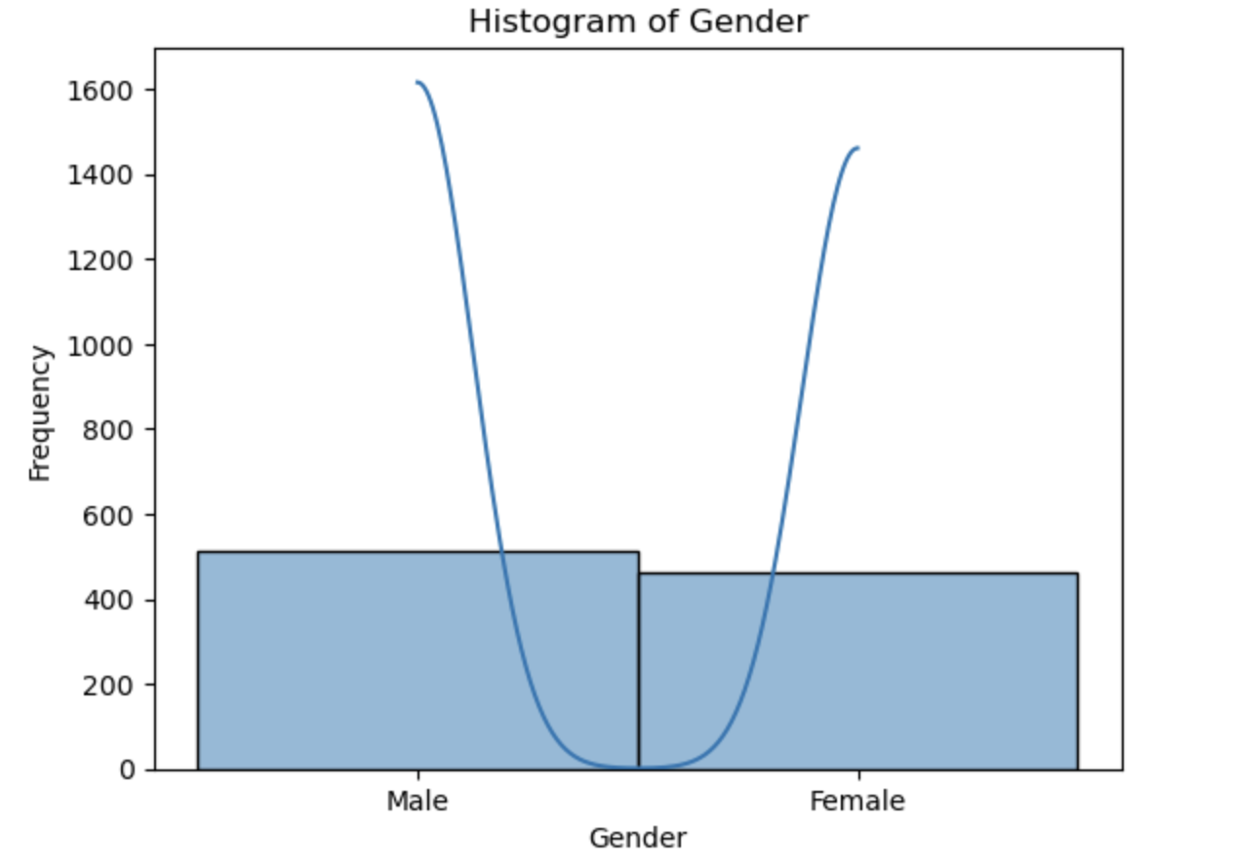
Summary statistics
Age: Gym members are between 18 and 55 years old.
Gender: More Male members are enrolled in the gym than Females.

Slide 7
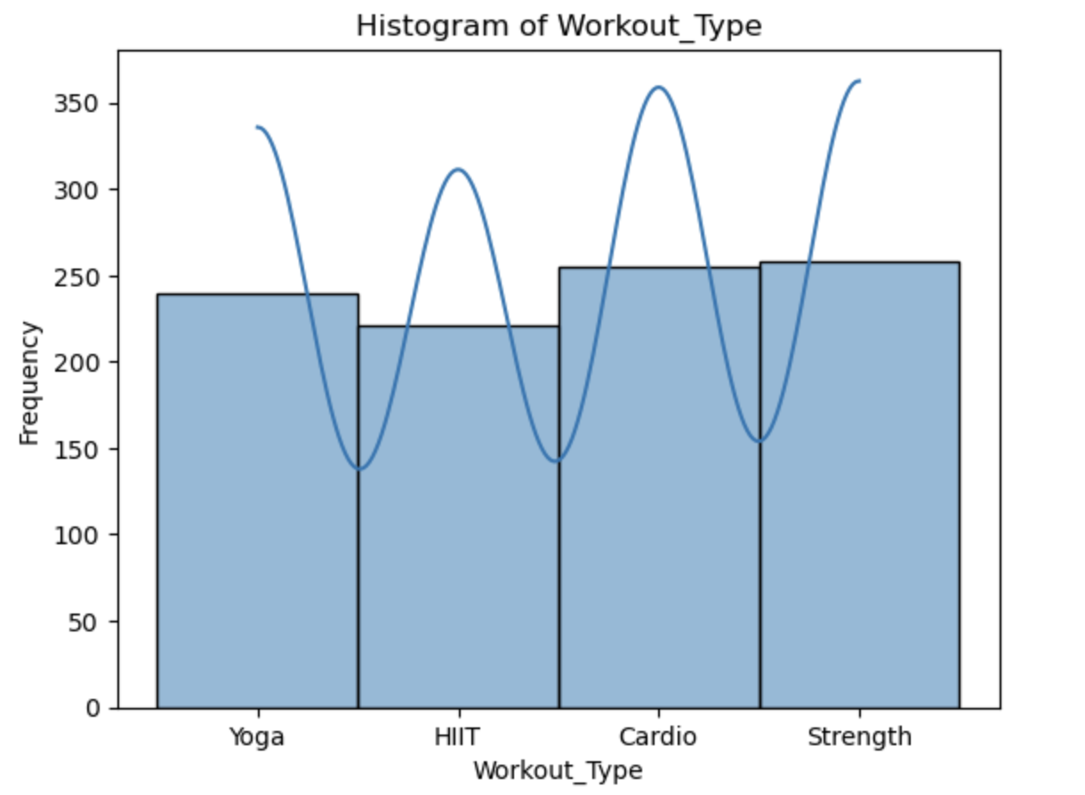
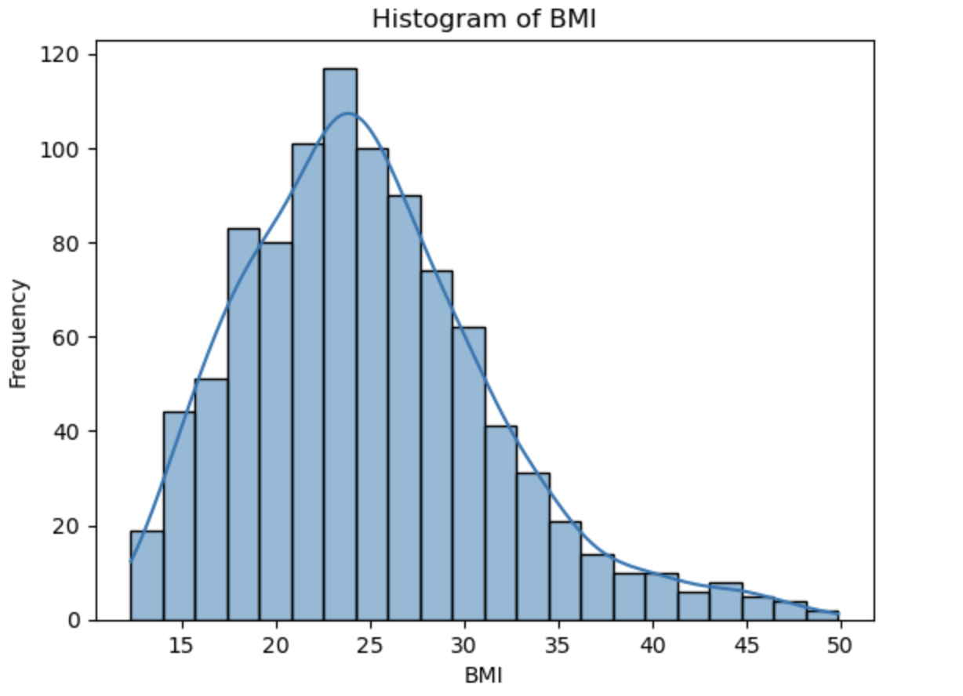
Summary statistics
Workout_Type: Gym members are between 18 and 55 years old.
BMI: It is right skewed, and most data is concentrated around 20-30 regions.

Slide 8
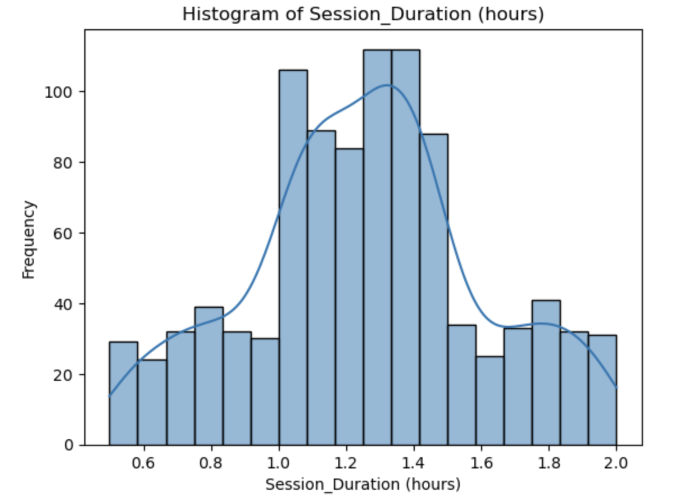
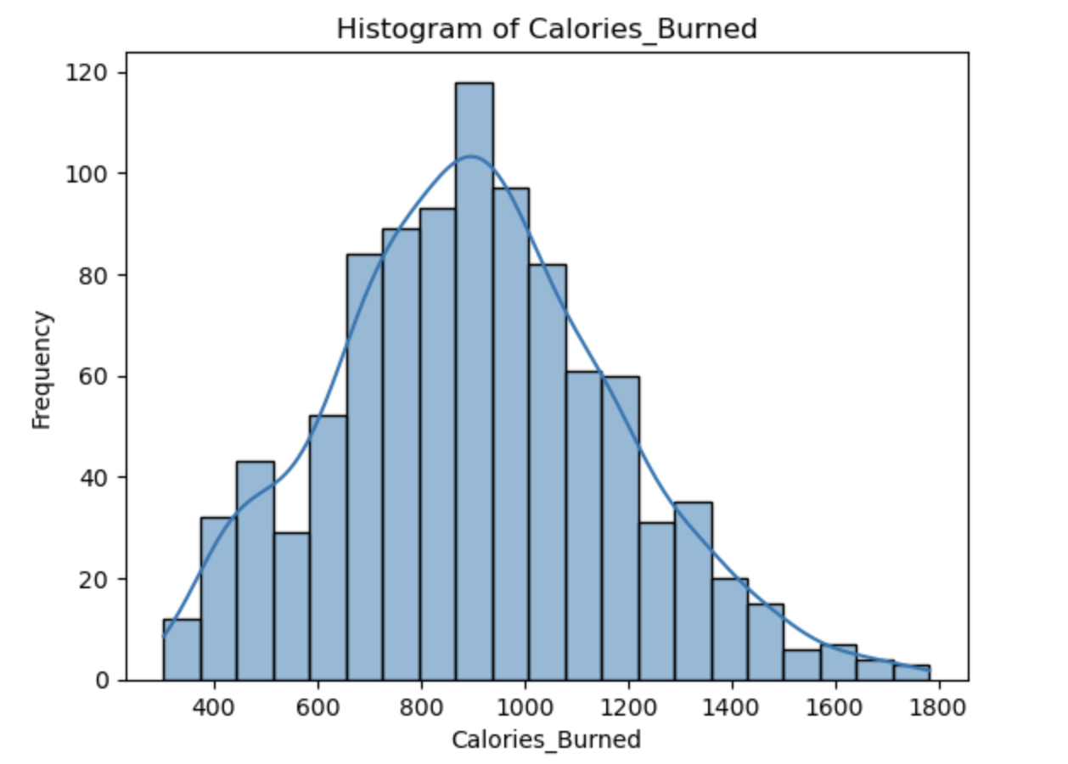
Summary statistics
Session_Duration: Most gym members work out between 1 hour and one and a half hours.
Calories_Burned: There are Gym members who burn median calories, and very few burn more calories.

Slide 9

Data PREPROCESSING
Encoded data for columns for Gender and Workout_Type as those have string values.
Outliers are found in Calories_Burned and BMI.

Slide 10
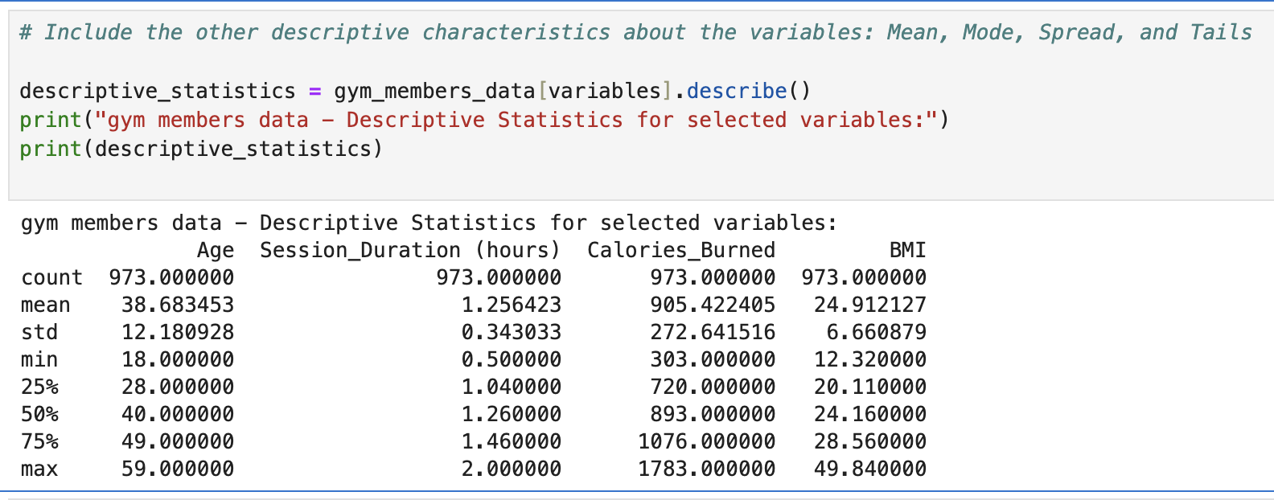
Descriptive analysis
Age: The average of individuals in the dataset are 38.68
BMI: Average BMI is 24.91%
Calories_Burned: Average calories burned 905.42.
Session_Duration (hours): Average Workout duration is around 1.25 hours

Slide 11
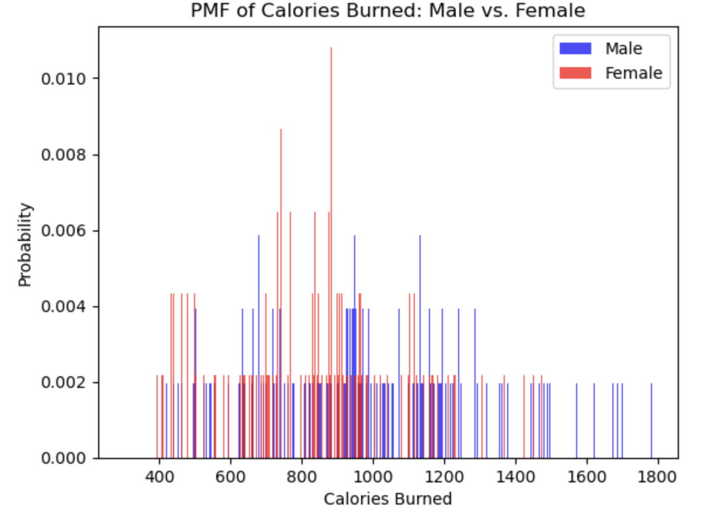
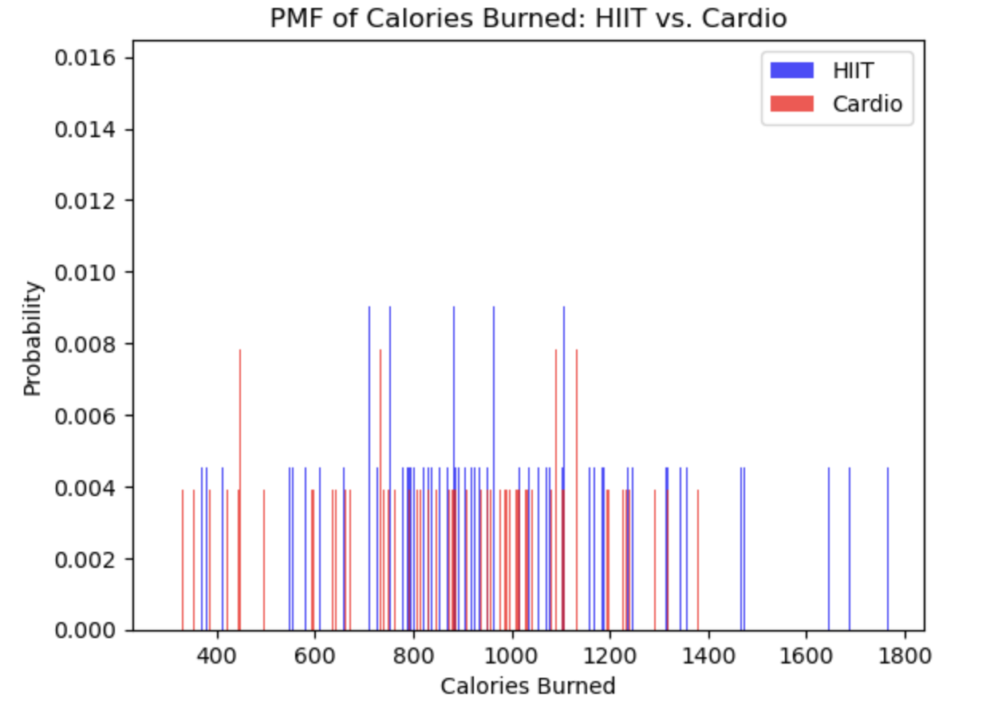
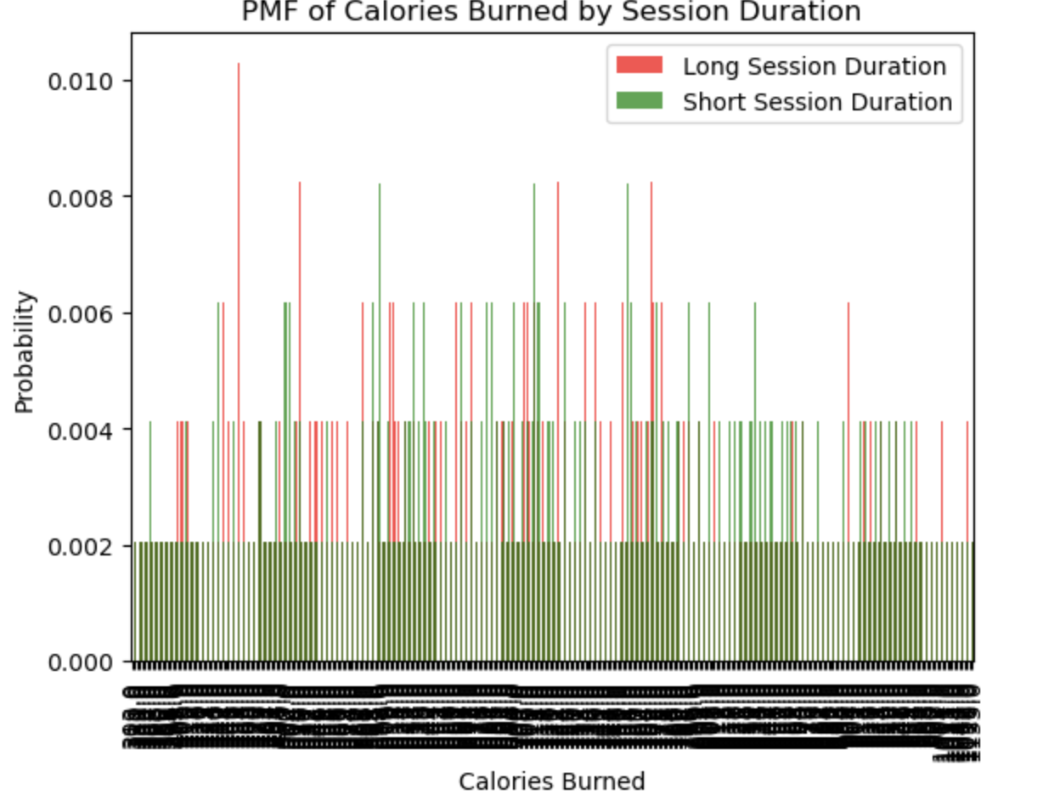
PMF analysis
Analysis Summary: Calories Burned by Gender, Workout Type, and Session Duration
Calories Burned by Gender: Female gym members tend to burn more calories on average than male gym members.
Calories Burned by Workout Type: HIIT (High-Intensity Interval Training) workouts result in significantly higher calorie burn than Cardio workouts.
Calories Burned by Session Duration: Shorter workout sessions are associated with fewer calories burned, while longer sessions lead to higher calorie expenditure.

Slide 12
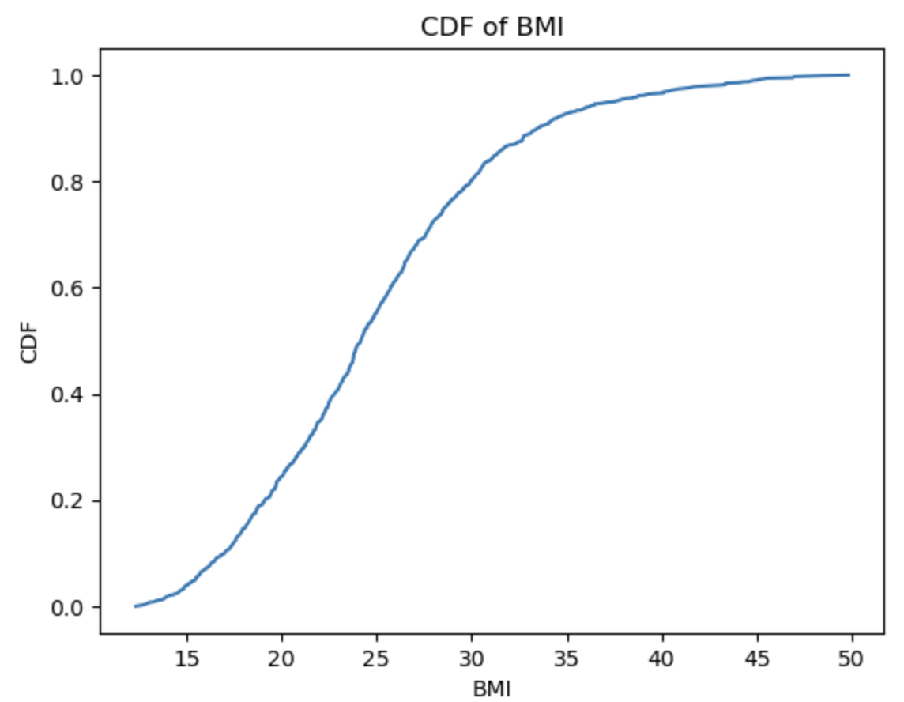
Cumulative Distribution Function (CDF)
The CDF helps us understand the distribution of BMI values across a population and answer questions like:
What percentage of individuals have BMI below 25?
About 60% of people.
What BMI value corresponds to the 50th percentile (median)?
22.5 is the BMI.

Slide 13
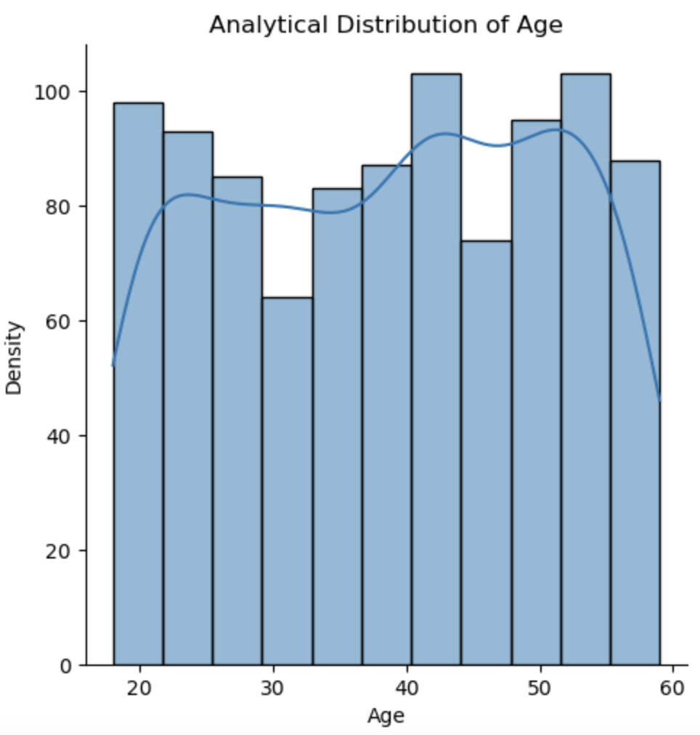
Analytical Distribution of age
The analytical distribution of age shows that all groups are interested in going to the gym.
Major age groups that are going to gym are 20 years, 40years and 55 years.

Slide 14
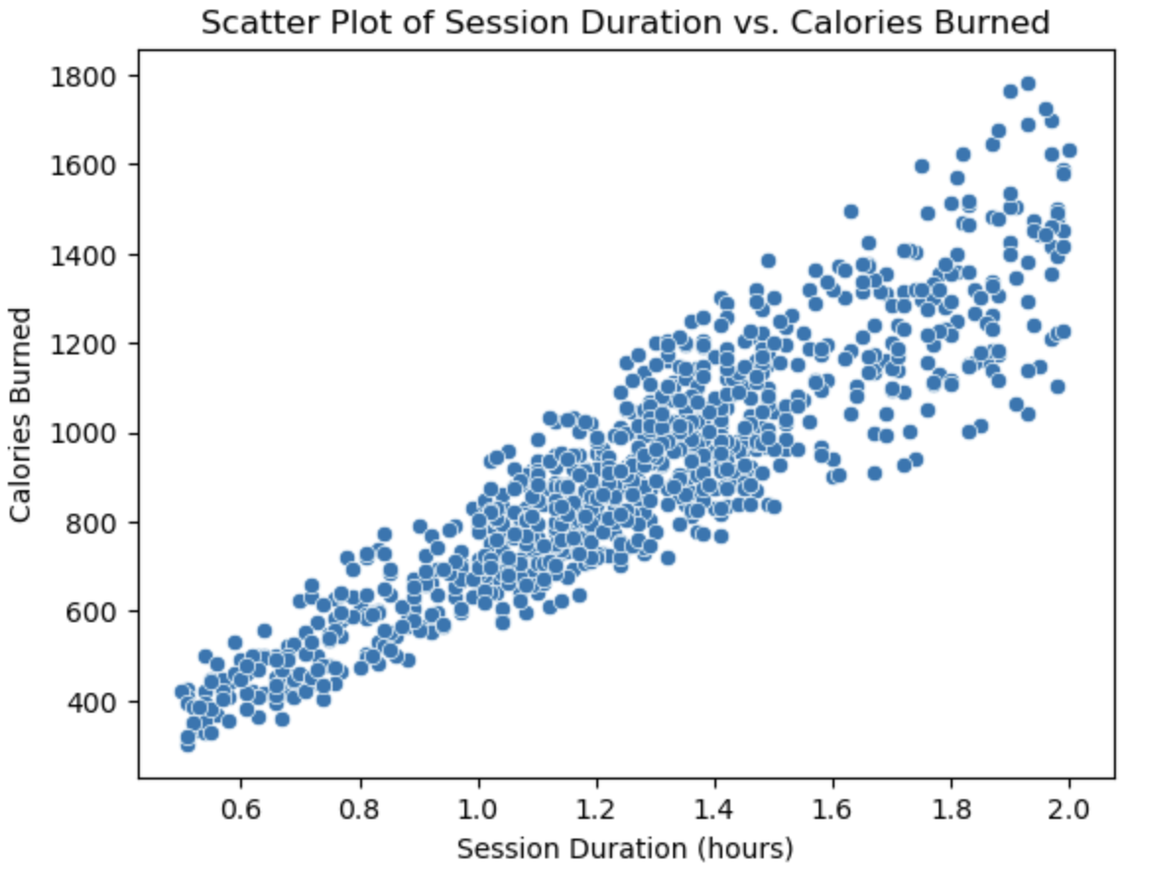
SCATTERPLOT, Covariance and Pearson’s Correlation
The covariance is 85, which indicates a positive correlation between session duration and calories burned. This means as session duration increases, calories burned tend to increase.
Pearson's correlation is positive (0.91), which indicates a strong tendency for calories burned to increase as session duration increases.

Slide 15
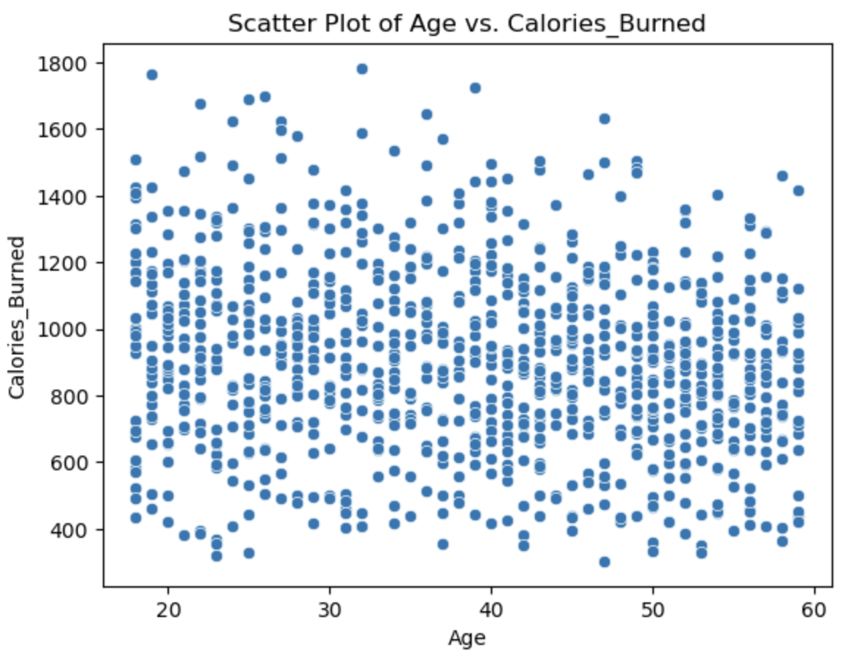
SCATTERPLOT, Covariance and Pearson’s Correlation
The covariance is -513, which indicates a negative correlation between age and calories burned. This means as age increases, calories burned tend to decrease.
Pearson's correlation is negative (-0.15), which indicates while there is a tendency for calories burned to decrease as age increases, the relation is not strong.

Slide 16
Hypothesis results
p-value: 0.000002358
Reject the null hypothesis: Male and female gym members have a significant difference in average calories burned.
t-statistic: 4.7485
This indicates that the difference in average calories burned between males and females is 4.7485, which is a standard error away from zero.
The larger the absolute value of the t-value, the stronger the evidence against the null hypothesis.

Slide 17
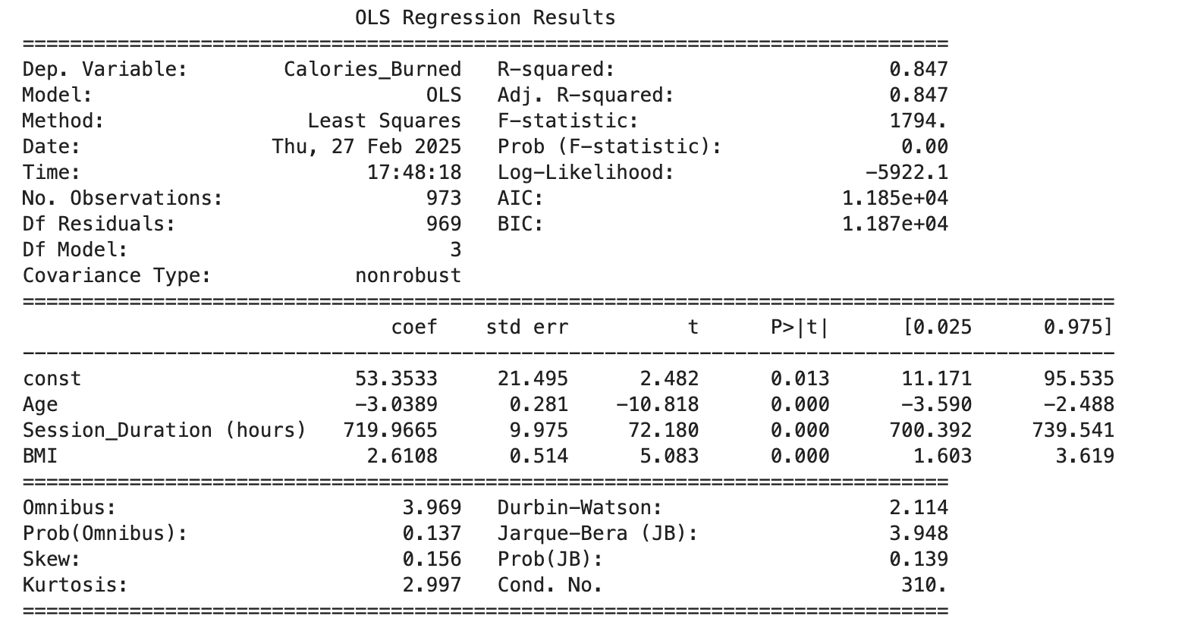
Regression analysis
Analysis of Predictors for Calories Burned
Session Duration:
Positive Coefficient: A positive coefficient for session duration indicates that longer workout sessions increase calorie burn.
Strongest Predictor: Based on the size of the coefficient, session duration is the strongest predictor of calories burned. Therefore, an increase in workout duration will significantly affect calorie expenditure.
Age:
Negative Coefficient: The negative coefficient for age indicates an inverse association; as age increases, calories burned decrease.
Interpretation: This may be due to such things as a natural slowdown in metabolism, lower levels of physical activity, or changes in body composition with age.

