Slide 1
The Impact of Screen Time on Mental Wellness
A Data-Driven Analysis
Rohit Patil
Bellevue University, Nebraska
DSC680: Applied Data Science

Slide 2
Contents
01
02
The Problem
Our Approach
03
04
Finding 1: Screen Time is the Norm
Finding 2: Occupation & Sleep
05
06
Finding 3: Leisure Time's Impact
Finding 4: The Power of Correlation
07
08
Finding the Best Predictive Model
Model Comparison
09
10
Key Conclusion
Recommendations
11
Limitations & Future Work

Slide 3

The Digital Dilemma
Our "always-on" culture is creating a mental health crisis.
Key Questions
How does screen time affect employee well-being and productivity?
What does the data really say?

Slide 4


A Rigorous, Data-Driven Investigation
The Data
Kaggle Dataset: "Screen Time vs Mental Wellness Survey”
400+ Respondents
The Methods
Pre-process: Cleaned data and converted
categorical features for modeling.
Correlate: Used statistical analysis to measure relationships.
Predict & Compare: Trained and evaluated 10 regression models to find the best fit.

Slide 5

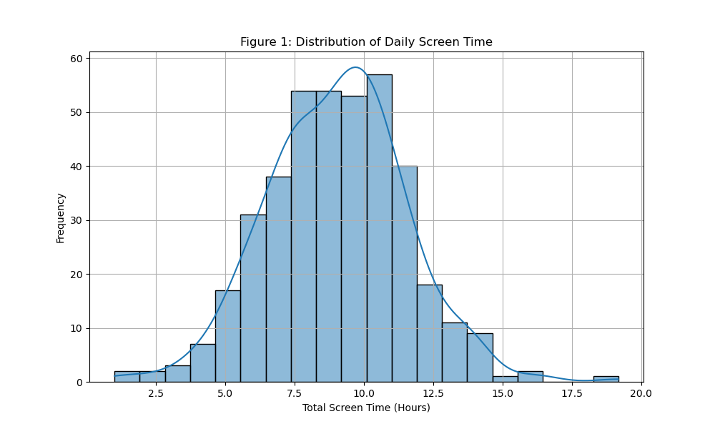
High Screen Time is the New Normal
Most people spend 4-10 hours on screens daily, with a peak at 8 hours. This is a pervasive environmental
factor.

Slide 6

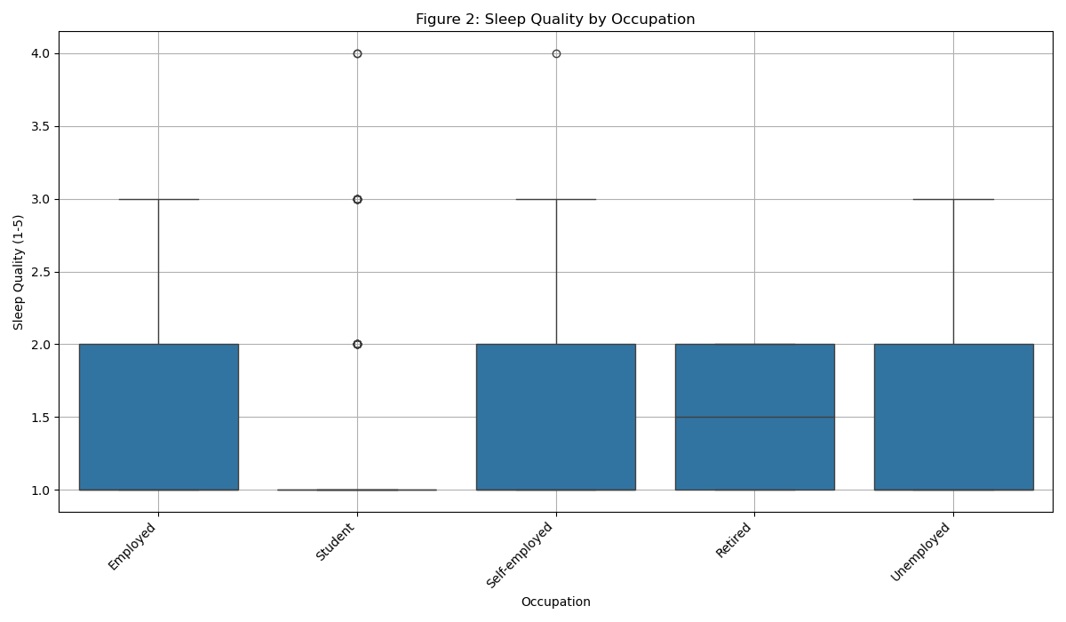
Sleep Quality Varies by Profession
Students and Software Engineers report slightly lower median sleep quality, suggesting work
context matters.

Slide 7

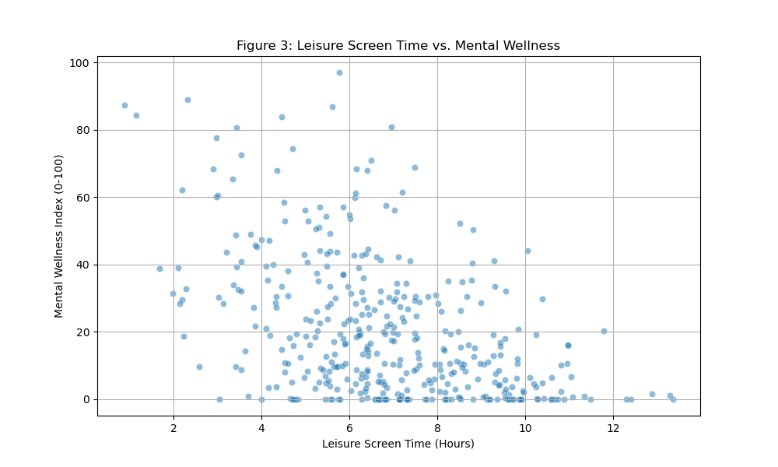
Leisure Screen Time vs. Wellness
A clear negative trend: as leisure screen time increases, mental wellness scores tend to decrease.

Slide 8
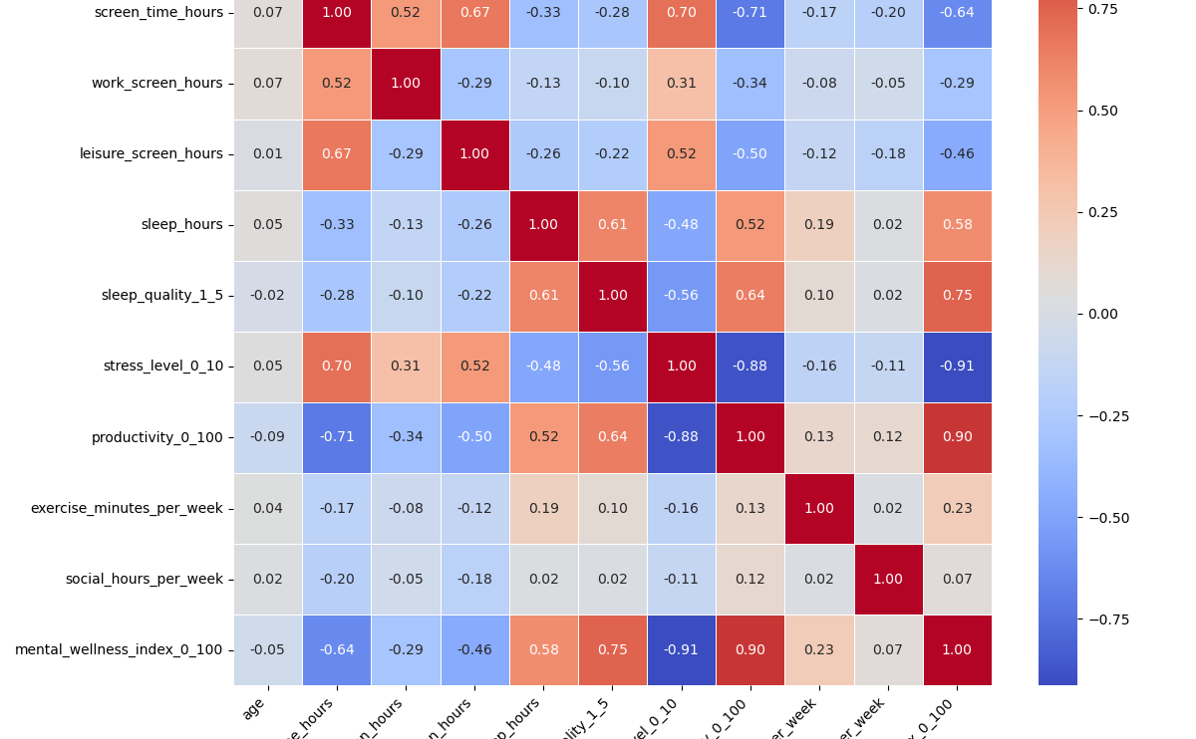
Uncovering Key Relationships
Strongest Positive: Sleep Quality (+0.78)
Strongest Negatives: Stress Level (-0.92), Screen Time (-0.69)

Slide 9



Love yourself
What Best Predicts Wellness?
Our best model (Ridge Regression) explains a remarkable 93.4% (R² = 0.9336) of the variance in mental wellness.
This high accuracy confirms that factors like sleep, stress, and screen time are the most critical predictors.

Slide 10
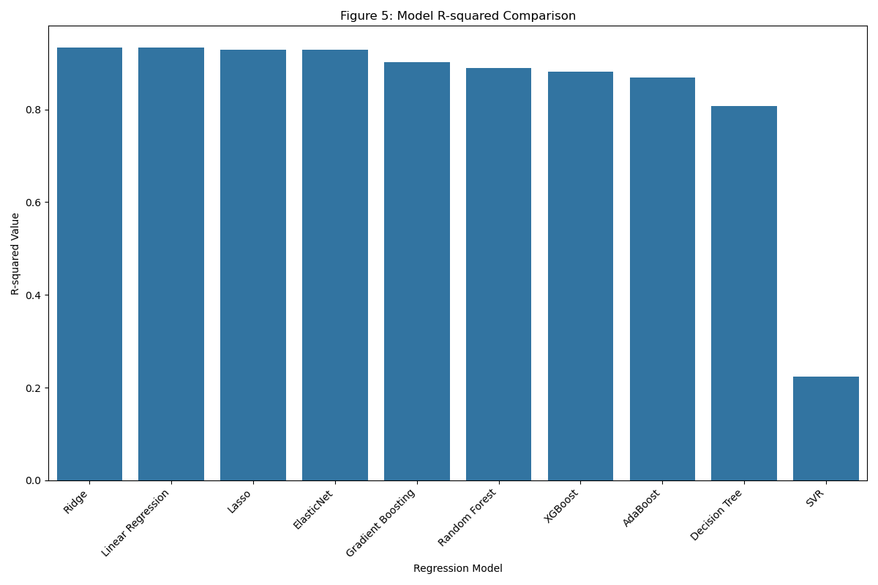
Choosing the Right Tool for the Job
While many models were effective, Ridge Regression provided a clear performance lift, validating the robustness of our findings.

Slide 11

What It All Means
There is a significant, negative relationship between screen time and mental wellness.
Good sleep is the single most powerful factor associated with positive mental wellness in this dataset.

Slide 12



What Can We Do?
Promote Digital Hygiene
Encourage Mindful Tech Use
Prioritize Sleep

Slide 13


The Road Ahead
Limitations
Correlation is not causation.
Data is self-reported.
Future Work
Longitudinal studies to track changes over time.
Analysis with objective, tracked data.
Testing specific intervention programs.

Slide 14
Thank You!

