Slide 1
Used Car Price Prediction and Market Analysis for the Indian Market
Rohit Patil
Bellevue University, Nebraska
DSC680: Applied Data Science

Slide 2
TABLE OF CONTENTS
01
02
03
04
05
06
The Business Problem
Our Data
Data Preparation
Our Approach: Machine Learning
Model Performance
What Drives the Price
07
08
09
Recommendations
Implementation Plan
Conclusion & Future work

Slide 3
The Business Problem
The Challenge of Accurate Pricing
Overpricing leads to stagnant inventory.
Underpricing results in lost revenue.
Accurate pricing builds trust with both buyers and sellers.
Our goal is to develop a data-driven model to predict the optimal market price for used cars

Slide 4
Understanding the Market Through Data
Dataset
cars24data.csv from Kaggle, containing 1,445 used car listings from Cars24
Key Features
Model Name, Price, Manufacturing Year
Engine Capacity, Transmission, Fuel Type
Kilometers Driven, Ownership History
Condition: Imperfections & Repainted Parts

Slide 5
Preparing the Data for Modeling
Feature Engineering
Created a Car_Age feature from the Manufacturing_Year.
Encoding
Converted categorical features like Fuel Type and Transmission
into a numerical format using one-hot encoding.
Feature Selection
Removed the Model Name for this initial analysis due to its complexity.
Splitting
Divided the data into 80% for training our models and 20% for testing.

Slide 6
Building the Prediction Models
Baseline Model
Started with a simple Linear Regression model to establish a performance benchmark.
Advanced Model
Implemented a Random Forest Regressor, an ensemble model that combines multiple decision trees for higher accuracy.
Evaluation Metrics
R-squared (R²): To measure how much of the price variation our model can explain.
Mean Absolute Error (MAE): To see the average error in our price predictions.

Slide 7
Results: A Highly Accurate Model
Random Forest Outperforms Linear Regression
R-squared (R²): 0.83
Our model explains 83% of the variance in used car prices.
Mean Absolute Error (MAE): ₹54,435
On average, our model's prediction is off by about 54,000 rupees.

Slide 8
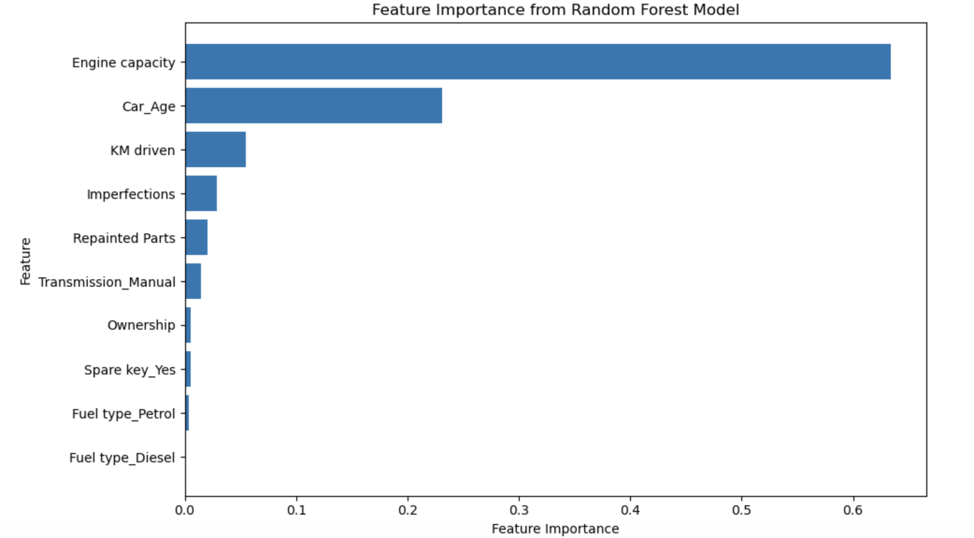
Key Drivers of Used Car Value
Engine Capacity (63%)
Car Age (23%)
Kilometers Driven (5.5%)
Imperfections & Repainted Parts

Slide 9
Actionable Recommendations
Implement Data-Driven Pricing:
Use the model to support pricing specialists and standardize the process.
Highlight Key Features:
Emphasize engine size, age, and low mileage in marketing and on listing pages.
Strategic Inventory Sourcing:
Use the model to identify undervalued cars for purchase and avoid overpriced ones.
Invest in Feature Engineering:
Dedicate resources to incorporate the Model Name for even better accuracy.

Slide 10
A Phased Rollout
Phase 1 (1-2 Months):
Offline Validation & Refinement
Phase 2 (2-3 Months):
Internal Tool & Dashboard Development
Phase 3 (3-6 Months):
A/B Testing with a control group
Phase 4 (Ongoing):
Full Integration & Continuous Monitoring
N
E
W
CAR

Slide 11
Conclusion and What's Next
We've successfully built a model that can accurately predict used car prices, identifying engine size and age as the primary value drivers.
Future Work:
Develop a dynamic pricing API for real-time estimates.
Create a customer-facing price estimator tool.
Expand the model to forecast future residual values.
Analyze market trends over time.

