Slide 1
Presented By- Rohit Pawar
BLUETOOTH HOTSPOT

Slide 2
Introduction
Bluetooth Hotspot:
A technology which allows Bluetooth enabled mobiles (clients) to access the internet
No need of GPRS connection in mobiles.

Slide 3
What is different with it?
Safer than Wifi
Provides Multiple devices to access internet simultaneously
Free of Cost

Slide 4
Bluecove API for Bluetooth
Stack initialization
Device Management
Device Discovery
Service Discovery
Service Registration

Slide 5
Implementation:Structure
Bluetooth Hotspot
Software
Server
Client

Slide 6
Implementation : Structure
Server (Bluetooth Hotspot server)
Designed in Java
Acts as gateway between client Bluetooth devices and the Internet Server
Controlled by Hotspot manager

Slide 7
Implementation : Structure
Client Program
Designed in J2ME
Executed on Bluetooth devices (client )
Inputs the URL of required web page
Displays the web page on the client device

Slide 8
Modules
The Project is divided into 6 main modules -
Detection and Pairing of devices
Sending client program to appropriate device
Server program to manage clients and their request
Client program to control the connecting of device to the server, send URL and display web pages

Slide 9
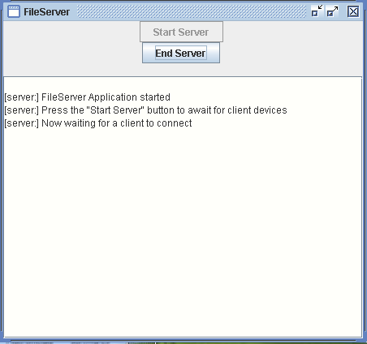
Implementation : Procedure
Hotspot Internet Server is continuously waiting for client’s web page request.

Slide 10
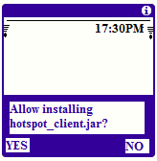
Implementation : Procedure
Client allows the installation of client program sent by the Hotspot Server.

Slide 11
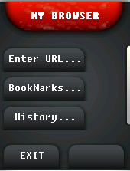
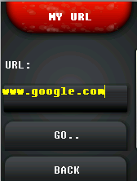
Implementation : Procedure
A window to accept URL is opened after installation. Client types the URL of required webpage.

Slide 12
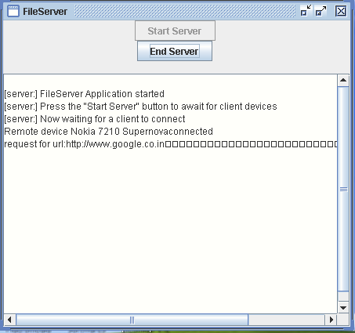
Implementation : Procedure
The server notes the URL and the device that requested it.

Slide 13
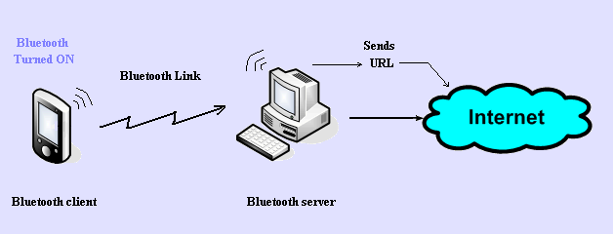
Implementation : Procedure
The URL is then sent to Internet server.

Slide 14
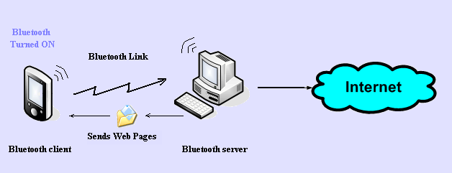
Implementation : Procedure
The web page is fetched and returned to Bluetooth Server. The web page is then sent to the Bluetooth Device.

Slide 15
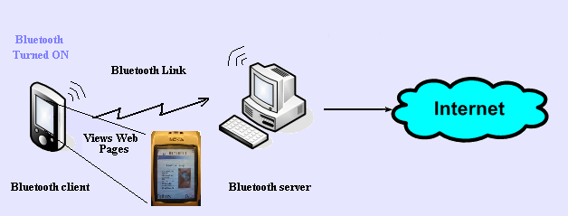
Implementation : Procedure
The client program opens the web page for client to read.

Slide 16

Implementation : Procedure
The client can now request for another web page or close the client program application.

Slide 17
Implementation : Procedure
One request is processed at a time. The process starts when the URL is request is sent to Hotspot server and completes when the web page is sent to the requesting client device.

Slide 18
Future Scope of Project
Extend Bluetooth Hotspot area by deploying
multiple access points in the form of server.
The hotspot servers at a greater distance (in
Kms) can be connected through internet and the
clients of both the hotspots can communicate
with each other free of cost.
Enable client to support JavaScript and emailing
to give full advantage of Internet surfing.

Slide 19
For concluding
It will make surfing Internet free of cost in Bluetooth Hotspot
It will bridge the gap between tech-
savvy people and layman by giving them opportunity to access internet on their own mobile phones

Slide 20
References:
BOOKS:
1. C.S.R. Prabhu, A. Prathap Reddi “BLUETOOTH TECHNOLOGY and its Application with Java and J2ME”
2. Bruce Hopkins, Ranjith Antony “BLUETOOTH FOR JAVA”
3. Jazilah Jamaluddin, Ratish Nair, Reuben Edwards, and Paul Coulton “Widening Access to Broadband Hotspots Employing Bluetooth”, IEEE 2004.
WEBSITES:
http://www.bluetooth.com
.http://forum/nokia.com
http://www.ieee.com
.http://www.jsr82.com
http://www.bluecove.com

Slide 21
Thank You!

