Slide 1
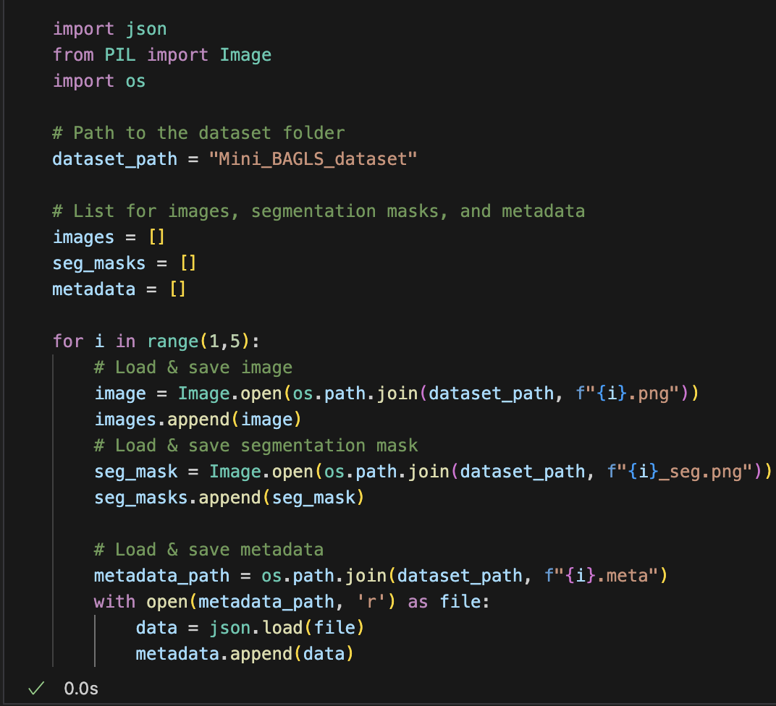
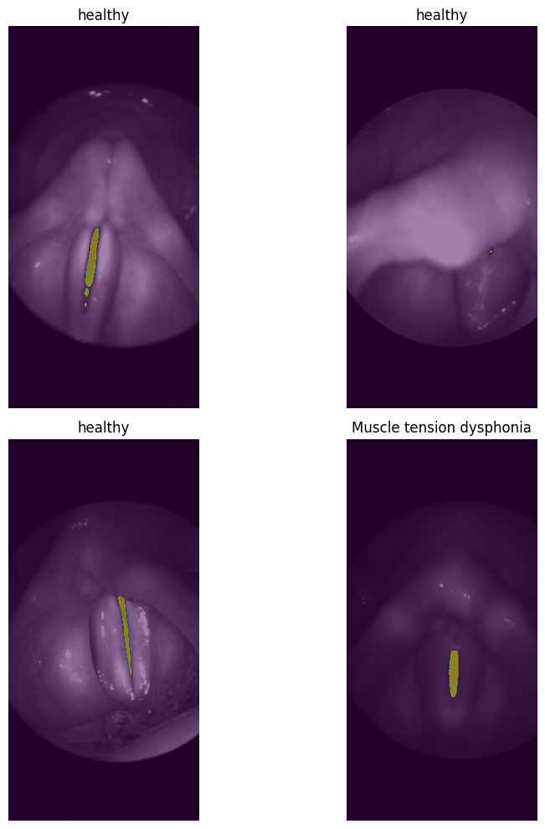
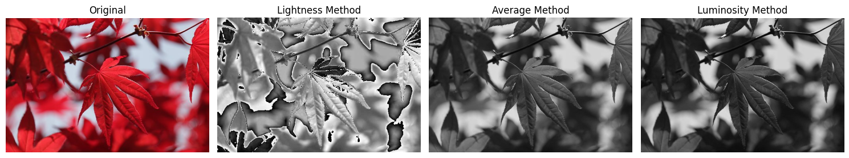
Task 1
Task 2
Task 4
Average Method of RGB scaling is the preferred one, as it gives a balanced grayscale image by averaging all the three color channels.
Task 3

