Slide 1
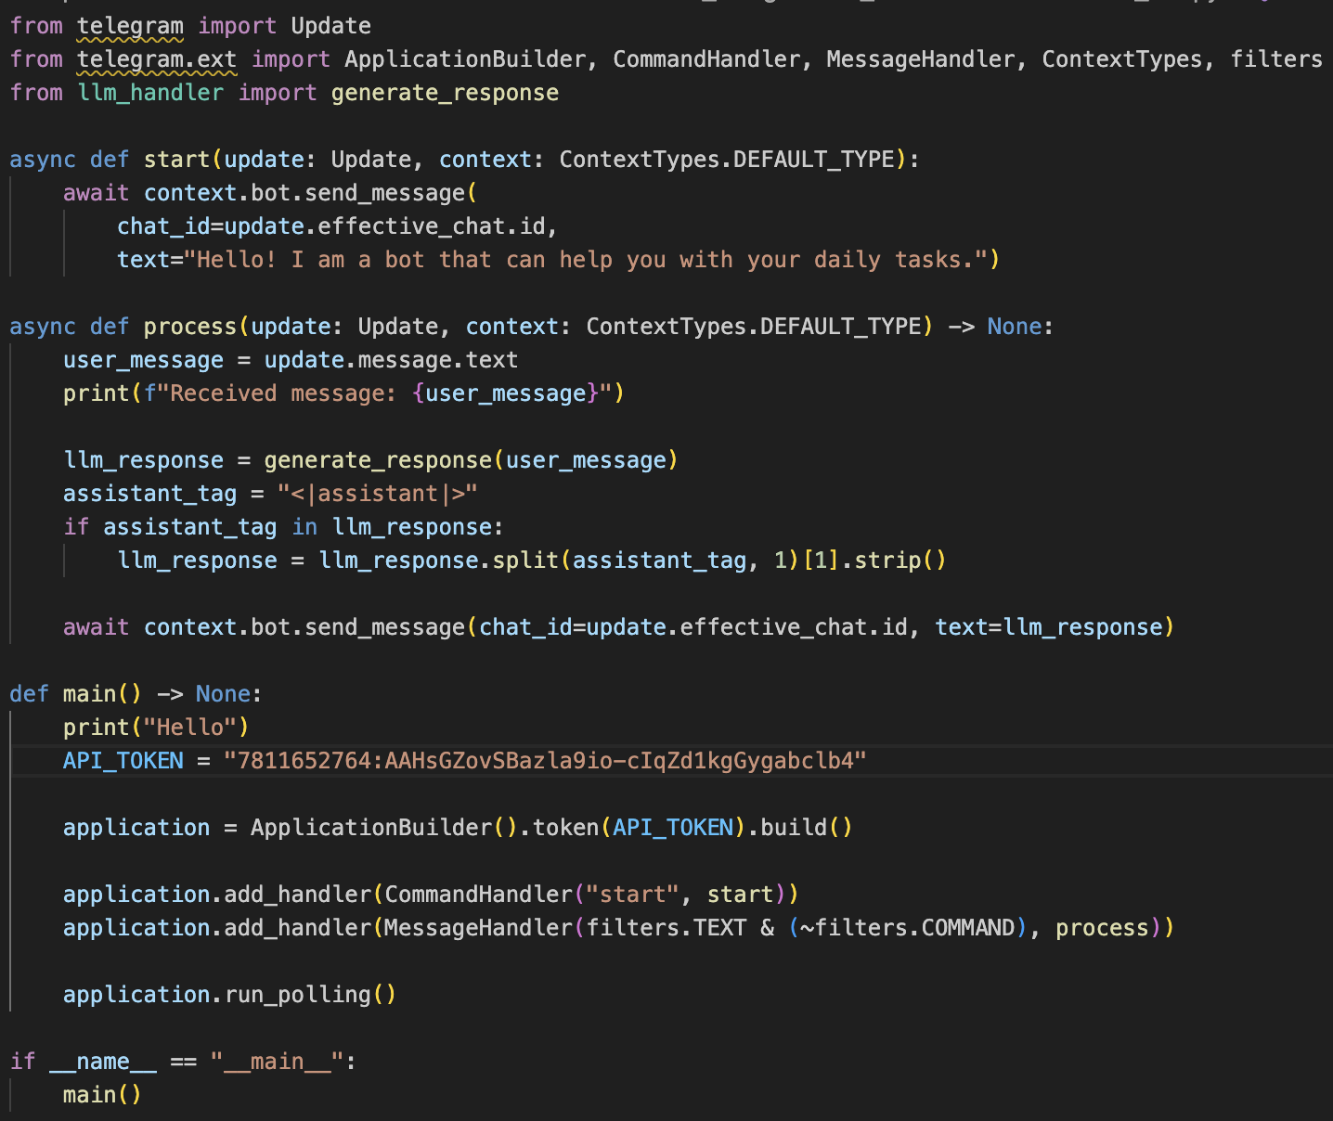
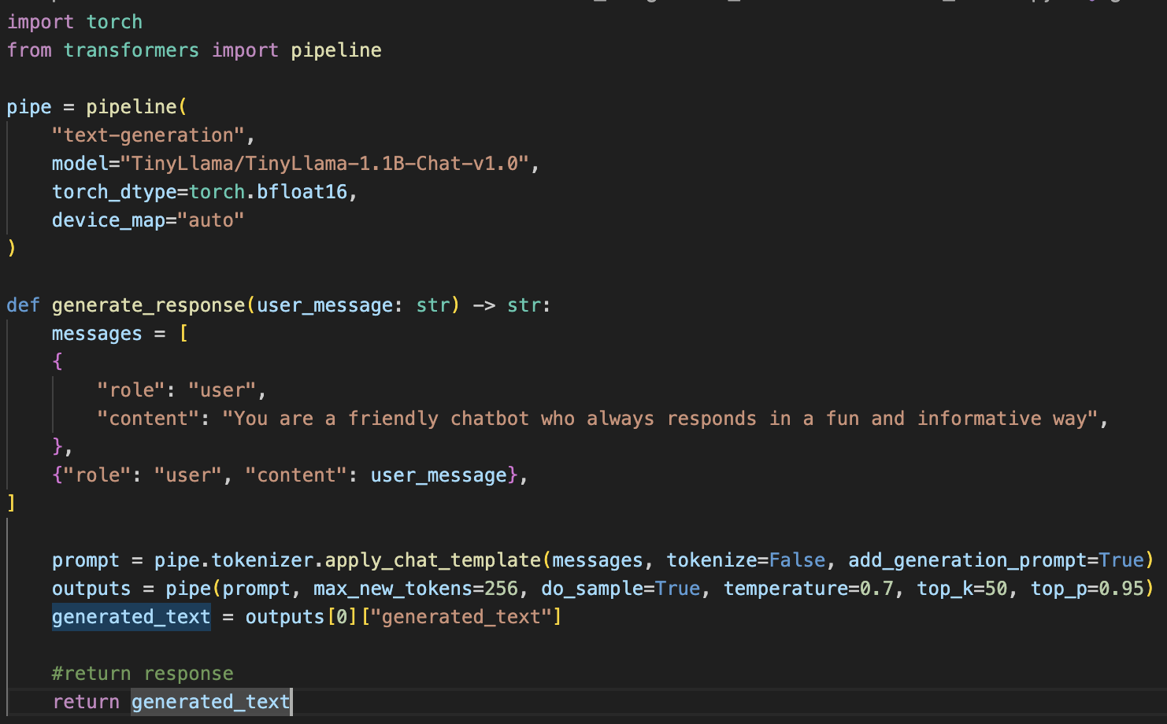
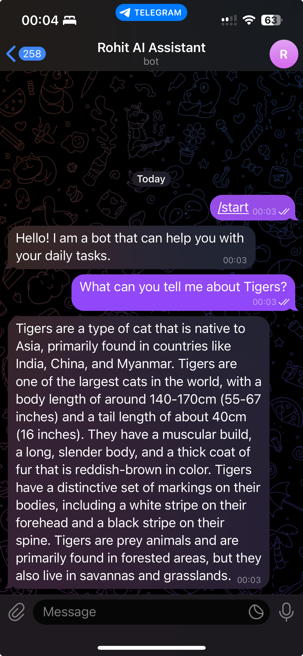
Task 1 :
Task 2 :
Telegram bot link : t.me/ropo_ai_bot
Github link : https://github.com/rohitpotdukhe01/DSSS_Assignments/tree/main/HW9
Rohit Potdukhe, M. N.: 22985091, IdM: yx49uxym

