Slide 1
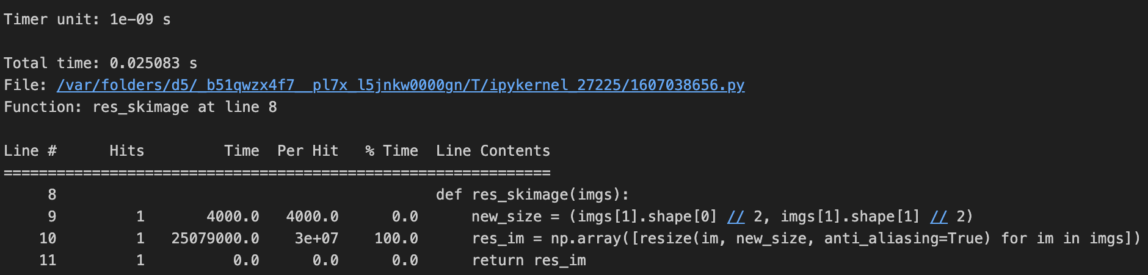
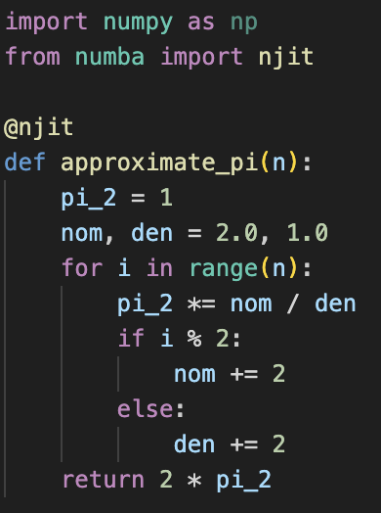
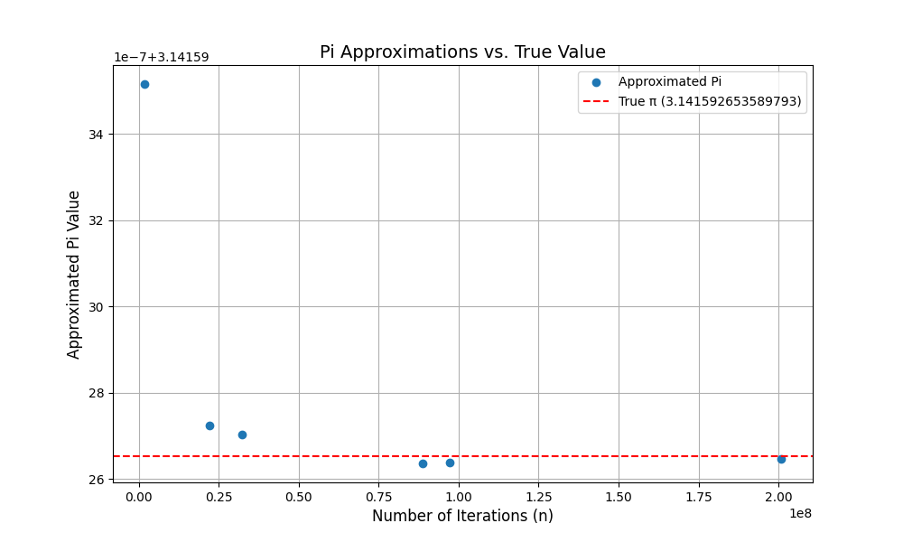
Task 1 :
Task 2 :
I used multiprocessing, because it allows each function call to run on a separate CPU core. In multithreading, the difference is that threads run in the same memory space, while in multiprocessing the processes have separate memory. This makes it much faster.
Sequential call of the function ran in 21.59 seconds.
Multiprocessing call of the function ran in 10.51 seconds.
Performance improved by 51.32%.
Task 3 :
Task 4 :
By using Numba the function is 2294.90% faster.
Rohit Potdukhe, M. N.: 22985091, IdM: yx49uxym

