Slide 1
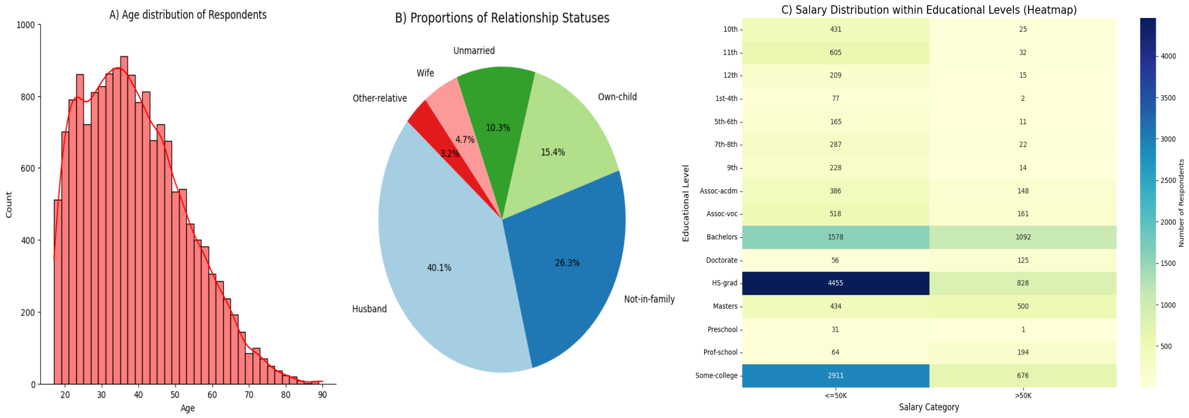
Figure 1: Visualization of the Census Income dataset. (A) Histogram provides a clear summary of the age distribution, it also highlights trends within the data. It suitable for continuous data like age, as it groups individuals into age intervals, which helps in quick identification of trends. (B) Pie chart is adequate as it provides a clear representation of the proportion of respondents across different relationship statuses. (C) Heatmap gives compact representation of the of the salary distribution across various educational levels.

