Slide 1
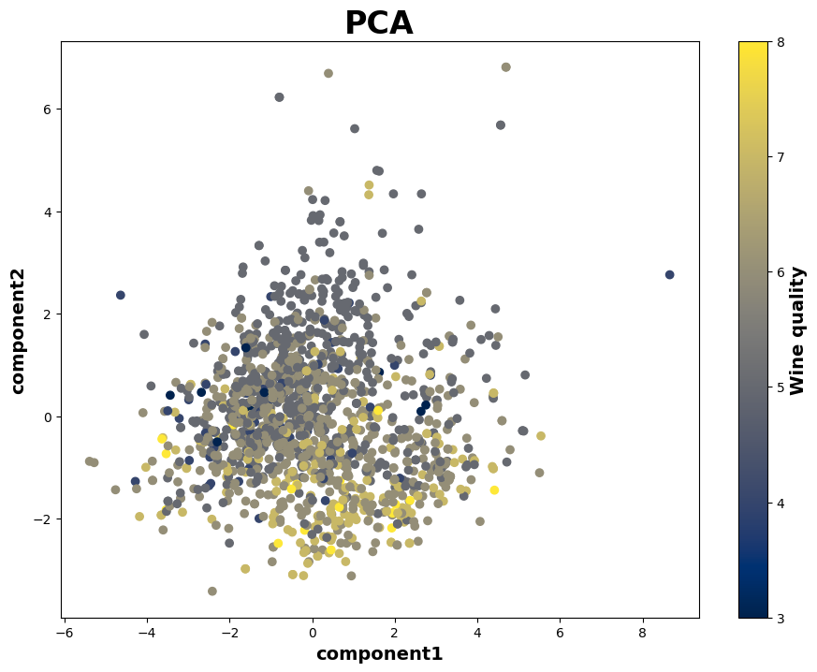
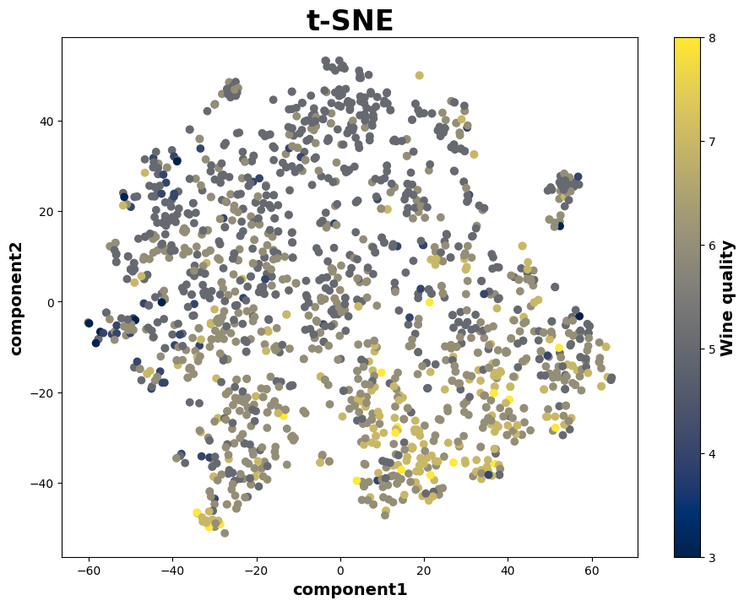
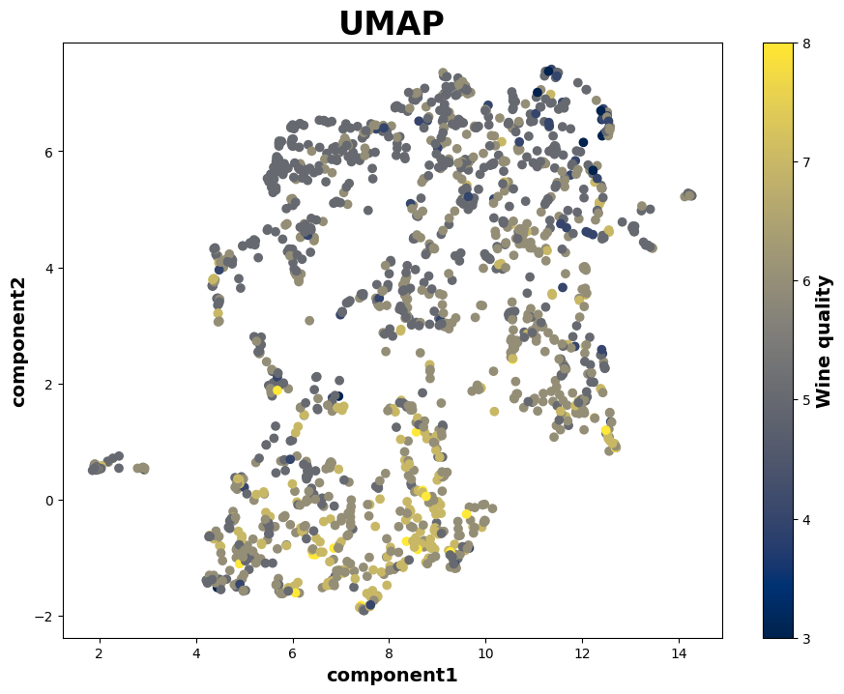
Homework-5
Task 1 :
Task 2 :
Hypothesis, H₀ : There is no significant relationship between wine’s density and wine’s quality.
Statistical test: I choose Pearson correlation test.
Reason: As Pearson correlation test helps in assessing the pairwise relationship between variables and calculates the linear dependence between the continuous variable that is wine’s density and an ordinal variable that is wine’s quality.
p-value = 1.87 x 10⁻¹²
Conclusion: Since p-value is less than significance level (0.05), we reject the null hypothesis. Hence, there is significant relationship
between Wine’s density and Wine quality.

