Slide 1
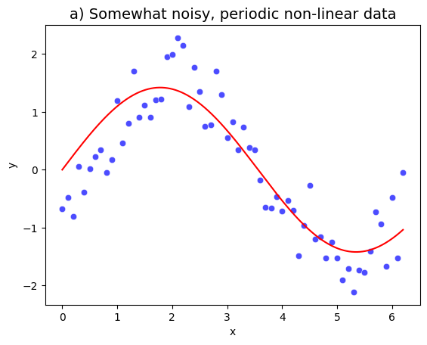
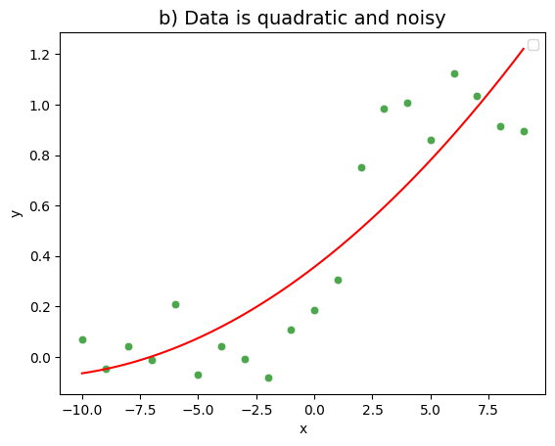
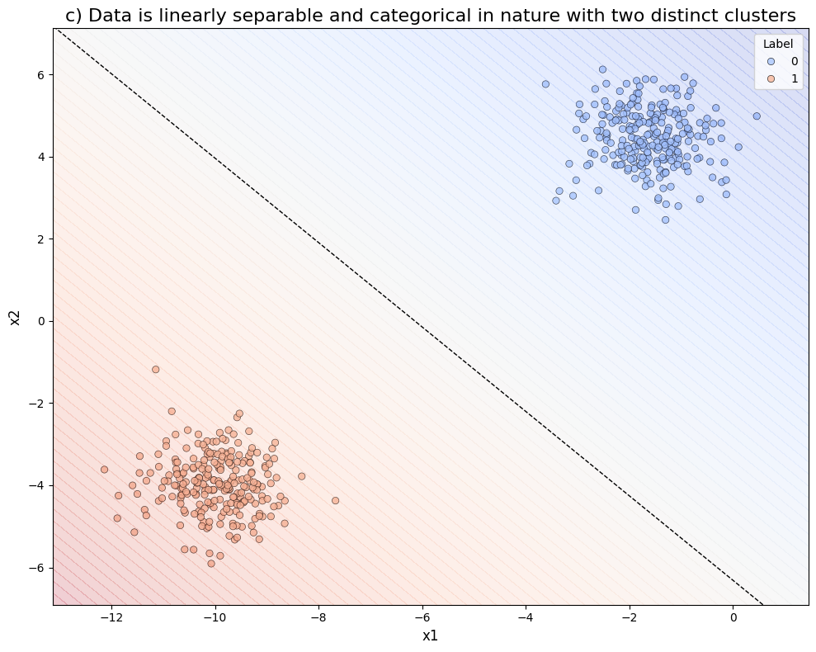
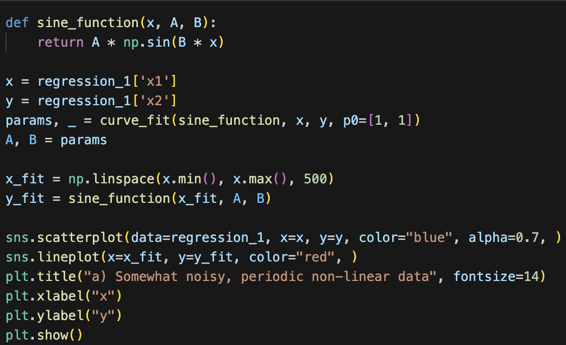
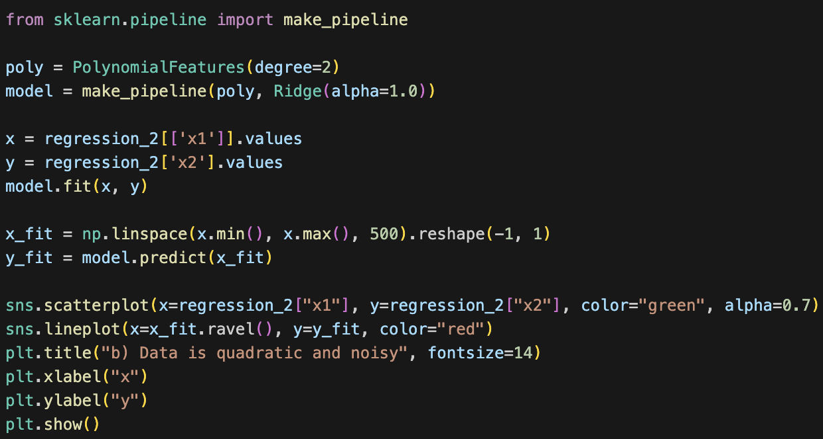
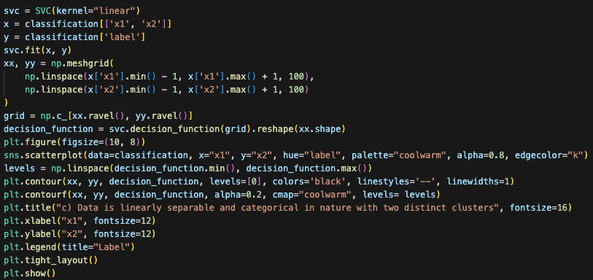
The scatter plot showed a periodic trend, so I used a sine function with curve fitting to model the data. The optimal parameters are Amplitude: 1.42, Angular Frequency: 0.88. The sine curve effectively captures the peaks and troughs of the data, minimizing residual error and aligning well with its periodic behavior.
The data exhibited an upward curvature, suggesting a quadratic relationship. I applied 2nd degree polynomial regression with Ridge regularization to handle noise. The key coefficients are Intercept: 0.357, Linear: 0.07, Quadratic: 0.0028. This model balances noise smoothing while capturing the non-linear trend accurately.
The data was linearly separable. So I used an SVM with a linear kernel to determine the decision boundary. The model maximizes the margin (7.99) between the two classes, with 3 support vectors contributing weights [−0.031,0.017,0.013]. The resulting boundary cleanly separates the two clusters without misclassifications.
Rohit Potdukhe, M. N.: 22985091, IdM: yx49uxym

