Slide 1
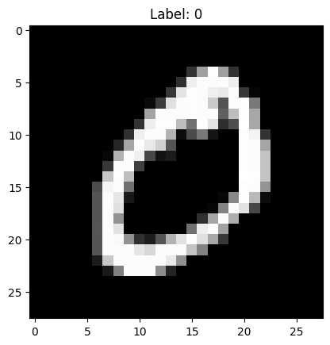
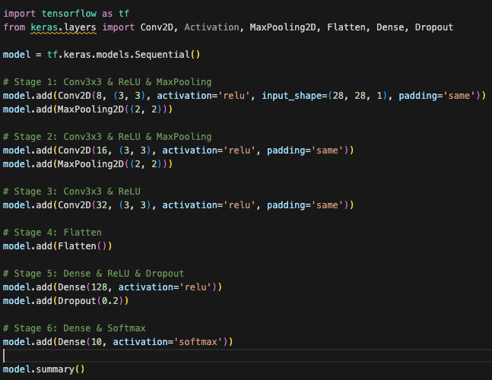
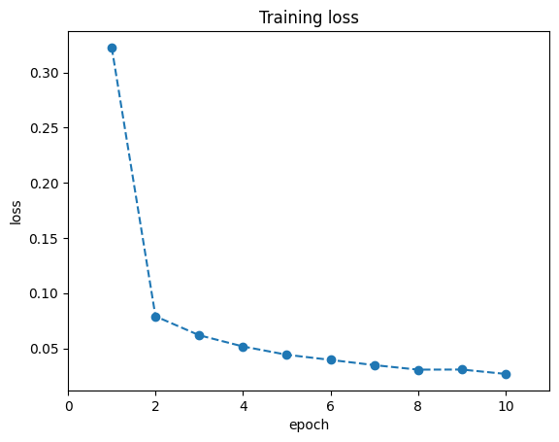
Task 1
Task 3
a) Adam Adam, short for Adaptive Moment Estimation, is an optimization algorithm used in training machine learning models. It computes adaptive learning rates for each parameter by estimating first and second moments of gradients, enhancing convergence efficiency. b) Sparse Categorical Cross-Entropy This loss function is applied in classification tasks where target labels are integers rather than one-hot encoded vectors. It measures the difference between the true class and the predicted probability distribution, aiding the model in learning to assign higher probabilities to correct classes. Epoch : An epoch is one complete pass through the entire training dataset during the training phase. To achieve good performance in a model, usually multiple epochs are needed.
List of Activations Functions:
Rectified Linear Unit(ReLU)
Leaky ReLU
Softmax
Hyperbolic Tangent(Tanh)
Sigmoid
Task 2
Task 4
Rohit Potdukhe, M. N.: 22985091, IdM: yx49uxym

