Slide 1
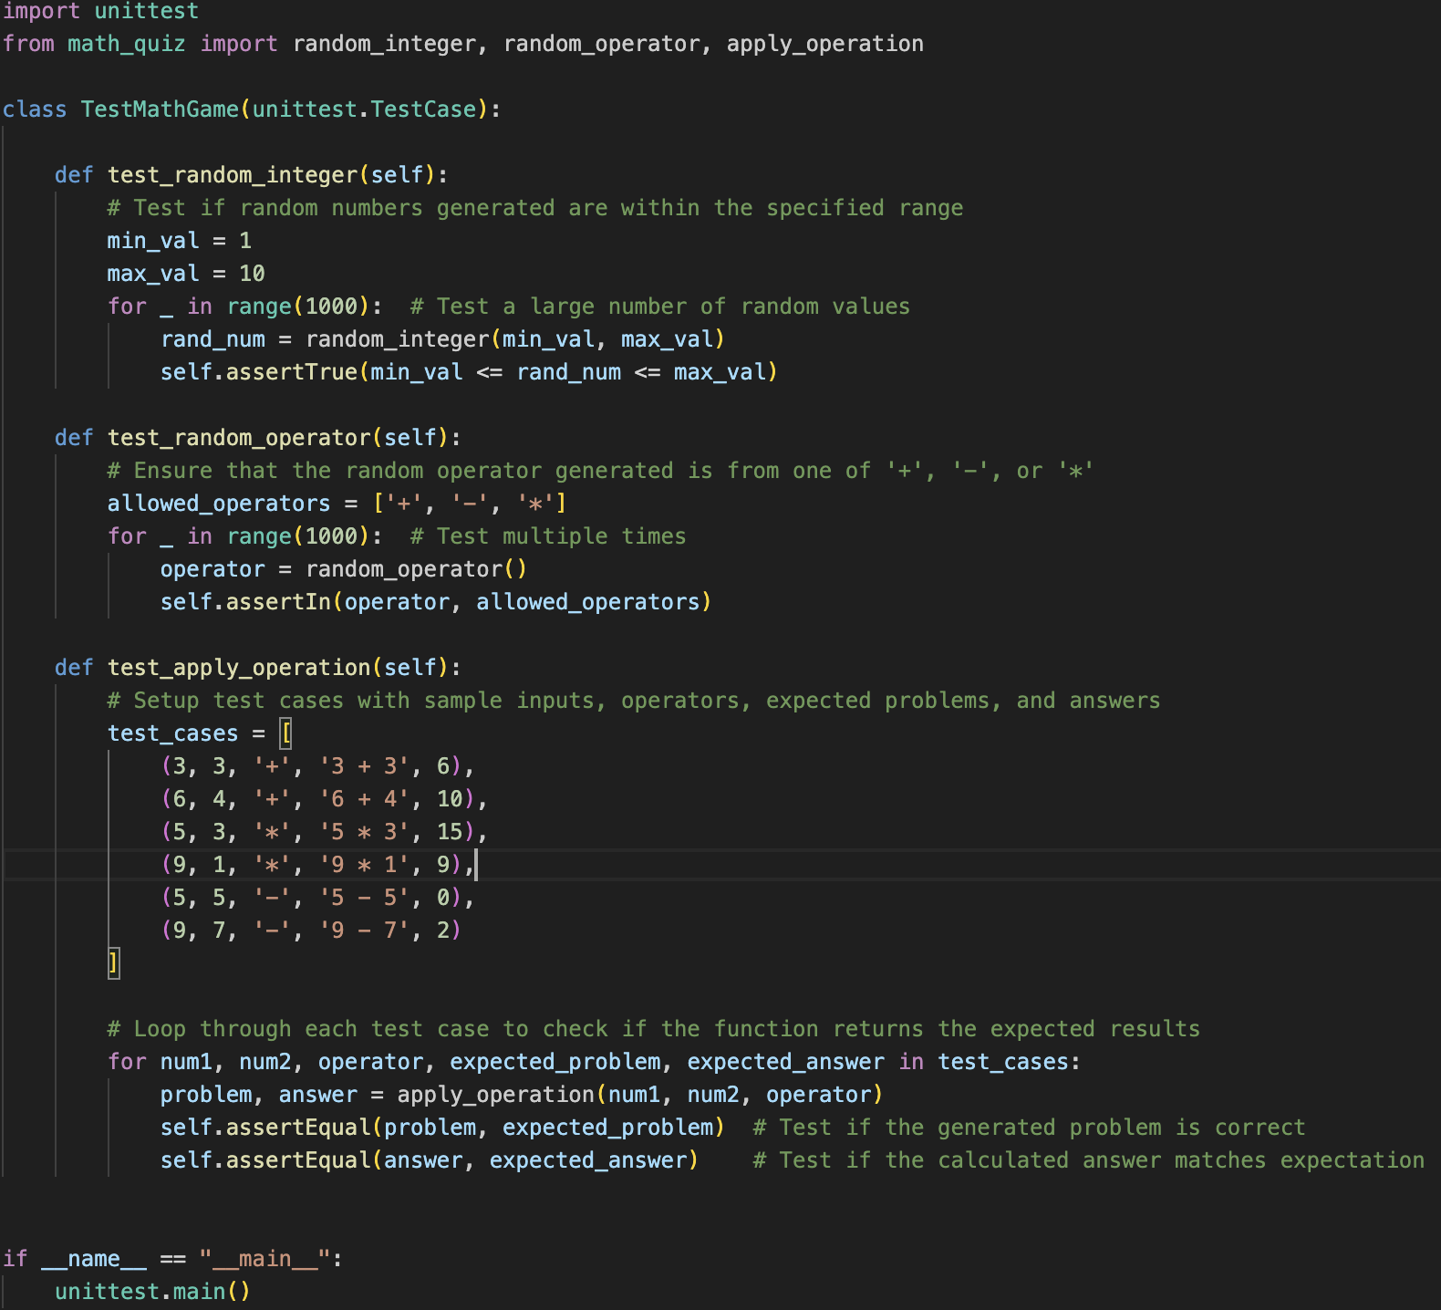

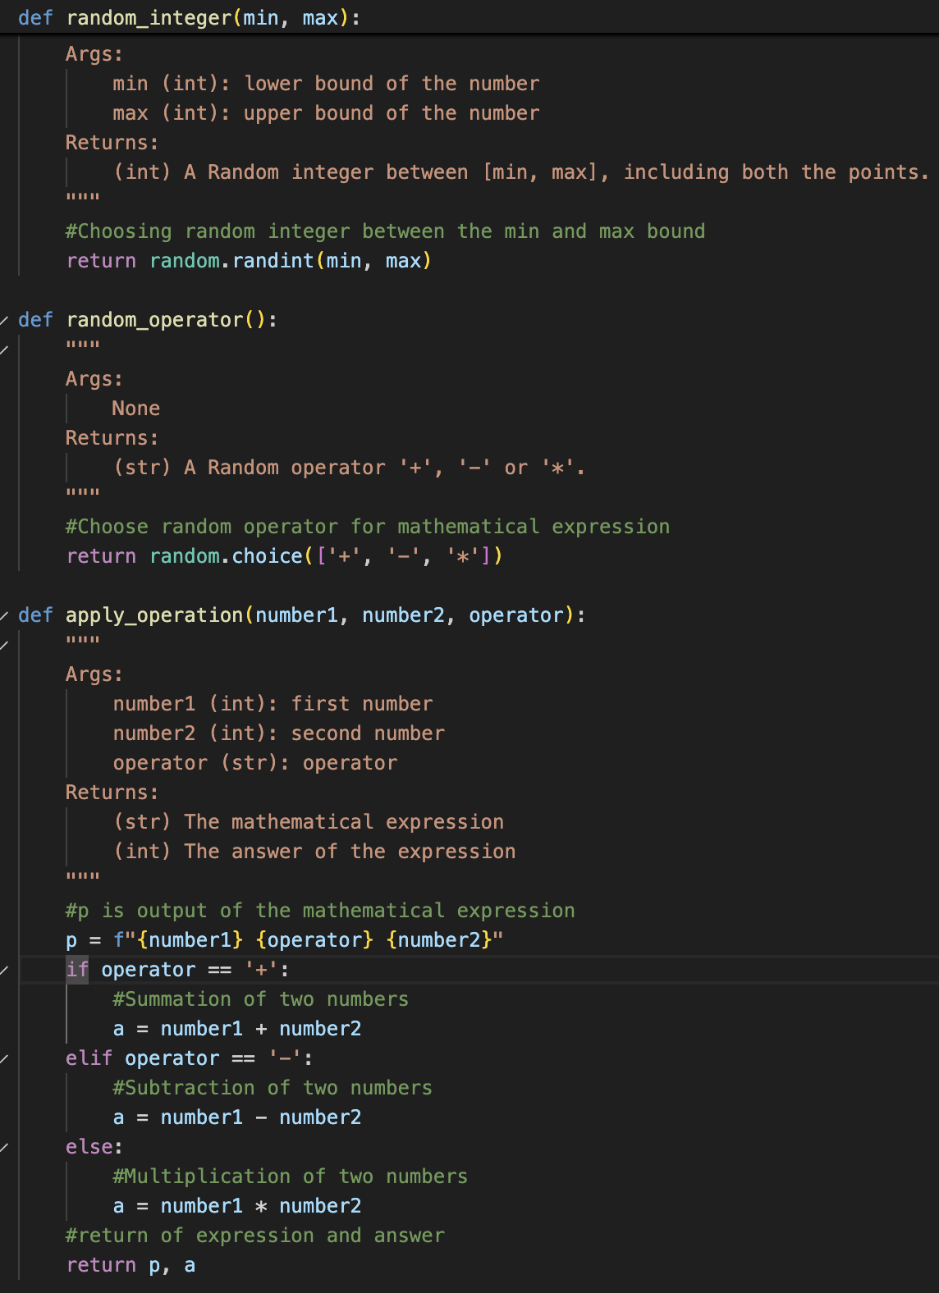
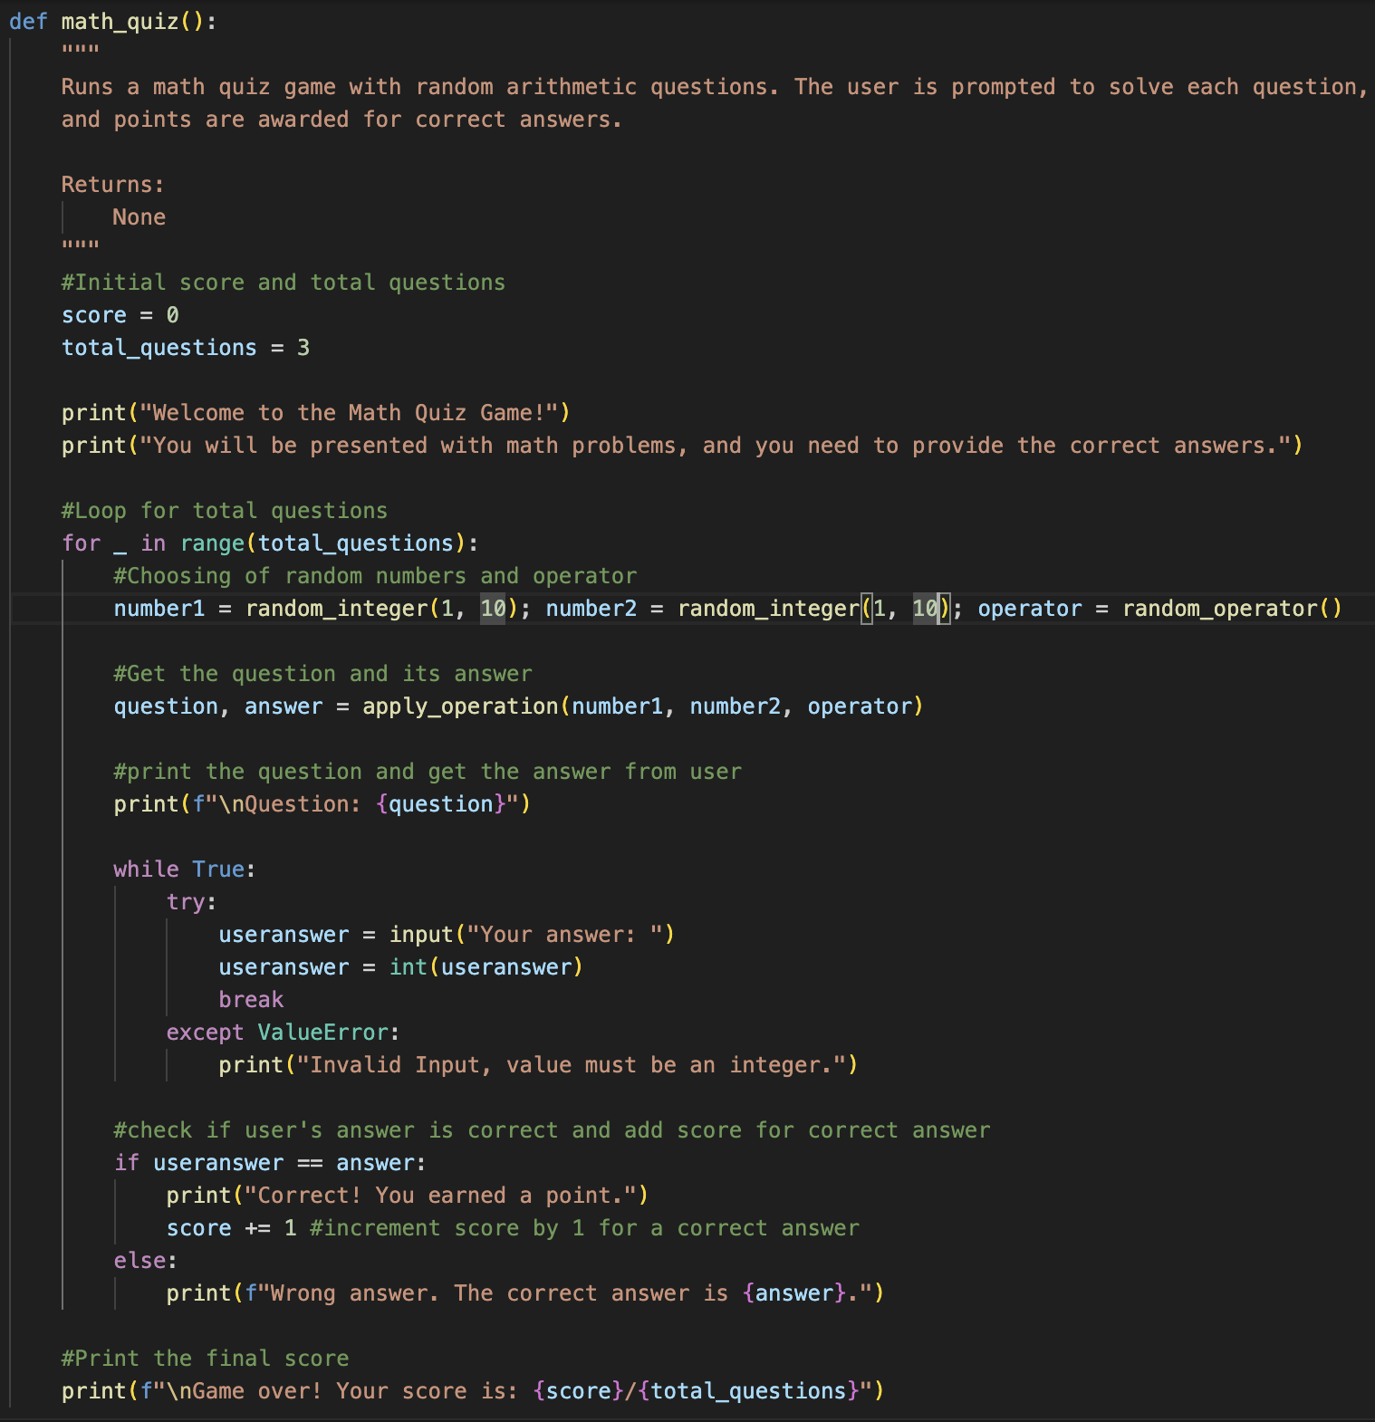

Task 1: https://github.com/rohitpotdukhe01/dsss_homework_2
Task 3:
Task 4:
Task 5:

