Slide 1
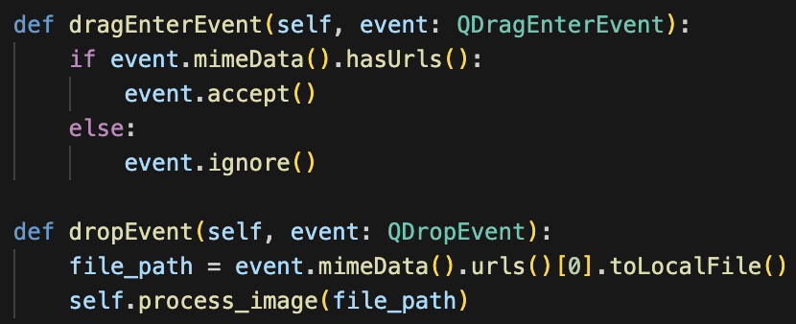
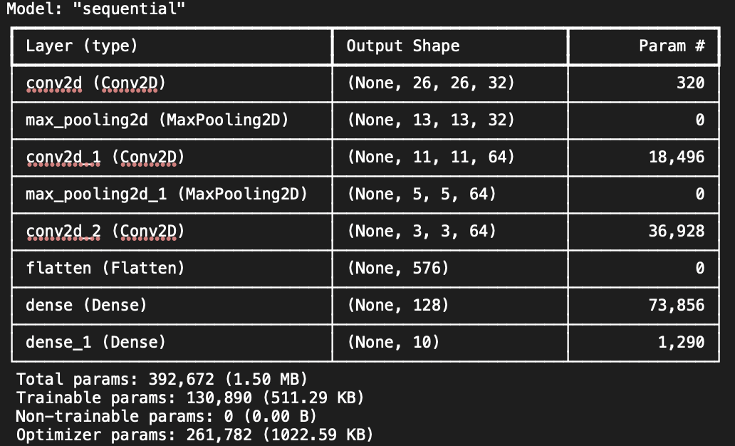
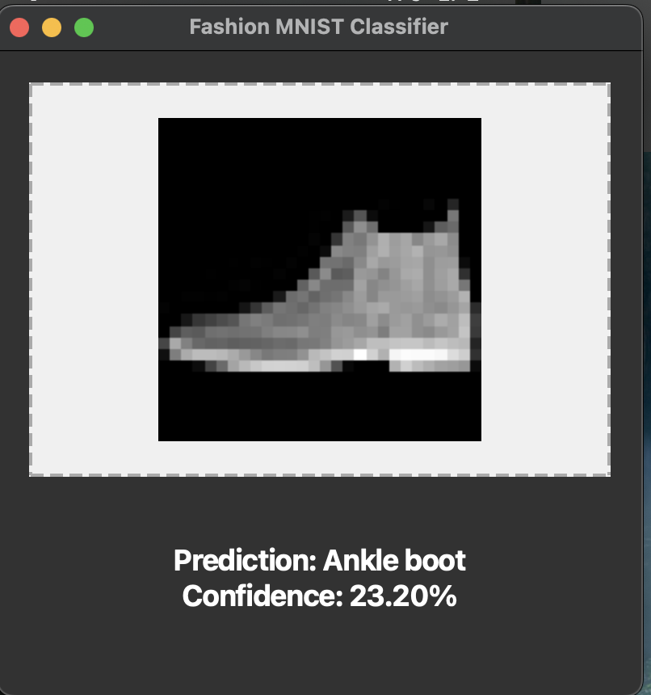

Task 1 :
Task 2 :
Rohit Potdukhe, M. N.: 22985091, IdM: yx49uxym

