Slide 1
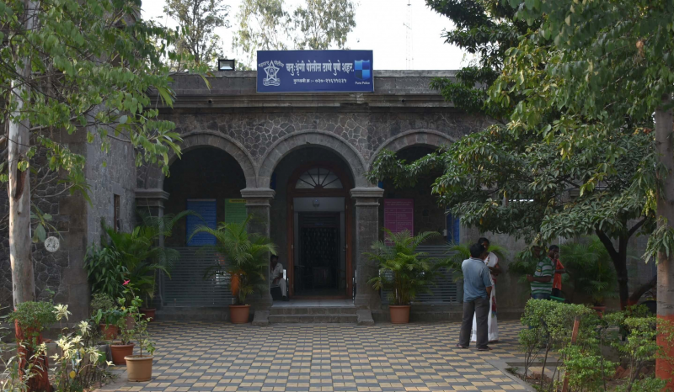
POLICE DUTY SCHEDULING

Slide 2
Team Members
230945920053 - SHUBHAM LOKHANDE
230945920044 - SAURABH KHARTUDE
230945920093 - ROHIT SHENDE
230945920033 - JAI PATANKAR
230945920067 - SHAILESH PATIL

Slide 3
Introduction
The Police Duty Scheduling System is a project designed to streamline and automate the process of scheduling police officers within law enforcement agencies. Efficient management of police duty schedules is critical for maintaining public safety, ensuring proper coverage, and preventing officer fatigue. This project focuses on developing a user-friendly and efficient system that leverages technology to simplify the scheduling process, taking into account various factors such as officer availability, preferences, and organizational requirements.

Slide 4
Problem Definition
Duty Repetition to Single Police Officer
In an offline duty assigning system using registers, the manual nature of the process increases the likelihood of duty repetition for a single police officer.
Data is Not Getting Stored Digitally
The register-based system relies on physical records, making it susceptible to damage, loss, or unauthorized access.
Manual Duty Assigning System is Confusing and Complicated
The manual process of duty assignment using registers can be prone to human errors, leading to confusion and complications.

Slide 5
Offline Duty Scheduling System is Time-Consuming
The manual nature of the offline duty scheduling system is time-consuming, requiring administrators to manually review and update duty assignments.
Register-Based System Not Available Globally
The traditional register-based system may not be universally accessible or compatible with the evolving technological landscape.

Slide 6
Objectives
Transparency
Foster transparency in duty assignments by providing a clear and accessible system that allows both administrators and officers to easily understand and access their schedules.
Adaptability
Develop a system that can adapt to dynamic operational needs, allowing for quick adjustments in response to emergencies, unforeseen events, or changes in officer availability
Compliance
Ensure compliance with labor laws, union agreements, and organizational policies regarding working hours, overtime, and rest periods, reducing the risk of legal issues.

Slide 7
Communication
Facilitate effective communication within the law enforcement agency by providing real-time updates and notifications regarding changes in duty schedules or other relevant information
Officer Satisfaction
Improve officer satisfaction by considering preferences and creating fair and balanced duty schedules, contributing to a positive working environment.
Resource Optimization
Optimize the allocation of police personnel to prevent issues like fatigue and burnout, ultimately enhancing the agency's ability to maintain public safety.

Slide 8
Technologies Used
Spring Boot
React JS
MySQL

Slide 9
Hardware Requirements
Intel i3 processor 3rd generation or later / AMD Ryzen 200 2nd generation or later
4GB RAM.
Windows 7 Home edition or later.
200 GB data HDD Space
Data Connection 200 kbps

Slide 10
Software Requirements
Eclipse 4.7
MySQL 5.8 with Workbench 8.0
Google Chrome version 119
Apache Tomcat Server 9.0
Maven Dependencies
Visual Studio Code

Slide 11
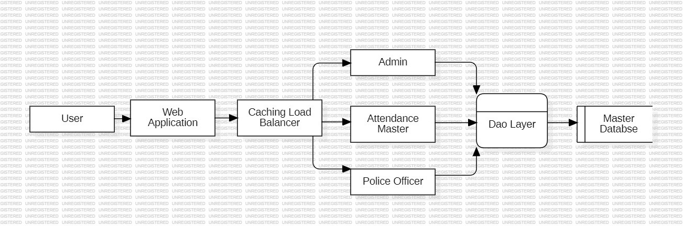
System Architecture

Slide 12
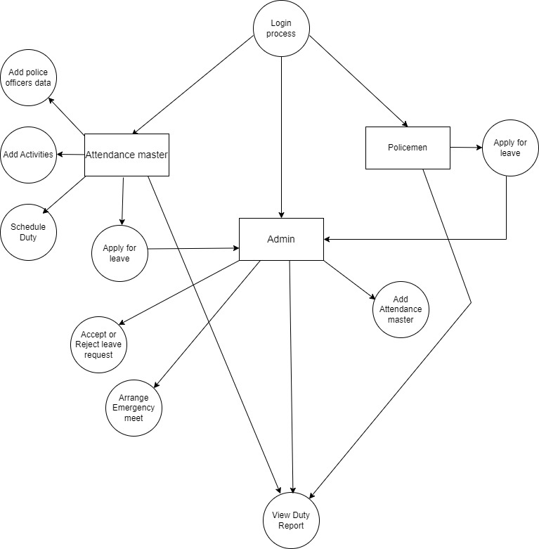
DFD

Slide 13
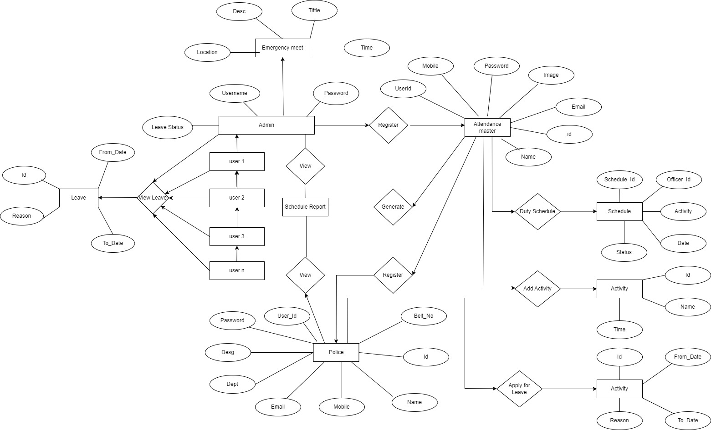
ER Diagram

Slide 14
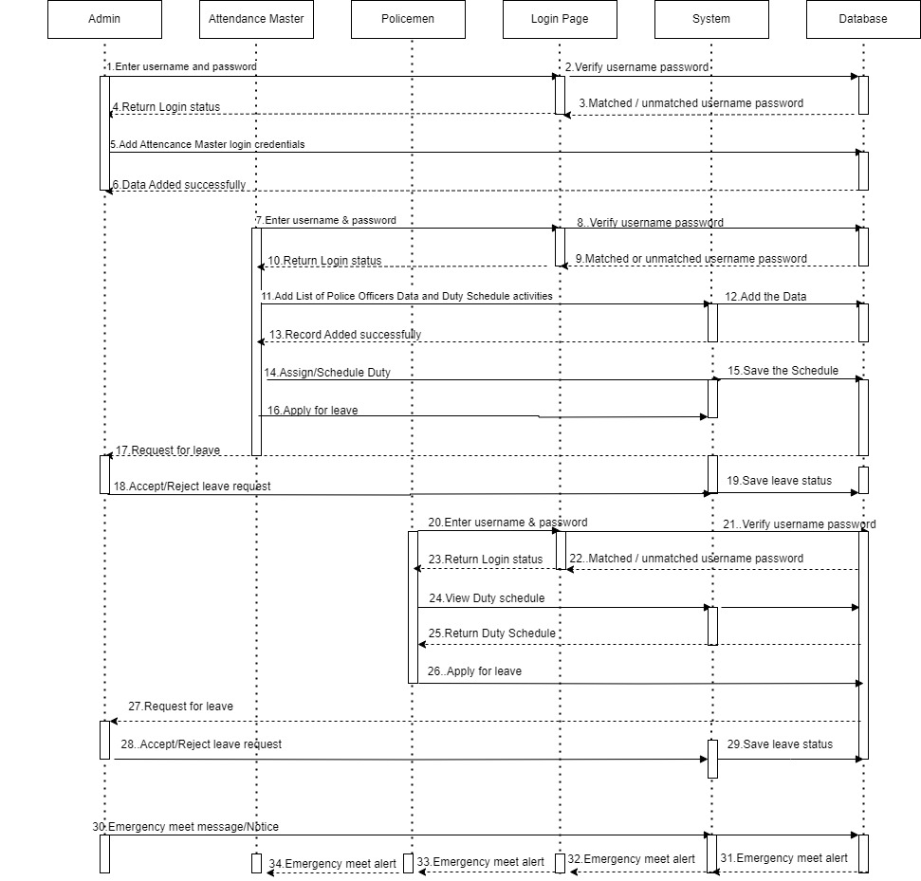
Sequence Diagram

Slide 15
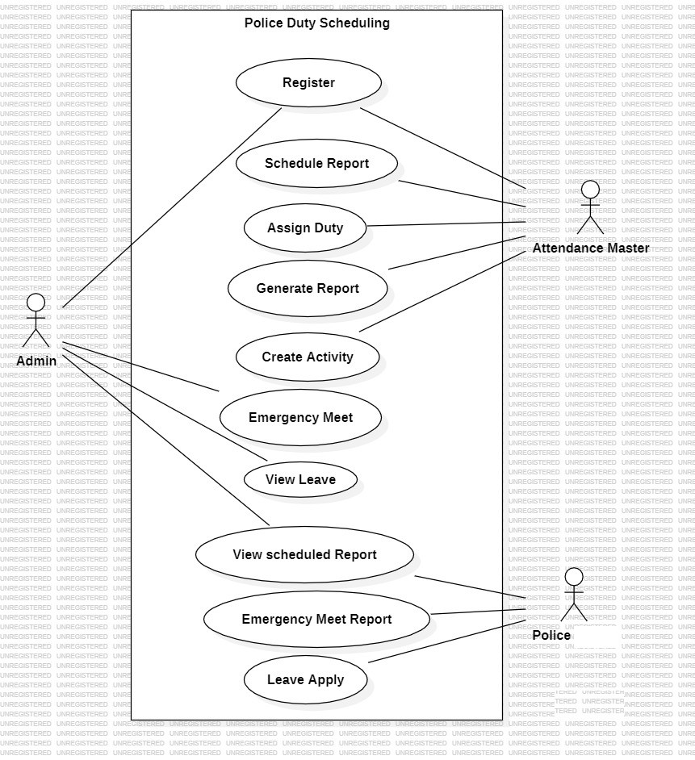
Use-Case Diagram

Slide 16
Scope
This system can be used in police station as well as corporate world.
Police man can use the portal at anytime and anywhere also it is web based application.
Admin and Attendance masters has privileges to create, modify, view schedules and also police man view schedules.
The system will provide functionalities to register attendance master, police man to manage scheduling reports for staff.

Slide 17
Conclusion

Slide 18
THANK YOU !!!

