Slide 1
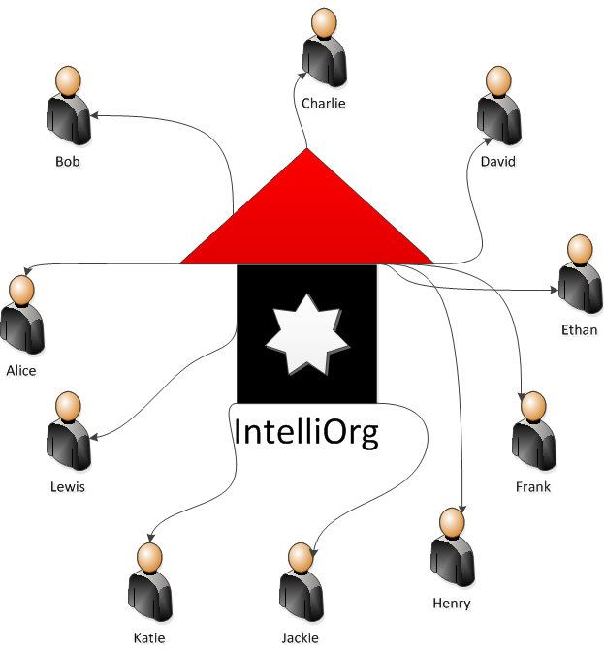
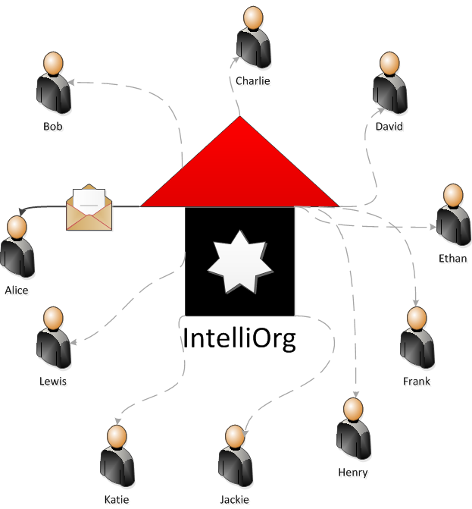
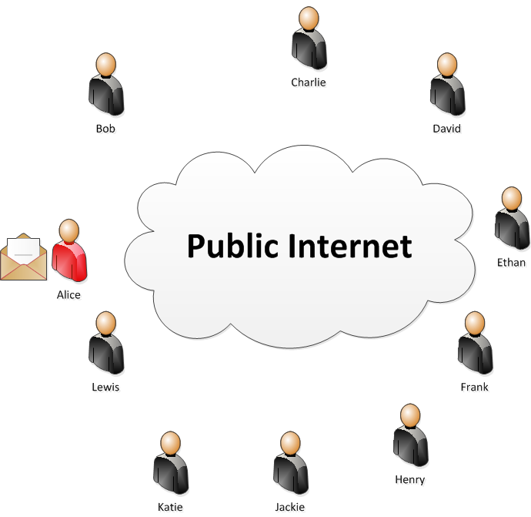
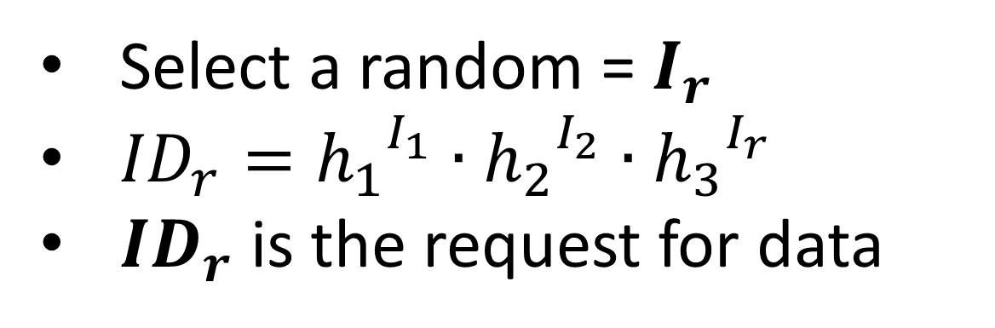




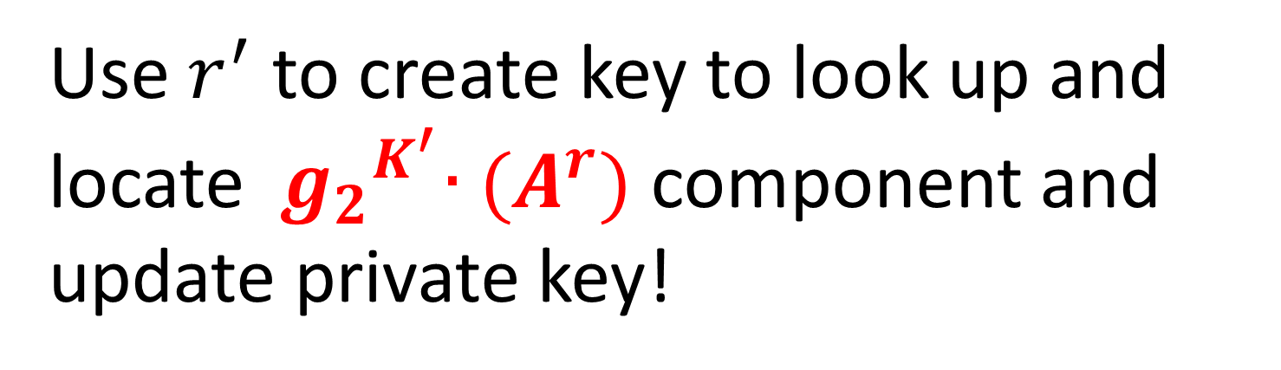

Private Anonymous Messaging
Ruchith Fernando, Bharat Bhargava
Department of Computer Science & The Center for Education and Research in Information Assurance and Security
Purdue University
Secret Agents of intelliOrg
Message sent to the only available agent
The organization is no longer accessible and other agents need the message
Requirements
Dynamic set of agents
Agents do not know each other
Obtain messages from other agents
Use public network
Requester and provider anonymity
Hierarchical Identity Based Encryption
Proposed Scheme
Group Membership Changes
Master key = K
$Kpriv\left(Agent\right)=\left({ g_{2}}^{K}{∙(A}^{r}),{ B}^{r}, { C}^{r} \right)$
Generate a fresh master key = $K^{′}$
Regenerate $Kpriv\left({Agent}_{i}\right)$ of all agents
Select a random = $I_{r}$
${ID}_{r}={h_{1}}^{I_{1}}∙{h_{2}}^{I_{2}}∙{h_{3}}^{I_{r}}$
${ID}_{r}$ is the request for data
$${ID}_{r}$$
Publish
Blinded ID | Key Component
… | …
$${({Agent}_{i})}^{r^{′}}$$ | $${ g_{2}}^{K^{′}}{∙(A}^{r})$$
… | …
& $r^{′}$
$$I_{r}$$
Use $r^{′}$ to create key to look up and locate ${ g_{2}}^{K^{′}}{∙(A}^{r})$ component and update private key!

