Slide 1
CSE523
Machine learning
Fuzzy Logic for Vehicle Motion Direction Detection
AU2140023 - Rohit Rathi
AU2140064 - Dhruvin Prajapati
AU2140122 - Kushalkumar Suthar
AU2140141 - Krutarth Trivedi
Group: The learner’s squad

Slide 2
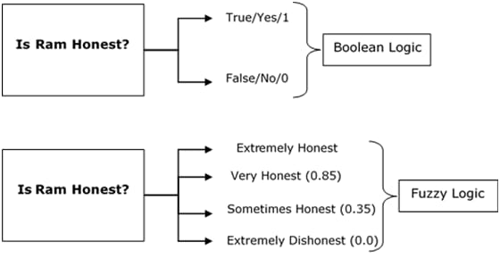
What is fuzzy logic?
Approximate
Fuzzy sets
Membership function
Fuzzy Logic - Quick Guide. (n.d.). Retrieved from https://www.tutorialspoint.com/fuzzy_logic/fuzzy_logic_quick_guide.htm

Slide 3
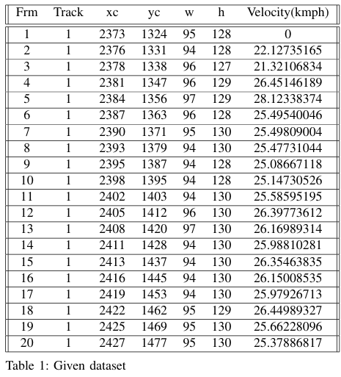
Data Set Explanation
There are seven entities:
Frm
Track
Xc
Yc
W
H
Velocity

Slide 4
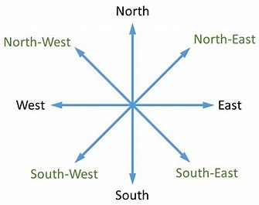
METHODOLOGY
Data Analysis and Loading
Calculate Motion Vectors (Centroid Difference)
Angle Calculation
Applying Fuzzy Logic
Direction Categorization
Visualization
India, B. E. (2024). Cheatsheet: Directions: IBPS PO prelims and Mains - documents, videos and tests - bank exams PDF Download. Retrieved from https://edurev.in/t/255895/Cheatsheet-Directions

Slide 5
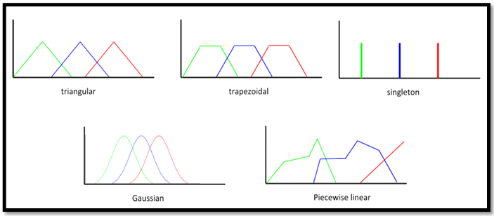
Different Methods:
Lecture 18 - different types of membership functions 1. (n.d.). Retrieved from https://www.scribd.com/document/493637688/Lecture-18-Different-Types-of-Membership-Functions-1

Slide 6
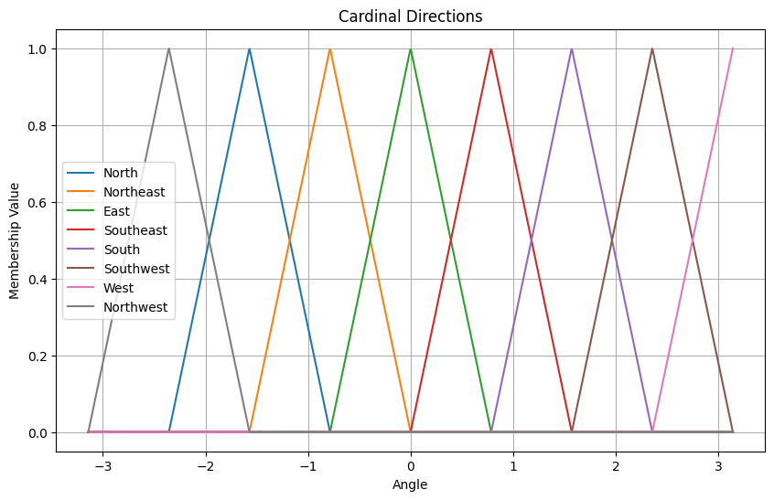
Triangular Approach:

Slide 7
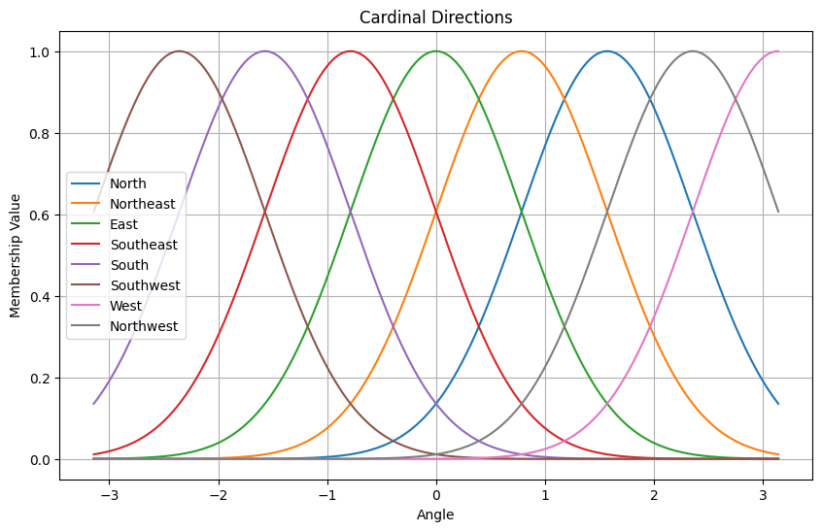
Gaussian Approach:
Notes:
Value of membership function for angle value of 0 for south direction is 0.3.

Slide 8
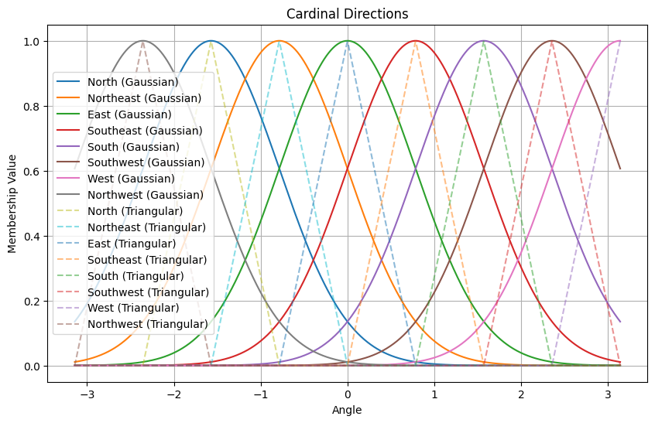
Representation:

Slide 9
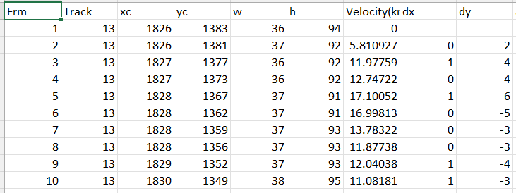
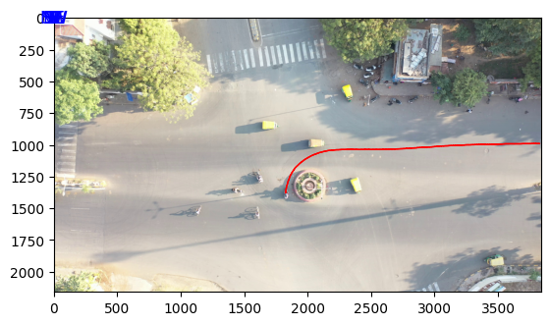
Results

Slide 10
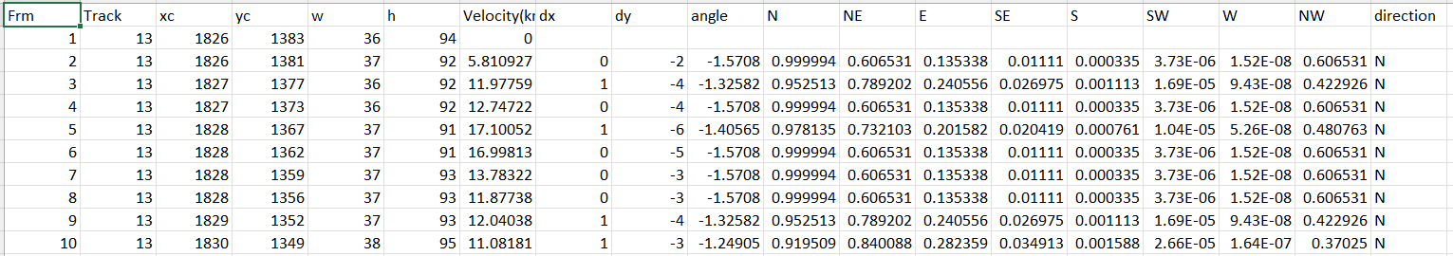
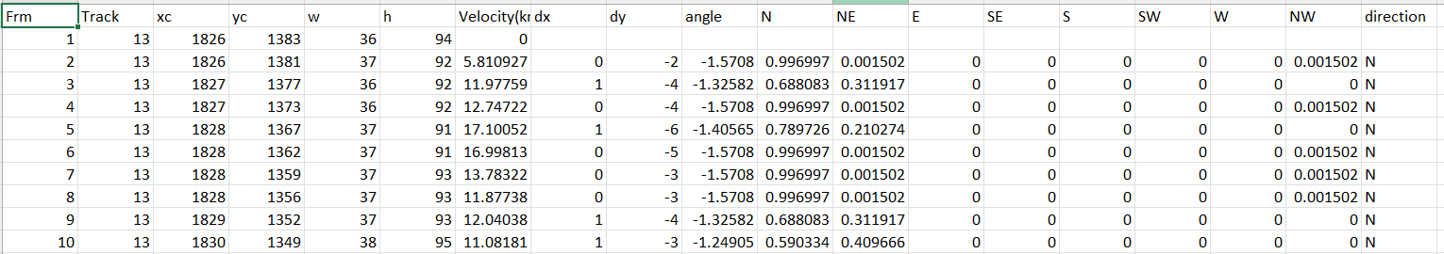
Results
Gaussian
Triangular

Slide 11
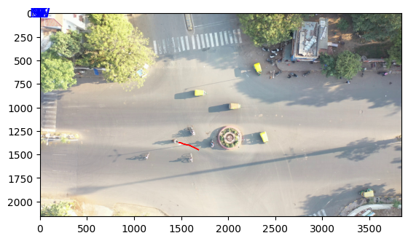
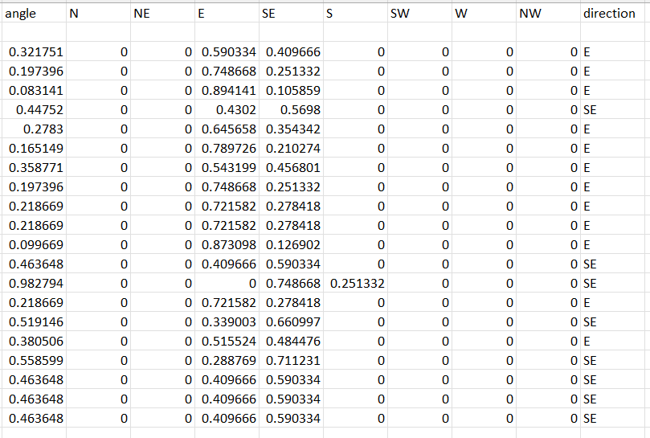
Results

Slide 12
Summary ,conclusion and future work
Fuzzy logic helps to figure out the direction of vehicle accurately.
Applying the approach would make traffic control and self driving cars better.
The flexibility of fuzzy logic of applying it on real time scenario makes it more efficient.
Hence it would make transportation systems more efficient and safer.
To increase the uses, we can apply machine learning models to the outputs.
To visualize the predictions, we can plot that predicted direction on the image.
Notes:
Applying fuzzy logic to detect the path of vehicle helps us to know direction of motion of vehicle. It would also control the flow of traffic and would enhance the performance of autonomous cars. Thus applying fuzzy logic on real time scenario would be better. Talking about the future work, we will try to depict the path of vehicle and annotate it on image to test it. Implementing machine learning algorithm with fuzzy logic will increase its performance on real time scenario.

Slide 13
References
Fuzzy Logic (Stanford Encyclopedia of Philosophy/Summer 2023 Edition). (2021, November 11).https://plato.stanford.edu/entries/logic-fuzzy/
Behavior recognition of moving objects using deep neural networks. (2018, October 1). IEEE Conference Publication — IEEE Xplore.https://ieeexplore.ieee.org/document/8560021
Yagiz, N., Sakman, E., Guclu, R. (2008, February). Different control applications on a vehicle using fuzzy logic control https://www.researchgate.net/publication/225142683_Different_control_applications_on_a_vehicle_using_fuzzy_logic_control
Lecture 18 - different types of membership functions 1. (n.d.). Retrieved from https://www.scribd.com/document/493637688/Lecture-18-Different-Types-of-Membership-Functions-1

Slide 14
Thank you

