Slide 1
CSE523
Machine learning
Fuzzy Logic for Vehicle Motion Direction Detection
AU2140023 - Rohit Rathi
AU2140064 - Dhruvin Prajapati
AU2140122 - Kushalkumar Suthar
AU2140141 - Krutarth Trivedi
Group: The learner’s squad

Slide 2
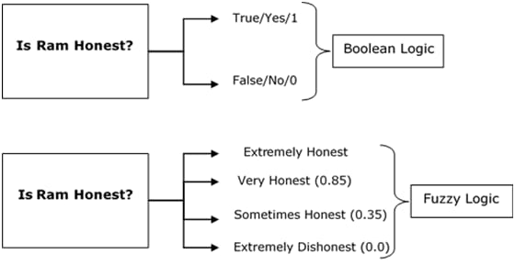
What is fuzzy logic?
Approximate
Fuzzy sets
Membership function
Fuzzy Logic - Quick Guide. (n.d.). Retrieved from https://www.tutorialspoint.com/fuzzy_logic/fuzzy_logic_quick_guide.htm

Slide 3
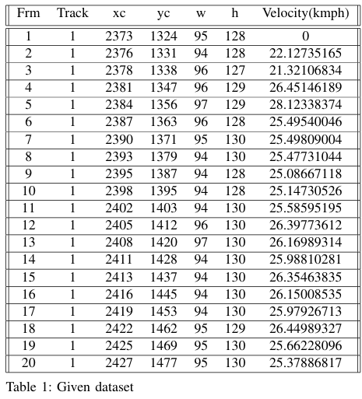
Data Set Explanation
There are seven entities:
Frm
Track
Xc
Yc
W
H
Velocity

Slide 4
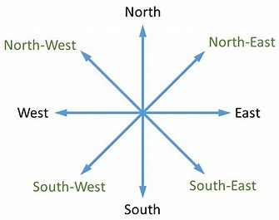
METHODOLOGY
Data Analysis and Loading
Calculate Motion Vectors (Centroid Difference)
Angle Calculation
Applying Fuzzy Logic
Direction Categorization
Visualization
India, B. E. (2024). Cheatsheet: Directions: IBPS PO prelims and Mains - documents,videos and tests - bank exams PDF Download. Retrieved from https://edurev.in/t/255895/Cheatsheet-Directions

Slide 5
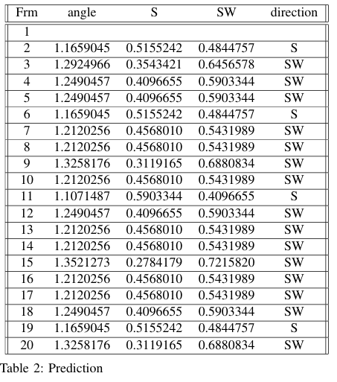
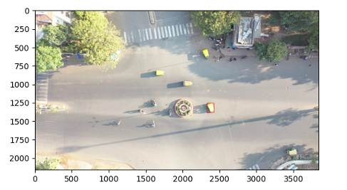
Results

Slide 6
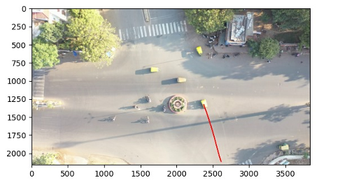
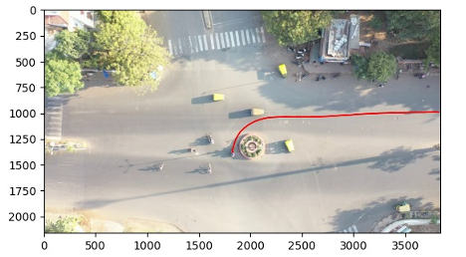
Results

Slide 7
Summary, conclusion and future work
Fuzzy logic helps to figure out the direction of vehicle accurately.
Applying the approach would make traffic control and self driving cars better.
The property of fuzzy logic to be flexible helps to easily apply it on real time scenario more efficiently.
Hence it would make transportation systems more efficient and safer.
We will depict the path for a vehicle from initial frames and annotate on image.
We will also try to implement machine learning algorithm with fuzzy logic so that performance can be improved.
Notes:
Applying fuzzy logic to detect the path of vehicle helps us to know direction of motion of vehicle. It would also control the flow of traffic and would enhance the performance of autonomous cars as fuzzy logic changes its membership function based on the surrounding for adaptive and dynamic fuzzy logic systems. Thus applying fuzzy logic on real time scenario would be better. Talking about the future work, we will try to depict the path of vehicle and annotate it on image to test it. Implementing machine learning algorithm with fuzzy logic will increase its performance on real time scenario.

Slide 8
References
Fuzzy Logic (Stanford Encyclopedia of Philosophy/Summer 2023 Edition). (2021, November 11).
Behavior recognition of moving objects using deep neural networks. (2018, October 1). IEEE Conference Publication — IEEE Xplore.
Yagiz, N., Sakman, E., Guclu, R. (2008, February). Different control applications on a vehicle using fuzzy logic control

Slide 9
Thank you

