Slide 1


Presented By: Rohit Rathore
Mobile Price Prediction Using Machine Learning
Feature Extraction • Data Analysis • Model Evaluation
Technology: Python | Pandas | NumPy | Matplotlib | Seaborn | Scikit-learn

Slide 2



Project Overview
Problem Statement
Smartphone prices depend on several specifications such as RAM, Memory, Battery, Camera and Processor. The objective of this project is to analyze these features and develop a Machine Learning model capable of predicting smartphone prices.
Project Objectives
Analyze smartphone specifications
Clean and prepare the dataset
Extract relevant numerical features
Study relationships between features and price
Train and compare regression models
Select the best-performing model

Slide 3
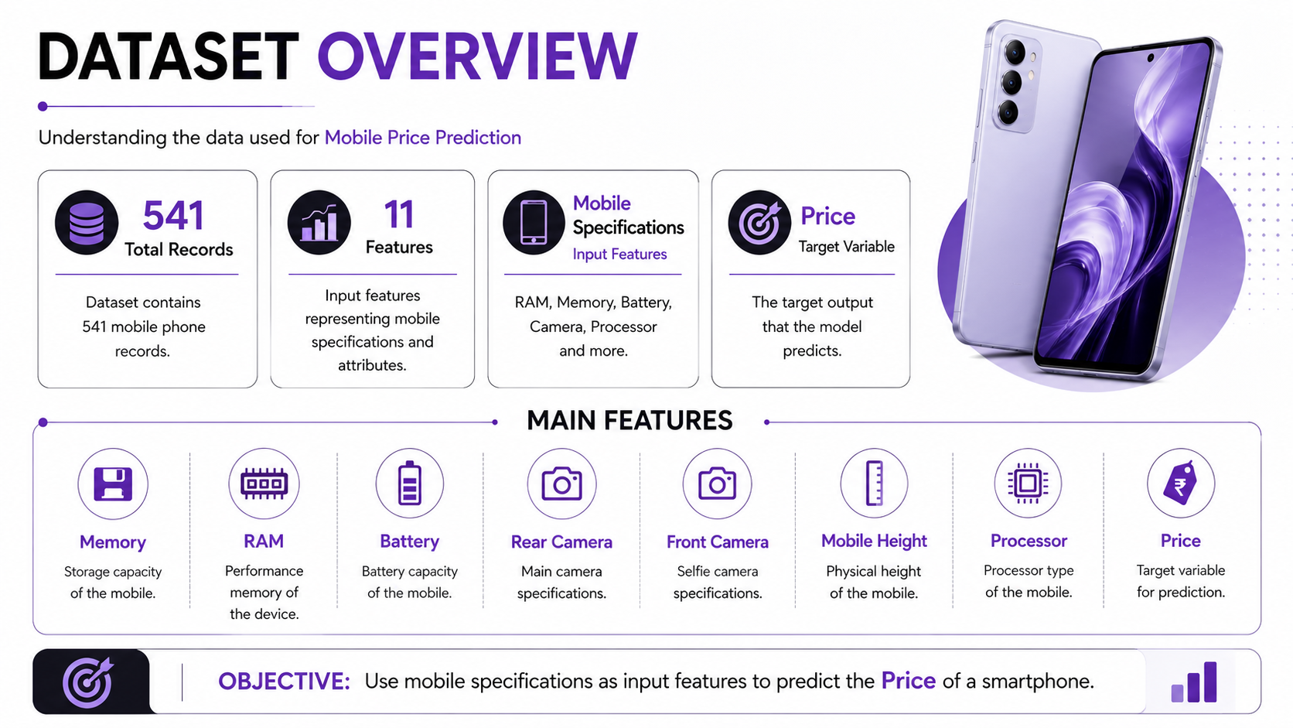
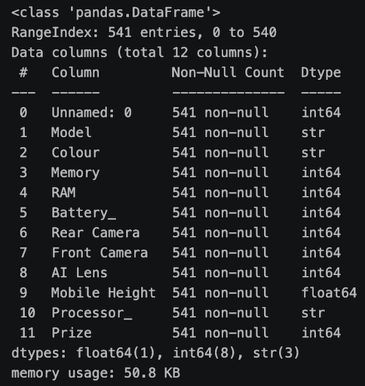

Slide 4

Data Preprocessing
Data Cleaning & Preparation
Removed unnecessary index information.
Converted Rear Camera and Front Camera from text to numeric.
Removed MP suffix from camera values.
Removed commas from Price and converted it to integer.
Checked missing values — no null values found.
Applied IQR method for outlier detection.

Slide 5

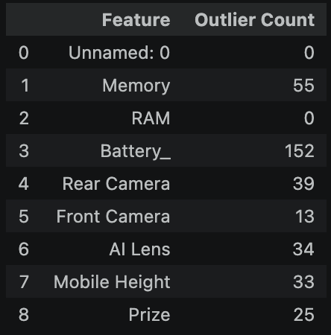
Exploratory & Feature Analysis
Feature Distribution & Relationships
Feature Distribution & Relationships
Important observations:
Battery Level had the highest number of detected outliers: 152.
Memory had 55 outliers.
Rear Camera had 39 outliers.
Price had 25 outliers.
RAM showed no detected outliers.

Slide 6
Feature Extraction & Model Building
Machine Learning Workflow
Features → Encoding/Transformation → Train-Test Split → Model Training → Prediction → Evaluation
Models used:
KNN Regressor
Decision Tree Regressor
Random Forest Regressor
Project brief also recommends regression algorithms such as Linear Regression, Decision Tree and Random Forest for price prediction.

Slide 7
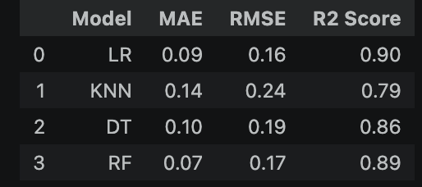
Best Model: Random Forest
Random Forest achieved the lowest MAE (0.07) and highest R² (0.89) among the compared models, so it was selected as the final model.

Slide 8
Key Findings & Business Recommendations
Key Findings
Smartphone price can be predicted using technical specifications.
RAM, Memory, Battery, Camera and Processor provide useful information for pricing analysis.
Data preprocessing significantly improves ML readiness.
Random Forest delivered the strongest predictive performance with R² = 0.89.
Business Recommendations
Use important specifications to support competitive pricing.
Identify feature combinations associated with higher-priced smartphones.
Use ML predictions to support pricing and marketing decisions.
Periodically retrain the model as smartphone specifications and mar

Slide 9


