Slide 1

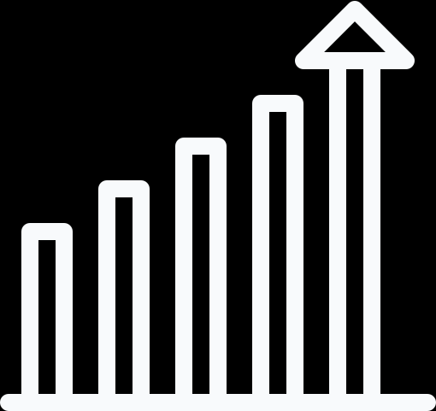


User Analytics in the Telecommunication
Industry
Project Presentation
Presented by:
ROHIT RATHORE

Slide 2
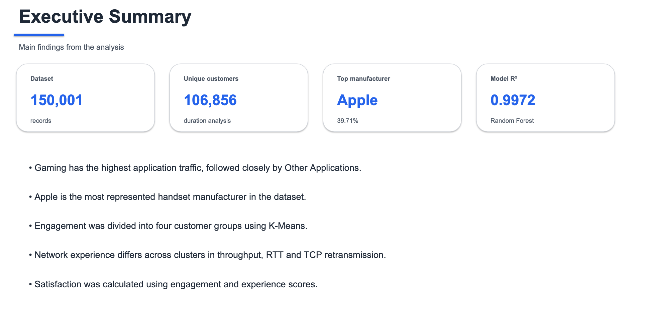

Slide 3

Data Preparation & Cleaning
1. Missing Value Identification
Missing values were identified across the dataset.
The missing data was then handled using suitable methods.
2. Outlier Identification
Unusual values were identified in numerical columns.
The IQR method was used to detect and treat these outliers.
3. Data Aggregation
Session-level data was converted into customer-level data.
This helped us understand individual customer behaviour.
4. Feature Preparation
Important variables were selected for further analysis.
The required features were prepared and scaled for clustering.
5. Data Validation
Data types and consistency were checked after cleaning.
The final dataset was prepared for analysis and machine learning.

Slide 4
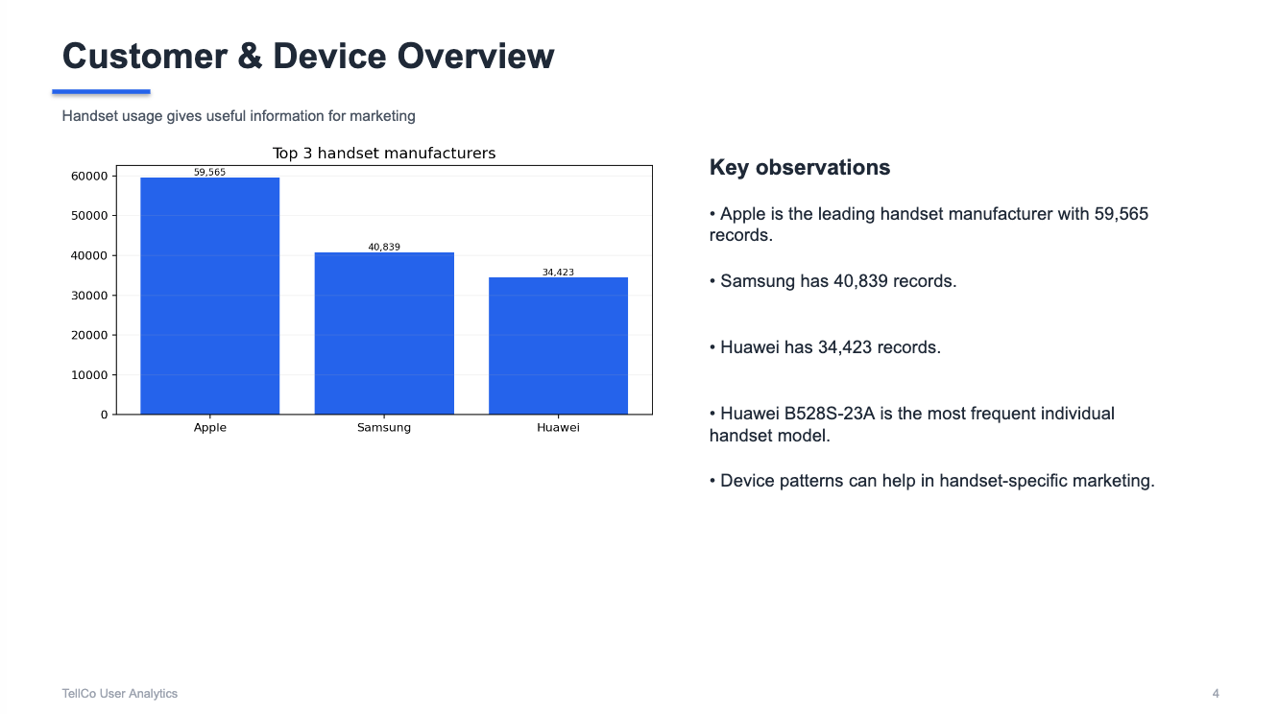
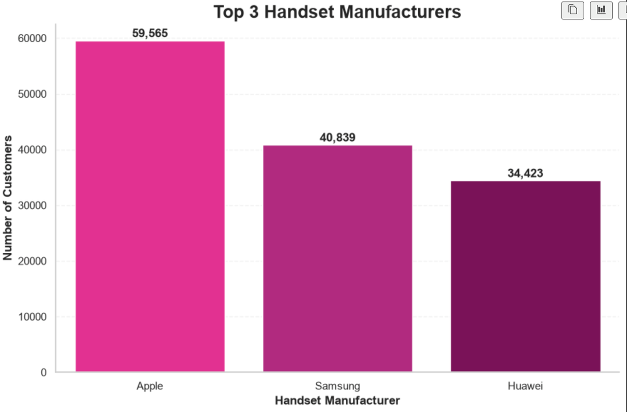

Slide 5
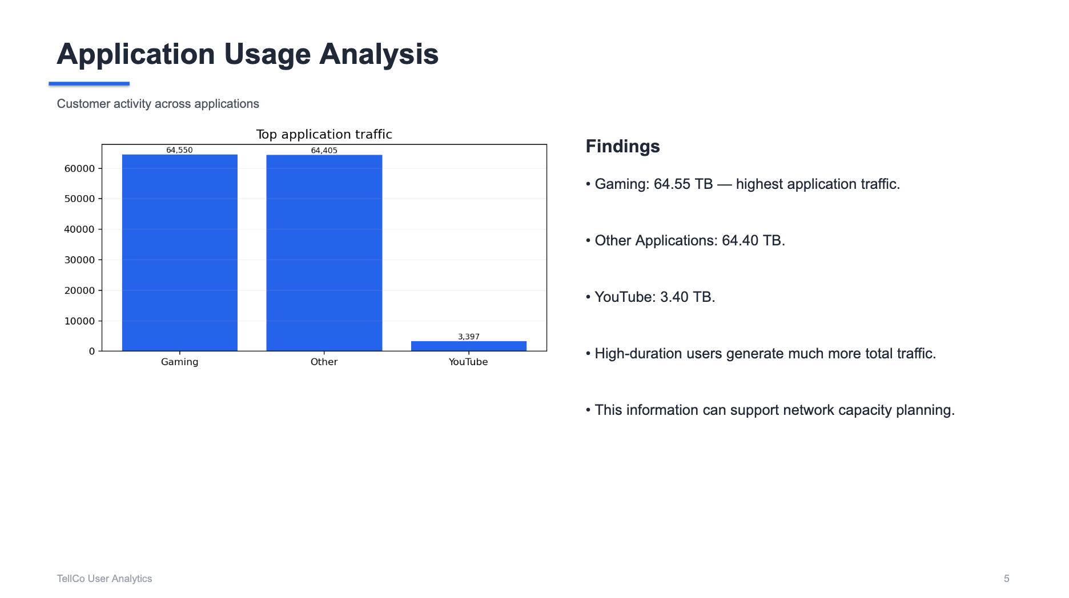

Slide 6
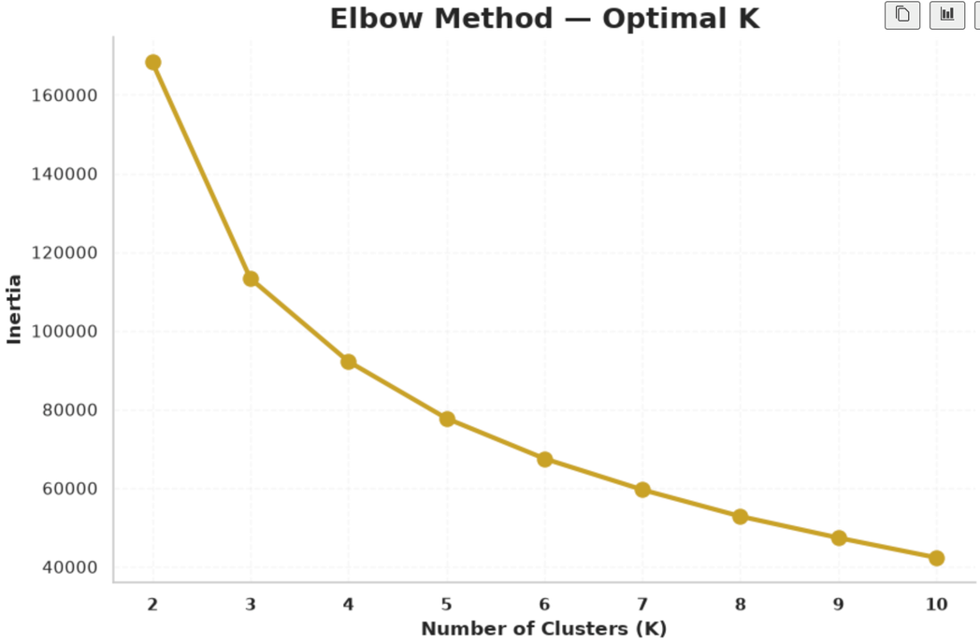
User Engagement + K-Means
1. User Engagement Analysis
Customer engagement was measured using sessions, session duration and total data traffic.
These metrics helped us understand the level of network usage.
2. K-Means Clustering
K-Means was used to group customers with similar usage behaviour.
Customers with similar engagement patterns were placed in the same cluster.
3. Optimal Clusters
The Elbow Method was used to find the suitable number of clusters.
The analysis selected K = 4.
4. Four Engagement Groups
Customers were divided into Low, Medium, High and Very High Engagement groups.
The Very High group showed the highest usage activity.
5. Key Insight
Engagement increases with sessions, duration and data consumption.
These groups can help in creating targeted offers and customer strategies.

Slide 7
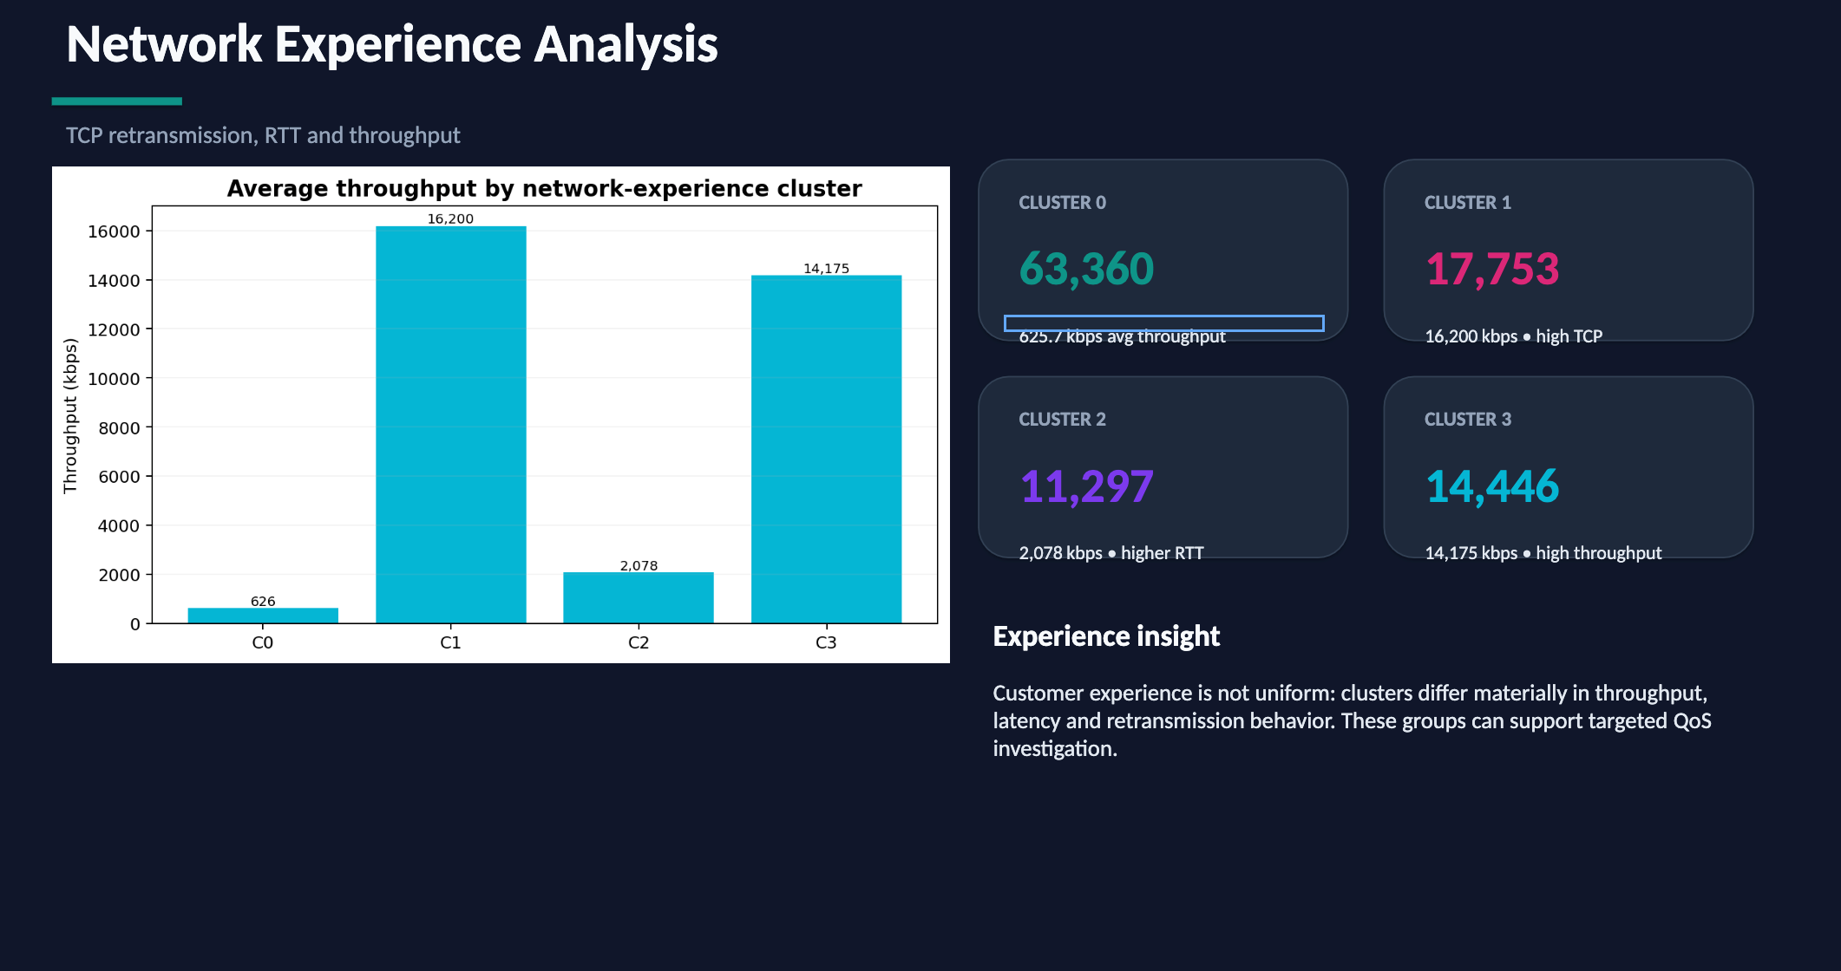
Network Experience

Slide 8
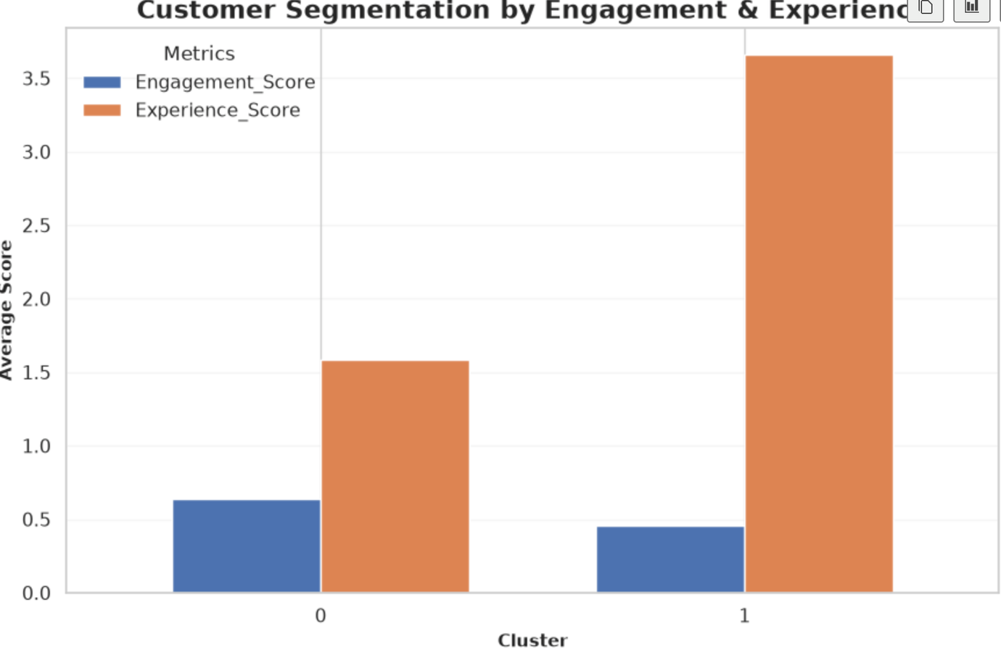
Customer Satisfaction
Customer satisfaction was analysed to understand the overall experience of TellCo customers. The analysis combined User Engagement and Network Experience to get a broader view of how customers interact with the network and how they experience its performance.
The Engagement Score was based on customer usage behaviour, including the number of sessions, session duration and total data traffic. The Experience Score considered network performance factors such as TCP Retransmission, RTT and Throughput, which helped in understanding differences in network experience among customers.
The final Satisfaction Score was calculated as the average of the Engagement Score and Experience Score. This helped identify differences in satisfaction between customer groups and provided useful insights for improving customer experience and developing better retention strategies.

Slide 9
Random Forest + MLflow
The main goal of this stage was to build a model that could predict customer satisfaction from the patterns found in the data. For this, we used the Random Forest Regressor, which combines multiple decision trees and uses different customer engagement and network-related features to make the final prediction.
The model gave very strong results on the test data, with an R² score of 0.9972, while the MAE was 0.0125 and RMSE was 0.0289. These metrics show how closely the predicted satisfaction values matched the actual values in the test dataset.
Along with modelling, MLflow was used to keep the entire experiment organised. It stored important details such as the model parameters, evaluation results, run information and prediction outputs, making it easier to track what was done and reproduce the experiment later.

Slide 10
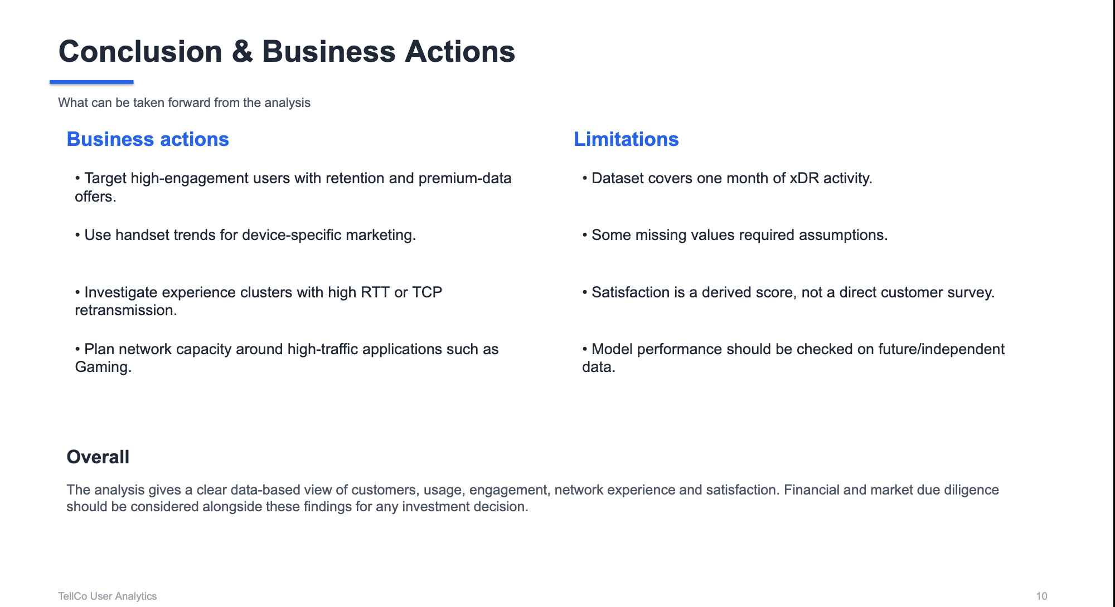

Slide 11

.........

