Slide 1






ABSTRACT CLASS & INTERFACES

Slide 2



ABSTRACT CLASS
An Abstract class is like a normal class , can contain properties / constructor / concrete method but at least one method that is incomplete (Abstract method)
When a method is abstract, the class also becomes abstract (class should be modified with keyword abstract).
An object cannot be created for an abstract class,

Slide 3
NOTES :
An object cannot be created for an abstract class, only a reference is possible.
If the child class does not override the abstract method of the parent abstract class, then even the child class also become abstract.

Slide 4
DRAWBACKS OF ABSTRACT CLASS :-
No multiple inheritance — can't extend more than one class
Tight coupling — changes in abstract class affect all subclasses
Less flexible than interfaces — limited adaptability
Can't instantiate — must use subclass
Encourages inheritance over composition — less modular
Risk of incomplete implementation — subclasses must implement all abstract methods

Slide 5
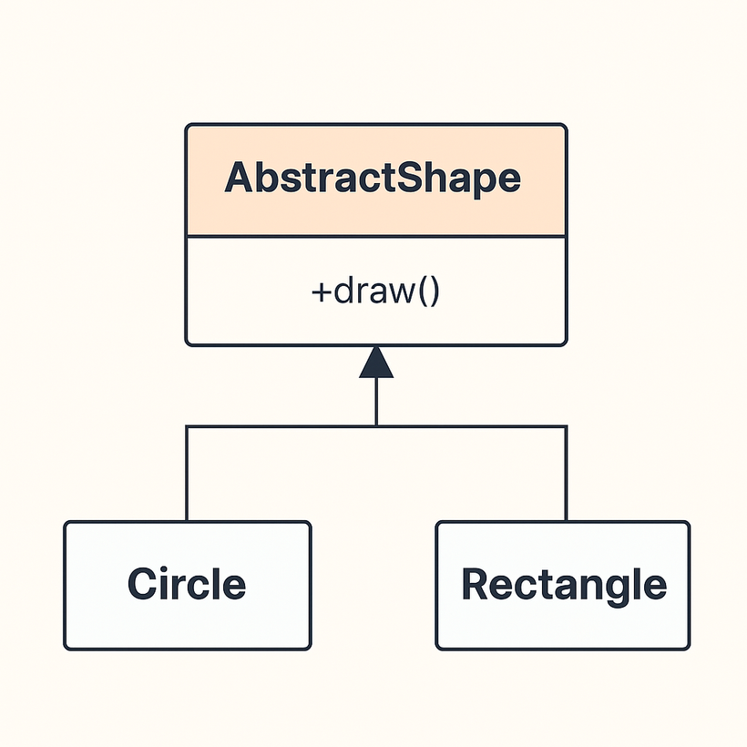
simple diagram :
Here’s a simple diagram showing how an abstract class works in object-oriented programming. It illustrates an abstract class Shape with an abstract method draw(), and two concrete subclasses Circle and Rectangle.

Slide 6

realtime usecase :

Slide 7

iNTERFACES :
It allows loosely coupled applications.
It is contract to be signed mandatorily by the implementing class.
It leads to polymorphism.
An Interface can contain the following :
static & final keyword
(they are non-access modifiers)

Slide 8
NOTES :
Object is not possible for an interface, only a reference is possible with the help of Dynamic Method Dispatch (DMD), we can invoke the appropriate method.
A class can implement “N” no of interfaces.

Slide 9
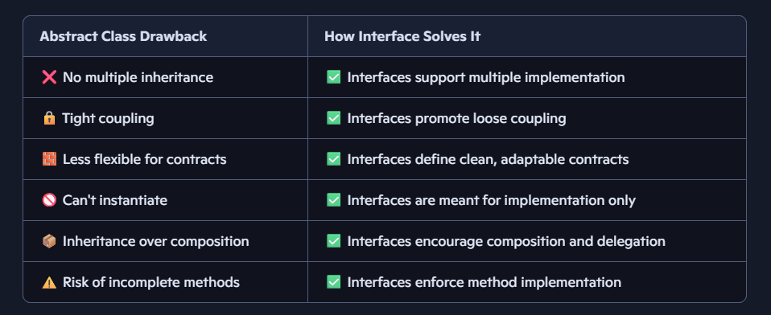
interface advantages over abstract class :

Slide 10


Thank you!

