Slide 1
Freight Rate Prediction
ML Engineer assessment: findings, validation and model
Predict 12,000 Nov-Dec 2025 loads from 48,000 Jan-Oct loads
Notes:
Ten seconds. The task is to train on January to October and predict November and December. The test is the future, and that shaped every decision.

Slide 2
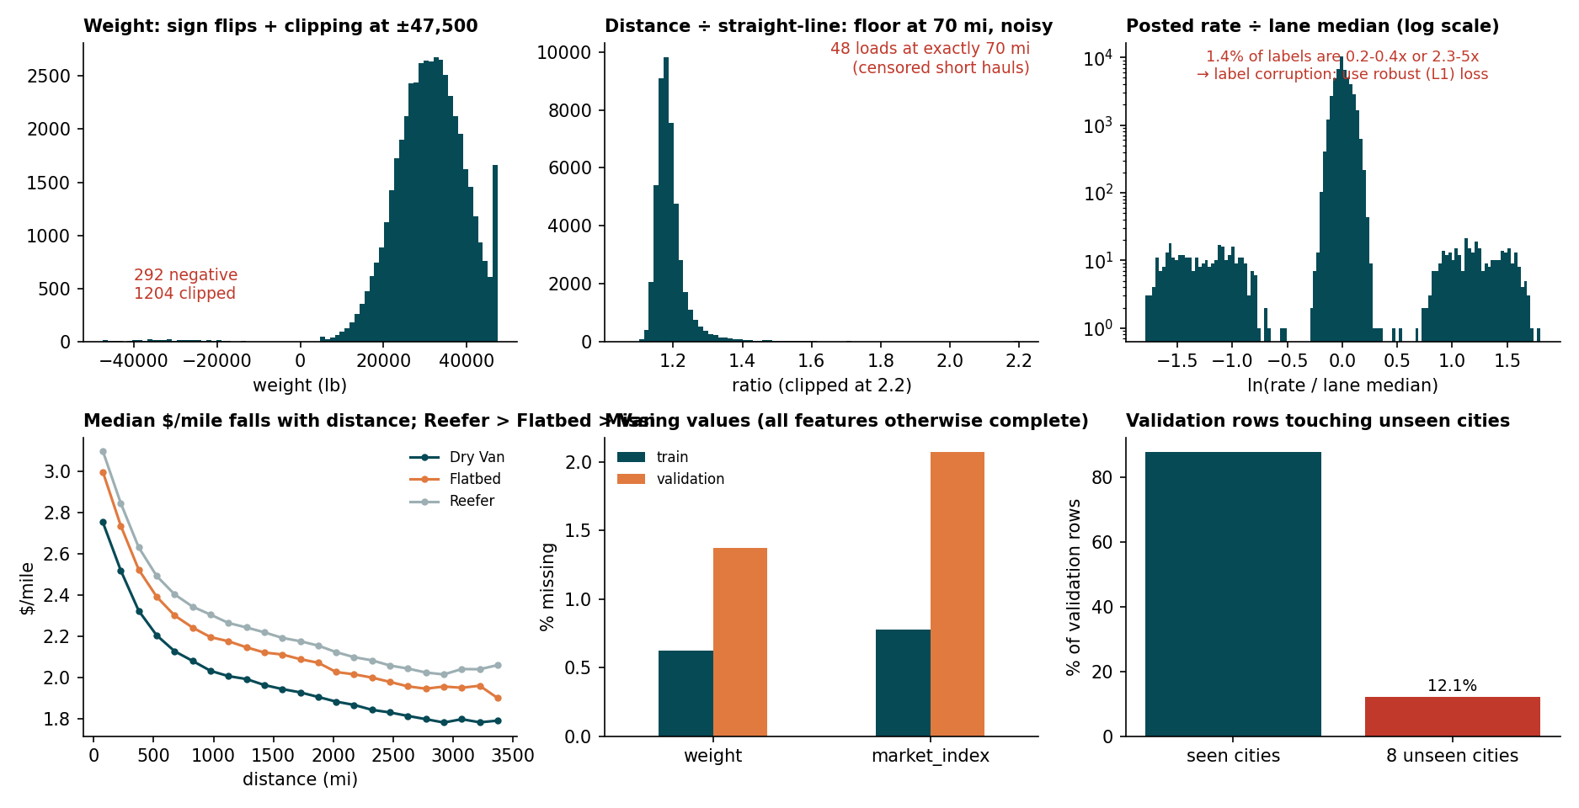
Key findings from exploring the data
Rate driven by distance, equipment, weight; $/mile falls with distance; Reefer > Flatbed > Van
Test set is the future (Nov-Dec): validate by time, not at random
quote_signal flips meaning by month: positive, negative, or pure noise (Nov-Dec = noise, like Aug)
market_index is a noisy daily reading: use the daily mean
~1.4% of labels corrupted (0.2-0.4x or 2.3-5x of lane median)
Rate level drifts by month, so recent data matters more
Notes:
Five findings. Rate is driven by distance, equipment and weight. The test set is the future so validation must be by time. quote_signal switches meaning month to month and Nov and Dec look like August. market_index is a noisy daily reading. About 1.4 percent of labels are corrupted.

Slide 3
Data-quality issues and how I handled them
Check | Train | Validation
rows | 48,000 | 12,000
missing weight | 300 | 165
missing market_index | 374 | 249
negative weight | 292 | 145
weight at +/-47,500 | 1,204 | 301
distance == 70 | 48 | 21
duplicate load_id | 0 | 0
Weight: abs() for sign flips; NaN stays NaN
market_index: daily mean; no reading = no adjustment
Distance: floor at 70 mi + noise: add straight-line distance
Unseen cities: no city IDs; geography via distance
Issue | Load | Evidence | Fix
Negative weight | TR-000069 | weight = -36,559 lb | abs() → 36,559
Corrupted label (high) | TR-000389 | rate $5,485 vs lane median $1,753 (3.1x) | L1 loss
Corrupted label (low) | TR-000509 | rate $699 vs lane median $3,576 (0.20x) | L1 loss
Notes:
Walk the table, then the three concrete examples. Same issues exist in the validation data, so the same cleaning applies. Negative weights are sign flips. Missing weight is left missing for LightGBM. A date with no market reading gets no daily adjustment. Corrupted labels stay in the data but the L1 loss limits their influence, and I report metrics with and without them.

Slide 4
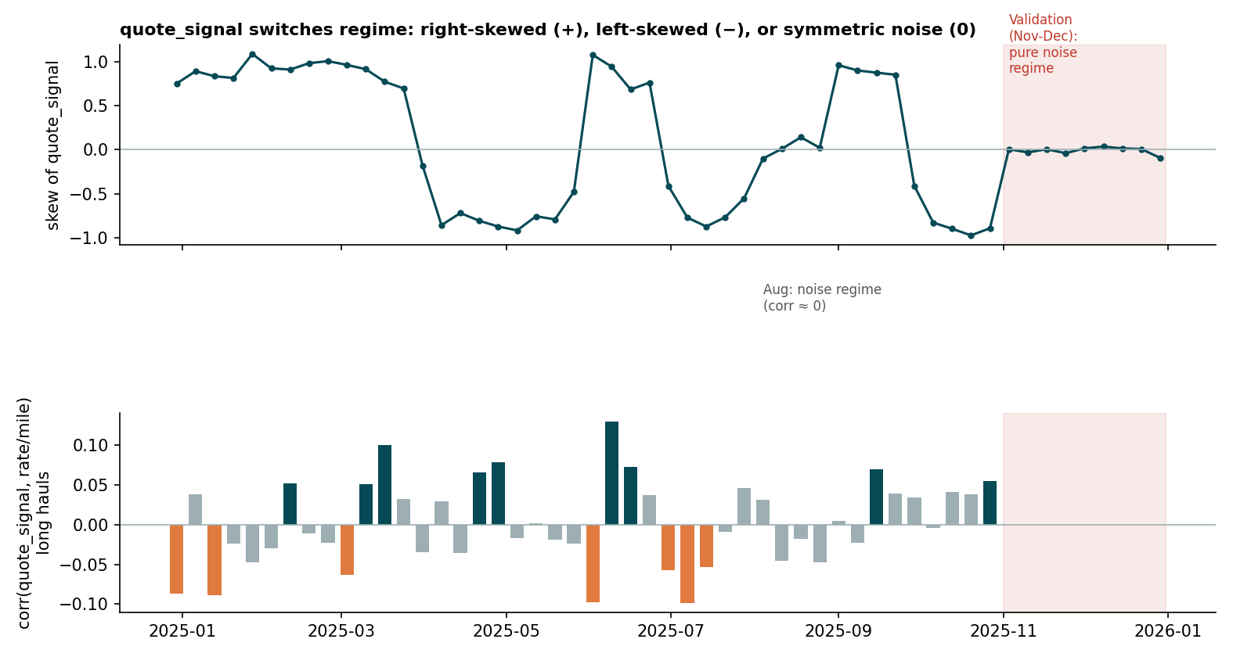
quote_signal: a regime-aware feature
Median % error | 5-fold | Noise test
Exclude | 2.80 | 2.45
Raw | 2.10 | 2.55
Regime-aware | 1.76 | 1.59
qs_signed = (qs - 2.05) x regime sign; 0 in noise months
First 7 days of a month give the same regime in 12 of 12 months
Caveat: one noise month in labels; supported, not proven
Notes:
The signal flips sign by month and is noise in August, November and December. I first excluded it, but that test was unfair because it trained on no noise month. With identical folds the regime-aware version wins on the five forward folds and on a causal noise-regime test where the model has seen part of August. The regime is knowable after the first seven days of a month. Caveat: only one noise month exists in the labels, so this is supported, not proven, for Nov and Dec.

Slide 5
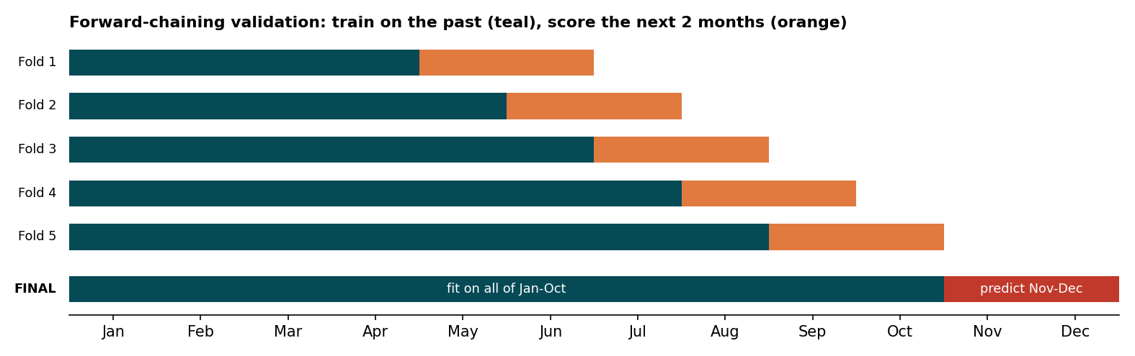
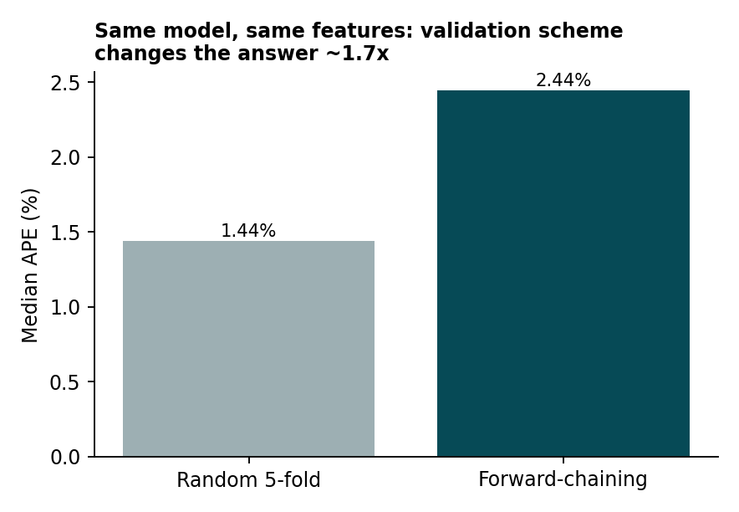
Training and validation approach
5 forward folds, 2-month horizon, expanding window
Weights, slope and model fitted inside each fold only
No month, day-of-year or date-ID features
Random 5-fold 1.44% vs forward 2.44% median error (1.7x too optimistic)
Unseen-city test (8 cities held out): 1.43% median error, same as without coordinates
Notes:
The test period is after the training period, so random splits leak daily market information. I use forward chaining: five folds, each trains on everything before and scores the next two months. The same model with random five-fold shows a lower error, so random validation overstates accuracy. The final model trains on all of January to October.

Slide 6
Why this model
LightGBM: nonlinear distance x equipment x geography
log(rate); L1 loss = median target
Recency weights (45-day half-life)
Linear daily-market term; regime-aware quote signal
5-seed average (small gain, stability)
Top features: ldist 48%, hav 13%, qs_signed 13%, dist 10%
Notes:
Gradient boosting for the nonlinear distance and geography effects, a log target because rates span a wide range, and an L1 objective because it targets the median and is robust to corrupted labels. Recency weights handle the level drift, a small linear term handles day-to-day market movement, and the regime-aware quote signal removes the sign-flipping noise.

Slide 7
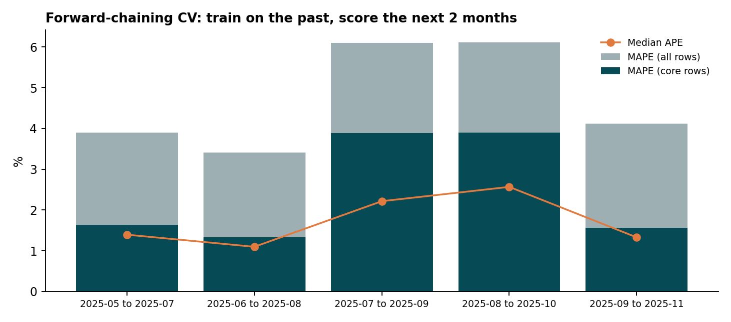
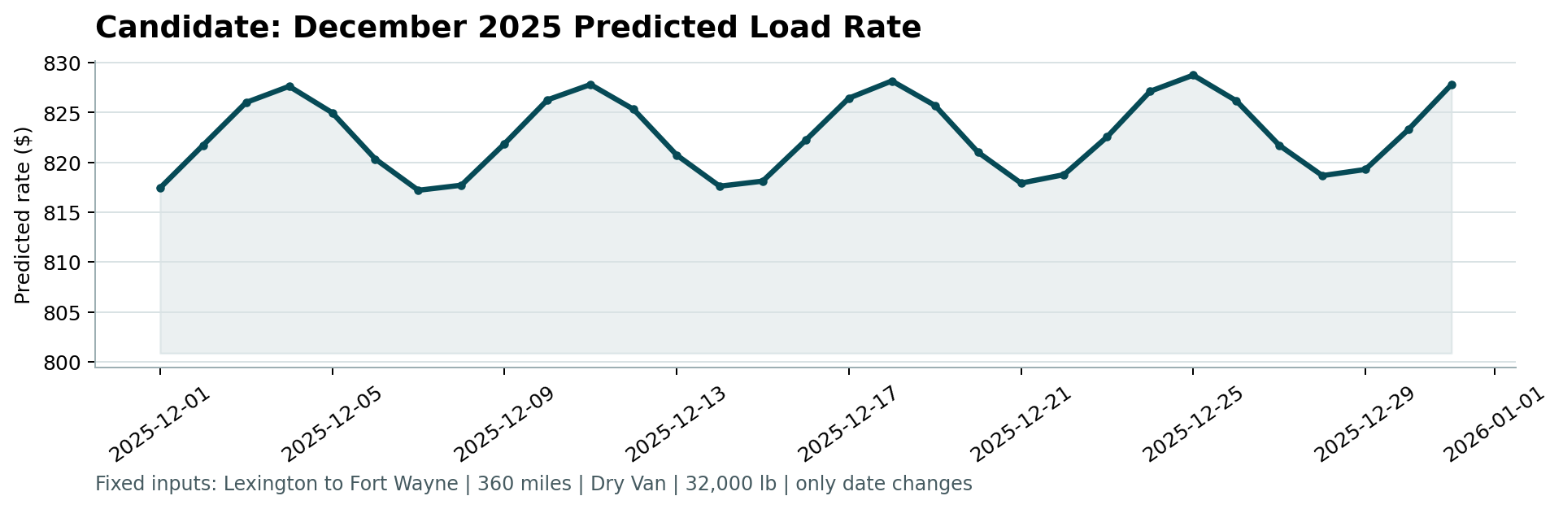
Results and December forecast
MAE $111; median error 1.72%; mean 4.73% (2.47% core); R2 0.83
Latest fold: median 1.33%, MAE $92
Weak spot: August median 5.60% vs 1.0–1.8% elsewhere (unseen regime)
December: $817-$829, a model estimate: typical error ±1.6%, up to ~±$83 in an August-like regime; no holiday information
Notes:
Across five forward folds mean absolute error is about 111 dollars, median error 1.72 percent, mean error 4.73 percent or 2.47 excluding corrupted labels. August is the weak spot at 5.60 percent, because the early folds had never seen a noise month. Nov and Dec share that regime, so the test error could be higher than the headline. The December chart comes from the supplied score.py on the same final model.

Slide 8
Code walkthrough: the parts that matter
features.py: regime-aware signal
model.py: L1 on log-rate, recency weights
sign = month -> +1 / -1 / 0 from skew of quote_signal
X["qs_signed"] = where(sign == 0, 0,
(qs - 2.05) * sign)
day["dm_dev"] = dm - monthly mean of dm
w = 0.5 ** (age_days / 45)
LGBMRegressor(objective="l1").fit(X, log(rate), w)
pred = exp(base + slope * dm_dev)
validation.py: forward chaining
Run it
for s, e in FOLDS:
train = dates < s
val = (dates >= s) & (dates < e)
fit on train only; score on val
python run_pipeline.py
python score.py --predictions validation_predictions.csv \
--december-predictions december_chart_inputs.csv
python tests/check_outputs.py
src/freight_rate/{data,features,model,validation}.py | run_pipeline.py | eda.py | scripts/ | tests/
Notes:
Show the layout, then three snippets. Features use only feature columns, never labels. The model is a LightGBM ensemble with recency weights. Validation is forward chaining. Then run the tests and the scorer live.

Slide 9
Risks and next steps
December level is extrapolated from recent months; holiday effects are not captured
Only one noise-regime month in the labels: regime-aware gain is supported, not proven, for Nov-Dec
Daily market and regime features assume the whole file is available; a strictly causal version costs little (median 1.77% vs 1.76%)
~1.4% corrupted labels put a floor on mean % error
Verified: full from-scratch run in a new virtualenv reproduced every output identically
Next: refit as new months arrive and monitor the quote_signal regime
Notes:
Close with the honest risks. The December level is extrapolated. Only one noise-regime month exists in the labels. The daily market feature assumes same-day and same-month rows are available at scoring time. Corrupted labels set a floor on mean error.

Slide 10
Recording checklist (2-3 minutes)
0:00 Findings (slide 2) and data quality with the three examples (slide 3)
0:50 quote_signal regime and why (slide 4), model reasoning (slide 6)
1:30 Split and leakage demo (slide 5); results and December chart (slide 7)
2:00 Terminal: python tests/check_outputs.py, then the score.py command
2:30 Show features.py / model.py / validation.py briefly (slide 8); close with risks
Notes:
Not part of the deck narration; use it as a script outline. Roughly: 30 seconds findings, 30 seconds data quality, 30 seconds model, 45 seconds validation, 45 seconds code and live commands.

