Slide 1
Agenda
RNN Introduction.
RNN Architecture
Types Of RNN
Training
Issue : Vanishing / Exploding Gradient
LSTM

Slide 2
RNN Intro
Artificial neural network which uses sequential data or time series data.
Sequential Data : Entities occur in a particular order
Commonly used for ordinal or temporal problems
Recurrent neural networks utilize training data to learn.
Distinguished by their “memory

Slide 3
RNN Architecture
Input, output and hidden layers
Neurons are connected to themselves through time.
Neurons have some short term memory
RNNs have two dimensions
  Time t (along the sequence length)
  The depth (usual layers).

Slide 4
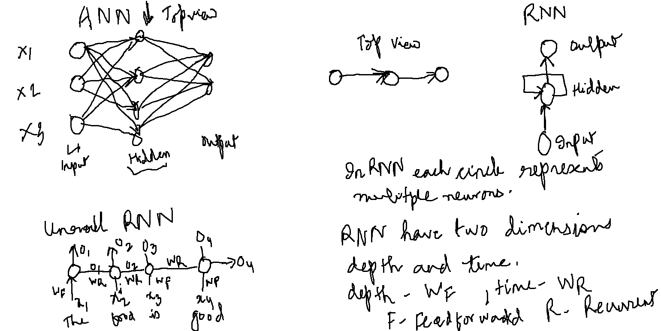
RNN Architecture

Slide 5
Types Of RNN
Many to one RNN
Many to Many RNN (equal input and output)
Many to many (unequal input and output)
One to many RNN

Slide 6
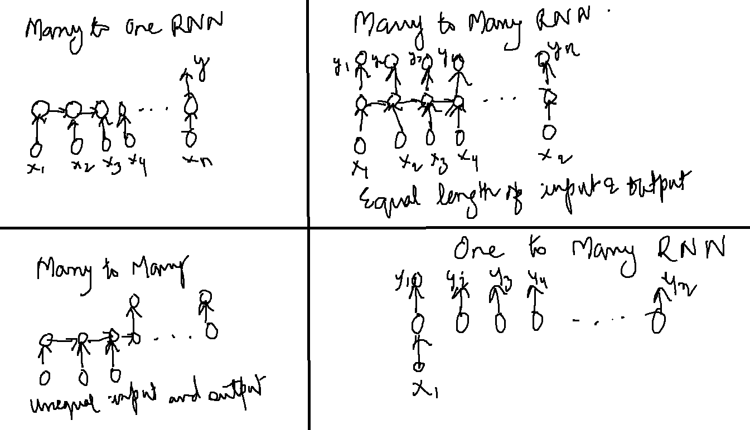
Types Of RNN

Slide 7
Training
Many to one
  Loss is simply the difference between predicted and actual
Many to Many
  Loss is calculated at each time-step

Slide 8
Vanishing/Exploding Gradient
Learn the long term dependencies between first word and last word
Output depends upon the depth and also time
Back propagation through time (BPTT).

Slide 9
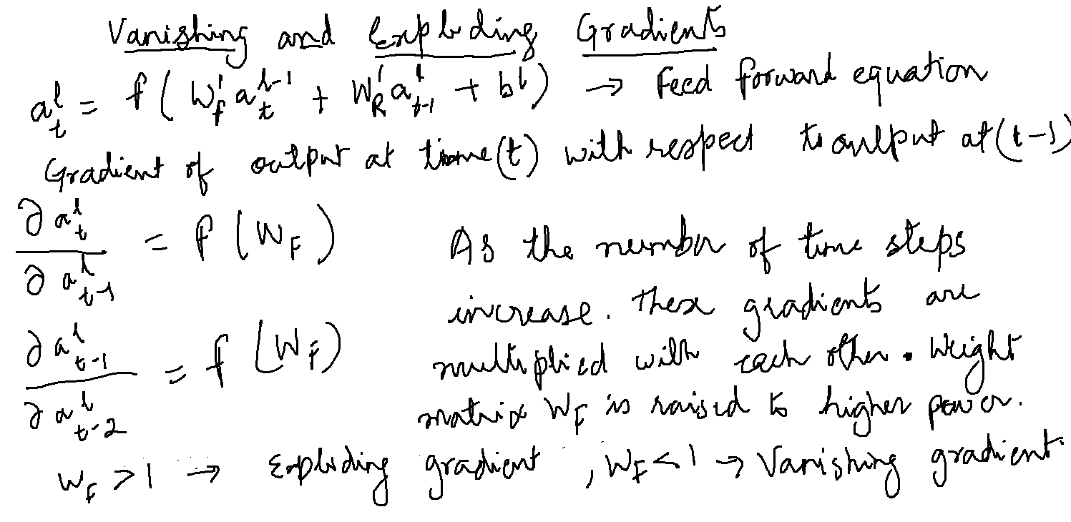
Vanishing/Exploding Gradient

Slide 10
Possible Solution
Gradient Clipping
Use Short Sequences
LSTM
GRU

Slide 11
LSTM
LSTM is characterised by the following three main properties:
The cells have an explicit 'memory'
The gating mechanisms
Constant error carousel

Slide 12
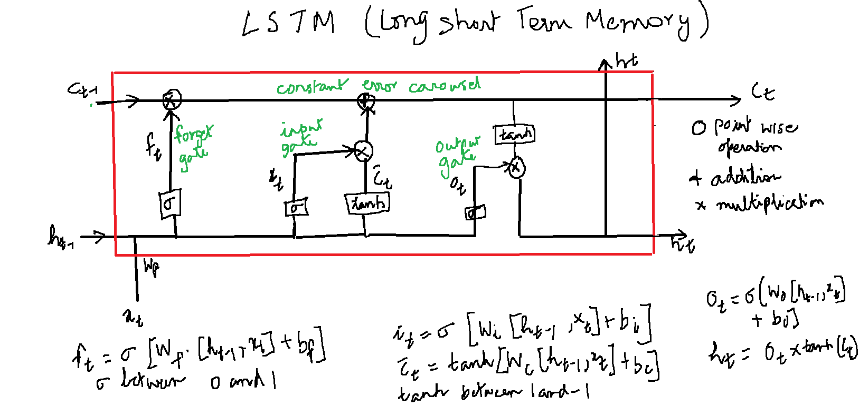
LSTM

