Slide 1
Simple Linear Regression
Most elementary type of regression model
Explains the relationship between a dependent variable and one independent variable using a straight line.
Straight line is plotted on the scatter plot of these two points.

Slide 2
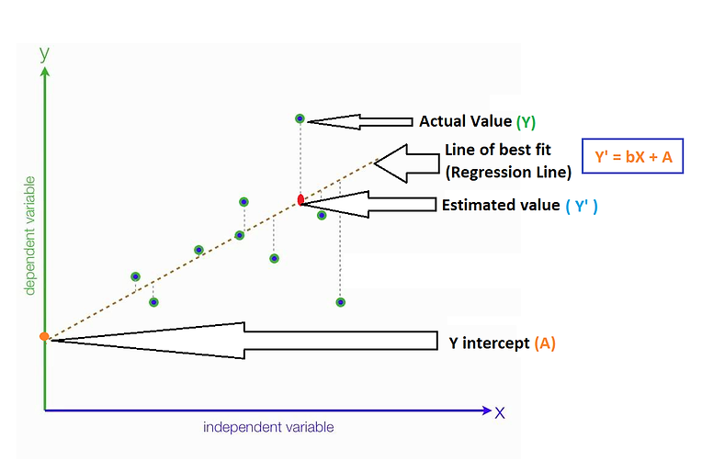
Simple linear Regression
Y` denotes the predicted value
b denotes the slope of the line
X denotes the independent variable
A is the Y intercept

Slide 3
Best fit line
Found by minimizing the expression of RSS (Residual Sum of Squares) which is equal to the sum of squares of the residual for each data point in the plot.
Residuals for any data point is found by subtracting predicted value of dependent variable from actual value of dependent variable

Slide 6
R² or Coefficient of Determination
Explains what portion of the given data variation is explained by the developed model. It always takes a value between 0 & 1.
The higher the R-squared, the better the model fits your data.

Slide 7
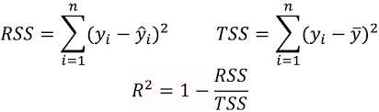
RSS (Residual Sum of Squares):
Summing the squared difference between the actual and the predicted.
A small RSS indicates a tight fit of the model to the data.
TSS (Total sum of squares):
Summing the squared difference between the actual and the average.

Slide 8
R –squared

Slide 9
Assumptions of Simple Linear Regression
There is a linear relationship between X and Y
Error terms are independent of each other
Error terms are normally distributed
Error terms have equal variance

Slide 10
Assumptions

Slide 11
Assumptions

Slide 12
Multiple Linear Regression
Statistical technique to understand the relationship between one dependent variable and several independent variables.
Objective is to find a linear equation that can best determine the value of dependent variable Y for different values independent variables in X.
Similar to simple linear regression with the small change that instead of having beta for just one variable, you will now have betas for all the variables used

Slide 13
Problems with the R-squared
Additional input variables will make the R-squared stay the same or increase.
Even if the additional input variables show no relationship with the output variables, the R-squared will increase.

Slide 14
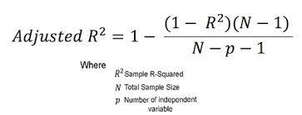
Adjusted R-squared?
Modified version of R-squared that accounts for predictors that are not significant in a regression model.
Shows whether adding additional predictors improve a regression model or not.

Slide 15

Variance Inflation Factor?
Detects multicollinearity in regression analysis.
Estimates how much the variance of a regression coefficient is inflated due to multi-collinearity in the model.
Calculated by taking a predictor, and regressing it against every other predictor in the model.

