Slide 1
T
A
L
A
R
(ONLINE GROCERIES SHOPPING)
Presented by,
RATHNA SHARMA R.S(18CS093)
RANJITH R(18CS092)
RINITA J(18CS094)
RISHIKA A(18CS095)
10-08-2020
CFC - Product Development ,Department of Computer Science and Engineering.

Slide 2
INTRODUCTION:
DEFINE
EMPATHIZE
Tell Stories
Search for meaning
Frame Opportunities
Understand the challenge
Prepare Research
Gather Inspiration
IDEATE
2
1
Generate Ideas
Refine Ideas
3
PROBLEM STATEMENT
4
PROTOTYPE & TEST
5
Make Prototypes
Get Feedback
STAGES OF DESIGN THINKING
EVOLVE
Track Learnings
Move Forward
10-08-2020
CFC - Product Development ,Department of Computer Science and Engineering.

Slide 3
PROBLEM STATEMENT AND OBJECTIVE:
"Problems faced on ONLINE GROCERIES SHOPPING" is the problem statement and our objective is to solve the problems faced by the people
10-08-2020
CFC - Product Development ,Department of Computer Science and Engineering.

Slide 4
PART
01
10-08-2020
CFC - Product Development ,Department of Computer Science and Engineering.

Slide 5
EMPATHY :
PAYMENT ISSUES &
NETWORK ISSUES
PRICE FLUCTUATIONS
FRESHNESS OF THE ITEM
NON ACCURACY OF WEIGHT
INEFFICIENT DELIVERY & DELIVERY COST
10-08-2020
CFC - Product Development ,Department of Computer Science and Engineering.

Slide 6
PART
02
10-08-2020
CFC - Product Development ,Department of Computer Science and Engineering.

Slide 7
DEFINE:
The freshness and the quality of the item was unknown to the customer. Though, the item was purchased through online and not by offline (i.e.physically).
Any issues in the website regarding payment, delivery, etc.,need to be rectified.
KEYS
KEYS
KEYS
MAIN KEYS
KEYS
KEYS
KEYS
KEYS
10-08-2020
CFC - Product Development ,Department of Computer Science and Engineering.

Slide 8
PART
03
10-08-2020
CFC - Product Development ,Department of Computer Science and Engineering.

Slide 9
We have multiple delivery methods like direct delivery, click and pickup delivery
Even for bulk orders, we are providing free delivery
3
4
We also provide the details of the item,like manufactured date and expiry date on the website. so, that the customer can know about the quality and freshness
We had provided multiple payment methods like online payment and cash-on-delivery
2
5
IDEATE
We will provide a HELP & SUPPORT BOX, on the website. To help the customer by answering their queries and to rectify the complaints.
1
6
If the customer feels that the item's quality was bad, they can return the item and can get the new one."We assure the quarentee"
10-08-2020
CFC - Product Development ,Department of Computer Science and Engineering.

Slide 10
PART
04
10-08-2020
CFC - Product Development ,Department of Computer Science and Engineering.

Slide 11
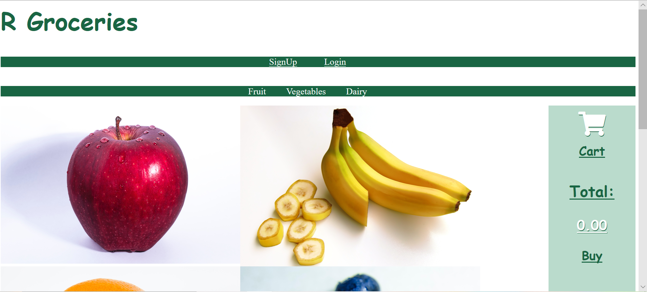
HOME PAGE
10-08-2020
CFC - Product Development ,Department of Computer Science and Engineering.

Slide 12

10-08-2020
CFC - Product Development ,Department of Computer Science and Engineering.

Slide 13
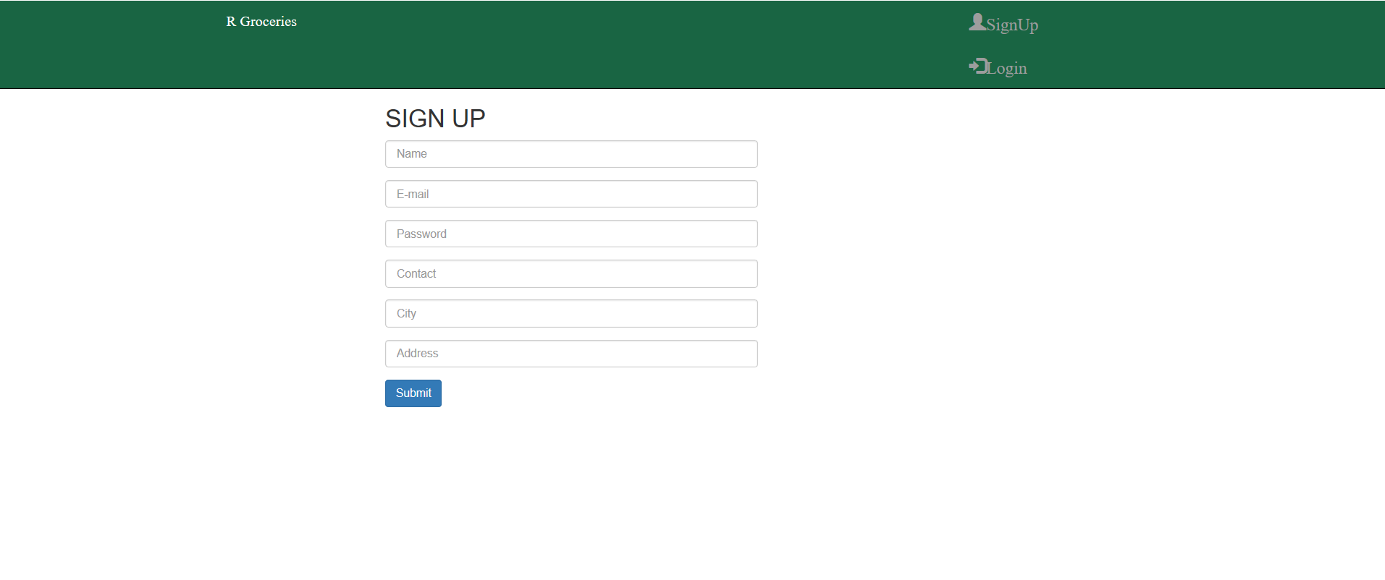
10-08-2020
CFC - Product Development ,Department of Computer Science and Engineering.

Slide 14
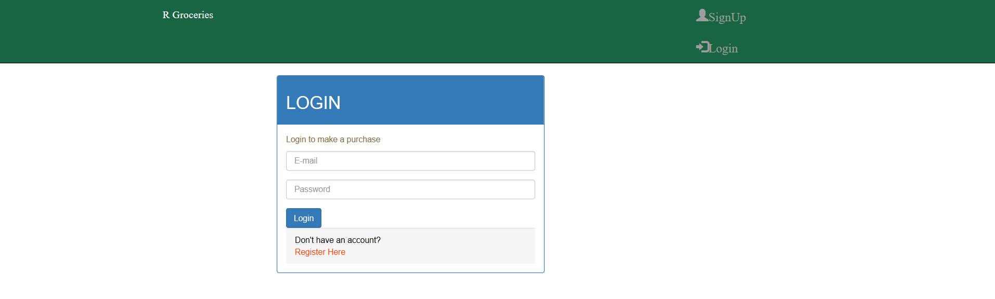
10-08-2020
CFC - Product Development ,Department of Computer Science and Engineering.

Slide 15
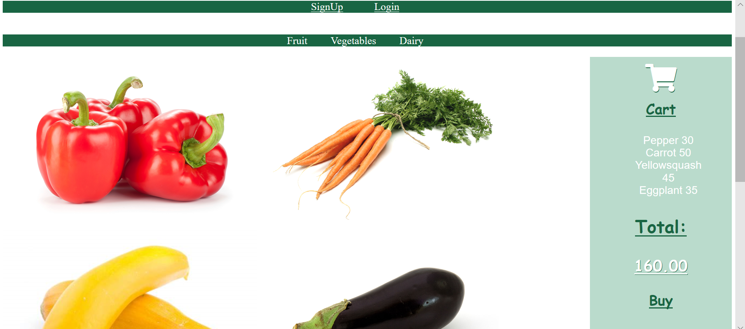

10-08-2020
CFC - Product Development ,Department of Computer Science and Engineering.

Slide 16
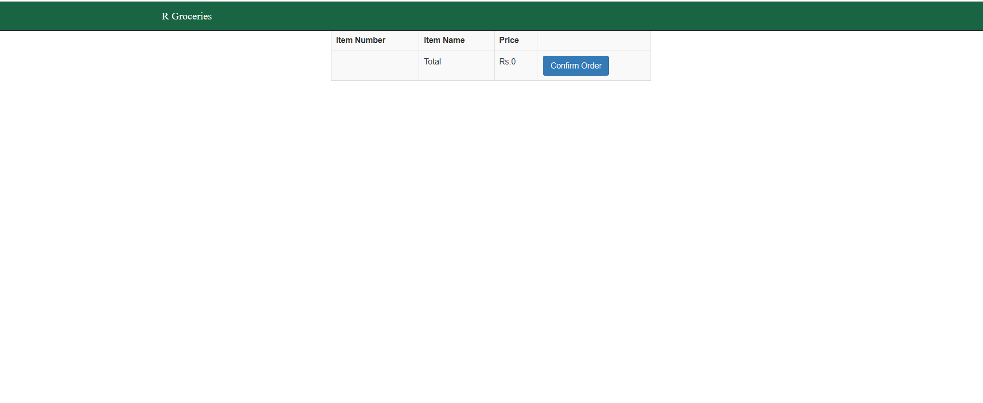
10-08-2020
CFC - Product Development ,Department of Computer Science and Engineering.

Slide 17
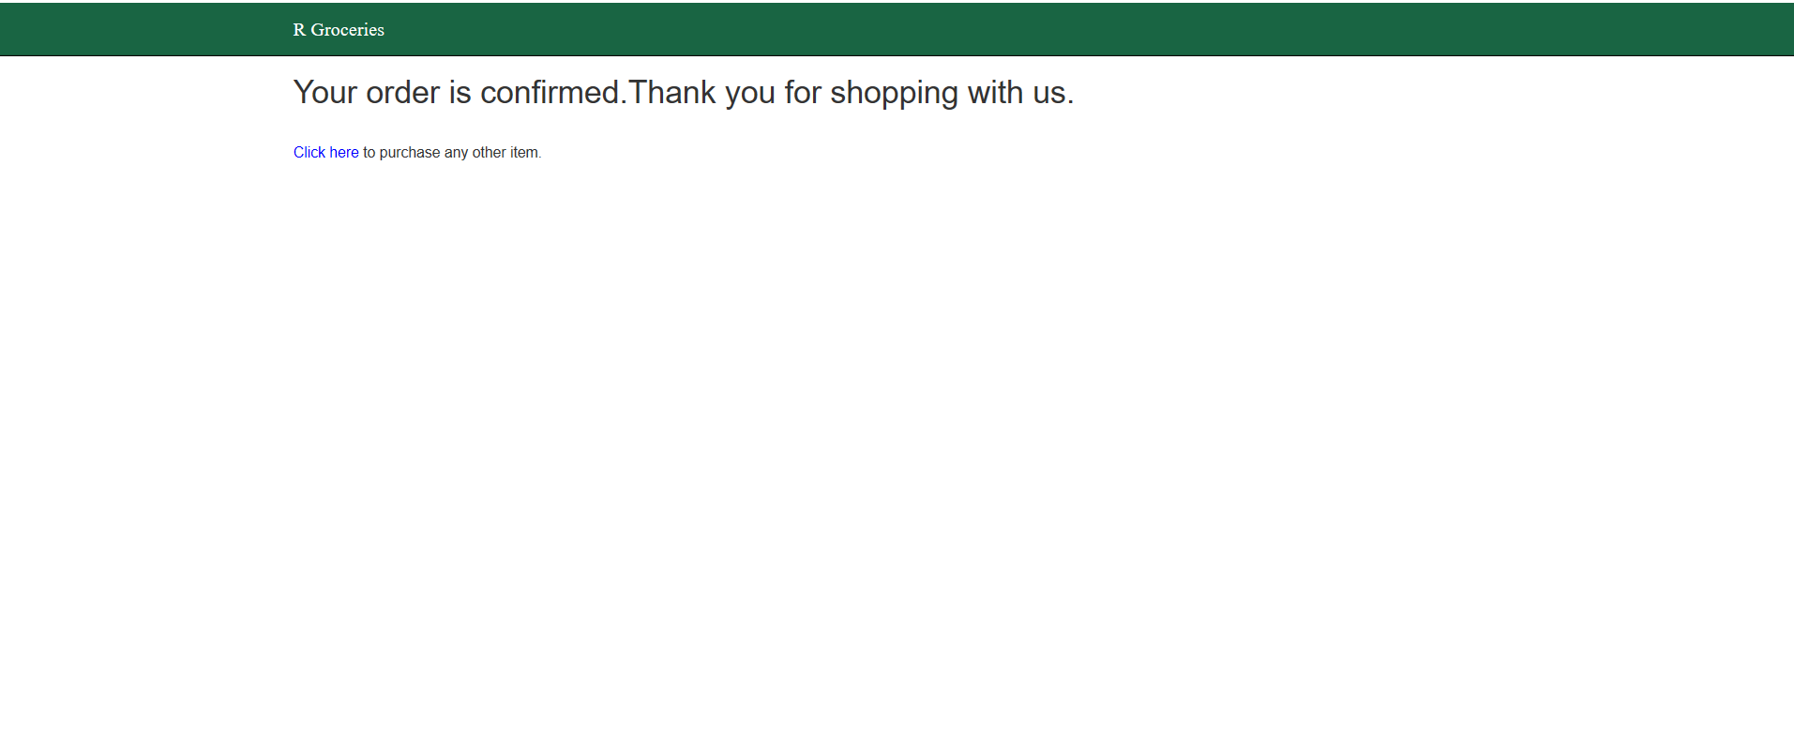
10-08-2020
CFC - Product Development ,Department of Computer Science and Engineering.

Slide 18
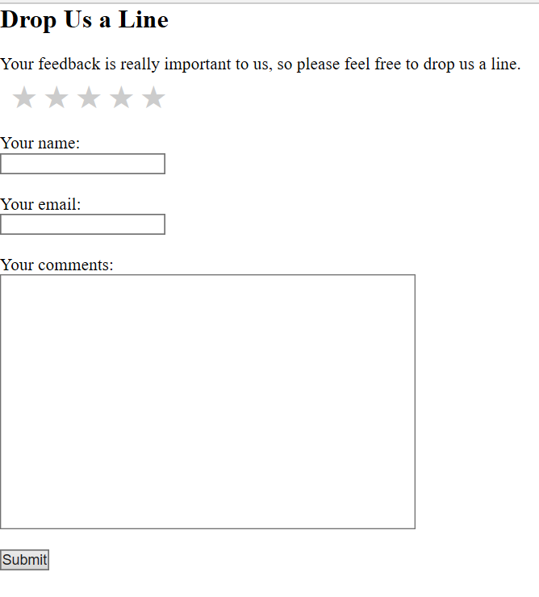
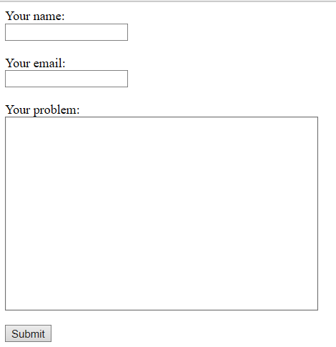
10-08-2020
CFC - Product Development ,Department of Computer Science and Engineering.

Slide 19
PART
05
10-08-2020
CFC - Product Development ,Department of Computer Science and Engineering.

Slide 20


EVOLVE:
REVIEW SESSION:
Average ratings
Average ratings
Average ratings
The fruits and vegetables were really fresh and good....
There is no drawback in the delivery...worthy....
I like the delivery methods... It was comfort for me....
We are going to implement these features in the upcoming days.
10-08-2020
CFC - Product Development ,Department of Computer Science and Engineering.

Slide 21
CONCLUSION:
You can do endless online shopping without getting tired.
24*7 availability, So you can start purchasing at anytime.
We makes your work easier, delivery at your doorstep.
Our only moto is "Enhancing the lifestyle of shopping to the next level".
10-08-2020
CFC - Product Development ,Department of Computer Science and Engineering.

Slide 22
QUERIES
10-08-2020
CFC - Product Development ,Department of Computer Science and Engineering.

Slide 23
THANK YOU...
10-08-2020
CFC - Product Development ,Department of Computer Science and Engineering.

