Slide 1
Adaptive Learning System: Automatic Student Segmentation Based on Online Course Interaction
Presented by: Rohit Singh Rawat CSE-B
2021395

Slide 2

Introduction:
Overview:
Adaptive learning systems personalize education by tailoring content to individual student needs.
Problem Statement:
Online courses generate vast amounts of interaction data, but categorizing students based on this data remains a challenge.
Objective:
Develop a system that segments students automatically, enhancing the learning experience.

Slide 3
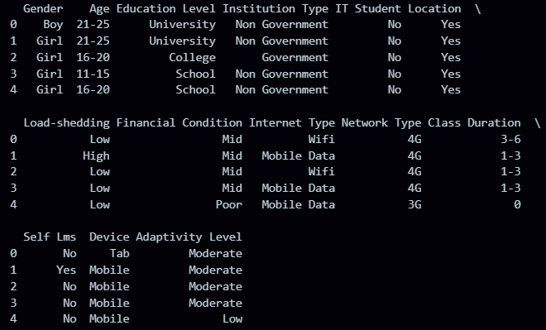
Dataset:
- Collected from kaggle ( https://www.kaggle.com/code/sanmiodunt an/online-learning-adaptivity-eda-ml ), consisting of 1205 students.
Features includes gender, age, education, institution, IT Student, Location, Load- shed, Financial condition, Internet , network types, class duration, self lms, Device.
Target Variable (label):"Adaptivity Level" representing the student's engagement and adaptability.

Slide 4
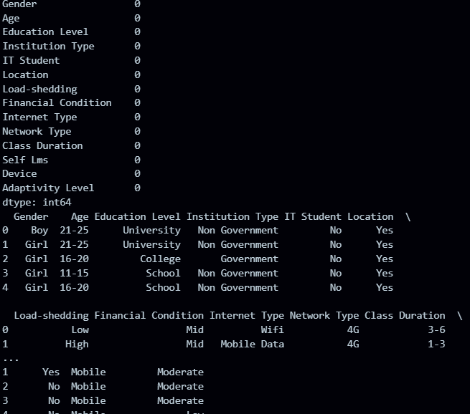

Data Preprocessing:
Handling Missing Values:
Removed rows with missing values to ensure data integrity.
Encoding Categorical Variables:
Used LabelEncoder to convert categorical data into numerical format.
Visualization:Distribution of adaptivity levels using a count plot.

Slide 5
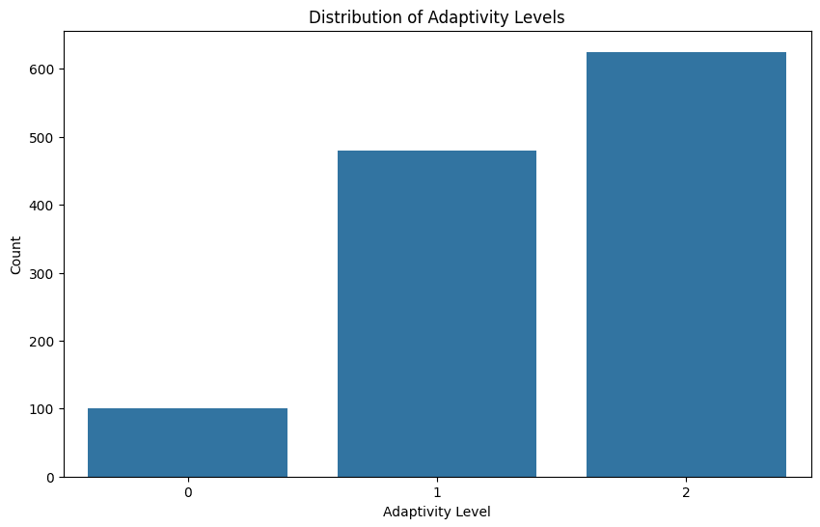
Adaptability Levels:

Slide 6
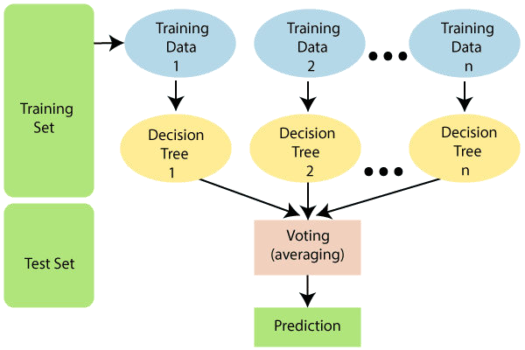
Model Training:
Model Selection:
I used RandomForestClassiﬁer for
training and testing the data for its robustness and interpretablity.
Training Process:
Split data into training (80%) and testing (20%) sets.

Slide 7
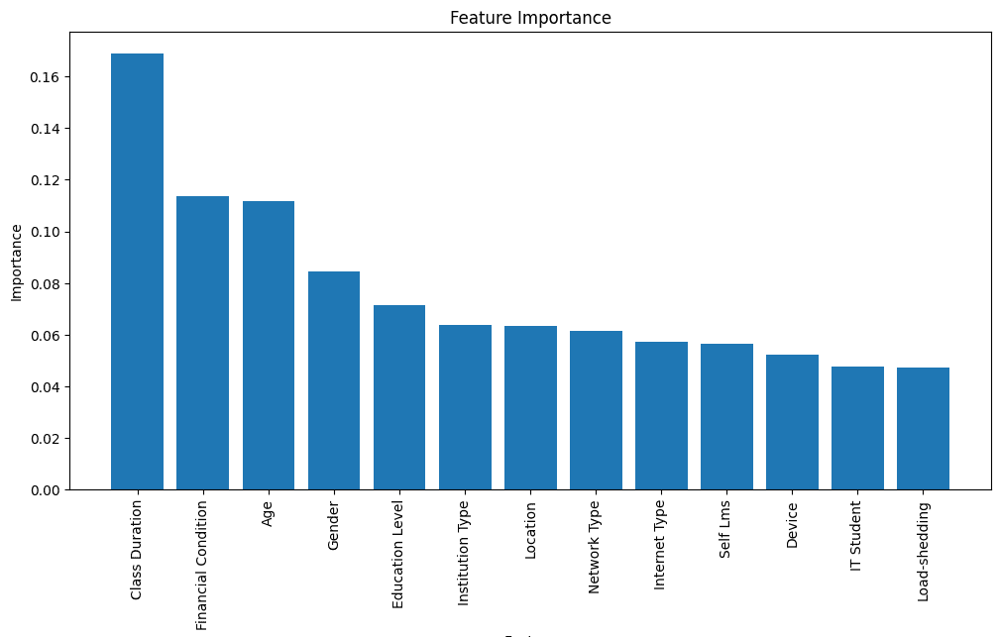
Feature Importance:

Slide 8
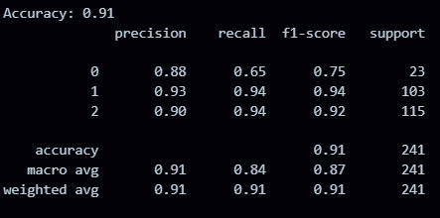
Model Evaluation:
Model Accuracy:
This model achieved a good accuracy o
91% which is way better than other machine learning algorithms.
Classiﬁcation Report: Precision: Correct positives Recall: Retrieved positives
F1-score: Balance metric for each class

Slide 9
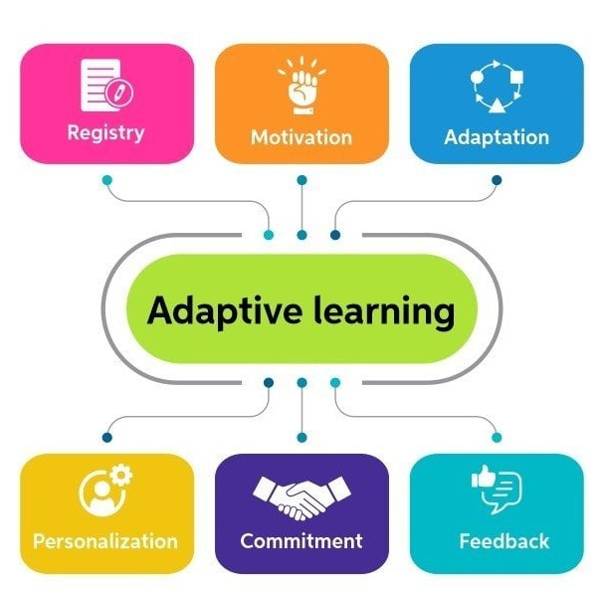
Results and Discussion:
Identiﬁed Key Features:
The Random Forest Classiﬁer provided insights into which features are most inﬂuential in determining adaptivity levels.The top three features identiﬁed were:
Feature 1: "Class Duration" Feature 2:"Financial Condition" Feature 3: "Age"
Results Suggest:
The model's accuracy and feature importance analysis indicate that certain behaviors and metrics are strong indicators of student adaptivity.

Slide 10
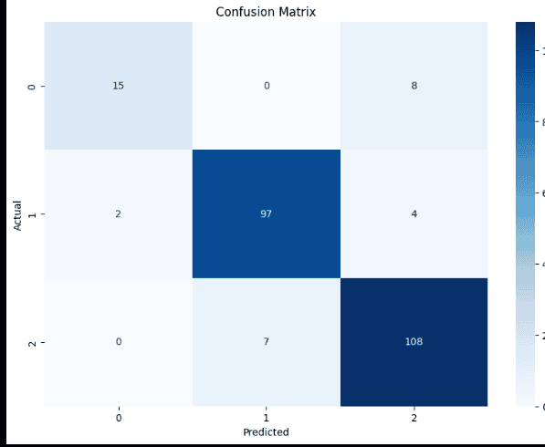
Confusion matrix:

Slide 11

Conclusion:
In this project, we successfully developed an adaptive learning system that segments students based on their online course interactions using a Random Forest Classifier. By identifying key features such as Class Duration, Financial Condition and Age, we were able to predict adaptivity levels with notable accuracy. These findings highlight the potential of data-driven approaches to enhance personalized learning experiences, enabling educators to better understand and support diverse learning needs
Thanks!

