Slide 1
Prediction of Maintenance for
Locomotive Engines
PHD- Submission-2
G Rohit Sai Kiran
16th Sep 2018

Slide 2
Contents
Introduction
Exploratory Data Analysis
Feature Engineering
PHD- Submission-2

Slide 3
Introduction
Dataset is about maintenance history of Locomotive engines
Five datasets provided regarding the Locomotive engines:
Machine Details:
List of all machines
Model of each machine
Service period
Complaint Log
Errors logged in each machine with time
Five types of Errors
Service Log
Date, time and type of services done on each machine
Only two types of services listed
Components replaced
History of components replaced(also a type of service)
Operating conditions
Timestamp of sensor data
PHD- Submission-2

Slide 4
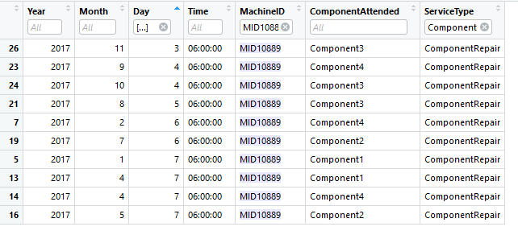
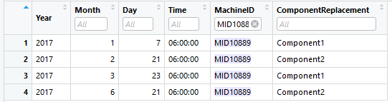
Exploratory Data Analysis
Some of the Component repairs and Scheduled services are actually component replacements
Attending to the engine is done on the next day after occurrence of an Error
PHD- Submission-2

Slide 5
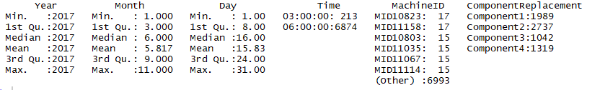
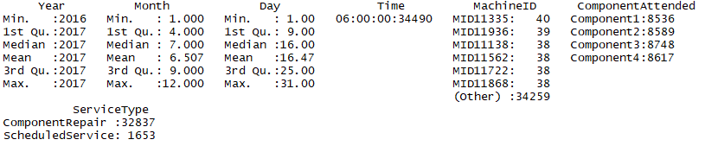
Exploratory Data Analysis
Summary of Components Replaced
Summary of Components Serviced
PHD- Submission-2

Slide 6
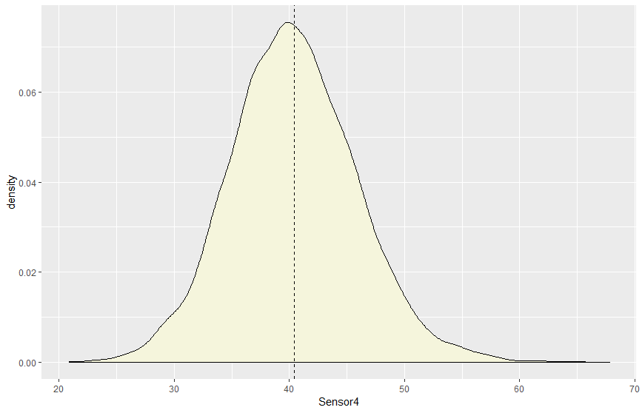
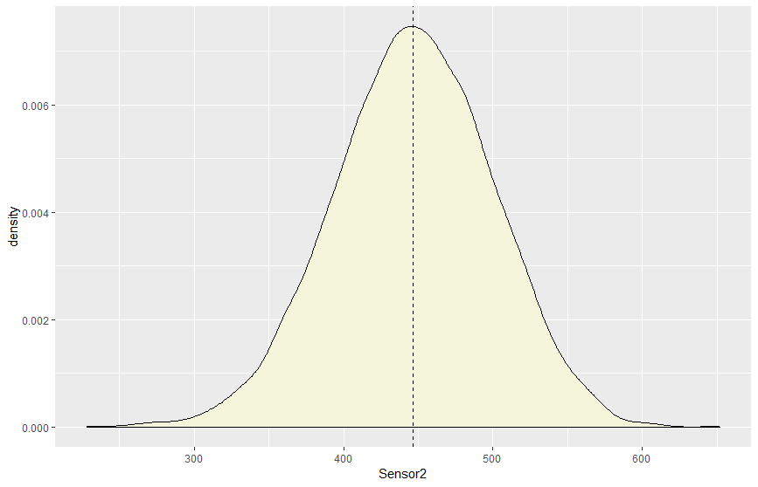
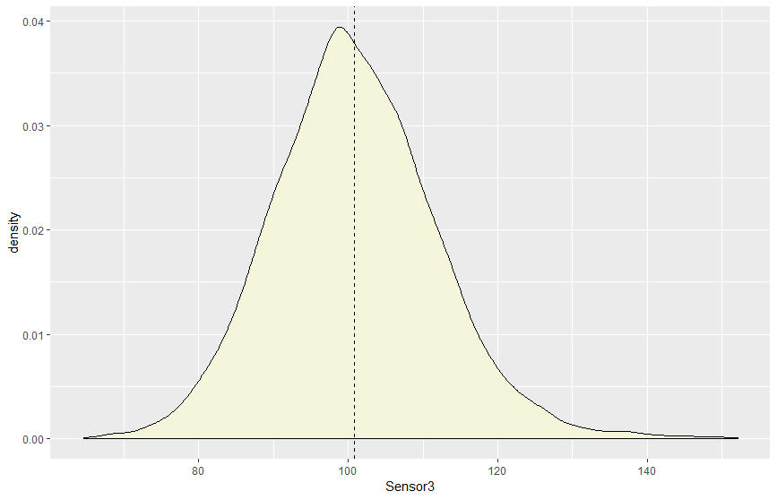
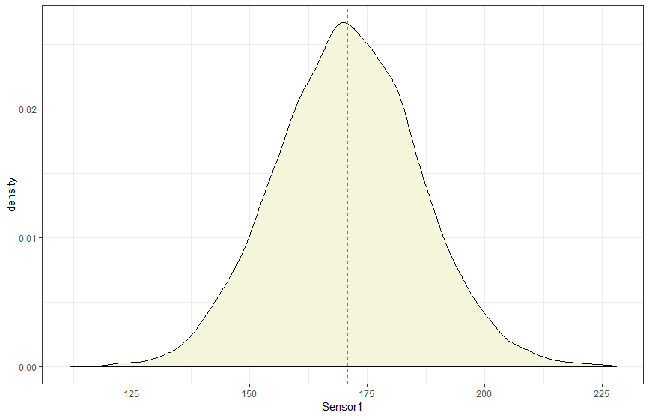
Exploratory Data Analysis
All the sensors have specific zones of operation. All sensors are of range type. Sensors 3 & 4 have instances that are towards the tail indicating possible malfunction
PHD- Submission-2

Slide 7
Feature Extraction & Engineering
Sl.No | Features
1 | MachineModel
2 | ServicePeriod
3 | No.Replacements
4 | No.schservice
5 | No.Repairs
6 | mean_Compreplaced
7 | min_Compreplaced
8 | max_Compreplaced
9 | mean_schrepair
10 | min_schrepair
11 | max_schrepair
12 | mean_comprepair
13 | min_comprepair
14 | max_comprepair
15 | min.Sensor1.
16 | max.Sensor1.
17 | min.Sensor2.
18 | max.Sensor2.
Sl.No | Features
19 | min.Sensor3.
20 | max.Sensor3.
21 | min.Sensor4.
22 | max.Sensor4.
23 | error2
24 | error3
25 | error4
26 | error5
27 | error1
28 | Noaction_Errors
Initial Modelling
PHD- Submission-2

Slide 8
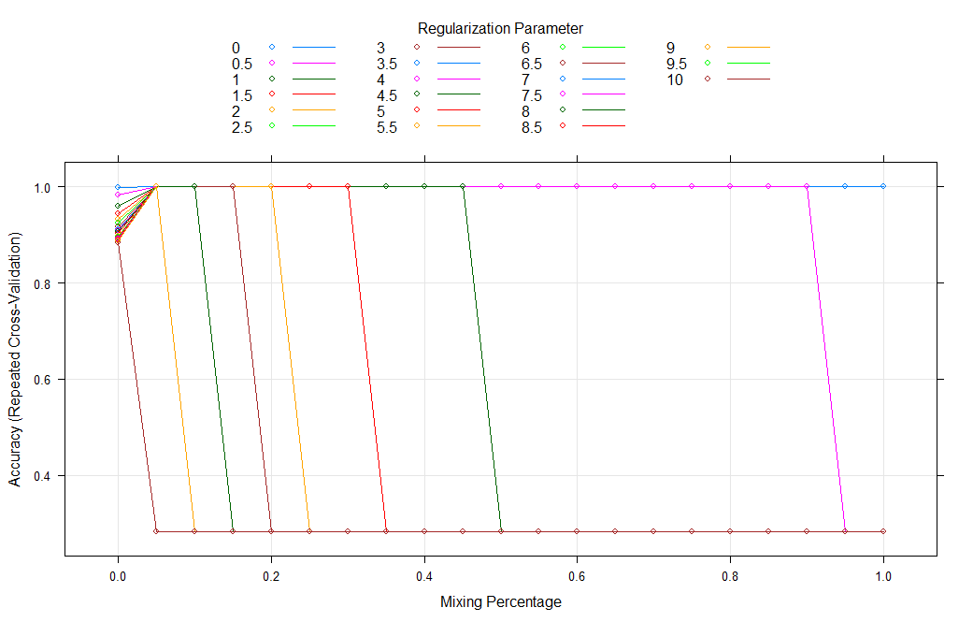
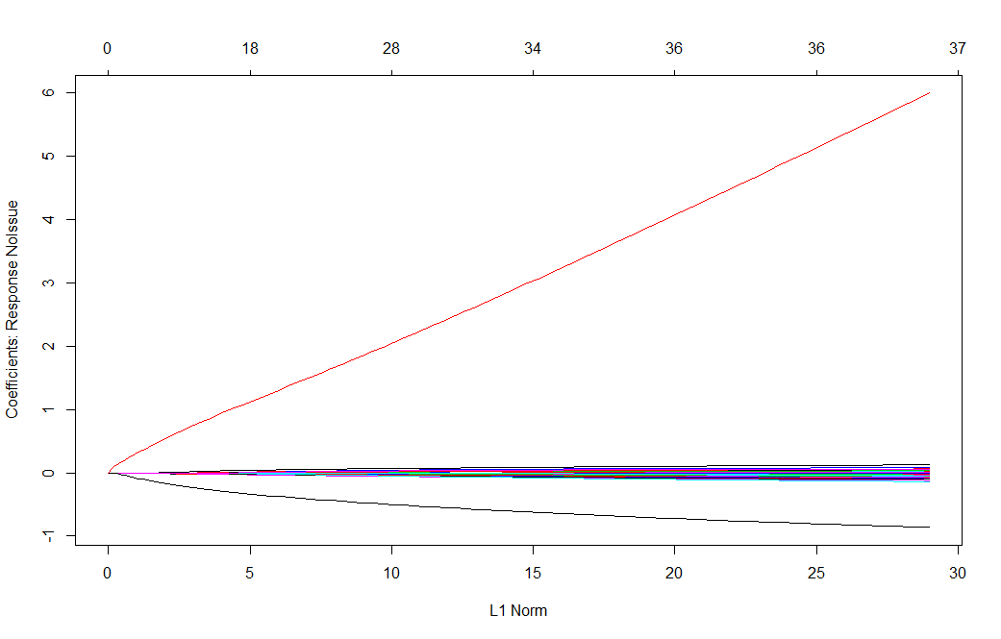
Model Building Approaches
Model-1: Elastic NET
28 Predictor Variables
3 Classes
Imbalanced Dataset
Smote Sampling
with
Elastic net
F-1 Stat
Validation Dataset
~25%
F-1 Stat
Grader
~15%
PHD- Submission-2

Slide 9
Model Building Approaches
Model-2: XGBoost with Class weights
28 Predictor Variables
3 Classes
Imbalanced Dataset
XGBtree with class weights
F-1 Stat
Validation Dataset
~25%
F-1 Stat
Grader
~19%
Model-2: XGBoost Stack on three SVM Models
Component Replacement
Other
SVM
F-1 Stat
Validation Dataset
Component Replacement
Component Repair
Scheduled Service
~60%
Component Repair
Other
SVM
F-1 Stat
Grader
~28%
Noissue
Other
SVM
PHD- Submission-2

Slide 10
Feature Extraction & Engineering -Further
Sl.No | Features | Description
1 | Service Period | Service life of each Engine
2 | No.Replacements | No.of Component Replacements Done
3 | No.schservice | No. of Scheduled Services Done
4 | No.Repairs | No. of Component Repairs
5 | mean_Compreplaced | Mean time between Comp. Replacements
6 | min_Compreplaced | Min time between Comp. replacements
7 | max_Compreplaced | max time between Comp.replaced
8 | mean_schrepair | Mean time between Scheduled Repairs
9 | min_schrepair | Min time between Comp. replacements
10 | max_schrepair | Max time between Scheduled Repairs
11 | mean_comprepair | Mean Time between Comp. Repairs
12 | min_comprepair | Min time between Comp. Repair
13 | max_comprepair | Max Time between Comp.Repair
14 | error1 | Total No. of Error1
15 | error2 | Total No. of Error2
16 | error3 | Total No. of Error3
17 | error4 | Total No. of Error4
18 | error5 | Total No. of Error5
PHD- Submission-2

Slide 11
Feature Extraction & Engineering -Further
Sl.No | Features | Description
19 | Noaction_Errors | No. of times No action was taken for an Error
20 | Range_Sensor1_Noerror | min-max Ranges for Senors for each errors
21 | Mean_Sensor1_Noerror | min-max Ranges for Senors for each errors
22 | Range_Sensor2_Noerror | min-max Ranges for Senors for each errors
23 | Mean_Sensor2_Noerror | min-max Ranges for Senors for each errors
24 | Range_Sensor3_Noerror | min-max Ranges for Senors for each errors
25 | Mean_Sensor3_Noerror | min-max Ranges for Senors for each errors
26 | Range_Sensor4_Noerror | min-max Ranges for Senors for each errors
27 | Mean_Sensor4_Noerror | min-max Ranges for Senors for each errors
28 | Range_Sensor1_error2 | min-max Ranges for Senors for each errors
29 | Mean_Sensor1_error2 | min-max Ranges for Senors for each errors
30 | Range_Sensor2_error2 | min-max Ranges for Senors for each errors
31 | Mean_Sensor2_error2 | min-max Ranges for Senors for each errors
32 | Range_Sensor3_error2 | min-max Ranges for Senors for each errors
33 | Mean_Sensor3_error2 | min-max Ranges for Senors for each errors
34 | Range_Sensor4_error2 | min-max Ranges for Senors for each errors
35 | Mean_Sensor4_error2 | min-max Ranges for Senors for each errors
36 | Range_Sensor1_error3 | min-max Ranges for Senors for each errors
37 | Mean_Sensor1_error3 | min-max Ranges for Senors for each errors
PHD- Submission-2

Slide 12
Feature Extraction & Engineering -Further
Sl.No | Features | Description
38 | Noaction_Errors | No. of times No action was taken for an Error
39 | Range_Sensor1_Noerror | min-max Ranges for Senors for each errors
40 | Mean_Sensor1_Noerror | min-max Ranges for Senors for each errors
41 | Range_Sensor2_Noerror | min-max Ranges for Senors for each errors
42 | Mean_Sensor2_Noerror | min-max Ranges for Senors for each errors
43 | Range_Sensor3_Noerror | min-max Ranges for Senors for each errors
44 | Mean_Sensor3_Noerror | min-max Ranges for Senors for each errors
45 | Range_Sensor4_Noerror | min-max Ranges for Senors for each errors
46 | Mean_Sensor4_Noerror | min-max Ranges for Senors for each errors
47 | Range_Sensor1_error2 | min-max Ranges for Senors for each errors
48 | Mean_Sensor1_error2 | min-max Ranges for Senors for each errors
49 | Range_Sensor2_error2 | min-max Ranges for Senors for each errors
50 | Mean_Sensor2_error2 | min-max Ranges for Senors for each errors
51 | Range_Sensor3_error2 | min-max Ranges for Senors for each errors
52 | Mean_Sensor3_error2 | min-max Ranges for Senors for each errors
53 | Range_Sensor4_error2 | min-max Ranges for Senors for each errors
54 | Mean_Sensor4_error2 | min-max Ranges for Senors for each errors
55 | Range_Sensor1_error3 | min-max Ranges for Senors for each errors
56 | Mean_Sensor1_error3 | min-max Ranges for Senors for each errors
PHD- Submission-2

Slide 13
Feature Extraction & Engineering -Further
Sl.No |  | Features | Description
57 | Mean_Sensor3_error5 | min-max Ranges for Senors for each errors
58 | Range_Sensor4_error5 | min-max Ranges for Senors for each errors
59 | Mean_Sensor4_error5 | min-max Ranges for Senors for each errors
60 | Range_Sensor1_error1 | min-max Ranges for Senors for each errors
61 | Mean_Sensor1_error1 | min-max Ranges for Senors for each errors
62 | Range_Sensor2_error1 | min-max Ranges for Senors for each errors
63 | Mean_Sensor2_error1 | min-max Ranges for Senors for each errors
64 | Range_Sensor3_error1 | min-max Ranges for Senors for each errors
65 | Mean_Sensor3_error1 | min-max Ranges for Senors for each errors
66 | Range_Sensor4_error1 | min-max Ranges for Senors for each errors
67 | Mean_Sensor4_error1 | min-max Ranges for Senors for each errors
68 | Max_Occuring_error | Maximium Occuring Error
69 | Max_replaced_Comp | Maximum Replaced Component
70 | Max_service_comp | Maximum Service Component
71 | error2._NO.Comp_replacements | No. of components Replaced for each errro
72 | error3._NO.Comp_replacements | No. of components Replaced for each errro
73 | error4._NO.Comp_replacements | No. of components Replaced for each errro
74 | error5._NO.Comp_replacements | No. of components Replaced for each errro
75 | error1._NO.Comp_replacements | No. of components Replaced for each errro
PHD- Submission-2

Slide 14
Model Building Approaches
Model-4: XGBoost
75 Predictor Variables
3 Classes
Imbalanced Dataset
XGBtree with class weights
F-1 Stat
Validation Dataset
~60%
F-1 Stat
Grader
~29%
PHD- Submission-2

Slide 15
Thank You

