Slide 1
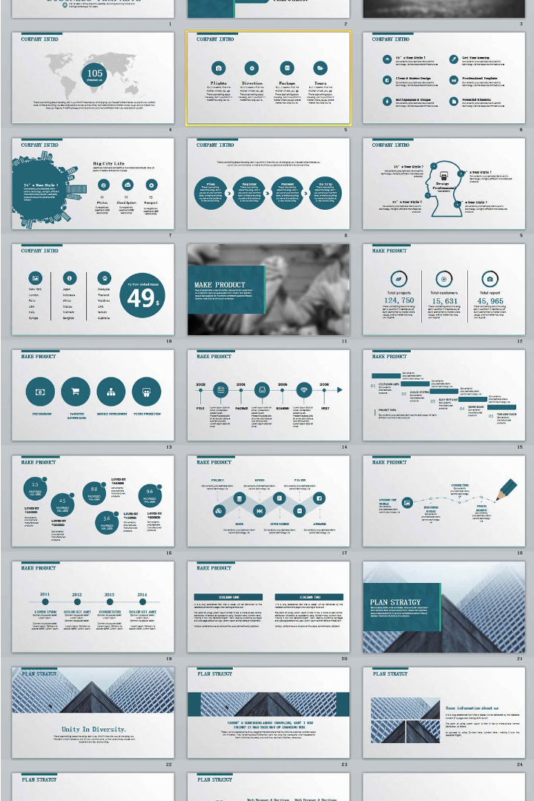


Adidas Sales Performance Dashboard
This presentation provides an overview of the Adidas sales performance and key outcomes from the project. It will be delivered to the Adidas sales and management teams.
by rohit saini

Slide 2
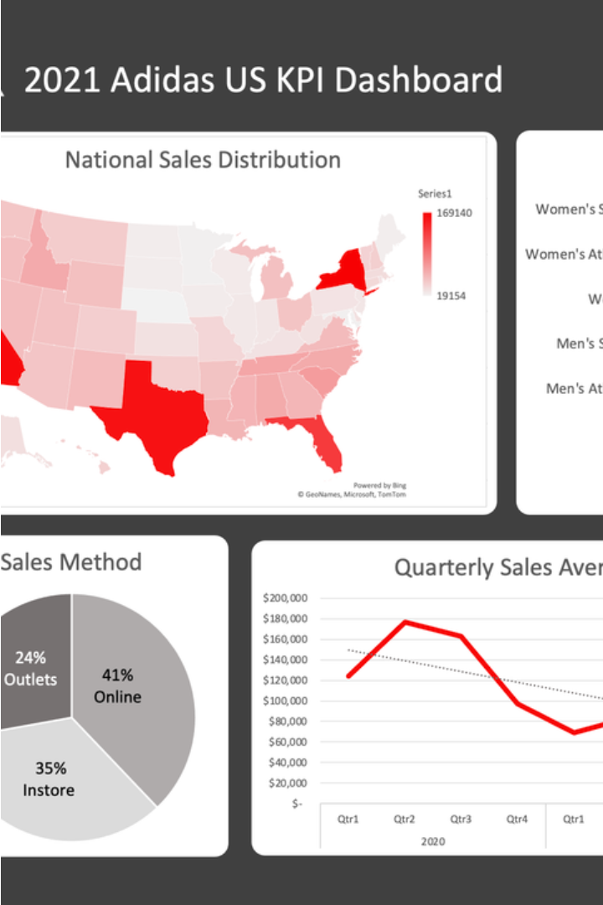
Introduction
Today, I will present the Adidas Sales Performance Dashboard, a comprehensive tool developed to analyze and visualize sales data for Adidas. This dashboard provides deep insights into sales performance, market trends, and regional analysis to help the Adidas team make data-driven decisions.

Slide 3

Project Objectives
Enhanced Data Visibility
Data-Driven Decisions
Detailed Insights
KPI Tracking
Establish effective tracking of sales goals and key performance indicators to measure progress and identify areas for improvement.
Improve understanding of sales performance and trends through increased data visibility and transparency.
Enable the sales and management teams to make informed, data-driven decisions to drive business growth.
Provide comprehensive insights into regional and product-level sales to support strategic planning and performance optimization.

Slide 4
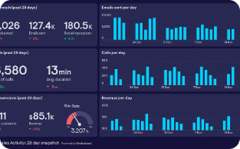
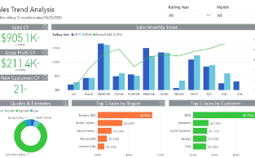
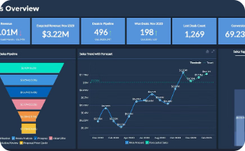
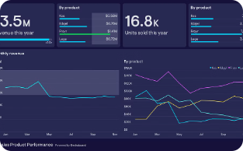
Dashboard Features
Sales Performance Overview
Sales Trend Analysis
Regional Sales Insights
Product Performance
Advanced line charts with forecasting capabilities allow users to project future sales based on historical data and identify emerging trends.
Geographical maps and bar charts highlight sales distribution and performance across different regions and states for targeted strategy development.
In-depth analysis of sales and profitability by product category provides visibility into best-sellers and underperforming items.
The dashboard provides a high-level summary of total sales, units sold, and operating profit using intuitive card visuals for quick insights.

Slide 5
Data Visualization and Analytics
Power BI
DAX Calculations
Data Transformation
User Experience
We utilized Power BI to create visually appealing and informative charts and graphs that bring the sales data to life.
Advanced DAX (Data Analysis Expressions) calculations were employed to develop dynamic measures and analyses for the dashboard.
An intuitive and user-friendly interface was designed to enhance the overall experience and accessibility of the dashboard.
The raw sales data was structured and transformed for optimal performance and usability within the Power BI platform.

Slide 6
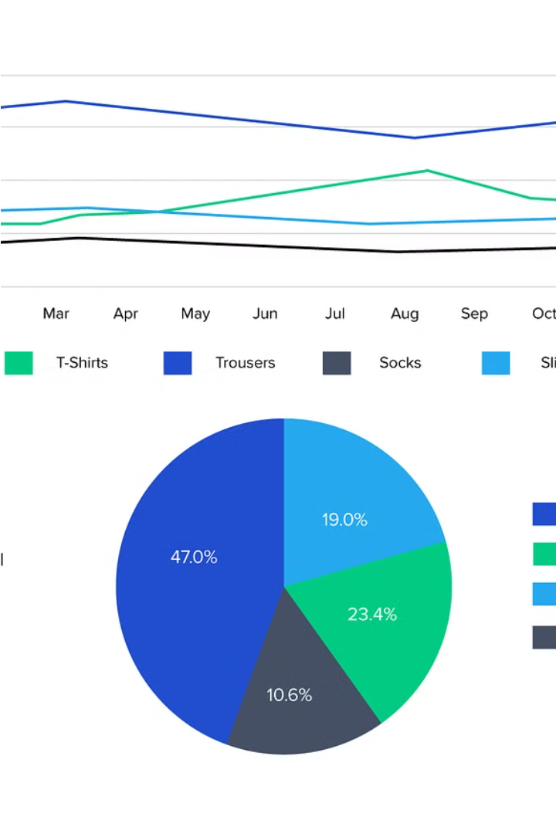
Sales Forecasting
The Adidas sales dashboard features robust forecasting capabilities, allowing the company to predict future sales trends based on historical data. By implementing advanced forecasting models, Adidas can strategically plan inventory and meet anticipated demand more effectively.
The sales forecasting module analyzes past sales patterns, market factors, and other key data points to generate accurate predictions of future performance. This enables Adidas to make informed decisions, optimize inventory, and stay ahead of the curve in a highly competitive industry.

Slide 7
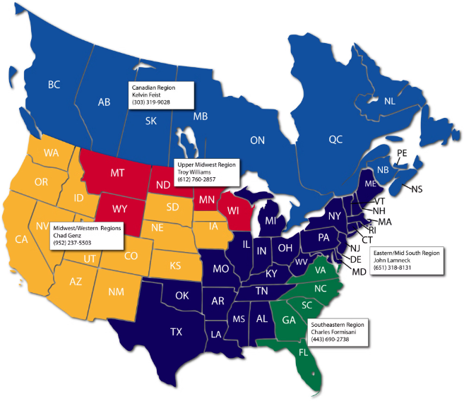
Regional Analysis
The dashboard provides detailed regional analysis, allowing us to examine sales performance across different regions and states. This insight is crucial for identifying key growth areas and opportunities to guide targeted marketing efforts and resource allocation.

Slide 8

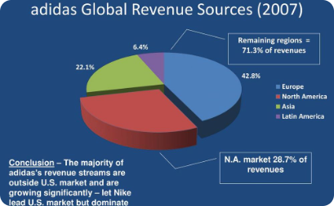
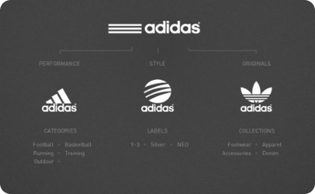
Product Performance Analysis
Identify Top-Selling Items
Analyze Profitability
Optimize the Product Mix
In addition to sales volume, the dashboard evaluates product profitability. This empowers us to focus resources on the most lucrative items and identify opportunities to improve margins on underperforming products.
The dashboard's product performance analysis allows us to pinpoint the best-selling Adidas products across categories. This data-driven insight supports strategic decision-making to optimize the product mix and meet consumer demand.
By combining sales and profitability insights, the dashboard enables us to strategically refine the Adidas product portfolio. This ensures we offer the optimal mix of products to meet evolving market needs and drive continued growth.

Slide 9
Outcomes
Enhanced Data Visibility
Data-Driven Decisions
The dashboard improved visibility of sales performance and trends, enabling stakeholders to quickly understand key metrics.
The insights provided by the dashboard facilitated informed, strategic decision-making for the sales and management teams.
Performance Tracking
User Engagement
The dashboard enabled effective tracking of sales goals and KPIs, helping the teams monitor progress and make data-backed decisions.
The dashboard increased user engagement and interactivity through the use of intuitive filters, slicers, and navigation features.

Slide 10

Conclusion
The Adidas Sales Performance Dashboard has been a transformative project, significantly improving how the company analyzes and utilizes sales data. By providing detailed insights and enabling interactive exploration, the dashboard empowers data-driven decision-making and strategic planning across the organization.

