Slide 1

Module 3

Slide 2
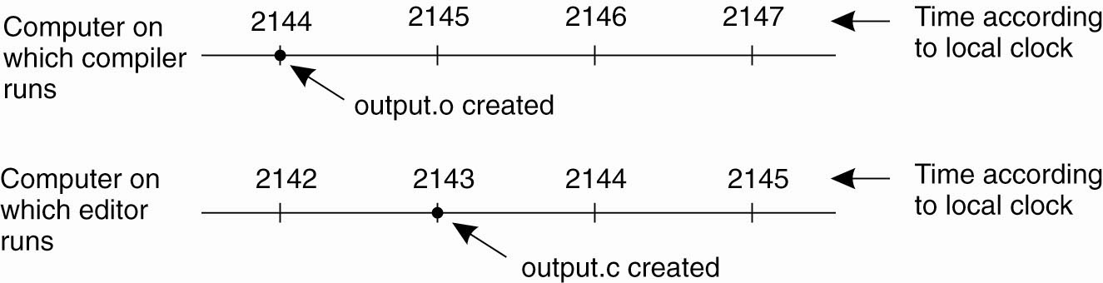
Clock Synchronization
Figure 1. When each machine has its own clock, an event that occurred after another event may nevertheless be assigned an earlier time.

Slide 3
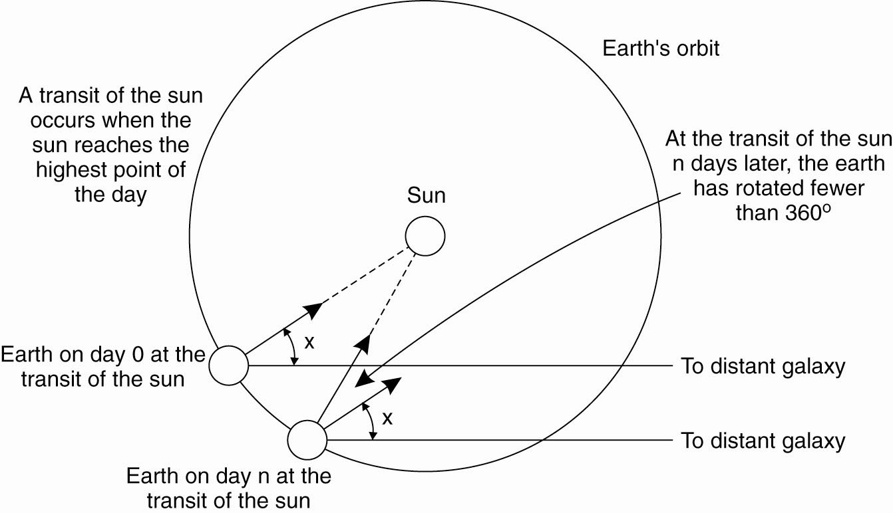
Physical Clocks
Figure 2. Computation of the mean solar day.

Slide 4
Physical clocks
Basically timers
Machine quartz crystal
Counter and holding register associated with it
Each oscillation decrements counter by one and when counter expires the interrupt is generated and loaded from holding register.
Each interrupt is one clock tick
Time entered is converted into ticks
Every tick adds one to time stored in memory.
60 ticks occur in one sec

Slide 5
Clock times
The difference between the any two time vales is clock skew
The difference in time between a computer clock and a real time clock is clock drift

Slide 6
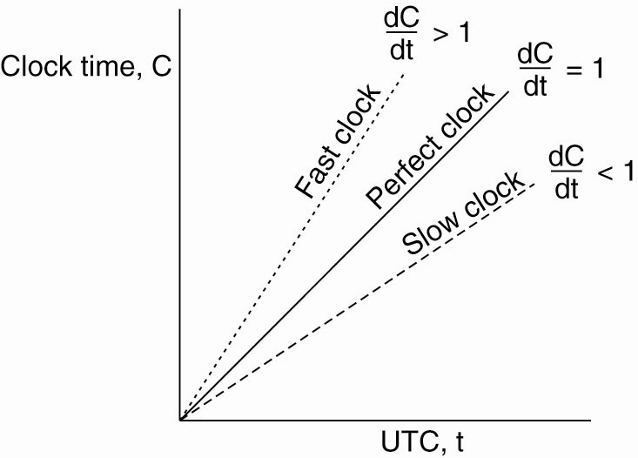
Clock Synchronization Algorithms
Figure 6-5. The relation between clock time and UTC (universal coordinated time) when clocks tick at different rates.

Slide 7
Clock synchronization algorithms
Centralized
Passive and active time server
Distributed
Global averaging distributed algorithm
Local averaging distributed algorithm

Slide 8
Clock synchronization algorithms
Passive time server centralized algorithm
Each node sends message to time server
Time server replies time = T
Time ? …..To
Time=T…..T1
Propagation time : (T1 – T0)/2
Client side clock = T + ( T1- T0)/2

Slide 9
Clock synchronization algorithms
Active time server centralized algorithm
Time server broadcasts time to other nodes
Time = T
The other nodes adjust their time accordingly
Each node has a priori broadcast time knowledge Ta[approx]
For propagation “time = T”
Time is T + Ta
Delays in broadcasts are major.

Slide 10
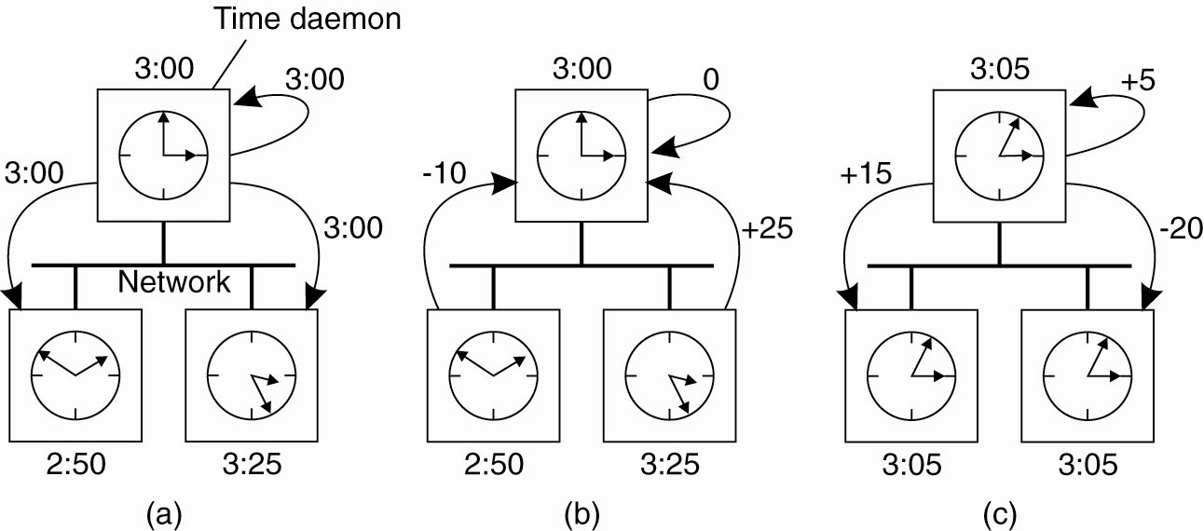
The Berkeley Algorithm
Figure 6-7. (a) The time
daemon asks all the other
machines for their clock
values.

Slide 11
The Berkeley Algorithm
Figure 6-7.
(b) The machines answer.

Slide 12
The Berkeley Algorithm
Figure 6-7. (c) The time
daemon tells everyone how
to adjust their clock.

Slide 13
Clock synchronization algorithms
Global averaging distributed algorithm
The clock process at every node broadcasts its local time in form of re-sync messages,
when its local time equals T0 + iR for some i , T0 is a fixed time in past agreed by all nodes,R depends on total no. of nodes in system.
Broadcasts are not simultaneous
After broadcast the clock awaits T,collection of other re-sync messages broadcast by others
Clocks record skew values with respect to others
Computes fault tolerant average,corrects local clock before next resync interval

Slide 14
Clock synchronization algorithms
Localized averaging distributed algorithm
The nodes are logically arranged in some pattern,ring/grid etc
The nodes exchange their clock times with its neighbours and sets its time as the average of its own clock time and clock times of its neighbours.

Slide 15
Event Ordering
Happened Before Relation (denoted by --> )
If a and b are events in same process, and a occurs before b then a->b
If a is an event of sending a message by one process and b is the event of receipt of same message by another process,then a->b…receiver cannot receive unless sender sends it.Time taken for the message propogation from receiver to sender is always positive.
If a -> b and b -> c,then a -> c,thus happened before is a transitive relation.

Slide 16
Logical clocks concept
The concept of a logical clock is a way to associate a timestamp (which maybe a simple number independent of any clock time)
Eg : Pi has a clock Ci associated with it that assigns a number Ci(a) to any event a in that process.

Slide 17
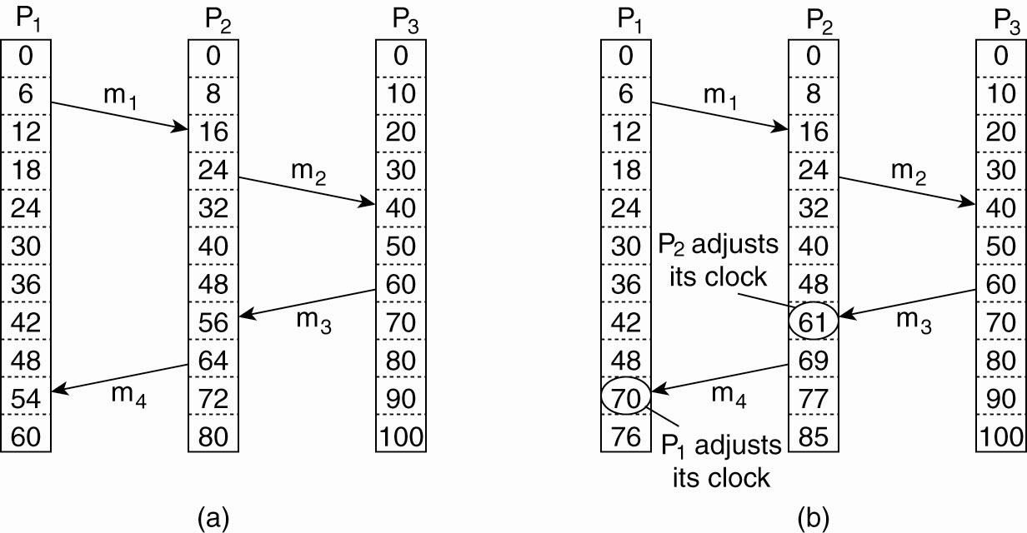
Lamport’s Logical Clocks (2)
Figure 6-9. (a) Three processes, each with its own clock. The clocks run at different rates.

Slide 18
Lamport’s Logical Clocks (3)
Figure 6-9. (b) Lamport’s algorithm corrects the clocks.

Slide 19
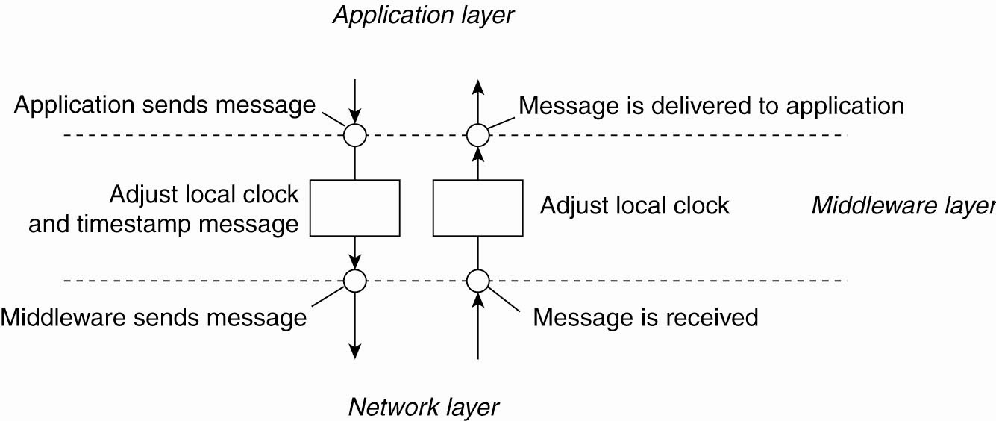
Lamport’s Logical Clocks (4)
Figure 6-10. The positioning of Lamport’s logical clocks in distributed systems.

Slide 20
Implementation of logical clocks
C1 : If a and b are two events within the same process Pi and a occurs before b,then Ci(a) <Ci(b)
C2 : If a is the sending of a message by process Pi and b is the receipt of that message by process Pj , then Ci(a) < Cj(b)
C3 : A clock Ci associated with a process Pi must always go forward,never backward.Correctness is made by adding value never subtracting it

Slide 21
Implementation of logical clocks
IR1 :Each process Pi increments Ci between any two successive events
IR2 :If event a is the sending of a message m by process Pi, the message m contains a timestamp Tm = Ci (a) and upon receiving the message m a process Pj sets Cj greater than or equal to its present value but greater than Tm.

Slide 22
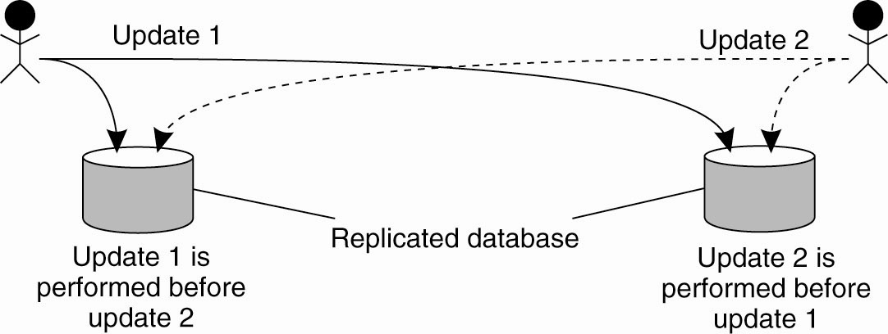
Example: Totally Ordered Multicasting
Figure 6-11. Updating a replicated database and leaving it in an inconsistent state.

Slide 23
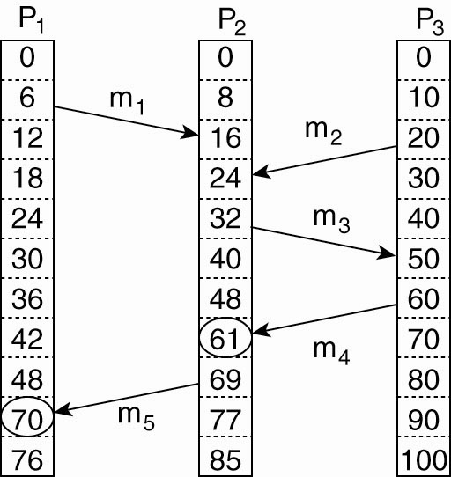
Vector Clocks (1)
Figure 6-12. Concurrent message transmission using logical clocks.

Slide 24
Implementation of logical clocks
Logical clocks can be implemented using :-
Counters
Physical clocks

Slide 25
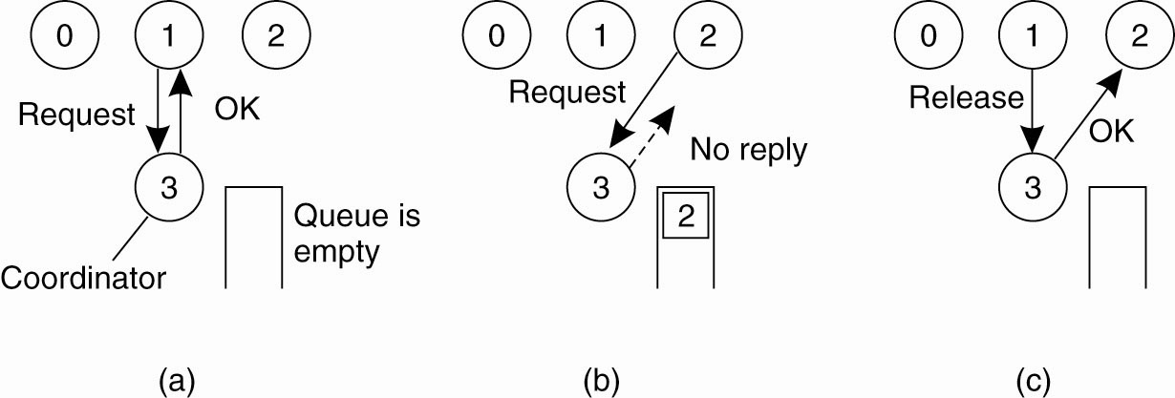
Mutual Exclusion A Centralized Algorithm (1)
Figure 6-14. (a) Process 1 asks the coordinator for permission to access a hared resource. Permission is granted.

Slide 26
Mutual Exclusion A Centralized Algorithm (2)
Figure 6-14. (b) Process 2 then asks permission to access the same resource. The coordinator does not reply.

Slide 27
Mutual Exclusion A Centralized Algorithm (3)
Figure 6-14. (c) When process 1 releases the resource, it tells the coordinator, which then replies to 2.

Slide 28
A Distributed Algorithm (1)
The message contains the following information :-
The process identifier of the process.
The name of the critical section that the process wants to enter.
A unique time stamp generated by the process for the request message.

Slide 29
A Distributed Algorithm (1)
Three different cases:
If the receiver is not accessing the resource and does not want to access it, it sends back an OK message to the sender.
If the receiver already has access to the resource, it simply does not reply. Instead, it queues the request.
If the receiver wants to access the resource as well but has not yet done so, it compares the timestamp of the incoming message with the one contained in the message that it has sent everyone. The lowest one wins.

Slide 30
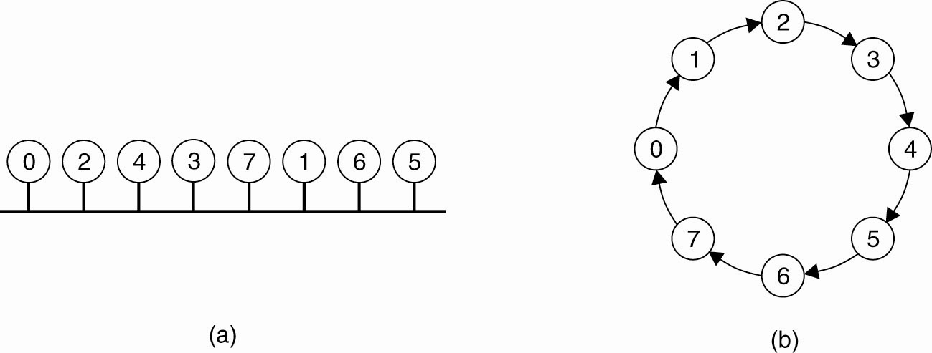
A Token Ring Algorithm
Figure 6-16. (a) An unordered group of processes on a network. (b) A logical ring constructed in software.

Slide 31
Election Algorithms
The Bully Algorithm
P sends an ELECTION message to all processes with higher numbers.
If no one responds, P wins the election and becomes coordinator.
If one of the higher-ups answers, it takes over. P’s job is done.

Slide 32
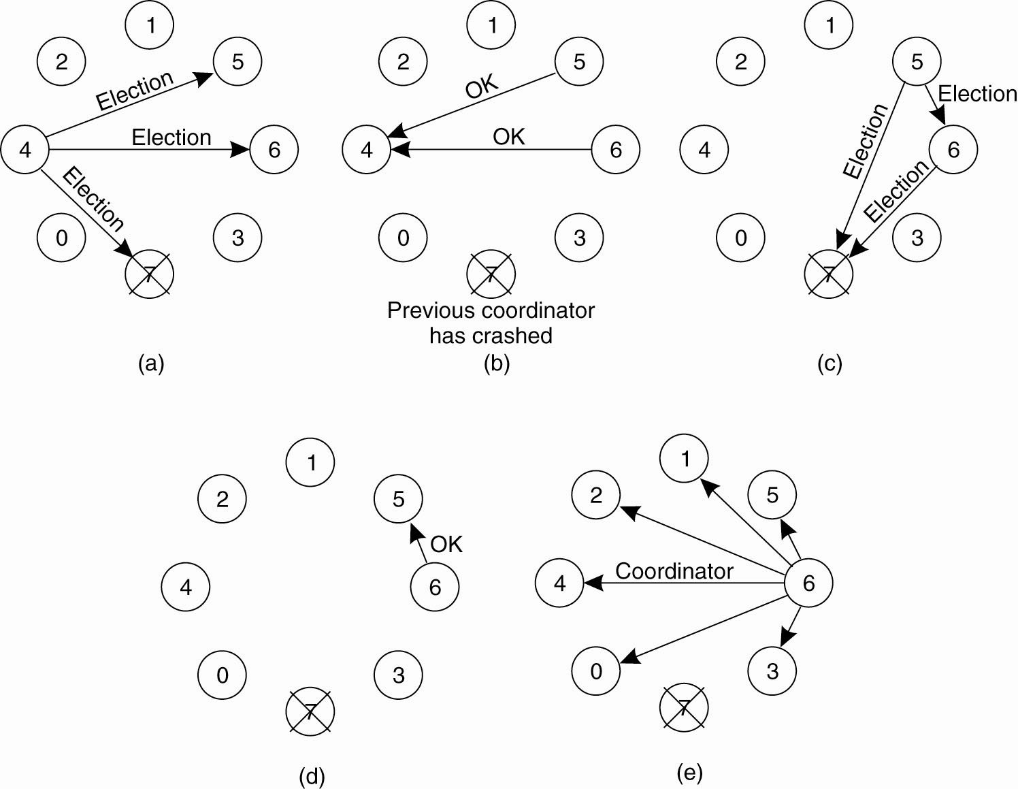
The Bully Algorithm (1)
Figure 6-20. The bully election algorithm. (a) Process 4 holds an
election. (b) Processes 5 and 6 respond, telling 4 to stop.
(c) Now 5 and 6 each hold an election.

Slide 33
The Bully Algorithm (2)
Figure 6-20. The bully election algorithm. (d) Process 6 tells 5 to stop. (e) Process 6 wins and tells everyone.

Slide 34
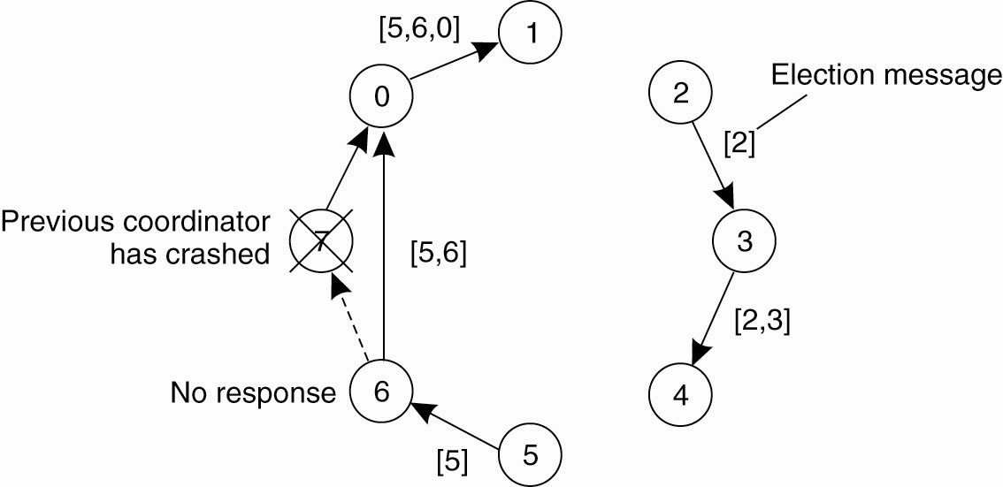
A Ring Algorithm
Figure 6-21. Election algorithm using a ring.

