Slide 1

Distributed Computing
Semester - 7
BTech - 2023-24
Syllabus to be shared with students after stamping
Weekly load hrs | Lectures | Laboratory | Credits
Hrs/w | 3hr/w | 2hr/w | 3 + 1

Slide 2
Distributed Computing
Course Contents ( All 5 modules ):
Introduction to Distributed Computing,Distributed Systems
Communication in Distributed Systems
Synchronization in distributed systems
Distributed file systems
Introduction to cloud computing

Slide 3
Syllabus
Module 1
Introduction to Distributed Systems
Definition, Characterization of distributed systems - Trends in distributed systems, Focus on resource sharing, Challenges.
Types of distributed systems.
A Model of Distributed Computations
System Models - Introduction, Physical models , Architectural models , Fundamental models

Slide 4
Distributed Computing - Where is it placed in subjects studied
The hierarchal approach:-
Applications related subjects [ eg. full stack ]
S/w Engineering, OOMD
DBMS
OS
Networking,
Data Communication, NIS
Hardware, MIT, DEL
DC

Slide 5
Distributed Computing
Arriving here :----
There are majorly 2 kinds of systems
Tightly coupled ( memory sharing)
---- parallel processing systems (Distributed Computing)
Loosely coupled ( independent memory)
---- Distributed Computing systems/Distributed Sytems/Distributed Computing

Slide 6
The TERMS
Distributed Systems
Distributed Computing Systems
Distributed Computing
Distributed Operating systems
Distributed computing is a field of computer science that studies distributed systems.

Slide 7
Distributed Computing
Distributed system: a collection of independent computers that are connected with an interconnection network.
Distributed computing system : A distributed computer system consists of multiple software components that are on multiple computers, but it runs as a single system. The computers that are in a distributed system can be physically close together and connected by a local network, or they can be geographically distant and connected by a wide area network.
Distributed Computing systems are many times known simply as Distributed Systems
Distributed computing : a method of computer processing in which different parts of a computer program are run on two or more computers that are communicating with each other over a network.
Distributed Operating System : Software for Distributed Systems

Slide 8
Distributed Computing
Distributed computing refers to the use of distributed systems to complete computing tasks.
It applies the principles of distributed systems to execute programs on different computer systems connected in a distributed system

Slide 9
Distributed Computing
Distributed computing and distributed systems share the same basic properties of scalability, fault tolerance, resource sharing, and transparency.
Distributed computing and distributed systems share the same benefits; namely, they’re reliable, cheaper than centralized systems, and have larger processing capabilities.
However, there’s a slight difference in the challenges faced in distributed computing. For example, it’s challenging to partition computational tasks into different parts that can be executed on different computers systems in parallel. [ HPC/parallel programming]
Additionally, we need to coordinate tasks in distributed computing.

Slide 10
Distributed Computing
Distributed Computing systems software.
Distributed Operating System(DOS)
Networking Operating System(NOS)

Slide 11
Distributed Operating System
What is a Distributed Operating System ?
How is it different ?
Why Distributed Operating Systems ?
Problems with Distributed Operating Systems
Distributed Operating System Models

Slide 12
What is a Distributed Operating System ?
A Distributed Operating System is the one that runs on multiple autonomous CPUs which provides its users an illusion of an ordinary
Centralized Operating System that runs on a Virtual Uni-processor.
Distributed Operating Systems provide resource transparency to the user

Slide 13
How is it different ?
The Distributed Operating System is unique and resides on different CPUs.
User processes can run on any of the CPUs as allocated by the Distributed Operating System.
Data can be resident on any machine that is the part of the Distributed System.
All multi-machine systems are not Distributed Systems.
It is the software not the hardware that determines whether a system is distributed or not.

Slide 14
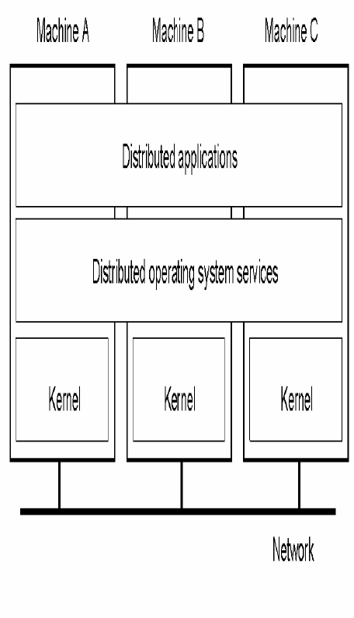
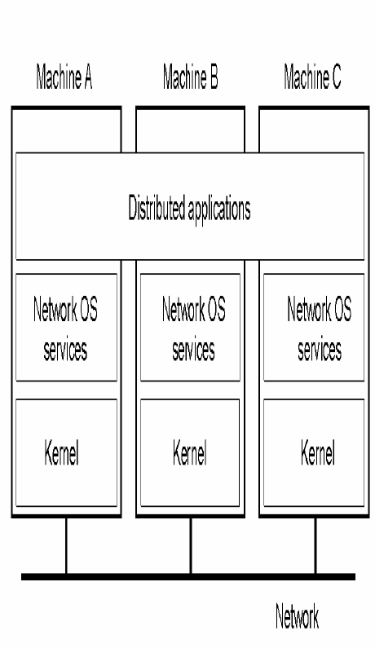
Distributed OS vs. Network OS.
DOS
NOS

Slide 15
Distributed OS
User is not aware of the multiple CPUs.
Each machine runs a part of the Distributed Operating System.
The system is fault-tolerant.

Slide 16
Network OS
User is aware of the existence of multiple CPUs.
Each machine has its own private Operating System.
The system is not fault-tolerant.

Slide 17
Why Distributed Operating Systems ?
Price/Performance advantage (Availability of cheap and powerful Microprocessors).
Incremental growth.
Reliability and Availability.
Simplicity of Software (Theoretically).
Provides Transparency.
Creates another level of abstraction (e.g. Process creation).

Slide 18
Problems with Distributed Operating System
Communication Protocol Overhead.
Lack of Simplicity.
High requirement of the degree of fault tolerance.
Lack of global state information (e.g. No global Process Tables).
Atomic Transactions.
Process and Data Migration (e.g. During Load Balancing and Paging respectively).

Slide 19
Back to distributed Computing
Back to distributed computing……

Slide 20
Definition of a Distributed System
A distributed system consists of a collection of autonomous computers linked by a computer network and equipped with a distributed software enables computers to coordinate their activities and to share resources of the systems.

Slide 21
Definition of Distributed Computing
Distributed computing is a computing concept that, in its most general sense, refers to multiple computer systems working on a single problem.
In distributed computing, a single problem is divided into many parts, and each part is solved by different computers.
As long as the computers are networked, they can communicate with each other to solve the problem. If done properly, the computers perform like a single entity.

Slide 22
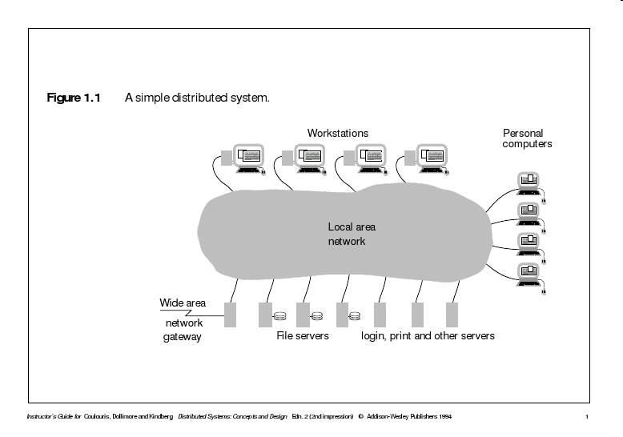
A Distributed System

Slide 23
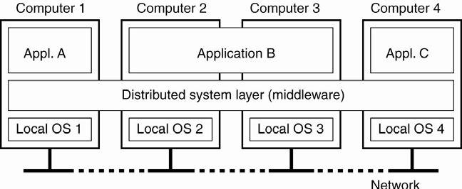
A Distributed System

Slide 24
Characteristics of a DS/DC
Resource sharing
Heterogeneity
Openness
Concurrency
Scalability
Fault tolerance
Transparency
(access, location,replication,failure,
migration)

Slide 25
Transparency Issues

Slide 26
Concurrent Computing / Parallel Computing/Distributed computing
The terms "concurrent computing", "parallel computing", and "distributed computing" have much overlap, and no clear distinction exists between them.
The same system may be characterized both as "parallel" and "distributed"; the processors in a typical distributed system run concurrently in parallel.
Parallel computing may be seen as a particular tightly coupled form of distributed computing. Distributed computing may be seen as a loosely coupled form of parallel computing.

Slide 27
Examples of Distributed Systems/Distributed Computing Systems
The Internet
The Intranet
Mobile devices
(telecommunication networks,network applications,real-time process control,parallel computation,peer-to-peer)

Slide 28
Goals of a Distributed System
Performance
Reliability
Scalability
Consistency
Security

Slide 29
Challengesof a Distributed System
Heterogeneity
Openness
Security
Scalability
Transparency
Concurrency
Data distribution
task distribution [ HPC ]

Slide 30
Trends in Distributed Computing
The emergence of pervasive networking technology.
The emergence of ubiquitous computing coupled with the desire to support user mobility in distributed systems.
The increasing demand for multimedia services.
The view of distributed systems as a utility.

Slide 31
Systems models
Architectural Models (describing components ,and their relationship)
Client server models
Peer process models
Fundamental Models
Interaction Model
Failure Model
Security Model
(formal description of properties common in all architectural models)

Slide 32
Architectural models
Simplification by distinction between client, server and peer processes
Assessment of workload (responsibilities)
Failure impact analysis
More dynamic systems can be built as variations on the client-server model
Moving code (from one process to another process)
Ex:: Client can download code from server & run it locally.
Code & objects are moved to reduce access delays & minimize comm. Traffic.
Adding/removing nodes or components
Discovery and advertisement of services
(Some DS enable comp & other mobile devices to be added or removed seamlessly, & allowed them to discover the available services & to offer their services to others.)

Slide 33
Service Layers
Software architecture
Structuring software as layers or modules
Services offered and requested by processes on same or different computers (More recently)
Service layers::
A distributed service can be provided by one or more interacting server processes
Ex:: Network Time Protocol
Software and Hardware service layers in DS

Slide 34
Service Layers
Middleware::
Masks heterogeneity & provide convenient prog. Model to application programmers.
Represented by processes or objects in a set of computers that interact with each other to implement communication & resource sharing,
To Implement communication and resource sharing
RMI
Group communication
Supplies application programming interface
Provides
Building blocks for software components

Slide 35
Service Layers: Middleware
Object oriented Middleware products & standards are::
Examples:
Sun RPC
Simple, remote procedure calling package
CORBA(Common Object Request Broker Architecture)
CORBA is useful because it enables separate pieces of software written in different languages and running on different computers to work with each other like a single application or set of services.
SERVICES:--Namming,Security,event notification,persistant storage, transactions.
Microsoft DCOM(Distributed Component Object Model)
is a proprietary Microsoft technology for communication among software components distributed across networked computers.
Java RMI

Slide 36
Service Layers: Middleware
Middleware services
Naming
Security
Transactions
Persistent storage
Event notification
Limitations
Many distributed applications rely entirely on the services provided by the available middleware to support their needs for communication & data sharing
TCP reliable for packets (basic error correction and detection)
Mail transfer service increase fault tolerance (maintain record of progress)
Some functions can only be correctly implemented with the help of application level information
Correct behaviour in distributed programs depends upon checks, error-correction mechanisms & security mechanism at various levels

Slide 37
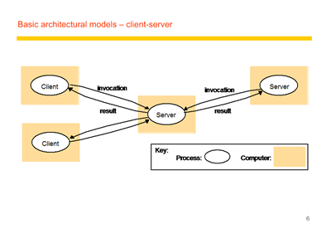

Slide 38
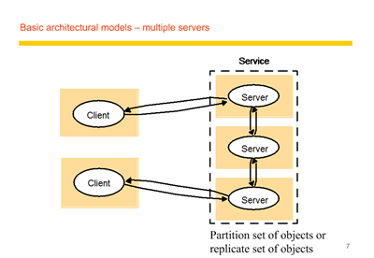

Slide 39
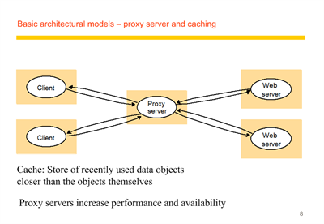

Slide 40
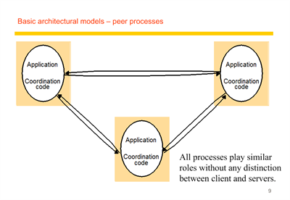

Slide 41
Variations on client server model
Use of mobile code and mobile agents
To be able to add and remove mobile devices in a convenient manner.

Slide 42
Mobile code & Mobile agents
Mobile code
eg applets
Only the code can be accessed
Mobile agents
It’s a running program that includes
Both code + data

Slide 43
Web applets
Client
Web
Applet code
server
b) client interacts with the applet
Web
Client
Applet
server

Slide 44
Mobile Devices and Spontaneous networking
Music
service
Alarm
gateway
service
Internet
Hotel wireless
Discovery
network
service
Camera
TV/PC
Laptop
Guests
PDA
devices

Slide 45
Mobile Devices and Spontaneous networking
Key features
Easy connection to local network
Transparently reconfigured devices
Easy integration with local services
Autonomous service discoveries
Issues
Internet addressing, and routing assumption
computers are at fixed locations
Limited connectivity
Security and privacy
Discovery services
Registration service
Lookup service

Slide 46
Fundamental Models
Interaction model
Failure model
Security model

Slide 47
Interaction model
Performance of communication channels
Computer clocks and timing events
Two variants of the interaction model
Event ordering

Slide 48
Performance of communication channels
Communication performance is often a limiting characteristic.
The delay between the sending of a message by one process and its receipt by another is referred to as latency.
Bandwidth
Jitter is the variation in the time taken to deliver a series of messages.

Slide 49
Computer clock and timing event
It is impossible to maintain a single global notion of time.
There are several approaches to correcting the times on computer clocks. (from GPS)

Slide 50
Two variants of the interaction model
Synchronous distributed system
The time to execute each step f a process has known lower and uper bounds.
Each message transmitted over a channel is received within a known bounded time
Each process has a local clock whose drift rate from real time has a known bound.
Asynchronous distributed system
No bound on process executiong speeds
No bound on message transmisson delays
No bound on clock drift rates.

Slide 51
Event ordering
In many cases, we are interested in knowing whether an event (sending or receiving a message) at one process occurred before, after or concurrently with another event at another process.

Slide 52
Failure Model
Omission failures
Arbitrary failures
Failure detection
Impossibility of reaching agreement in the presence of failure
Masking failure
Reliability of one to one communication

Slide 53
Byzantine or malicious failure
Byzantine or malicious failure, with authentication.
In this model,a process may exhibit any arbitrary behavior. However, if a faulty process claims to have received a specific message from a correct process, then that
claim can be verified using authentication, based on unforgeable signatures.
Byzantine or malicious failure.
In this model, a process may exhibit any arbitrary behavior and no authentication techniques are applicable to verify any claims made.

Slide 54
Security model
Protecting objects
Securing processes and their interactions
The enemy
Defeating security threats
Other possible threats from the enemy

