Slide 1

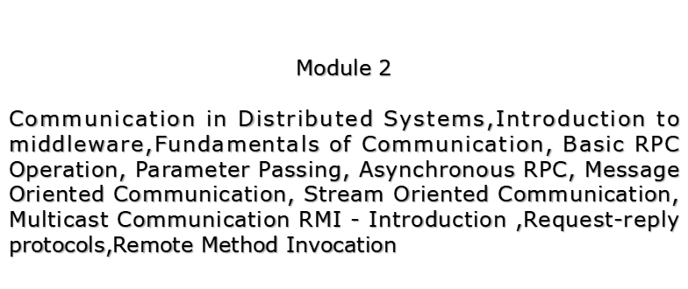

Slide 2
Communication
Inter-process communication :-
There is a requirement for communication and synchronization between co-operating processes.
Two communication patterns that are commonly used in distributed programs:-
Client-Server communication [ request –reply ]
Group communication [ same message is sent to several processes ]

Slide 3
Protocols for Distributed Systems
Versatile Message Transport Protocol (VMTP)
provides group communication facility,efficient Client-Server communication.
Fast Local Internet Protocol (FLIP),transparency,client-server based protocols,easy network management.

Slide 4
Middleware Layers
Applications,Services
RMI,RPC
Request-Reply protocol
Marshalling and External Data Representation
UDP and TCP

Slide 5
Discussion Focus
  Characteristics of protocols for communication between processes to model distributed computing architecture
    Effective means for communicating objects among processes at language level
  Representation of objects
    providing a common interface for object references
  Protocol construction
    Two communication patterns for distributed programming: C-S using RMI/RPC and Group communication using ‘broadcasting’

Slide 6
Characteristics of IPC
synchronous and asynchronous communication.
Message destinations.
Reliability.
Ordering.

Slide 7
Characteristics of IPC
synchronous and asynchronous communication.
Synchronous
  Queues at remote sites are established for message placement by clients (sender). The local process (at remote site) dequeues the message on arrival
  If synchronous, both the sender and receiver must ‘rendezvous’ on each message, i.e., both send and receive invocations are blocking-until

Slide 8
Characteristics of IPC
synchronous and asynchronous communication.
Asynchronous communication
  Send from client is non-blocking and proceeds in parallel with local operations
  Receive could be non-blocking (requiring a background buffer for when message finally arrives, with notification – using interrupts or polling) AND if blocking, perhaps, remote process needs the message, then the process must wait on it
  Having both sync/async is advantageous, e.g., one thread of a process can do blocked-receive while other thread of same process perform non-block receive or are active – simplifies synchronization. In general non-blocking-receive is simple but complex to implement due to messages arriving out-of-order in the background buffer

Slide 9
Characteristics of IPC
Message destinations
  Typically: send(IP, port#, buffer) – a many-to-one (many senders to a single receiving port), except multicast, which is many-to-group.
  Possibility: receiving process can have many ports for different message types
  Server processes usually publish their service-ports for clients
  Clients can use static IP to access service-ports on servers (limiting, sometimes), but could use location-independent IP by
    using name server or binder to bind names to servers at run-time – for relocation
    Mapping location-independent identifiers onto lower-level address to deliver/send messages – supporting service migration and relocation

Slide 10
Characteristics of IPC
  Reliability
  Validity: transmission is reliable if packets are delivered despite some drops/losses, and unreliable even if there is a single drop/loss
  Integrity: message must be delivered uncorrupted and no duplicates
Ordering
  Message packets, even if sent out-of-order, must be reordered and delivered otherwise it is a failure of protocol

Slide 11
Means of IPC
Sockets
  Provide an abstraction of endpoints for both TCP and UDP communication
  Sockets are bound to ports on given computers (via the computer’s IP address)
  Each computer has 2¹⁶ possible ports available to local processes for receiving messages
  Many processes in the same computer can deliver to the same port (many-to-one), however
  Sockets are typed/associated with either TCP or UDP

Slide 12
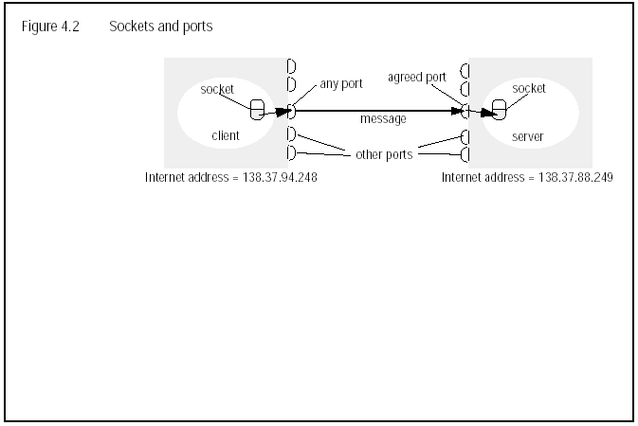
Means of IPC
Sockets
  Provide an abstraction of endpoints for both TCP and UDP communication
  Sockets are bound to ports on given computers (via the computer’s IP address)
  Each computer has 2¹⁶ possible ports available to local processes for receiving messages
  Many processes in the same computer can deliver to the same port (many-to-one), however
  Sockets are typed/associated with either TCP or UDP

Slide 13
UDP Datagram communication
No acknowledgements/retries.
Message size:The receiving process specifies an array of bytes,messages are truncated on arrival.
IP allows packets lengths of 2^16.
Larger messages are truncated
Non-blocking sends but blocking receives
Setting Time-outs on receives.

Slide 14
UDP Datagram communication..Failure Model
Omission Failures : Messages may be dropped,either due to checksum error or because no buffer space available.
Ordering : Messages can sometimes be delivered out of order.

Slide 15
UDP uses.
DNS is implemented over UDP.
These 3 sources of overhead are avoided.
Need to store state information at source and destination
The transmission of extra messages
Latency of sender.

Slide 16
TCP stream communication
Data is a stream of bytes
Message sizes..streams,one or more packets
Lost messages: Acknowledgement scheme
Flow control..if writer is too fast for reader(blocking)
Message duplication/ordering
Message destinations

Slide 17
Issues related to stream communication
Matching of data items
Blocking
Threads

Slide 18
Issues related to stream communication
Failure Model
To satisfy the integrity property of reliable communication TCP uses checksums to detect and reject corrupt packets

Slide 19
Use of TCP
HTTP ,80
FTP,20,21
Telnet 23
SMTP,25

Slide 20
A list of all TCP/UDP well known services.

Slide 21
TCP and UDP comparison
TCP protocol
It is a connection oriented protocol
It has flow control and error correction
Not very fast,primary use is data transmission
Schemes requiring delivery acknowledgement use TCP

Slide 22
TCP/IP and UDP comparison
UDP protocol
It is connectionless protocol which means it can send packets without establishing connection with the receiver at first.
It is error prone during transmission.
It is fast and used mostly for audio and video streaming
UDP ports are commonly used by services or programs that don’t require the confirmation of delivery of packets. Most commonly used is DNS queries using UDP port 53.

Slide 23
Client – Server Communication
The RPC exchange protocols
R- Request protocol
RR- Request Reply (itself is like an ack)
(HTTP)(different status codes)
RRA – Request Reply Acknowledgement

Slide 24
Group communication
Multicast messages : single message to a group of processes.
Fault tolerance and replicated servers
Discovery servers for spontaneous networking
Better performance through replicated data
Propagation through event notifications

