Slide 1
Remote Procedure Calls-RPC
It is an IPC mechanism used for communication between processes on different machines or processes on the same machine.

Slide 2
Remote Procedure Calls-RPC
For making a procedure call,the caller places arguments to the procedure in some well-specified location.
Control is then transferred to the procedure
The procedure executes in the newly created environment with the passed arguments
After execution of the procedure the control returns back to the calling point, possibly returning the result.

Slide 3
Remote Procedure Calls-RPC model
Caller Callee
(client process) (server process)
Request message,contains parameters
Call procedure and await reply
Receive request and start execution
Procedure executes
Send reply and wait for next request
Resume execution
Reply message,result of procedure execution

Slide 4
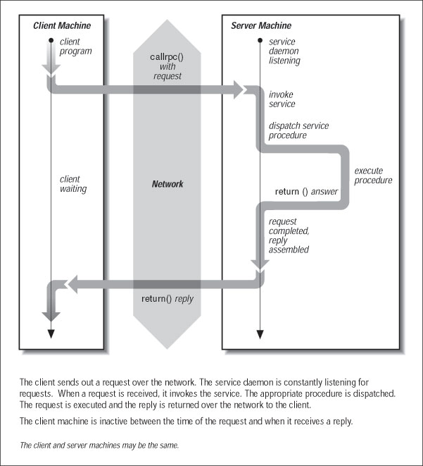
Remote Procedure Calls-RPC model

Slide 5
Transparency of RPC
Syntactic Transparency: means that a remote procedure call should have exactly same syntax as LPC.
Semantic transparency : means that the semantics of a remote procedure call are indentical to those of LPC.
Discussion of RPC and LPC

Slide 6
Implementing RPC mechanisms
Client : It initiates a remote procedure call
Client Stub :On receipt of a call request from client,it packs a specification of the target procedure and arguments into a message and asks RPCRuntime to send it to server stub.
On receipt of result of procedure execution,it unpacks the result and passes to the client.
RPCRuntime : handles transmission of messages across the network between client and server machines.
It is responsible for retransmissions, acknowledgements,packet routing, encryption.

Slide 7
Implementing RPC mechanisms
Server Stub : On receipt of the call request message from the Local RPCRuntime ,the server stub unpacks it and makes a perfectly normal call to invoke appropriate procedure of the server.
On receipt of the result of procedure execution from the server,the server stub packs the result into a message and then asks the local RPCRuntime to send it to client stub
Server : On receiving a call request from server stub,the server executes the appropriate procedure and returns result of procedure execution to server stub.

Slide 8
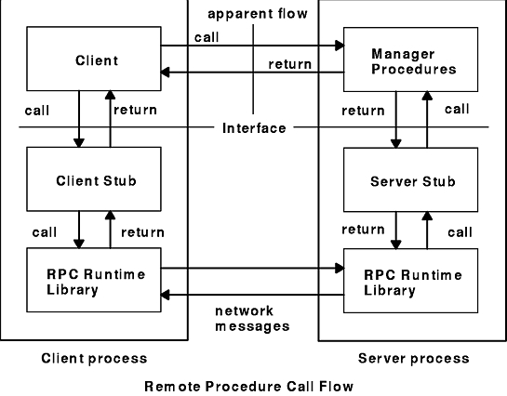

Slide 9
Stub Generation
Manually : The RPC implementor provides a set of translation functions from which a user can construct his/her own stubs
Simpleto implement,and can handle complex parameters.
Automatically : Commonly used method.It uses IDL :Interface definition language.

Slide 10
IDL : Interface Definition Language
IDL : Used to define interface between client and server.
It is a list of procedure names supported by the Interface,together with types of their arguments and results.
Client and Server independently perform compile time type checking.
IDL can indicate whether each argument is i/p,o/p or both.
IDL has information to type definitions,constants etc
The server is said to EXPORT the intetrface and the client is said to IMPORT the interface.
In a distributed application the programmer writes the interface using IDL

Slide 11
IDL : Interface Definition Language
IDL : Used to define interface between client and server.
It is a list of procedure names supported by the Interface,together with types of their arguments and results.
Client and Server independently perform compile time type checking.
IDL can indicate whether each argument is i/p,o/p or both.
IDL has information to type definitions,constants etc
The server is said to EXPORT the intetrface and the client is said to IMPORT the interface.

Slide 12
IDL : Interface Definition Language
IDL : Used to define interface between client and server.
It is a list of procedure names supported by the Interface,together with types of their arguments and results.
Client and Server independently perform compile time type checking.
IDL can indicate whether each argument is i/p,o/p or both.
IDL has information to type definitions,constants etc
The server is said to EXPORT the intetrface and the client is said to IMPORT the interface.

Slide 13
RPC messages
Call messages from the client to server
Reply messages from the server to the client.
RPC Call message format : 1. Message ID
2. Message Type
3. Client Identifier
4. Remote procedure Identifier
program number
Version number
Procedure number
5. Arguments

Slide 14
RPC messages
RPC reply message format :
Message Identifier
Message Type
Reply Status (success/failure)
Result

Slide 15
Server Management
Stateful servers /
Stateless servers
Server creation semantics :-
Instance per call servers :-
Exist for duration of a single call only
These servers are stateless.
Instance per session servers
Exist for an entire session
Can be stateful
Persistent Servers
Exist indefinitely
Can be bound to several clients
Stateful

Slide 16
RPC parameter passing and Call semantics
Call by value
Call by reference

Slide 17
RPC call semantics
“maybe” call semantics
  no retransmission of request messages
  not certain whether the procedure has been executed
  no fault-tolerance measures
  generally not acceptable

Slide 18
RPC parameter passing and Call semantics
“at-least-once” call semantics
  It guarantees call is executed one/more times but does not specify which results are returned to the caller.

Slide 19
RPC parameter passing and Call semantics
“last one call” semantics
Based on retransmission of call message based on timeouts
Procedure is executed many times.
Last call results are used by the caller.

Slide 20
RPC parameter passing and Call semantics
“exactly once call semantics”
This is the strongest semantic
Eliminates procedure being executed more than once no matter how many times the call is retransmitted.

Slide 21
Problems in RPC
The request is lost
The reply is lost
The client and server may crash

Slide 22
Communication protocols for RPC
The request Protocol
The request /reply Protocol
The request/reply/acknowledgement Protocol

Slide 23
Client-Server binding in RPC
Binding : refers to determining the location and identity (communication ID) of the called procedure.
static binding : (which binds the host address of a server into the client program at compilation time),less desirable
  The client and server programs are compiled separately and often at different times
  The server may be moved from one host to another
dynamic binding : (which binds the host address of a server into the client program at run time)
  allows servers to register their exporting services
  allows servers to remove services
  allows clients to lookup the named service

Slide 24
Locating a server in case of RPC
Binding Agent
2
1
3
Client Process
Server Process
4

Slide 25
Binding Time
Binding at Compile Time :
Hard-coding the servers network address into client code
-ve : if server moves to a different location,all client programs will have to be recompiled.
Binding at Link Time :
The server exports is services to the BA(Binding Agent)
The client makes an import before making a call.
The BA returns the server handle to the the client.
The client connects to the server directly via the handle

Slide 26
Binding Time
Binding at call time :
The client is bound to the server when it calls the server for the first time.
Client passes the server’s interface name and arguments of RPC call to the binding agent.
The binding agent looks up the location of target server and on behalf of client sends RPC to target server.
The target server returns the result to BA and it returns the result to the Client
Later calls are sent directly to the server

Slide 27
Client-Server call time binding in RPC
Binding Agent
1
2
4
3
Client Process
Server Process
5

Slide 28
Special types of RPCs
Call back RPC
It allows peer to peer paradigm
Client makes a call to the server and during execution the server calls back the client for certain details.
Broad cast RPC mechanisms
The client broadcasts the messages to the binding agent and the binding agent then sends them to the servers
Or the clients can also send messages to the broadcast port.
Batch mode RPC
Is to queue separate RPC requests in a transmission buffer on client side and then send them in one batch to the server.

Slide 29
Overview of RPC Systems
Sun RPC
DCE RPC
DCOM
CORBA
Java RMI
XML RPC, SOAP/.NET, AJAX, REST

Slide 30
Sun RPC
RPC for Unix System V, Linux, BSD
  Also known as ONC RPC
  (Open Network Computing)
Interfaces defined in an Interface Definition Language (IDL)
  IDL compiler is rpcgen

Slide 31
Programming with RPCs
A .x file
Client.c
Server.c
Header files need to be added
Client and server stubs are auto generated

Slide 32
Programming with RPCs
.X
rpcgen
.h
Client.c
clnt.c
xdr.c
Serv.c
Server.c
RPCRuntime
cc
cc
client.exe
server.exe

